Slide 1
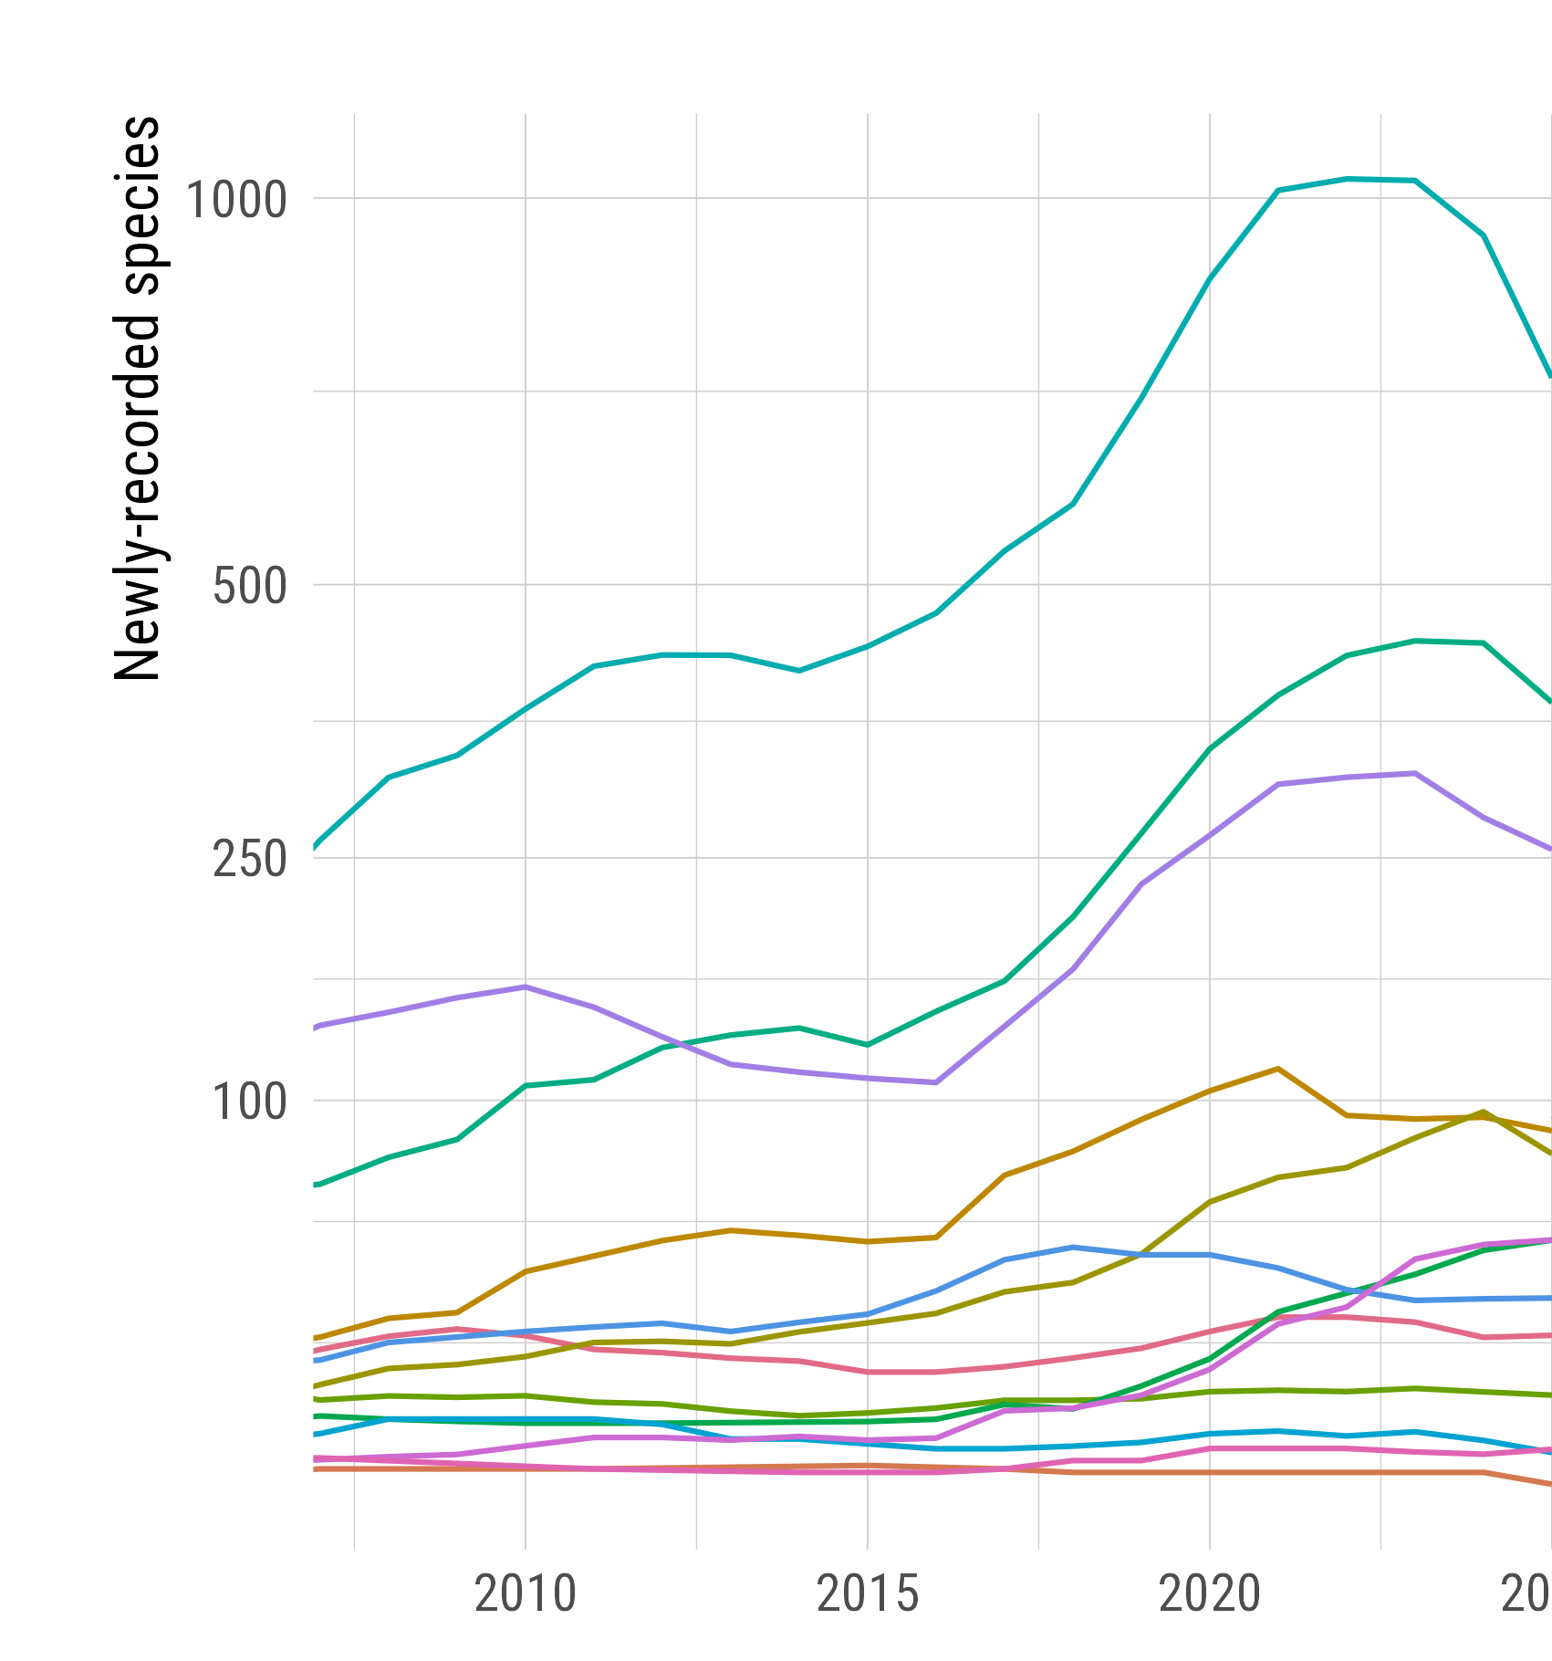
Insecta
Fungi
Plantae
Other Animalia
Arachnida
Chromista
Protozoa
Mollusca
Actinopterygii
Aves
Mammalia
Reptilia
Amphibia
2025

