Slide 1
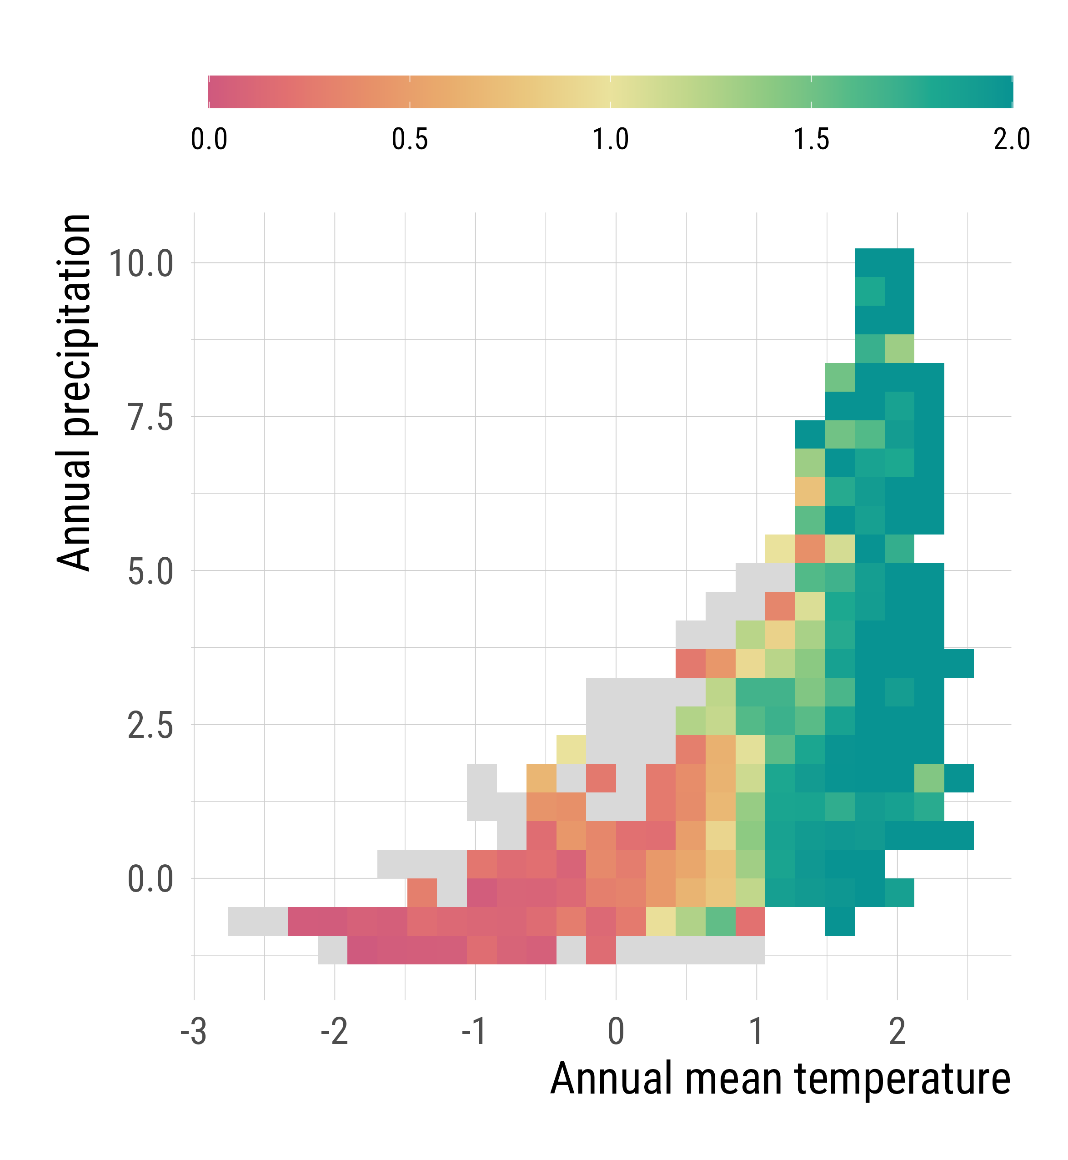
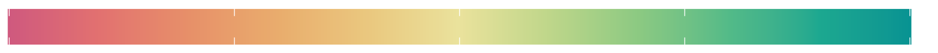
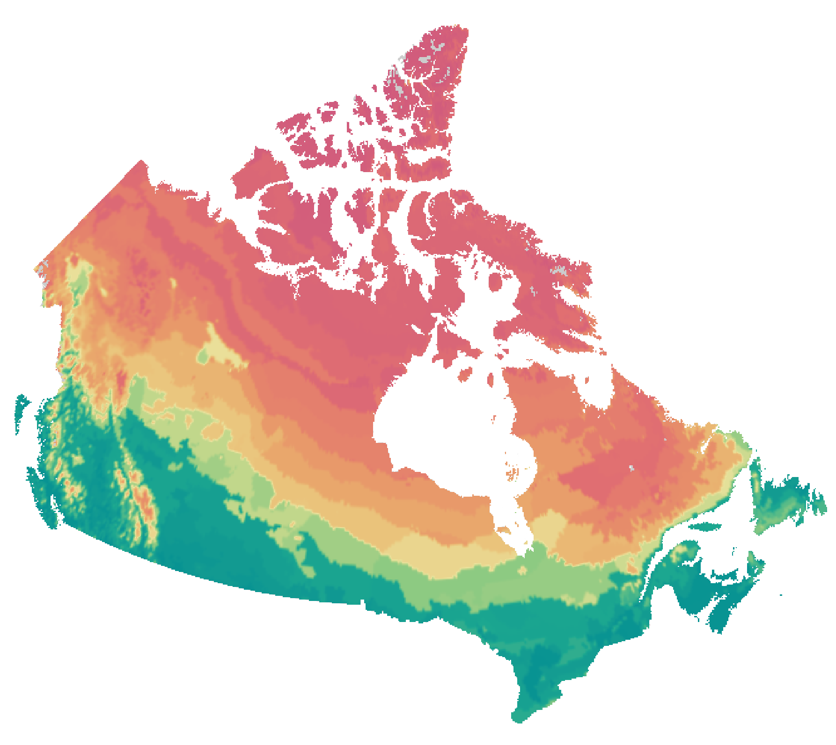
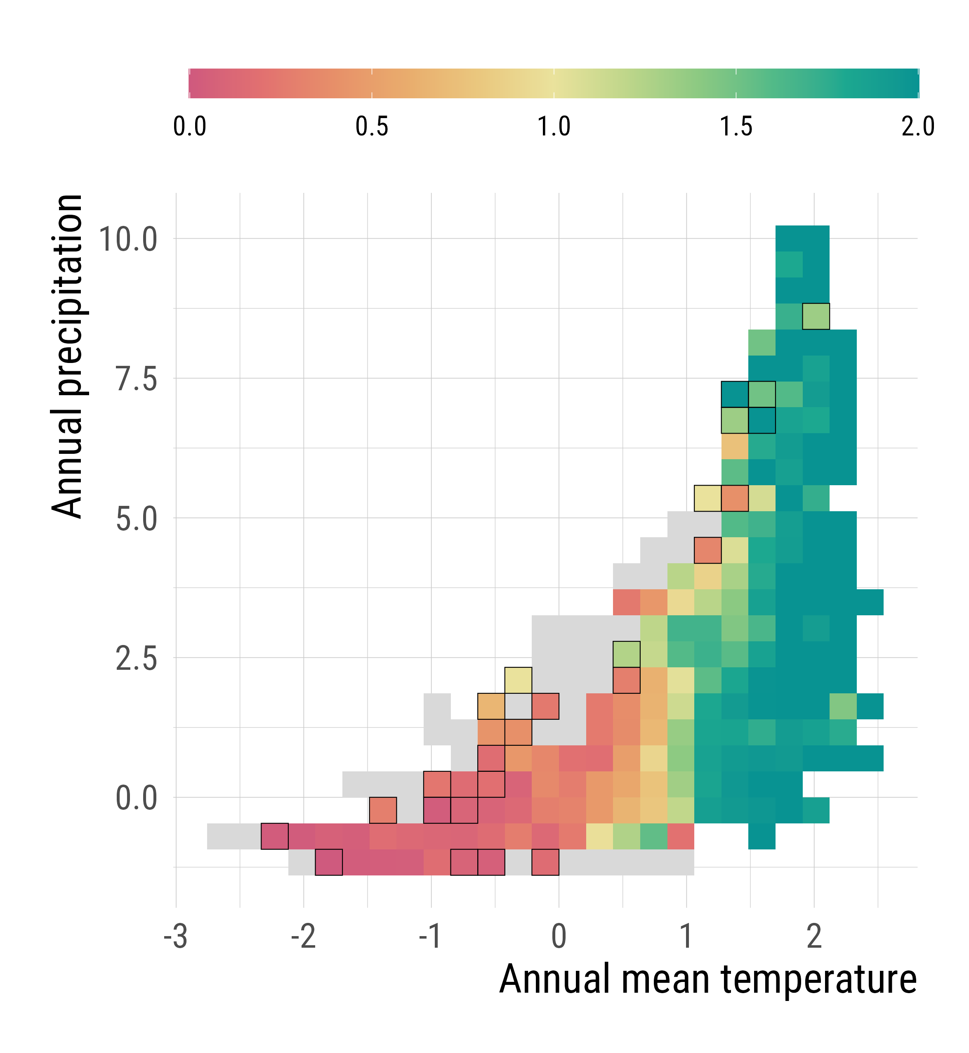
Climate coverage
None
Poor
Moderate
Full
a
b
Not sampled during BTG

Slide 2
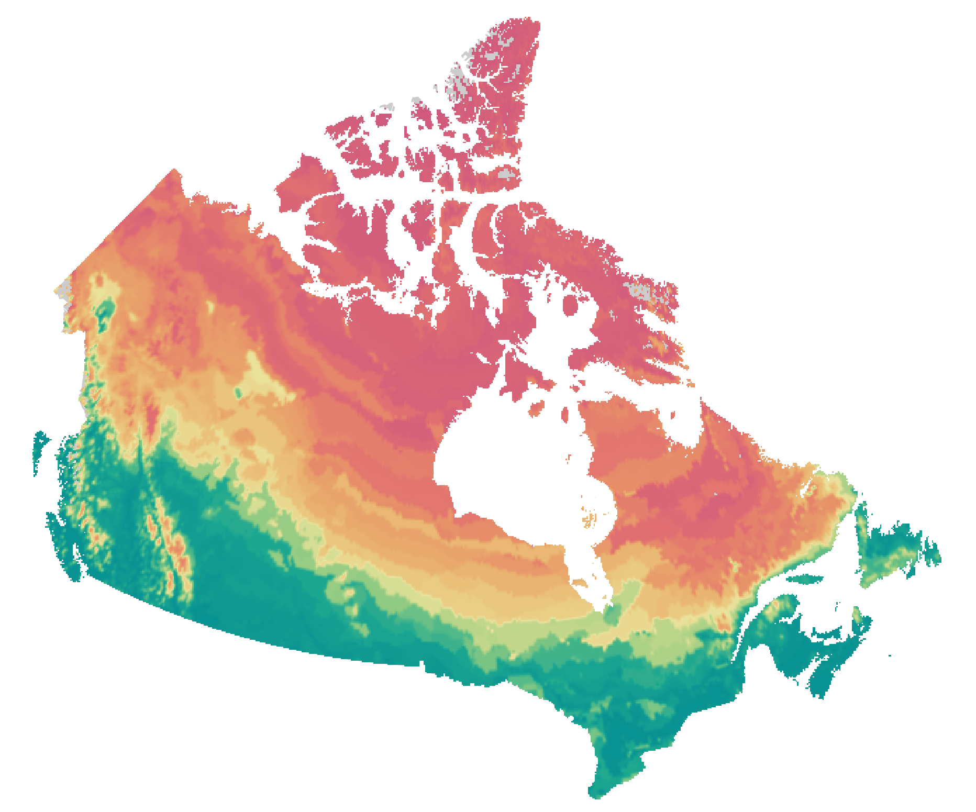
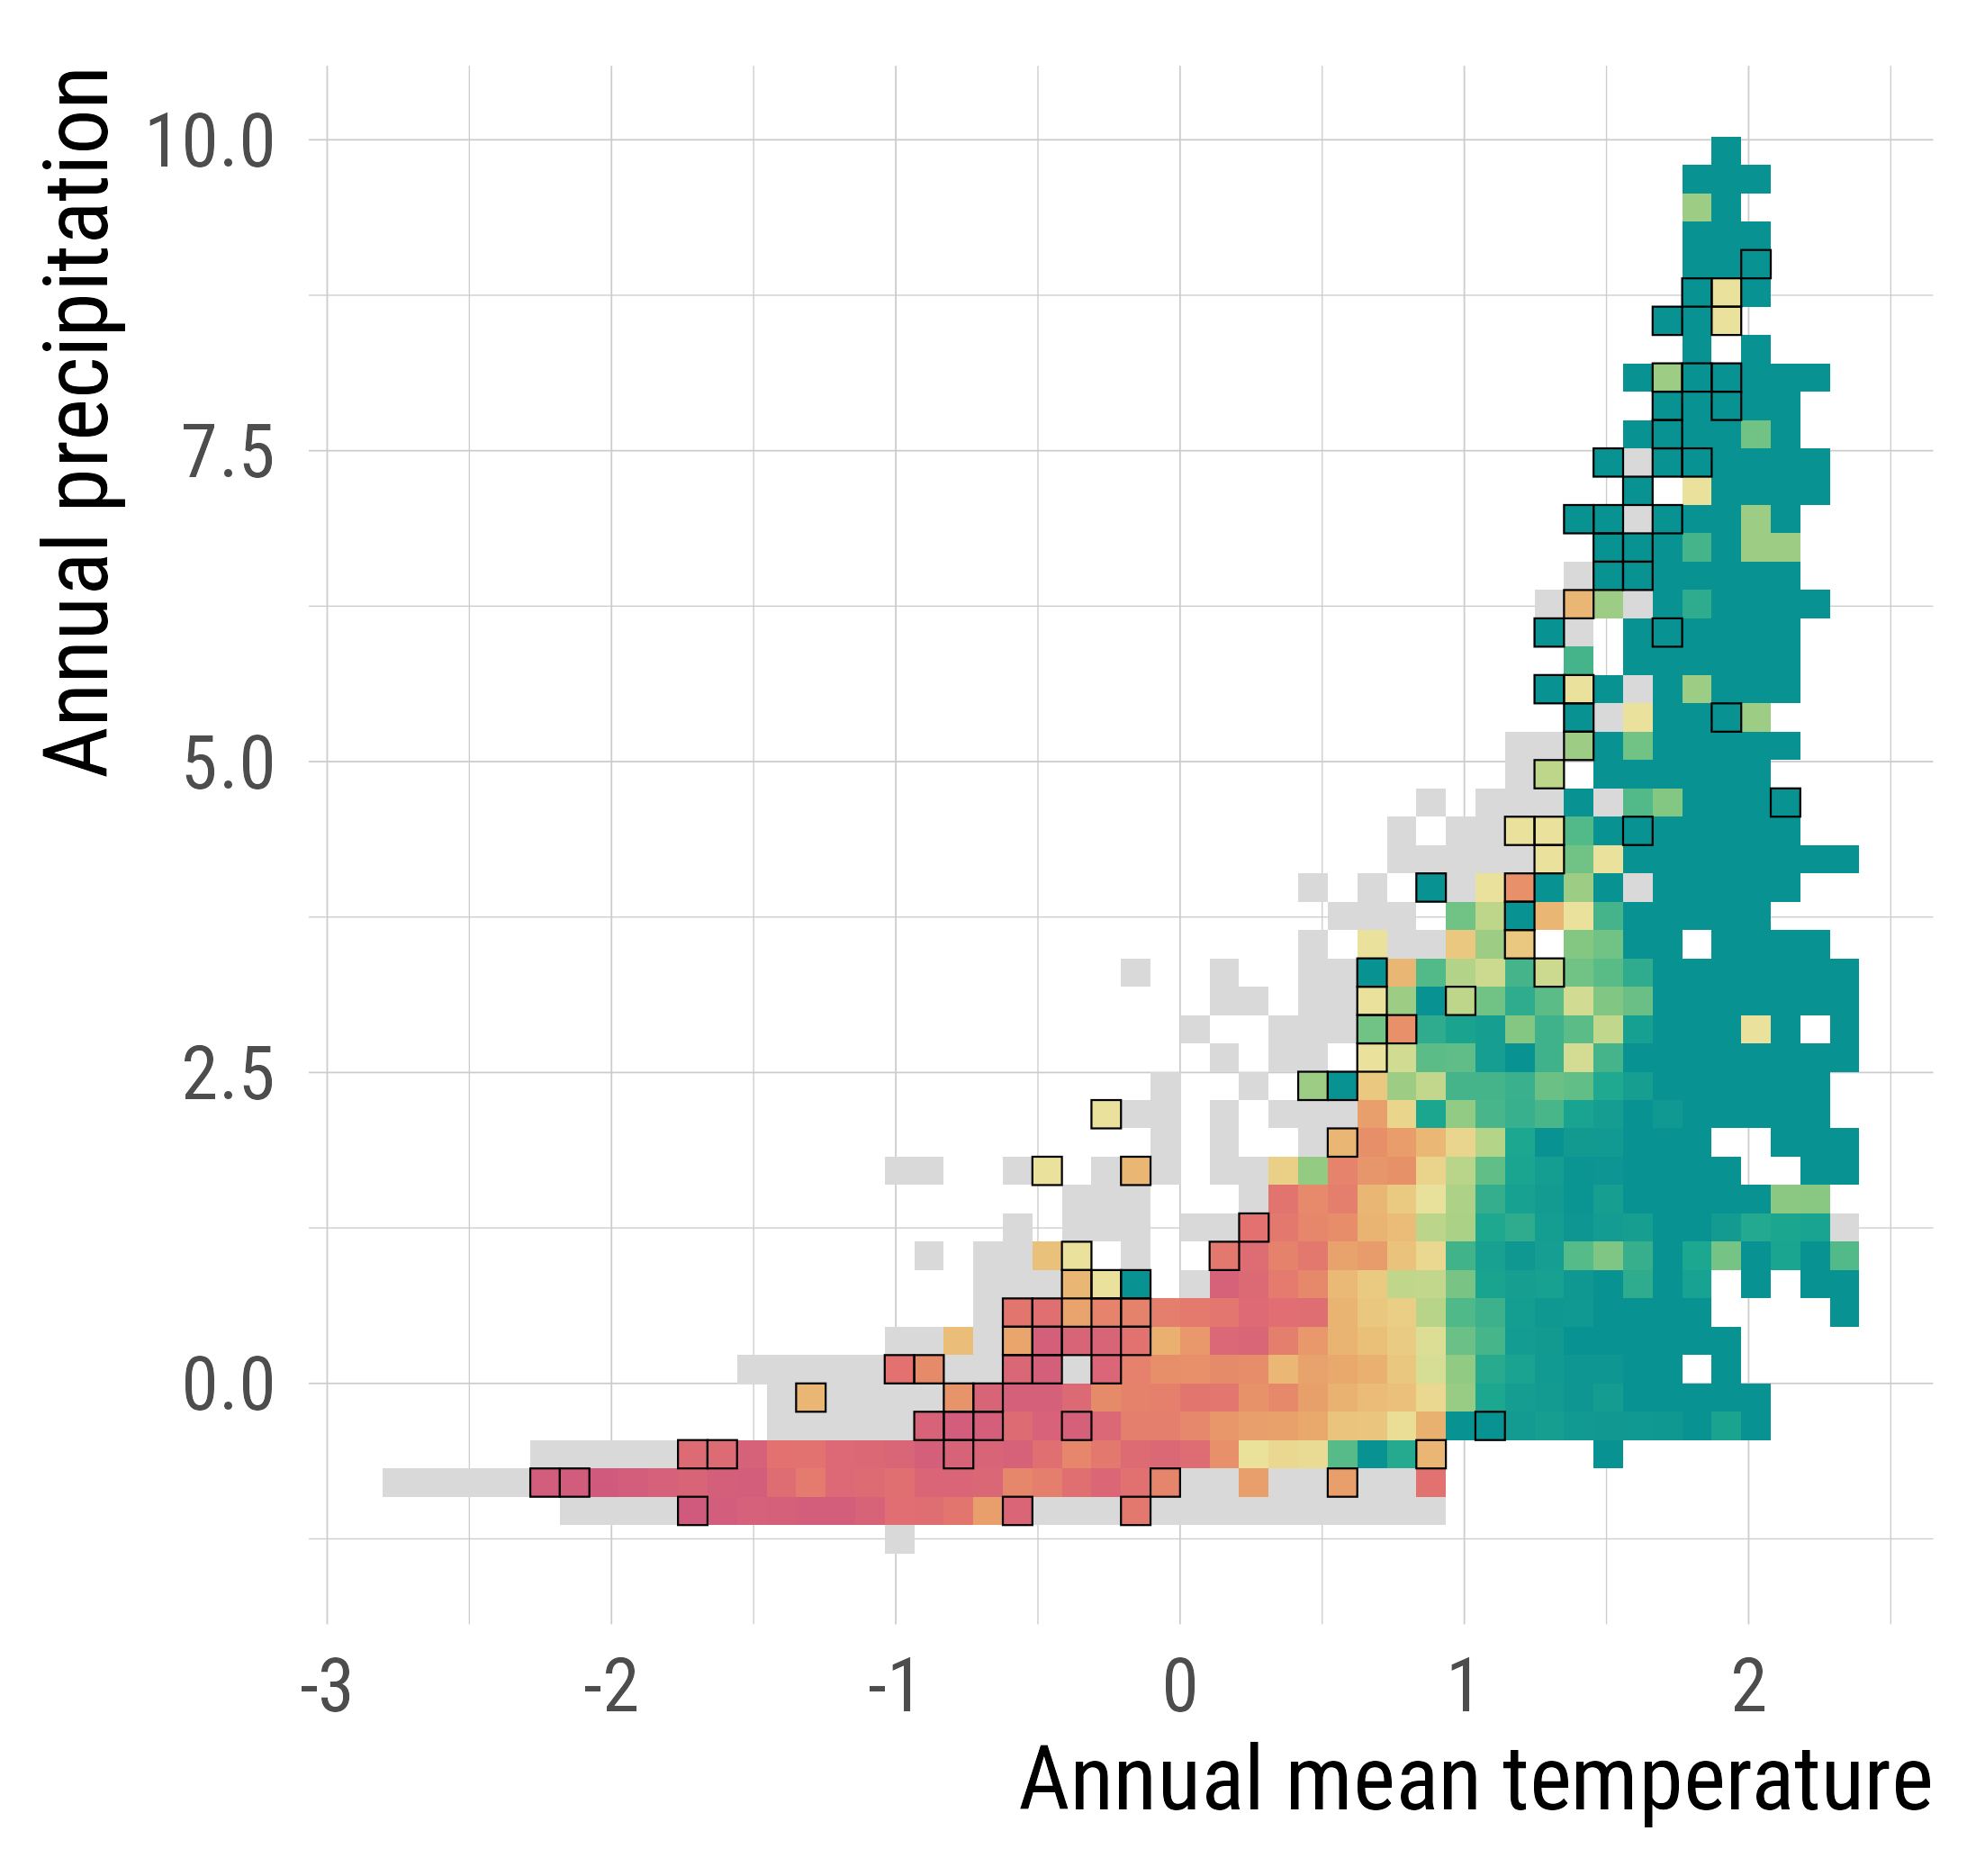
Climate coverage
None
Poor
Moderate
Full
a
b
Not sampled during BTG (outlined)

Slide 3
Climate coverage
None
Poor
Moderate
Full
a
b
Outline: Not sampled during BTG

Slide 4
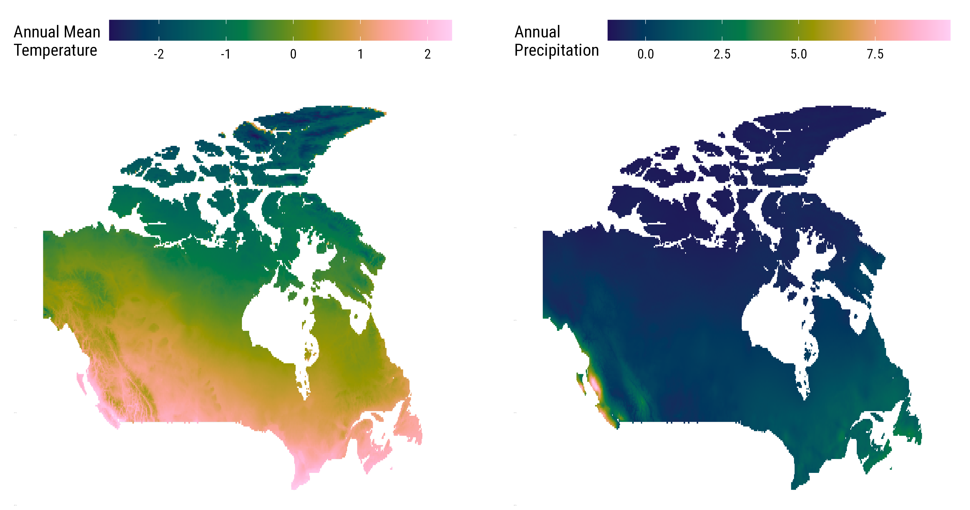
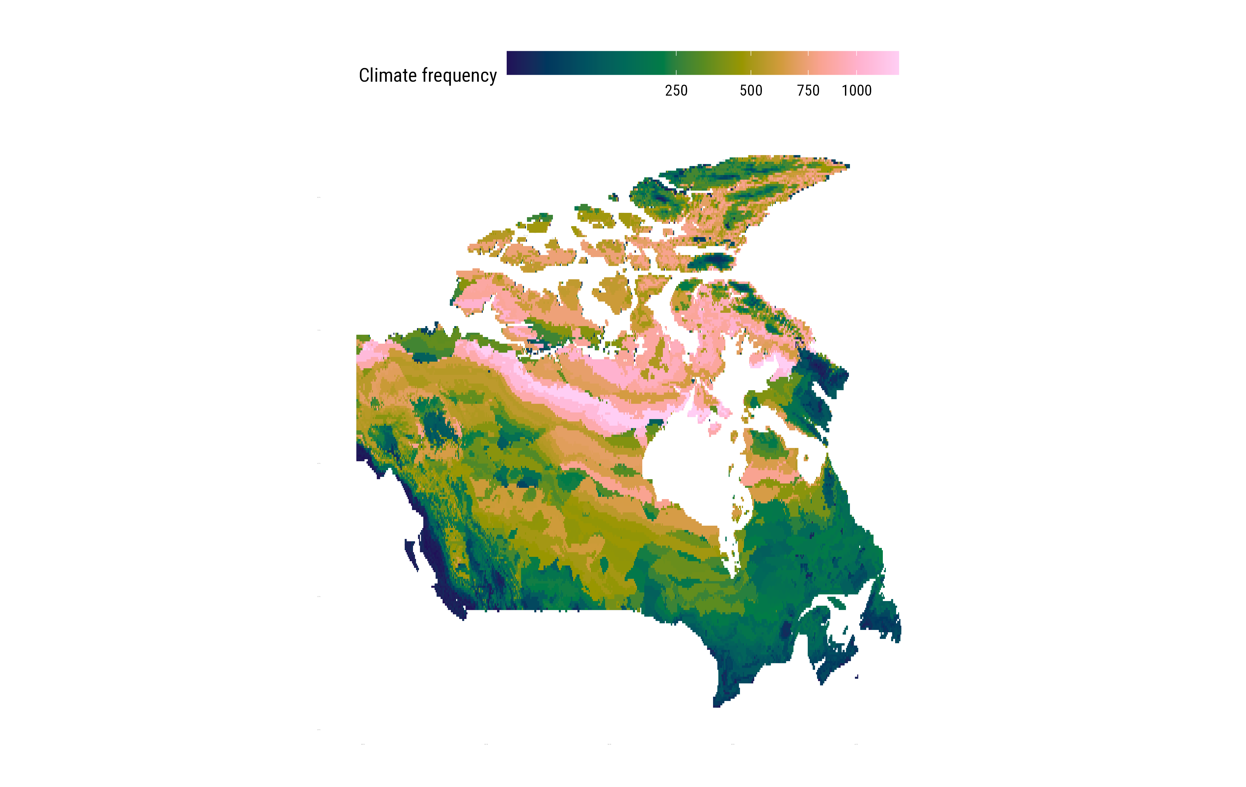
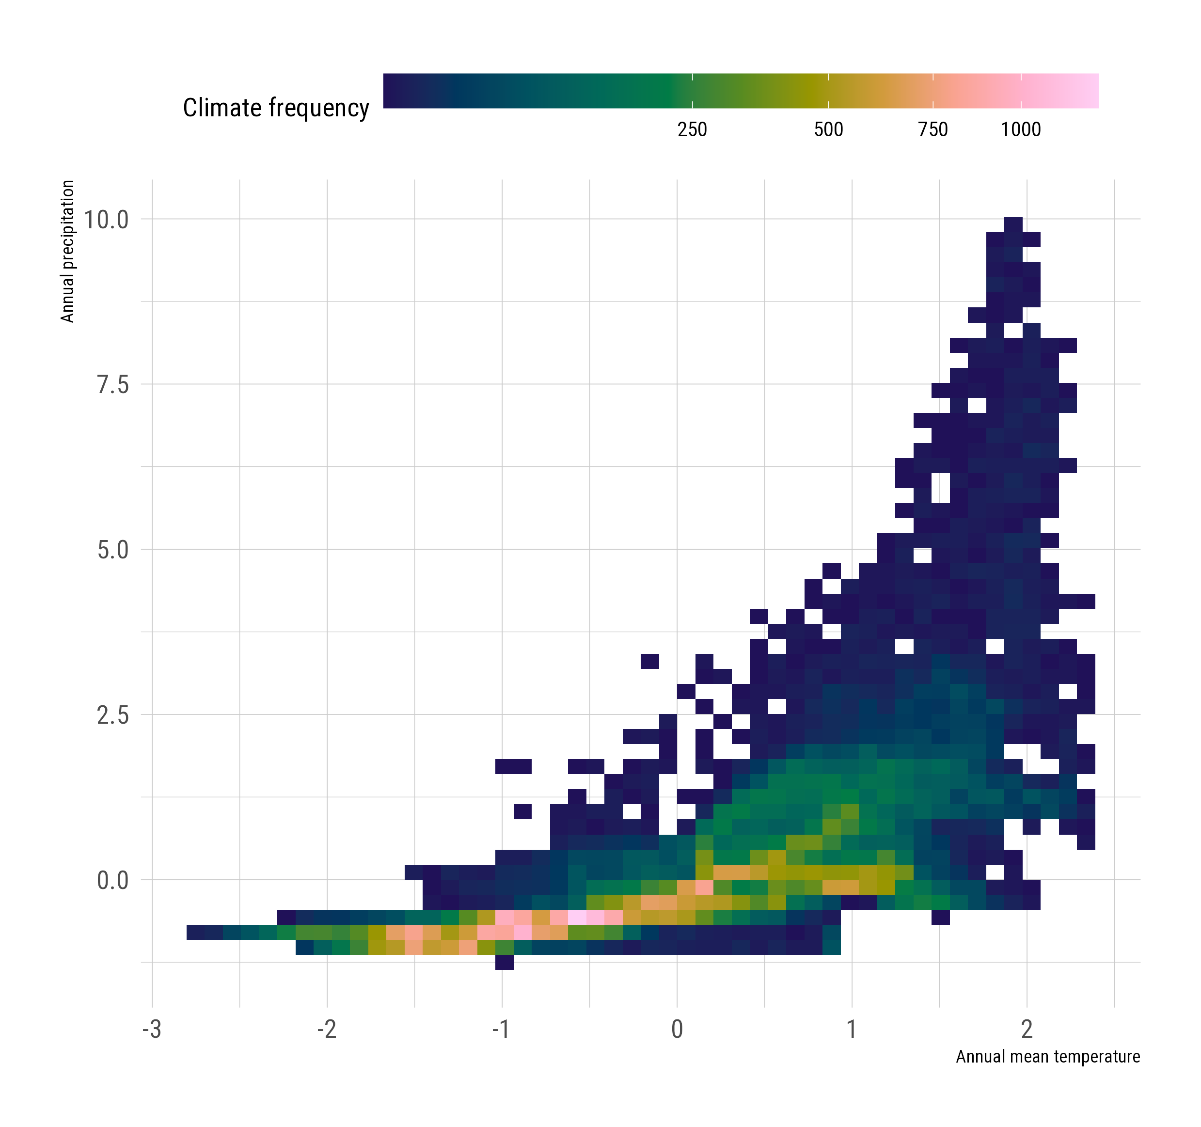
Climate variables
Canada’s climate space
Notes:
SI methods

Slide 5
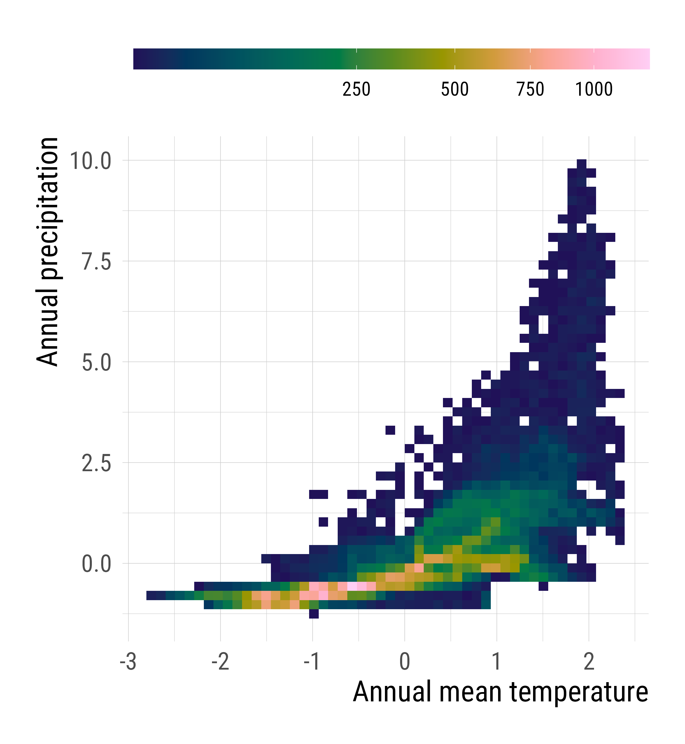
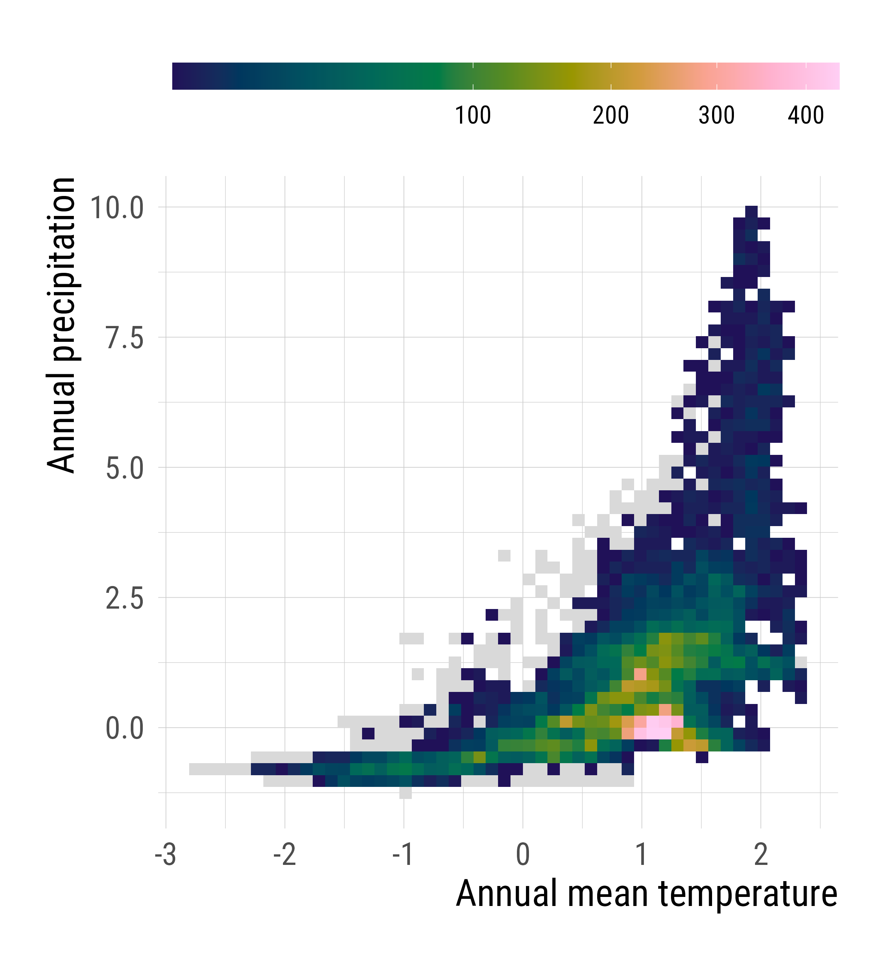
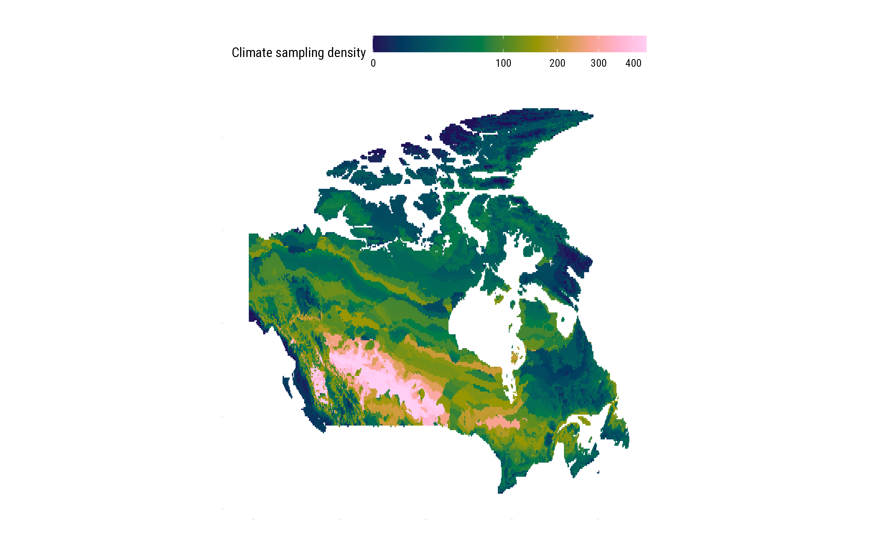
Available climate space
Sampled climate space
Climate frequency (cells/bin)
Sampling density (obs/bin)
a
b
Climate frequency (cells/bin)
d
Climate sampling density (obs/bin)
c
Notes:
SI methods

Slide 6
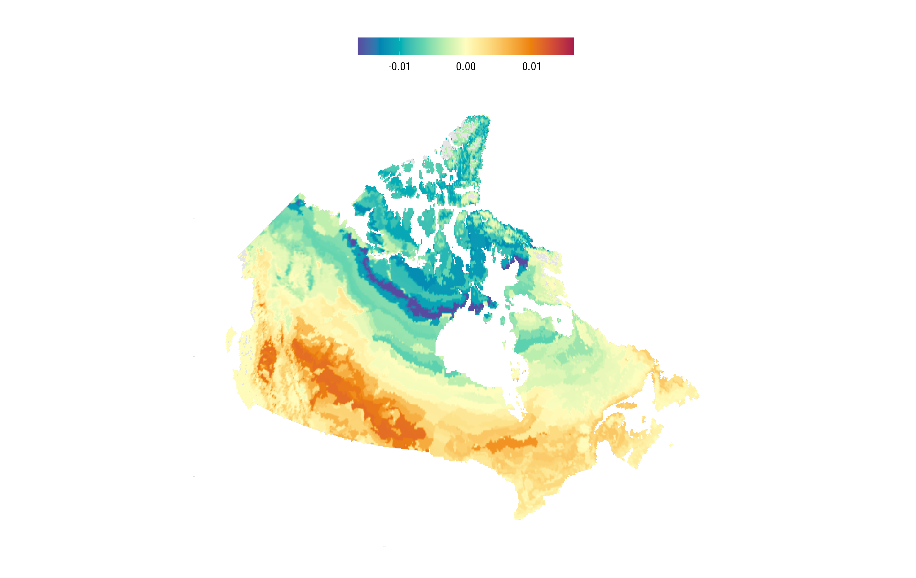
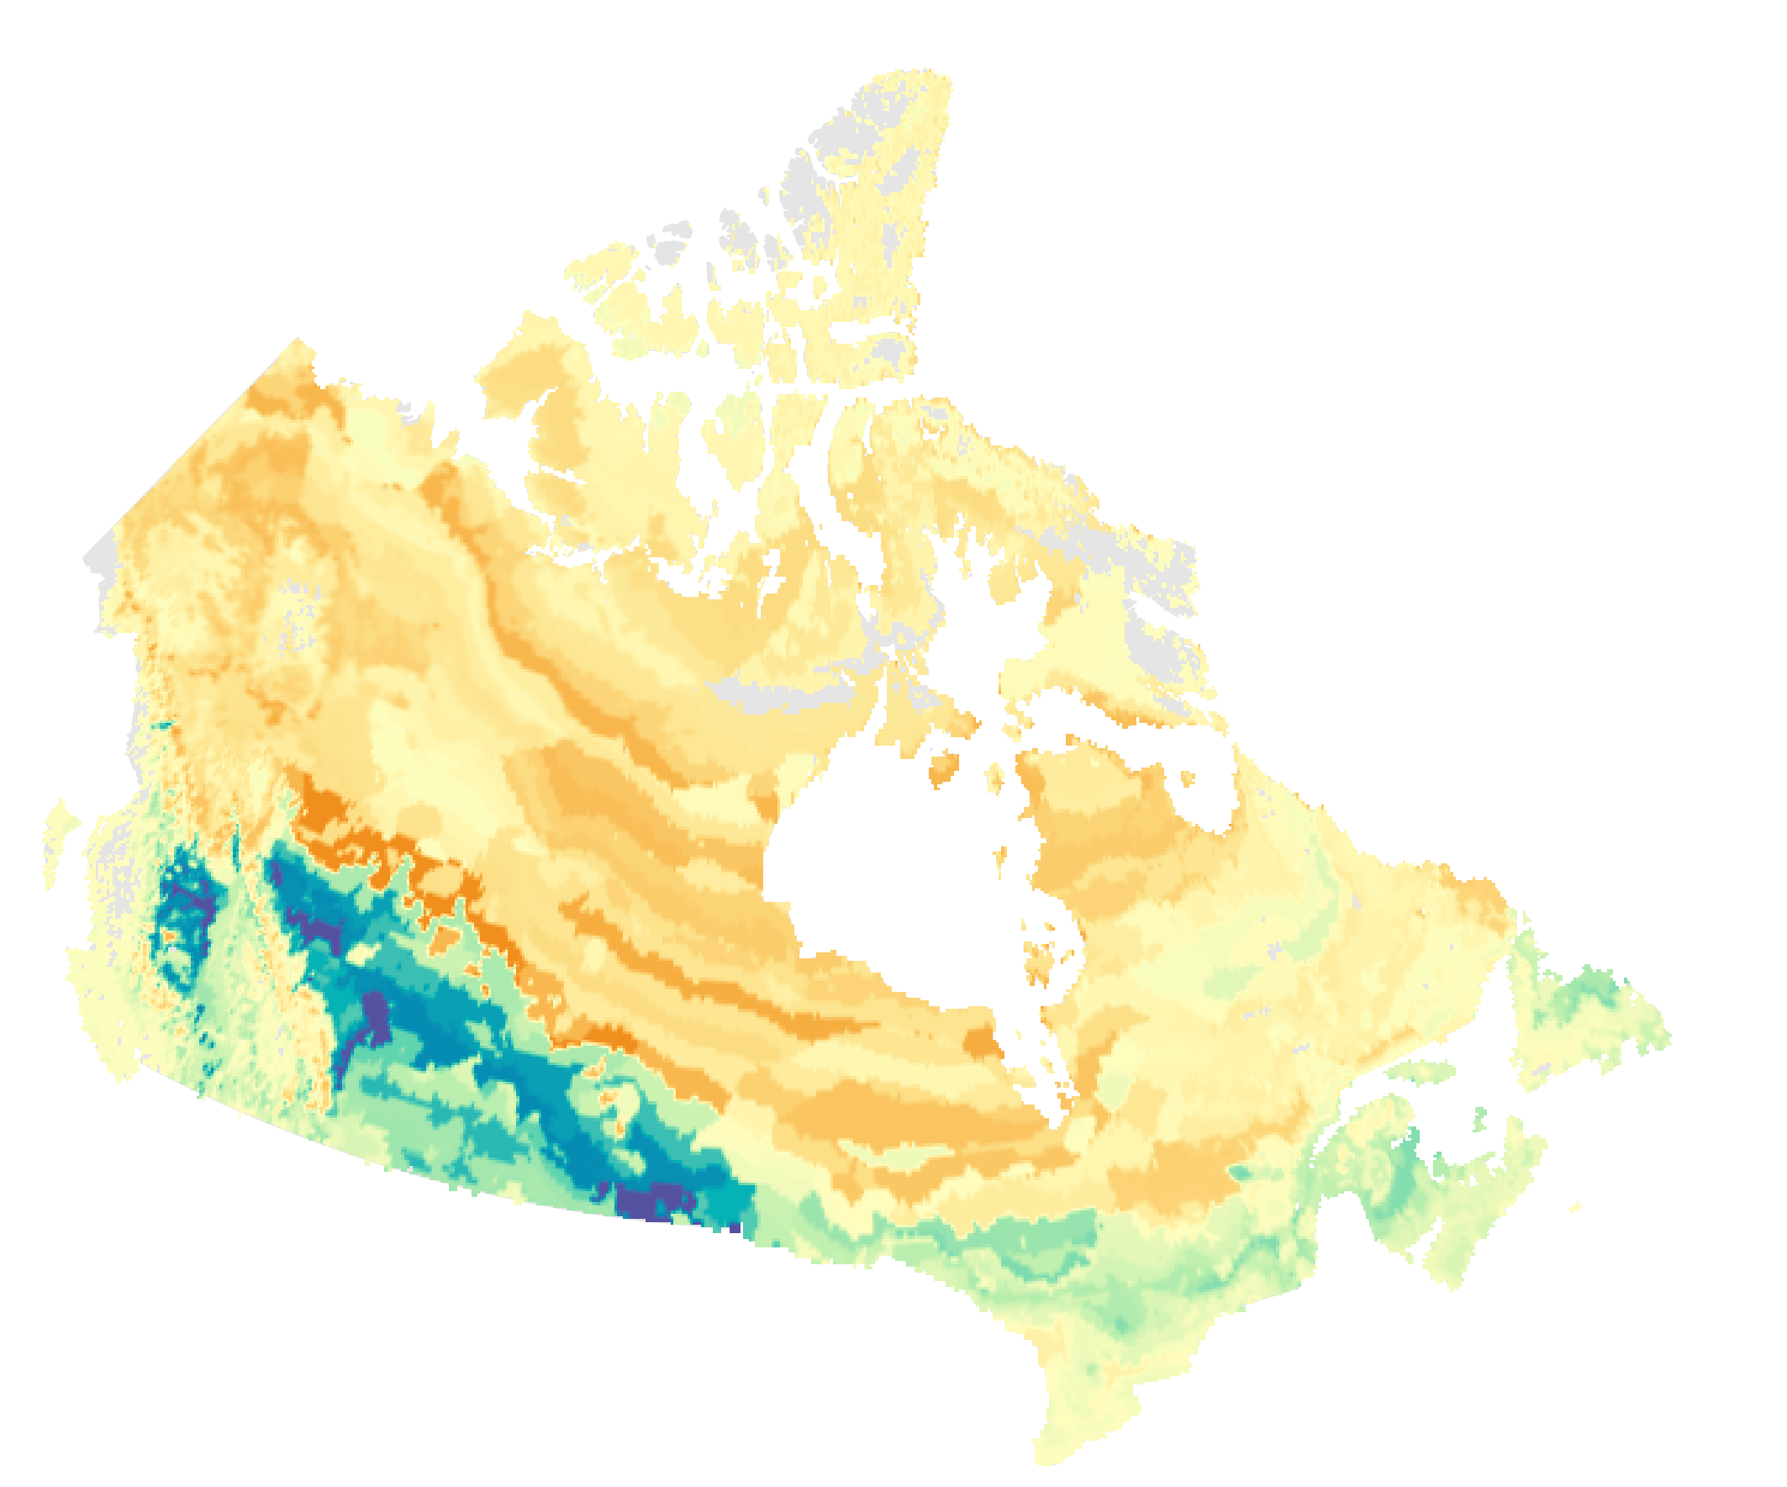
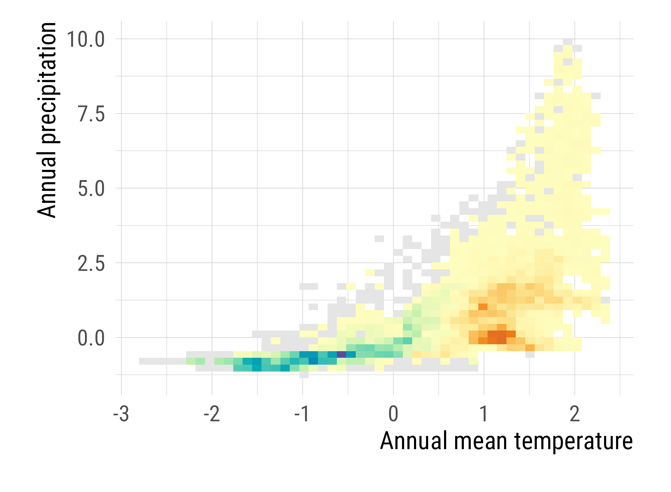
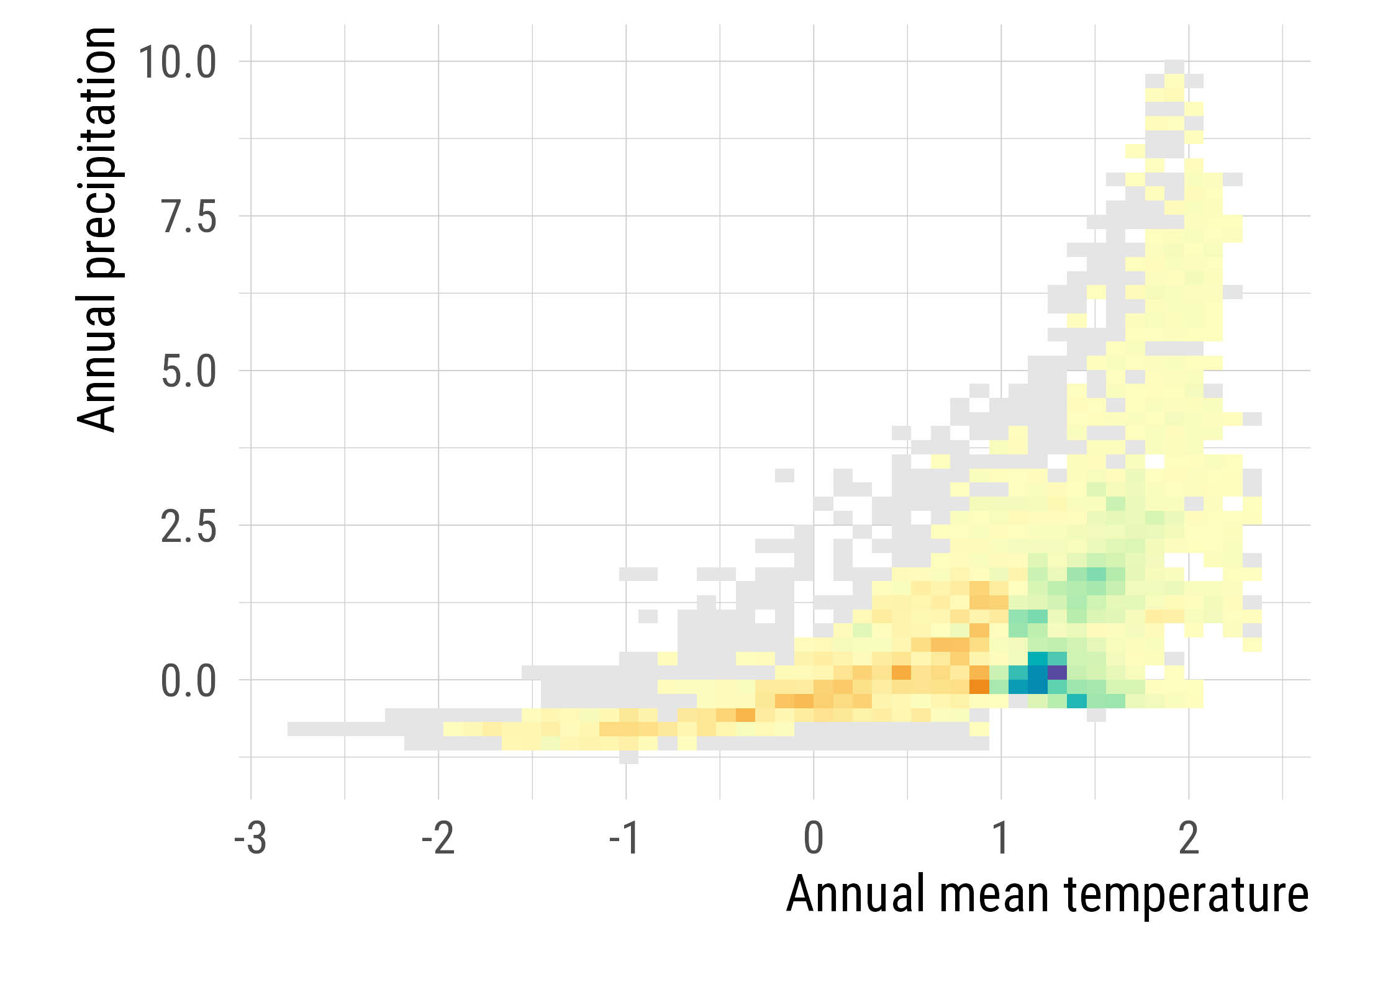
2008-2024
2025
Under-represented
Over-represented
Under-represented
Over-represented
More biased
More representative
a
b
a
b
c
d
c
d

Slide 7
