Slide 1
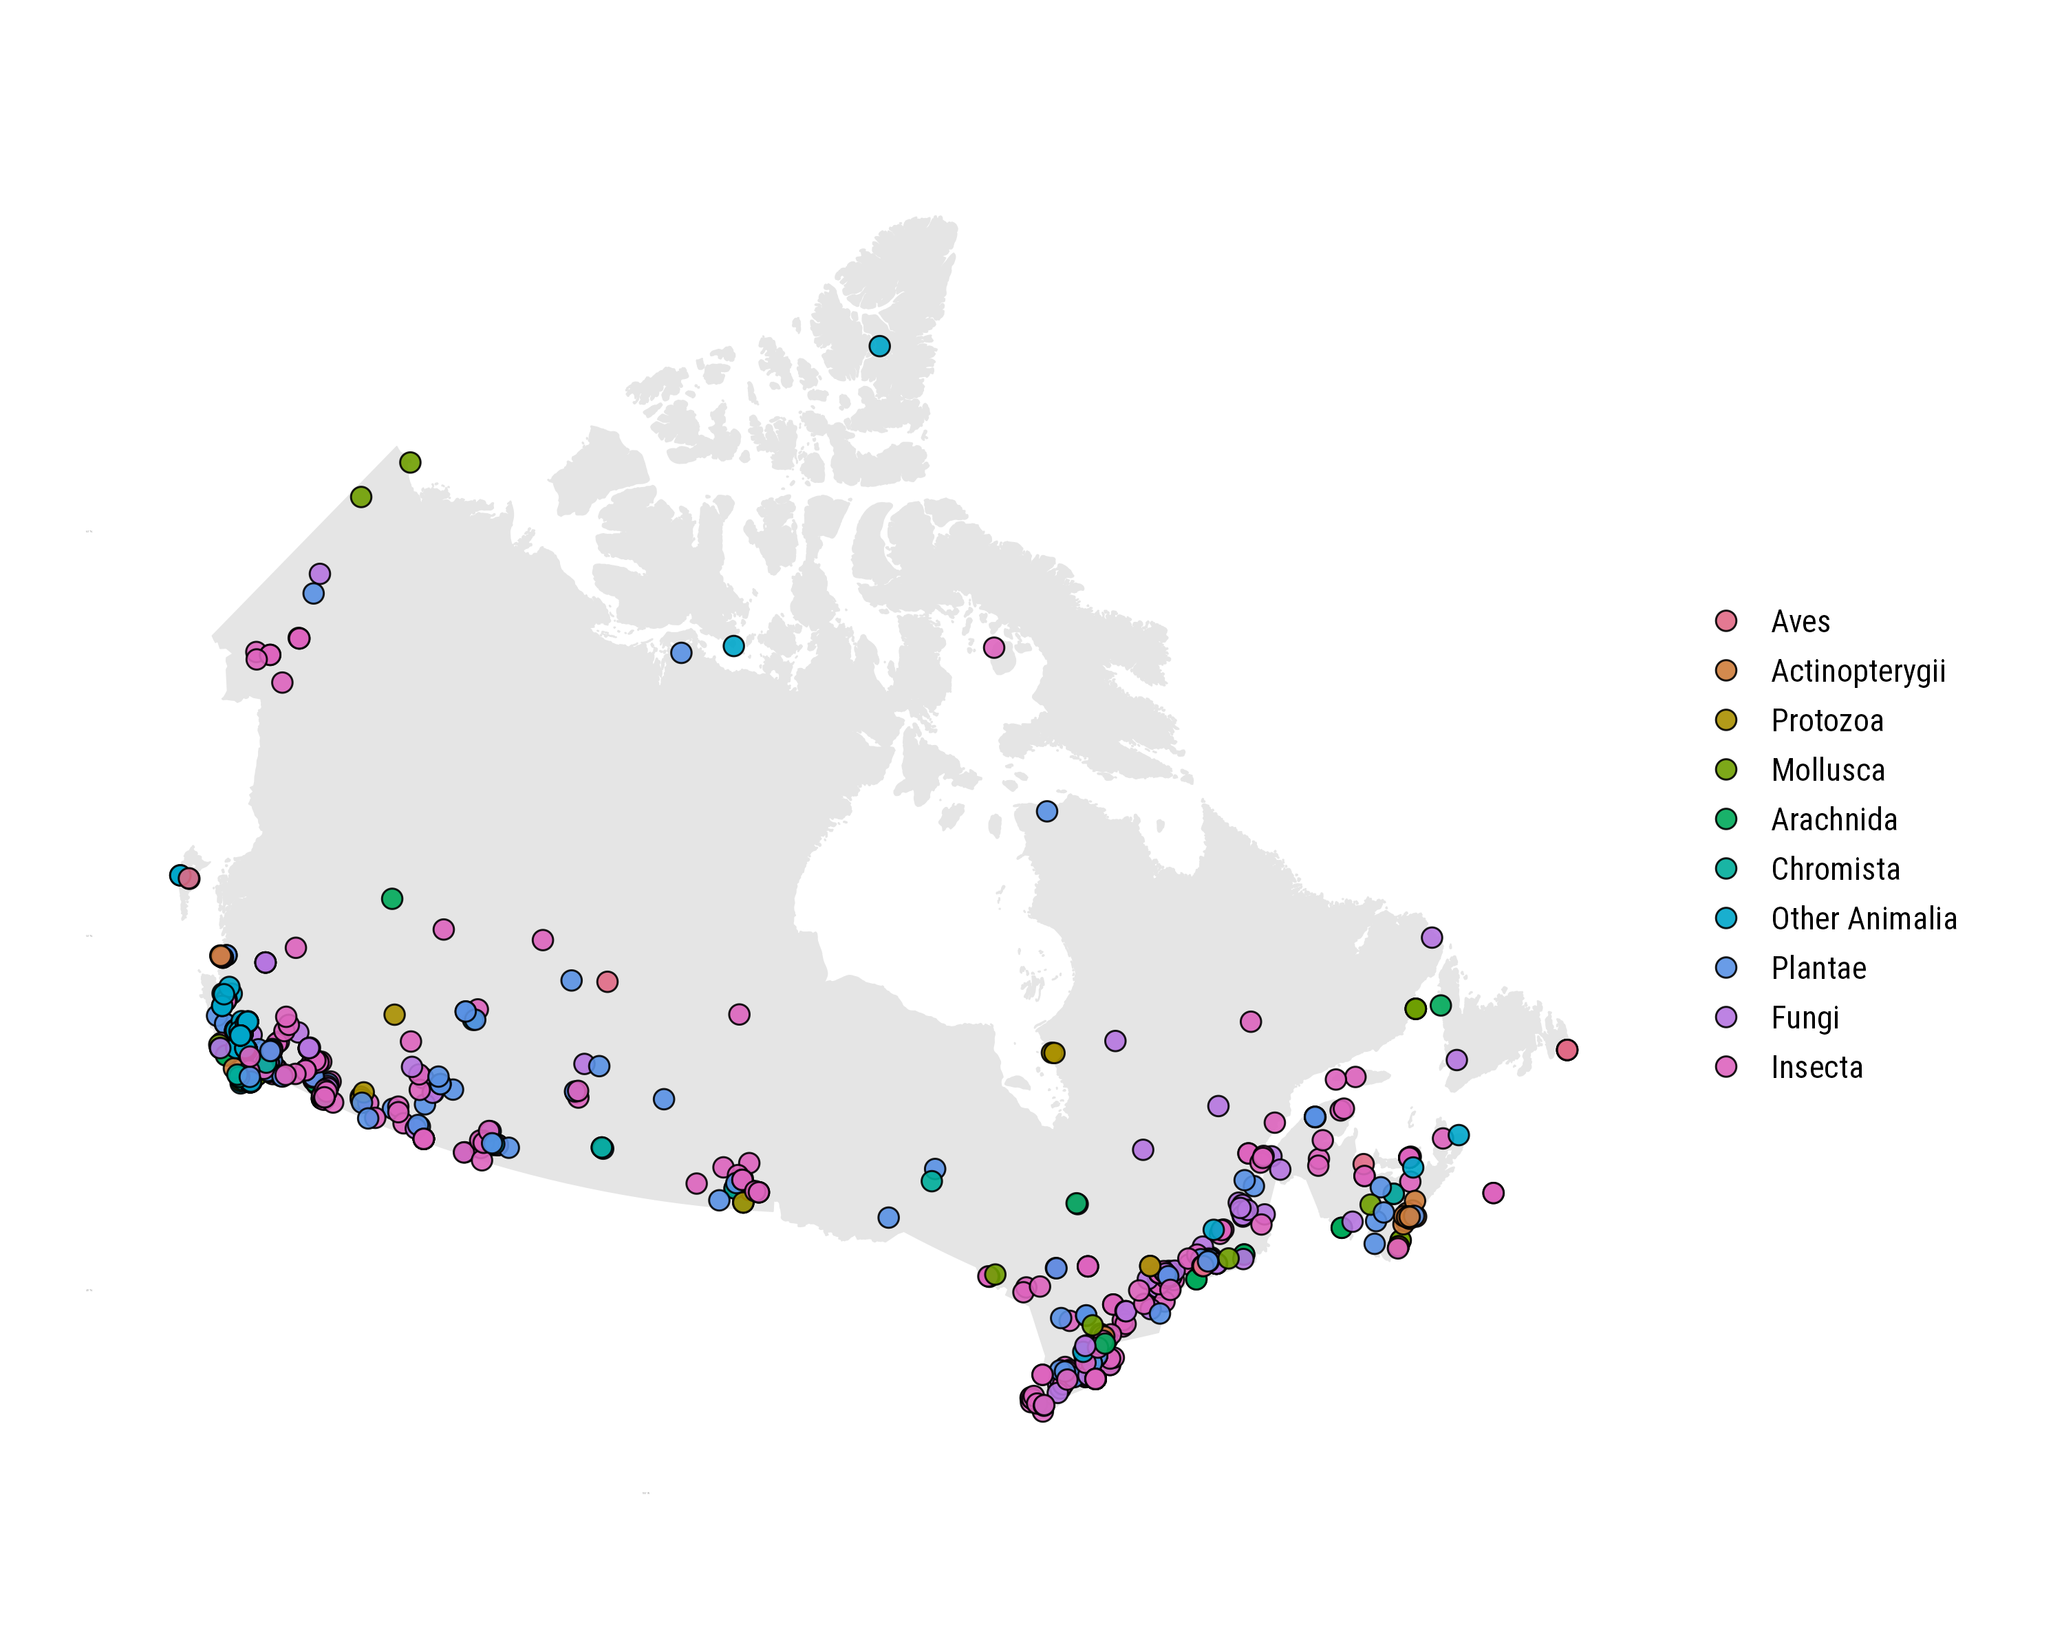
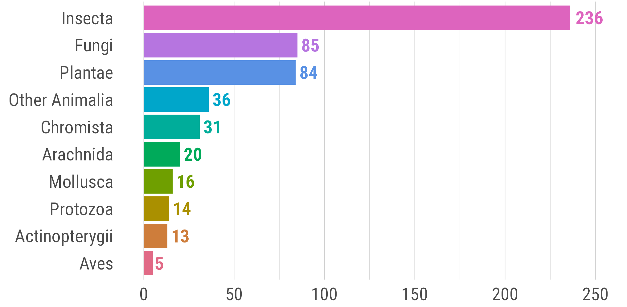
a
b
Newly recorded species

Slide 2
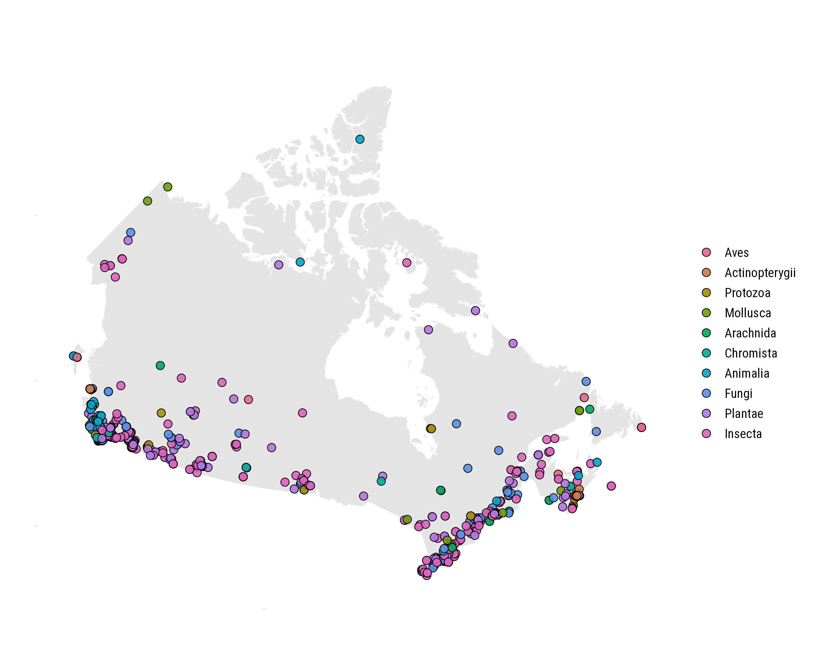
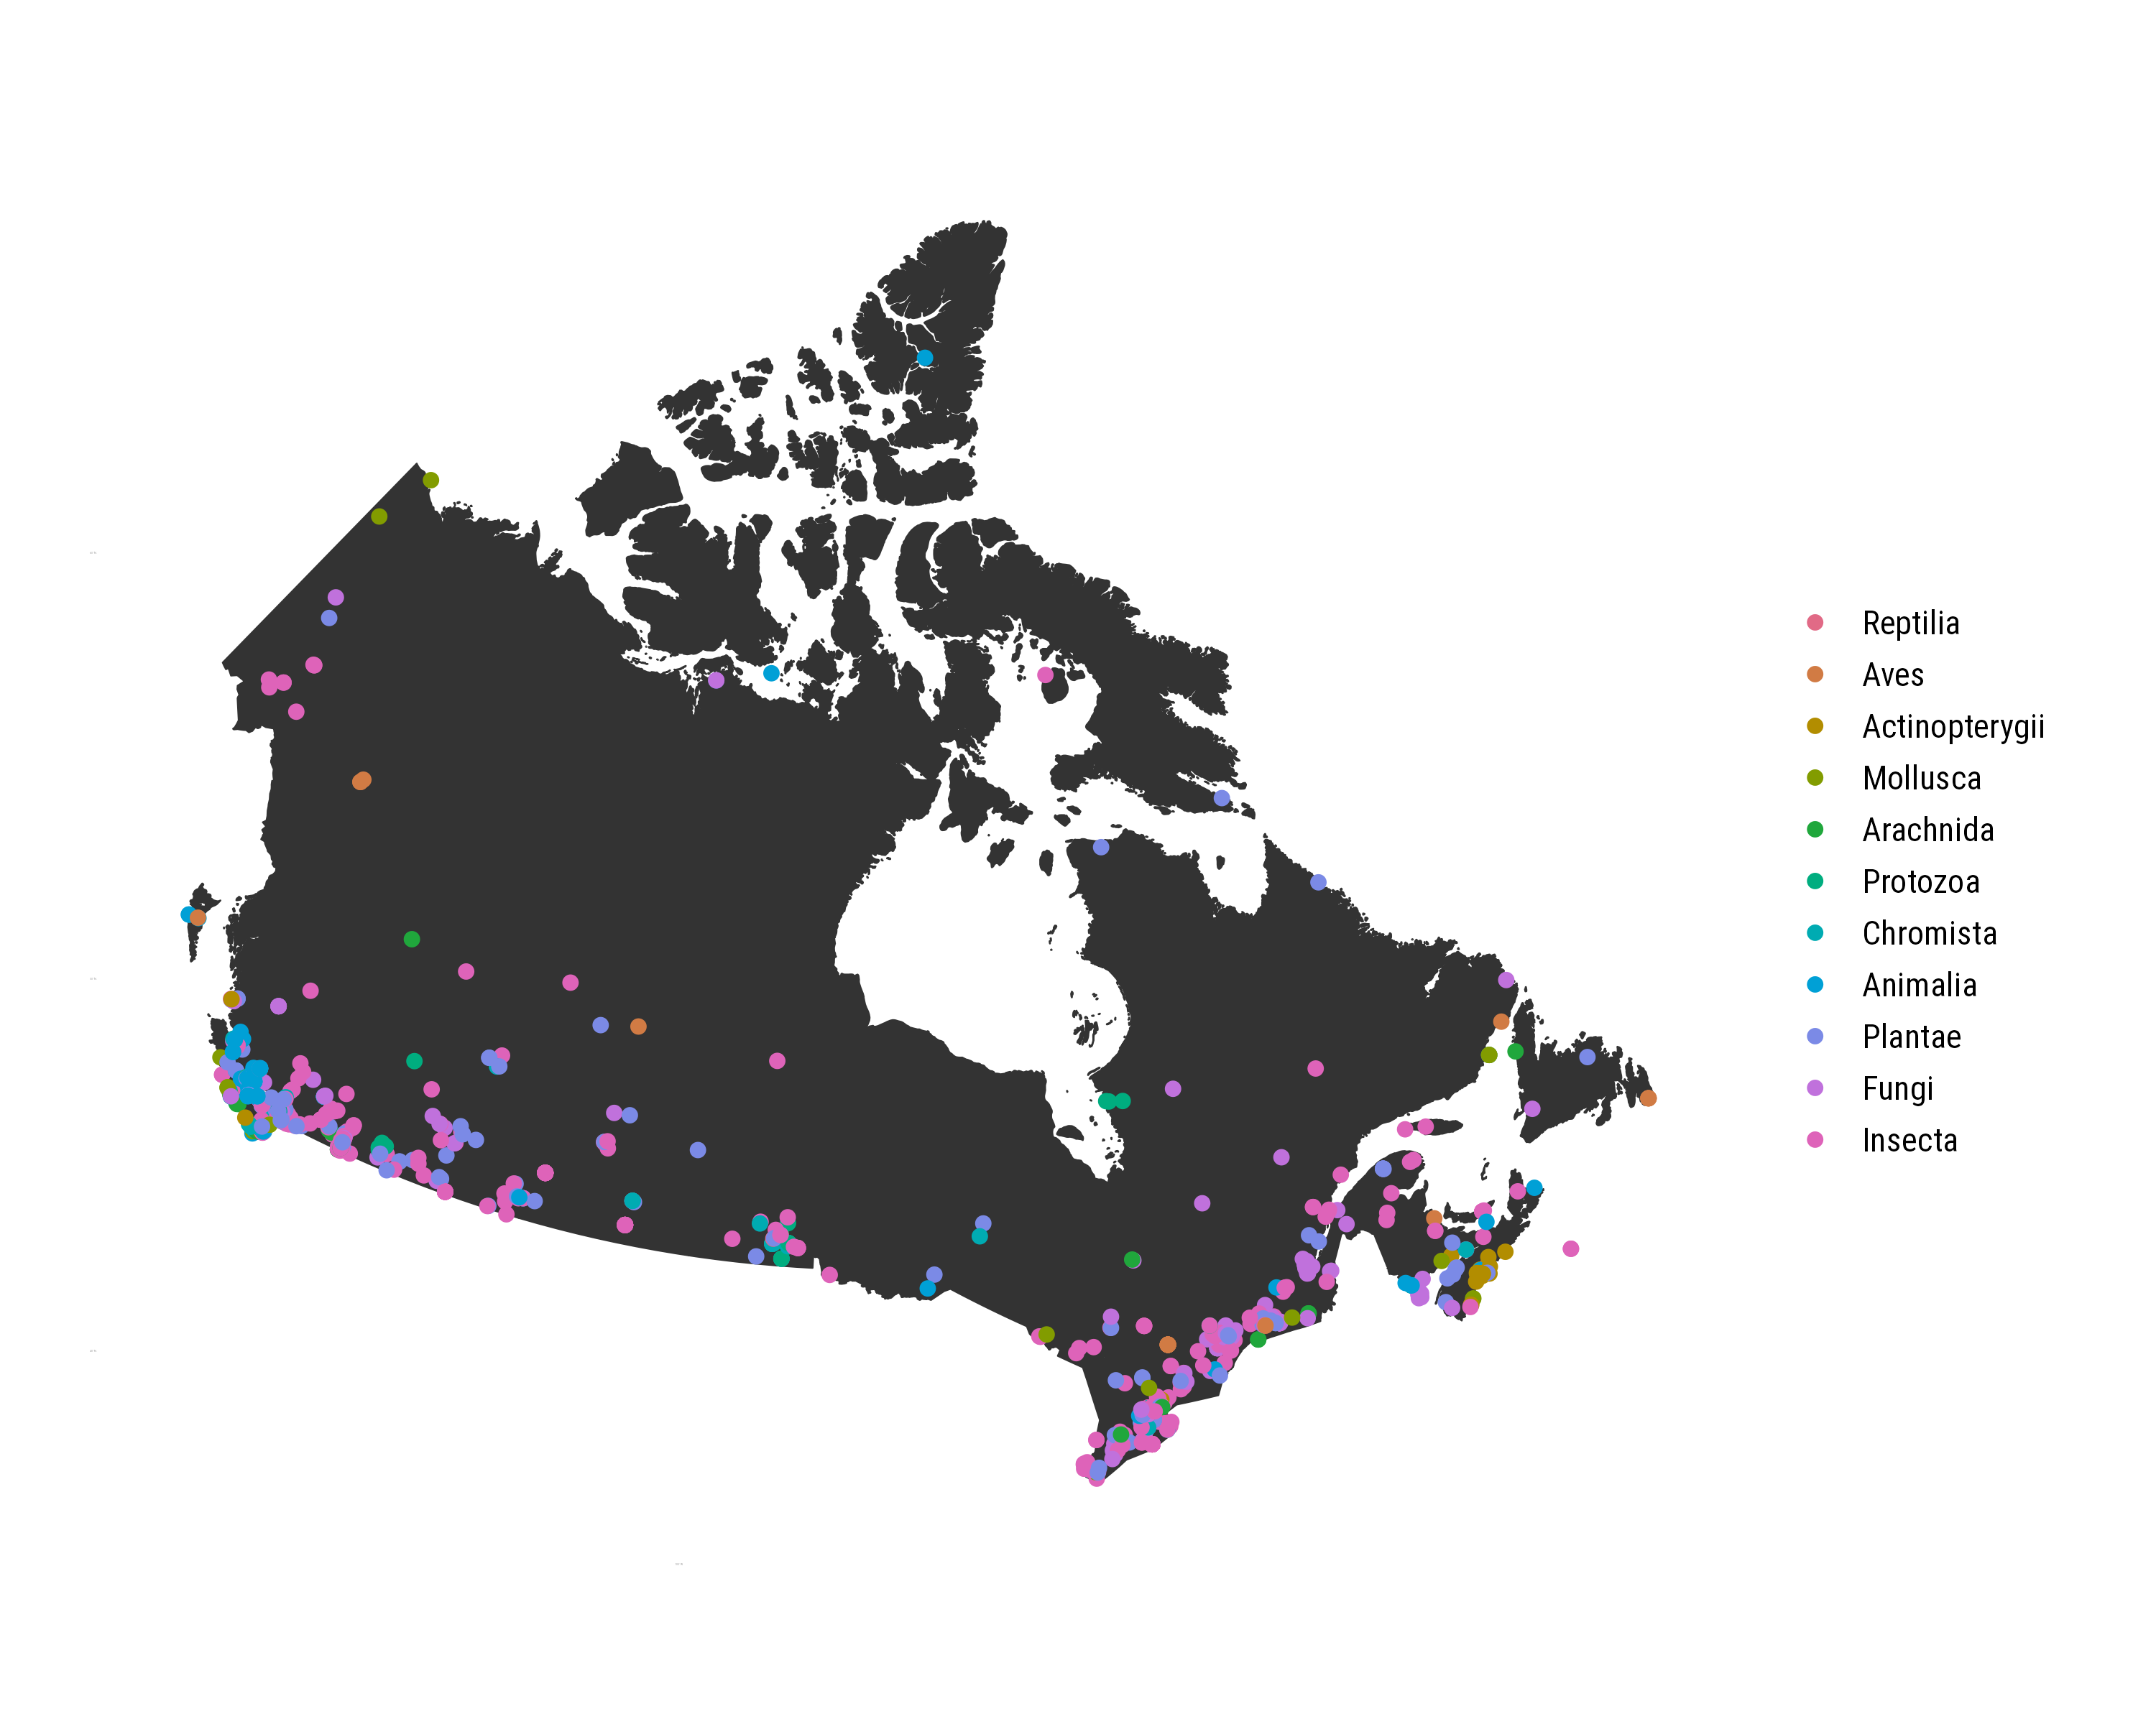
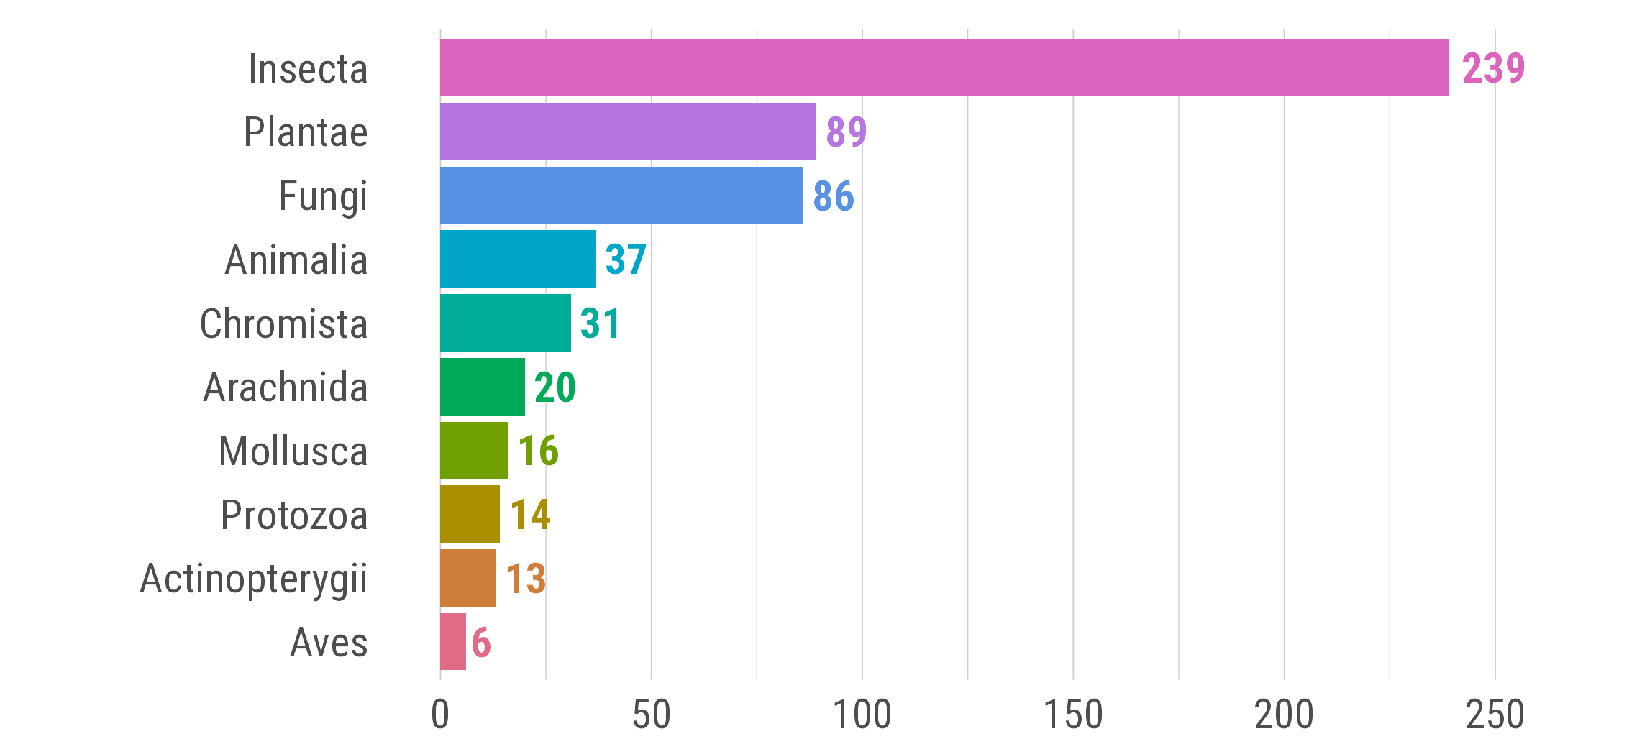
Reptilia
a
Reptilia
Aves
Aves
Actinopterygii
Actinopterygii
Mollusca
Mollusca
Arachnida
Arachnida
Protozoa
Protozoa
Chromista
Chromista
Other Animalia
Other Animalia
Plantae
Plantae
Fungi
Fungi
Insecta
Insecta
b
Insecta
Plantae
Fungi
Other Animalia
Chromista
Arachnida
Mollusca
Protozoa
Actinopterygii
Aves
Newly recorded species

Slide 3
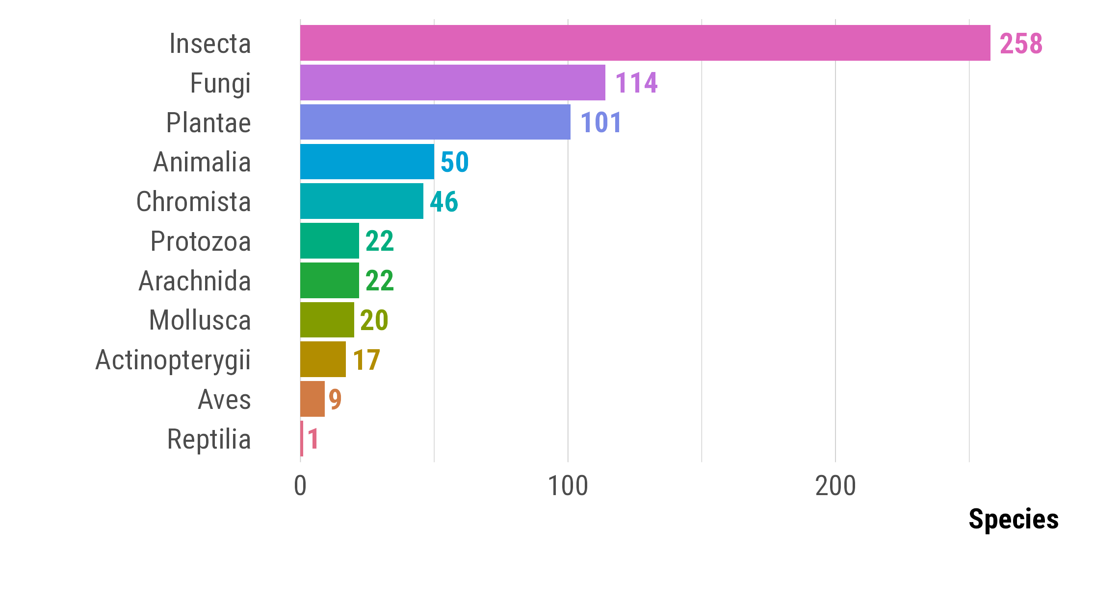
a
Newly recorded species in 2025
b

Slide 4
a
b
Newly recorded species in 2025

