Slide 1
Temperature and precipitation records, 1940-2025
What the observed records show for 12 countries, and whether the years that stand out in the climate also stand out in the economy
Track 1 · Environmental Economics · ESSEC BSc AIDAMS · 9 November 2026
[Group members]
Notes:
Speaker 1 (0:00-0:30). Introduce the group and the question in one sentence.

Slide 2
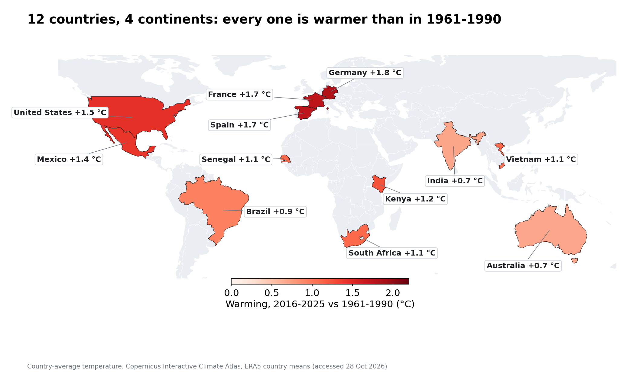
Notes:
Speaker 1 (0:30-1:30). Three countries per continent so that we cover temperate, Mediterranean, tropical, monsoon and semi-arid climates. Point at the colours: warming since 1961-1990 ranges from +0.7 °C (Australia) to +1.8 °C (Germany). Data: Copernicus Interactive Climate Atlas, ERA5 reanalysis, averaged over each country; World Bank WDI for the economy.

Slide 3
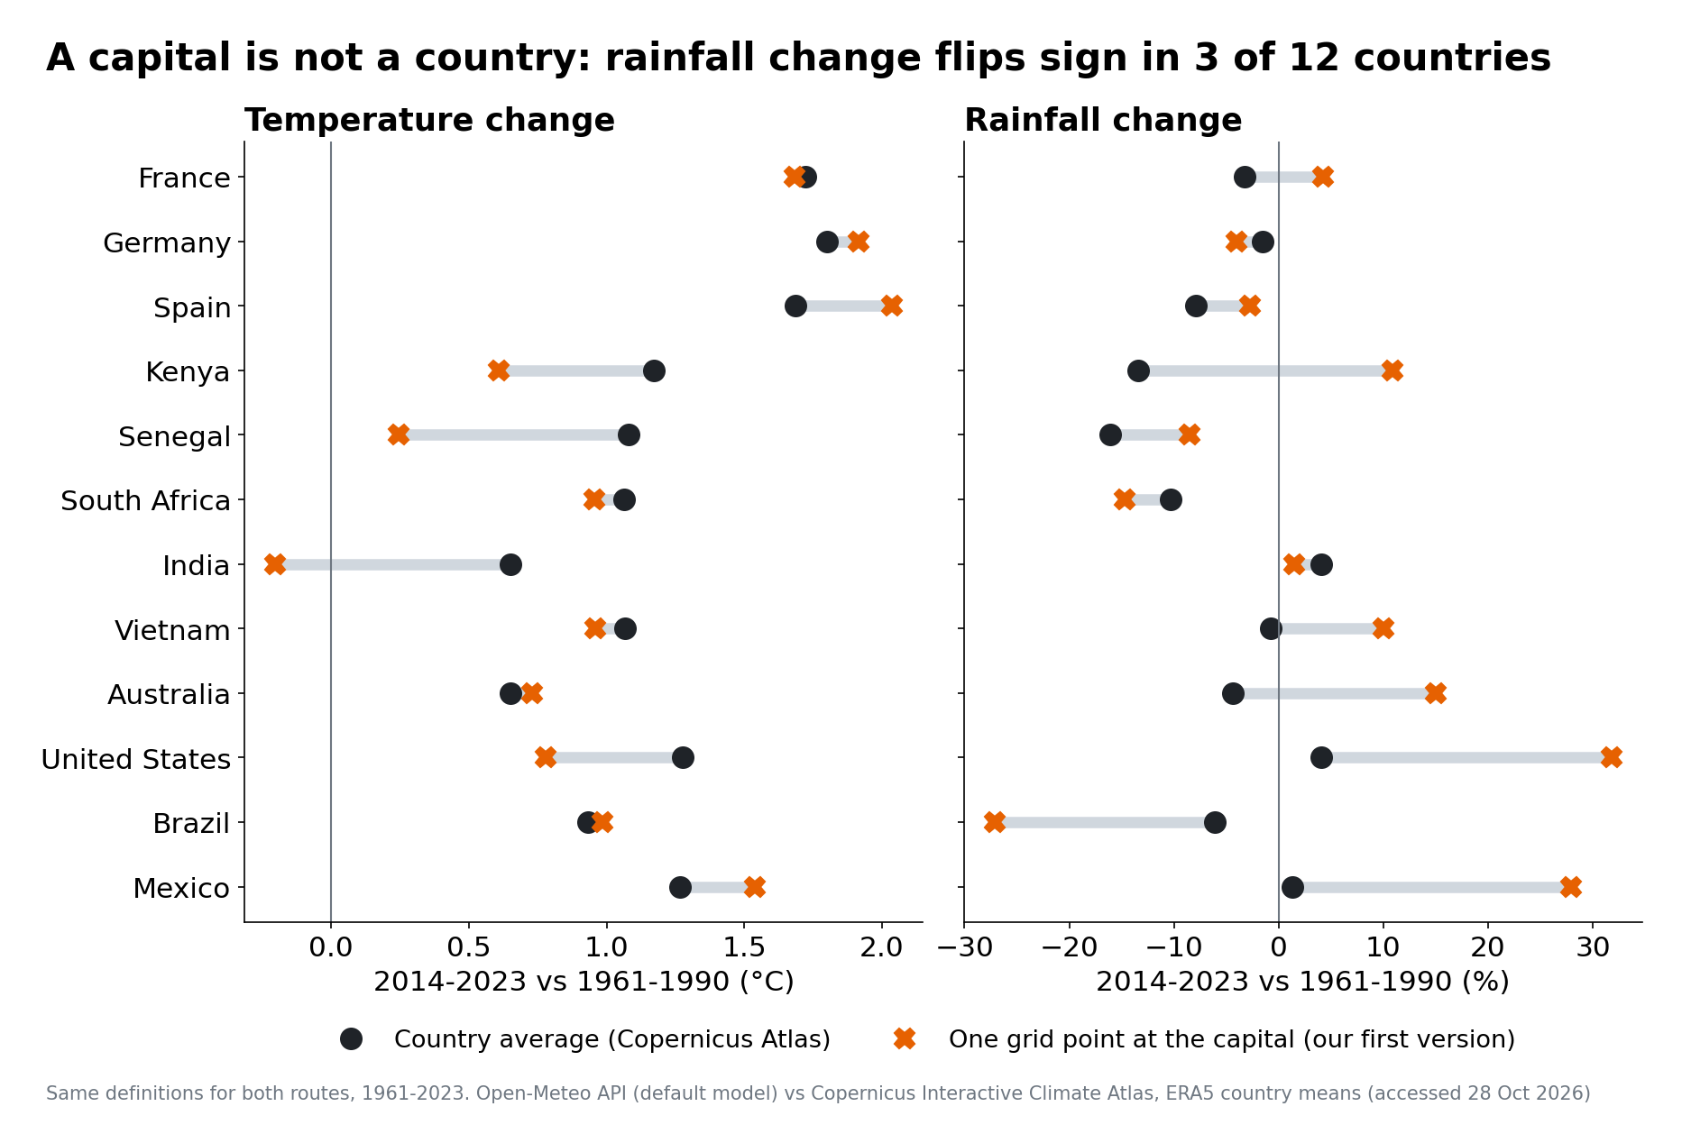
Notes:
Speaker 1 (1:30-2:45). Our first version used an API and one grid point at each capital. When we re-did it with the Atlas country averages the brief recommends, temperature barely changed, but rainfall did: Kenya, Mexico, the US change sign or size. Rainfall is local; a single 30 km cell is not a country. Lesson: check what the data measure before analysing them. Everything that follows uses country averages.

Slide 4
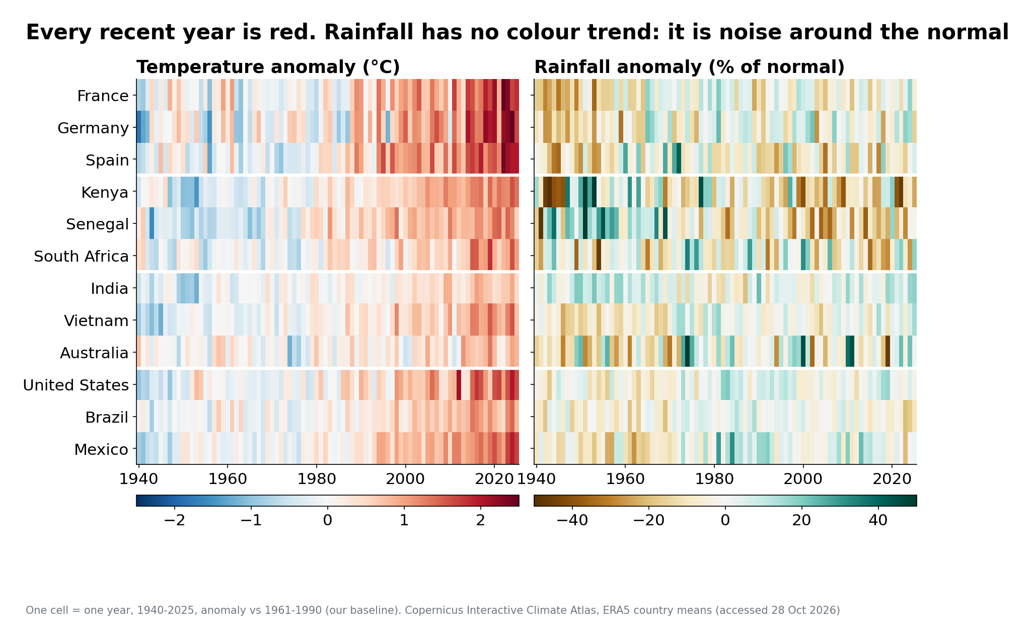
Notes:
Speaker 1 (2:45-3:45). Each row is a country, each cell a year since 1940. We compute monthly anomalies against our own 1961-1990 baseline (the Atlas gives absolute values), which removes the seasonal cycle. Left: the last two decades are red everywhere. Right: rainfall alternates wet and dry without a clear drift. Pre-1950 data rest on fewer observations.

Slide 5
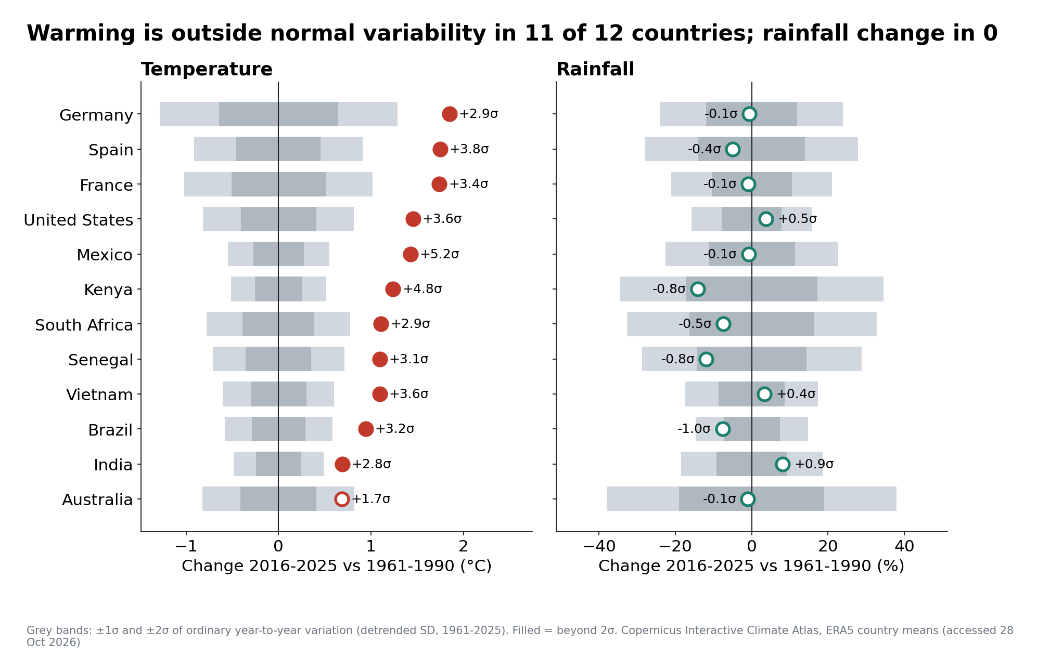
Notes:
Speaker 1 (3:45-5:00). Our core description. Change of the last decade against the baseline, compared with how much an ordinary year deviates (σ). Temperature: beyond 2σ in 11 of 12 countries, i.e. the recent climate is outside what normal variability would produce. Rainfall: only 0 of 12. Temperature moves most in Europe and Mexico; rainfall moves in different places, and mostly not detectably.

Slide 6
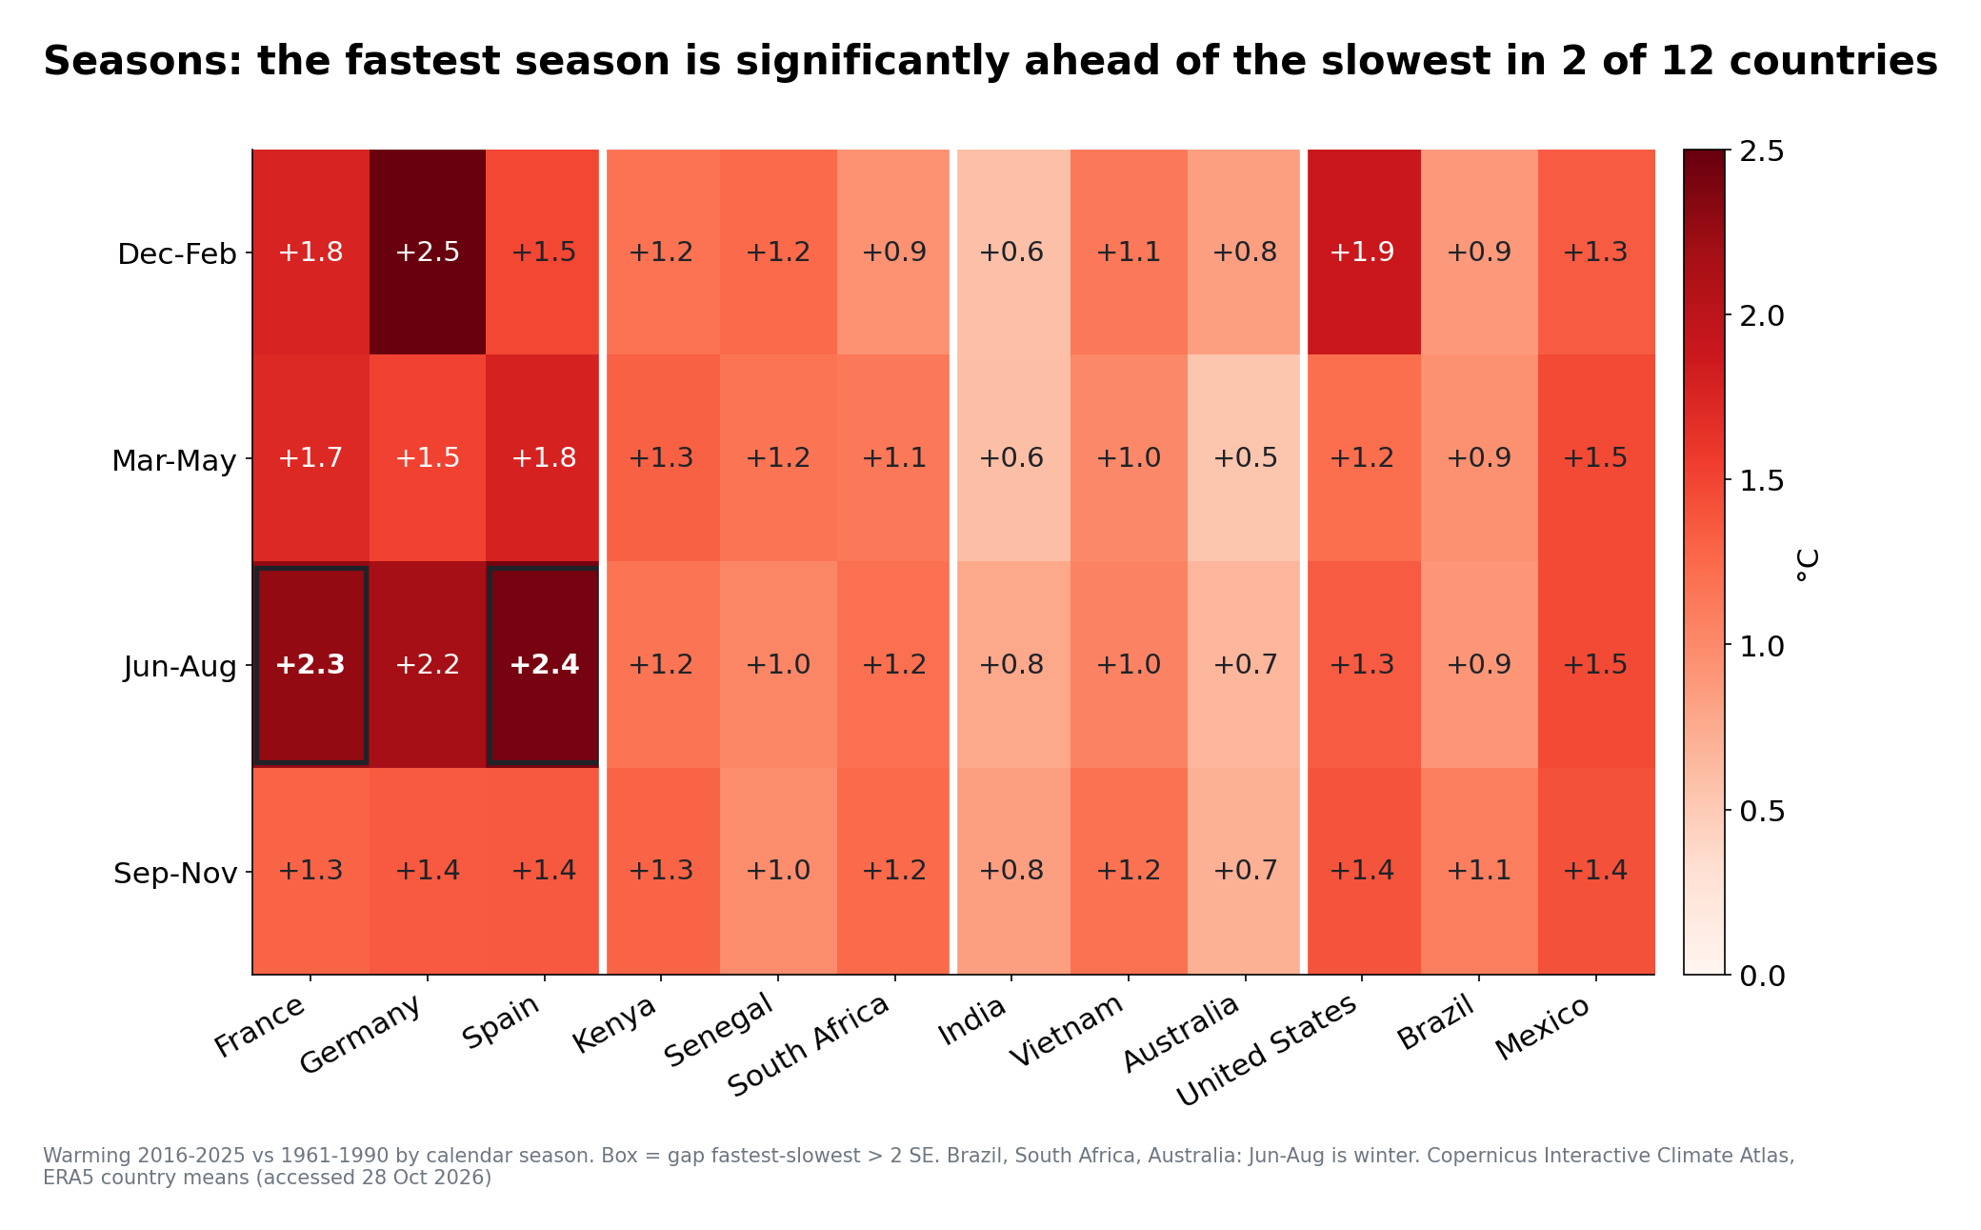
Notes:
Speaker 2 (5:00-6:00). Is the warming spread evenly across the year? Mostly yes within the noise. The boxed countries are those where the fastest season is significantly ahead, e.g. summer in France and Spain. Germany's winter warmed a lot but winters are so variable that the gap is not significant. Warning: Jun-Aug is winter in the southern hemisphere.

Slide 7
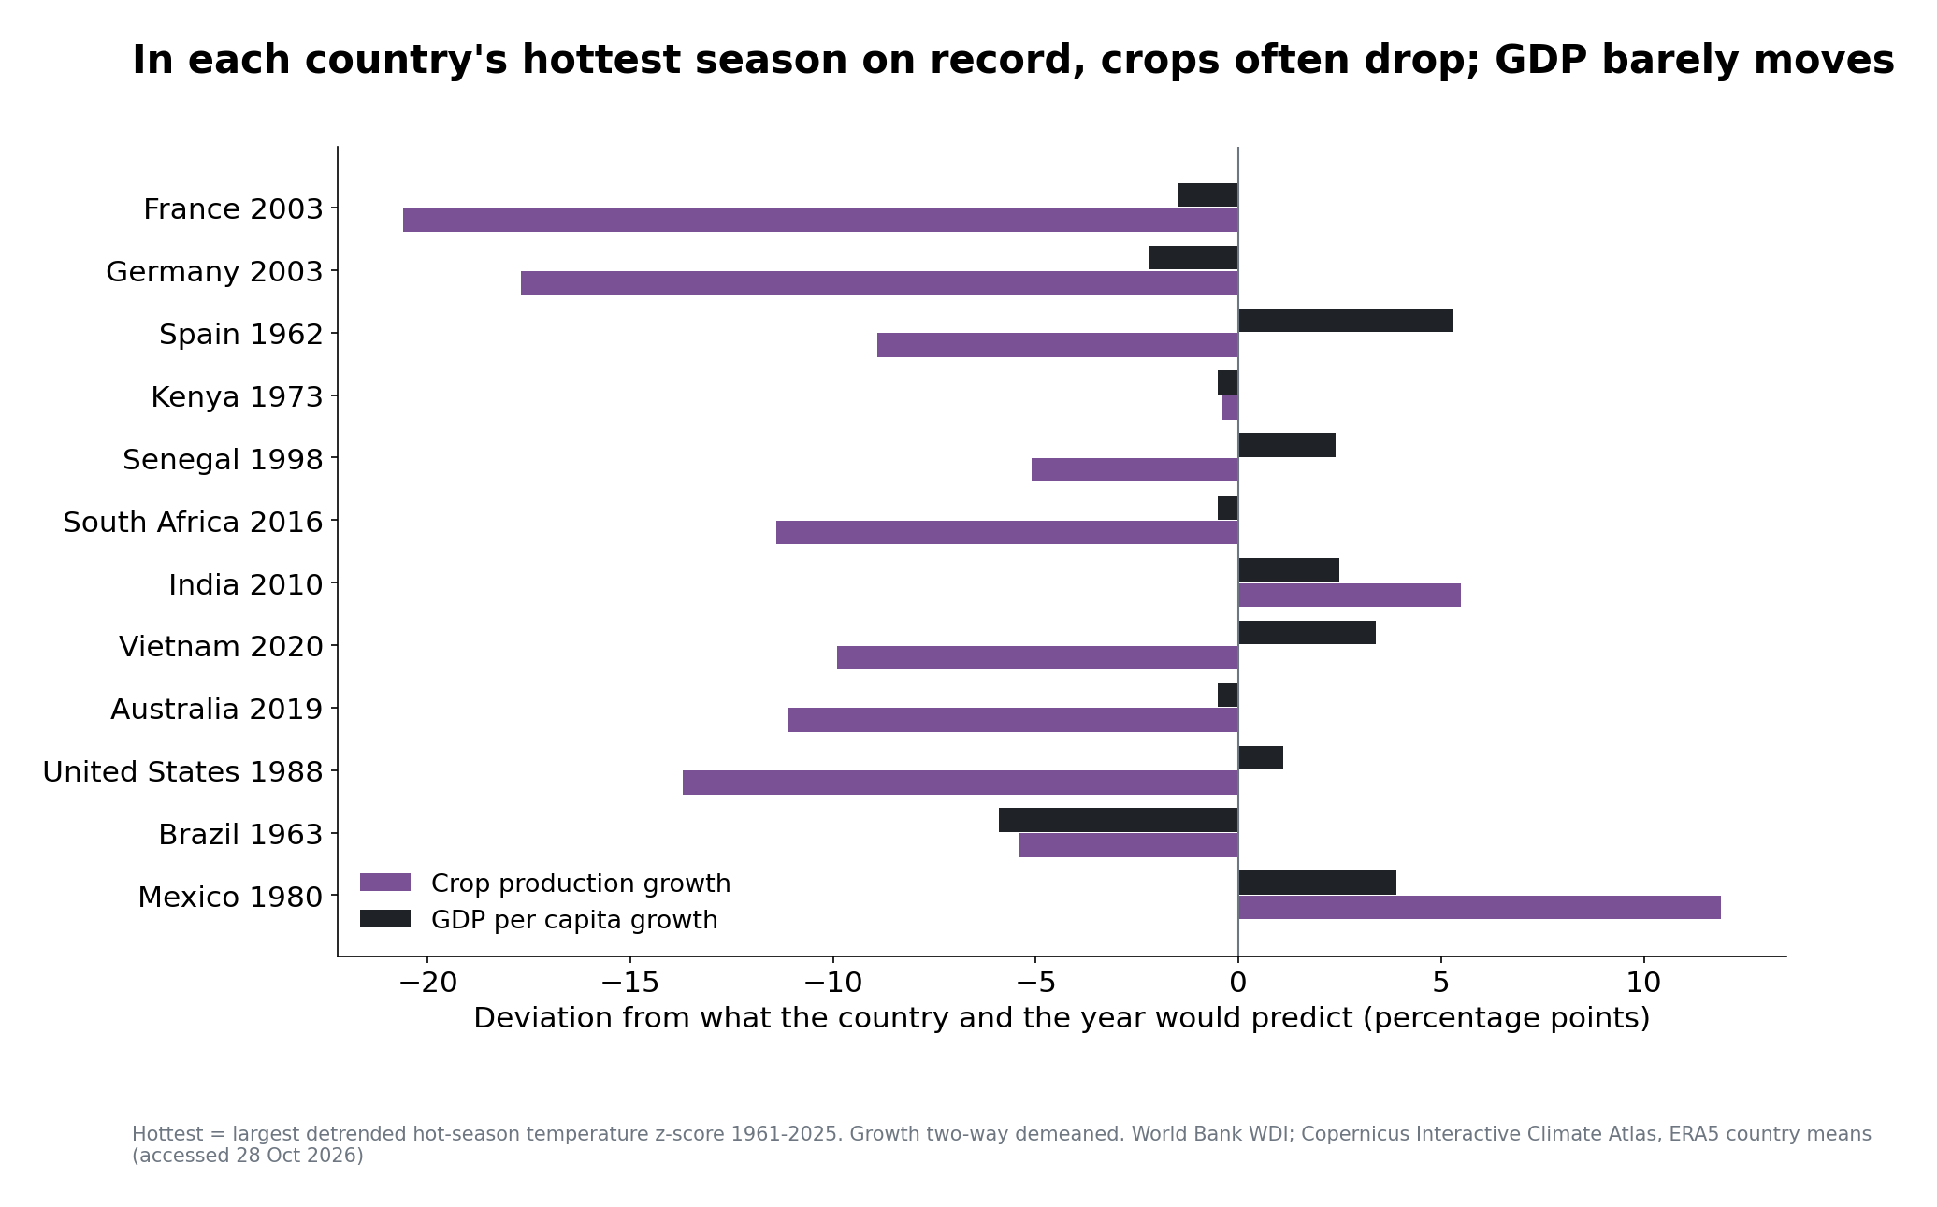
Notes:
Speaker 2 (6:00-7:15). Now the economy. Hot-season temperature catches heatwaves that annual means dilute: France 2003 is a 3.5σ summer, but only 1.2σ as an annual mean. In the hottest summers, crop output often falls well below normal; GDP per capita barely moves, because agriculture is a few percent of GDP in most of our countries.

Slide 8
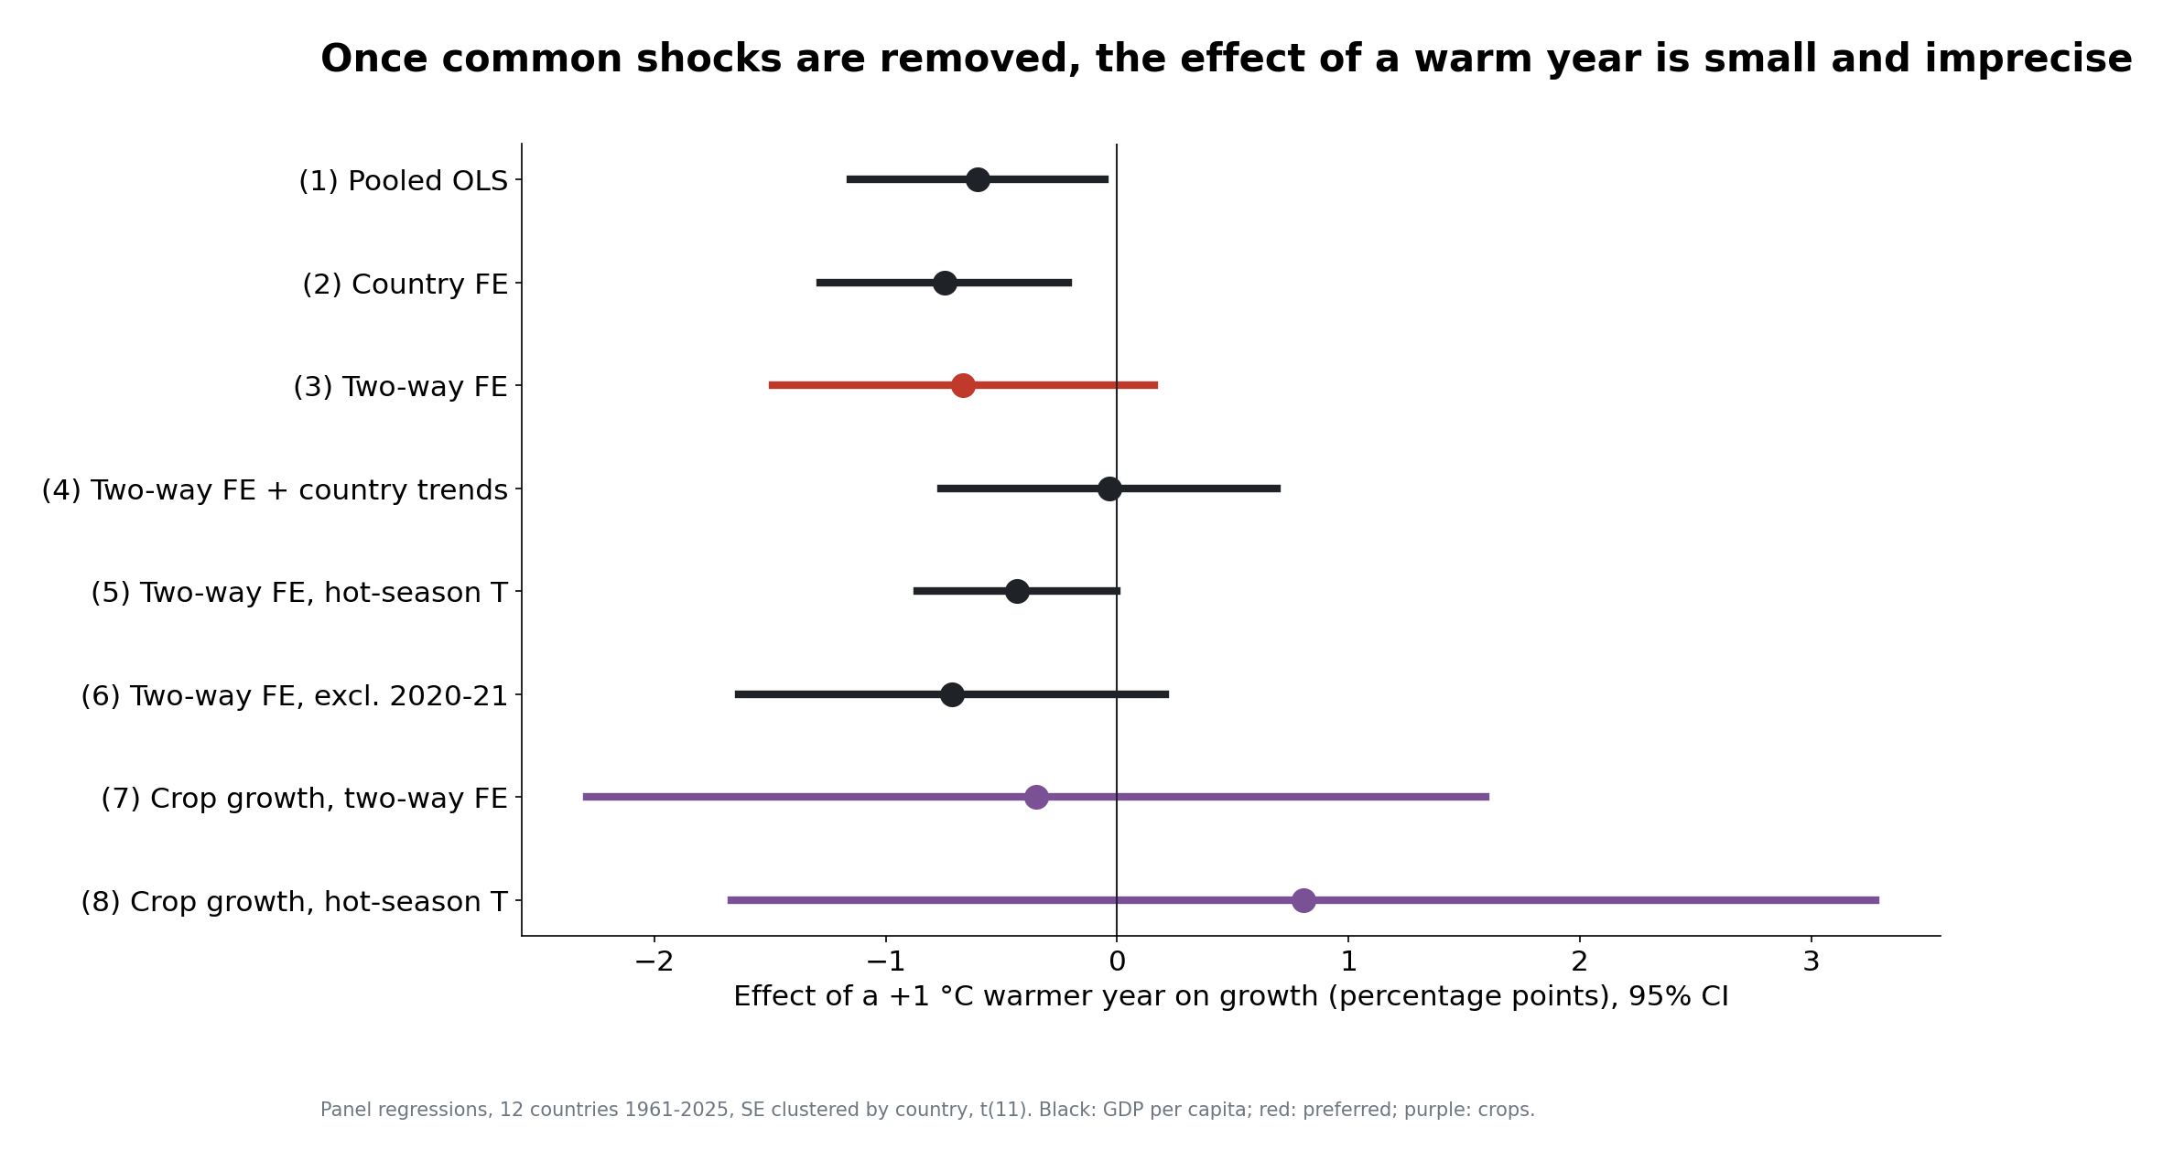
Notes:
Speaker 2 (7:15-8:30). Panel regression of growth on temperature and rainfall anomalies. Without year effects we would report -0.75 pp per °C, but warming and the post-1970 growth slowdown trend together. With country and year effects (preferred): -0.67 pp per °C, 95% CI [-1.49, +0.16], wild bootstrap p = 0.12. A typical warm year (1 SD) = -0.25 pp. 12 countries cannot tell this from zero.

Slide 9
What we can and cannot conclude
Description (solid): every country has warmed; the change exceeds year-to-year noise in 11/12. Rainfall change is mostly within the noise (0/12 beyond 2σ).
Correlation (weak): unusually warm years go with slightly lower growth and lower crop output, but 12 countries cannot distinguish this from zero.
Not causal, not climate change: year-to-year weather is not a permanent shift; adaptation and national aggregation hide local losses. Causality would need sub-national data, many more countries and a pre-specified exposure channel.
Notes:
Speaker 2 (8:30-9:30). Be explicit about the type of each result: description, correlation, not causal. This is what the brief grades.

Slide 10
Three takeaways
1. Warming is unmistakable: +0.7 to +1.8 °C since 1961-1990, far outside normal variability.
2. Rainfall is different: local, noisy, and sensitive to how you measure it.
3. Climate shocks show up in crops before they show up in GDP.
Notes:
Speaker 2 (9:30-10:00). Close, then hand over to the Q&A team.

Slide 11
Backup: data and definitions
Climate: Copernicus Interactive Climate Atlas (C3S/ECMWF), ERA5, monthly 1940-2025. France, Germany, Spain: Atlas 'European countries' masks; 9 others: Atlas 'user-defined region' with Natural Earth borders (USA = 48 contiguous states).
Anomalies vs 1961-1990 per calendar month; precipitation = mm/day x days.
Economy: World Bank WDI, release 8 Oct 2026: GDP per capita growth, crop production index, agriculture share.
Regressions: two-way fixed effects, SE clustered by country (t(11)) + wild cluster bootstrap.
Notes:
Use in Q&A only.

Slide 12
Backup: likely questions
Why not the capital-city API? Rainfall at one point is not the country's rainfall (slide 3).
Why does Country FE give a big effect? Warming and the growth slowdown both trend over time.
Is p ≈ 0.5 'no effect'? No: the CI is wide; we cannot rule out a sizeable effect.
Why hot season? An annual mean dilutes a 2-month heatwave (France 2003: 3.5σ summer, 1.2σ year).
Notes:
Use in Q&A only.

