Slide 1
matplotlib 2

Slide 2
➢ import matplotlib.pyplot as plt
➢ %matplotlib inline
➢ import numpy as np

Slide 3
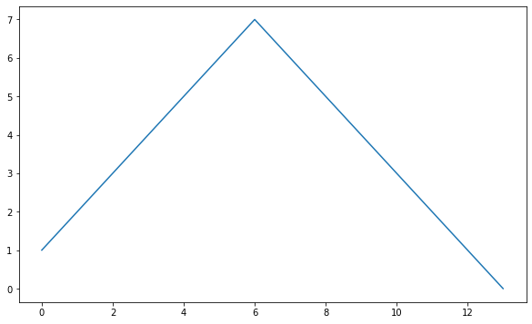
➢ plt.figure(figsize=(10,6))
➢ plt.plot([1,2,3,4,5,6,7,6,5,4,3,2,1,0])
plt.show()
# figsize: 차트그림(figure)의 크기(inch)

Slide 4
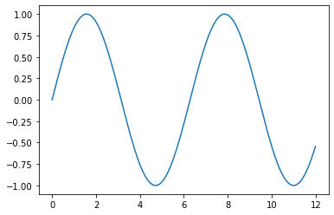
➢ t = np.arange(0,12,0.01)
y = np.sin(t)
plt.plot(t,y)
plt.show

Slide 5
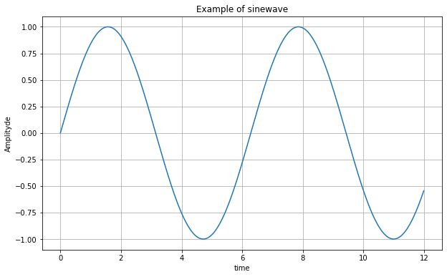
➢ plt.figure(figsize=(10,6))
➢ plt.plot(t,y)
➢ plt.grid()
➢ plt.xlabel('time')
➢ plt.ylabel('Amplityde')
➢ plt.title('Example of sinewave')
➢ plt.show()

Slide 6
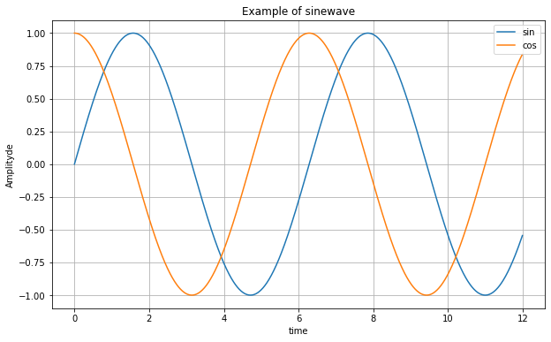
#legend() 범례
➢ plt.figure(figsize=(10,6))
➢ plt.plot(t,y,label='sin')
➢ plt.plot(t,np.cos(t),label='cos')
➢ plt.grid()
➢ plt.legend()
➢ plt.xlabel('time')
➢ plt.ylabel('Amplityde')
➢ plt.title('Example of sinewave')
➢ plt.show()

Slide 7
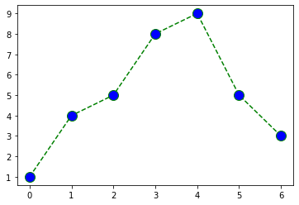
➢ t = [0,1,2,3,4,5,6]
y = [1,4,5,8,9,5,3]
➢ plt.plot(t, y, color='g’, linestyle=‘--’, marker='o’, markerfacecolor='b’, markersize=12)
➢ plt.figure(figsize=(10,6))
➢ plt.show()

Slide 8
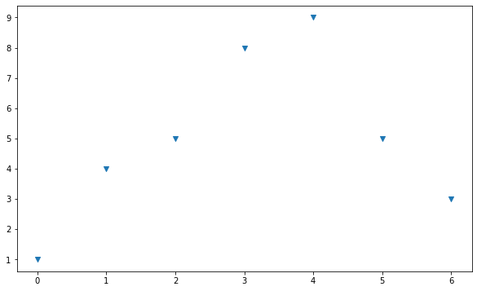
➢ plt.figure(figsize=(10,6))
➢ plt.scatter(t, y, marker='v')
➢ plt.show()

Slide 9
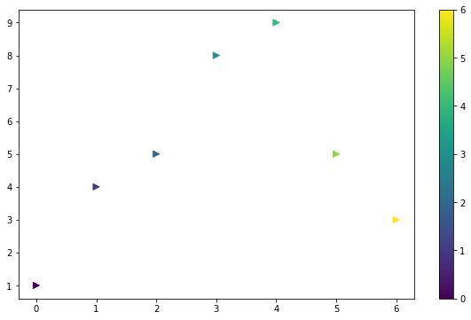
# colormap: x축값 t에 따라 색상을 바꿈
# s: 마커 크기
➢ colormap=t
➢ plt.figure(figsize=(10,6))
➢ plt.scatter(t, y, s=50, c=colormap, marker='>')
➢ plt.colorbar()
➢ plt.show()

Slide 10
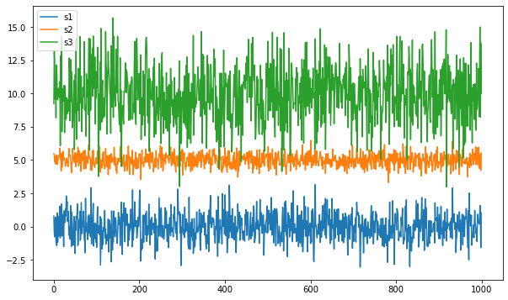
# normal(평균, 표준편차)
➢ s1 = np.random.normal(0, 1, size=1000)
➢ s2 = np.random.normal(5, 0.5, size=1000)
➢ s3 = np.random.normal(10, 2, size=1000)
➢ plt.figure(figsize=(10,6))
➢ plt.plot(s1, label='s1')
➢ plt.plot(s2, label='s2')
➢ plt.plot(s3, label='s3')
➢ plt.legend()
➢ plt.show

Slide 11
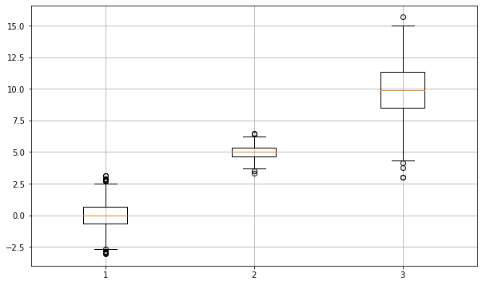
➢ plt.figure(figsize=(10,6))
➢ plt.boxplot((s1,s2,s3))
➢ plt.grid()
➢ plt.show()

