Slide 1

Introduction to Pollynet_Processing_Chain (Picasso)
Automate everything
Data Processing Platform
Zhenping Yin
2019-07-21
Polly community

Slide 2

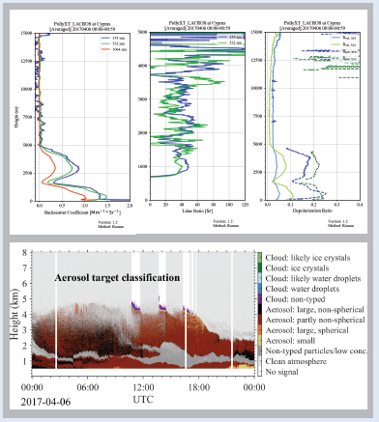
PollyNET
Automated Lidar (Polly^{XT})
PollyNET Data Server
Hours or days
Automated Lidar (PollyXT_LACRO)
Automated Lidar (PollyXT_TJK)
Automated Lidar (PollyXT_TAU)
Automated Lidar (arielle)

Slide 3
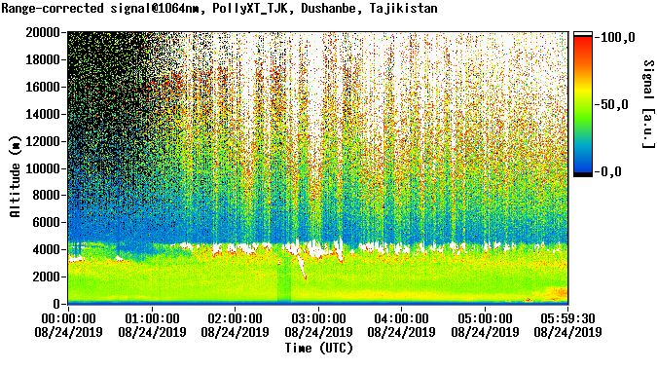
PollyNET
Within one hour!!!
Automated Lidar (Polly^{XT})
PollyNET Data Server
automatic program (1st)
1. No quality control
2. No target classification
3. No Housekeeping

Slide 4
PollyNET
Within one hour!!!
Automated Lidar (Polly^{XT})
PollyNET Data Server
Picasso
UI/polly web
Continuously
Lidar calibration
depol calibration, water vapor calibration
aerosol extensive and intensive properties
housekeeping, overlap function, …

Slide 5
Outline
Download and Setup
Hands-on
Concept about Version Control with Git
This introduction will assume you have good knowledge of lidar data retrievals

Slide 6
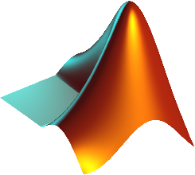




Requirements for Running Picasso
Interpreter
Python packages: matplotlib, numpy and scipy
MATLAB >= 2014a
Python 3
Polly Data
Root Dir + pollyType + ‘data_zip’ + yyyymm
Housekeeping data file
Compressed polly data file
Version control
Not necessary but recommended

Slide 7

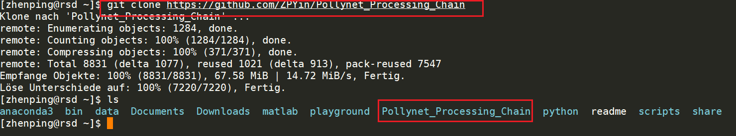
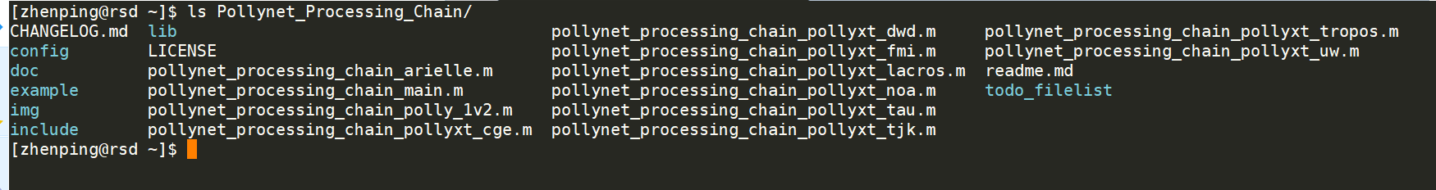
Download
git clone https://github.com/ZPYin/Pollynet_Processing_Chain
(There is also ‘download’ option under this link)
This command will download the code from the remote GitHub repository
One step further…
If you want to develop new features, we recommend you to pull the ‘dev’ branch as well:
git fetch origin dev:dev
(Detailed information about how to play with `git`, please go to ../doc/git_workflow.pptx).

Slide 8
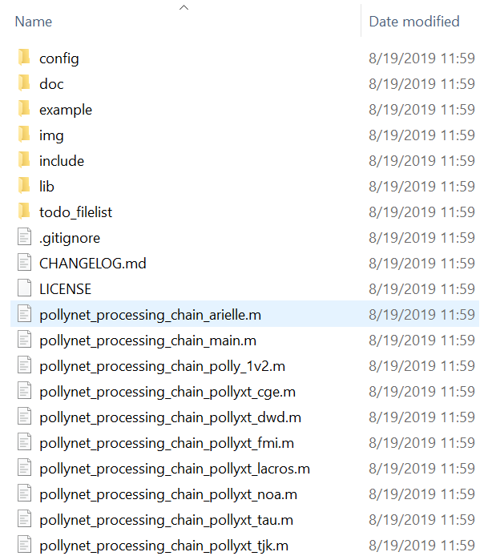
Structure of Picasso
figures
Unzip polly data
todo_filelist
results
Picasso
Single task
calibration
pollynet_history_of_places_new.txt
pollynet_processing_chain_link.txt
log
polly config file
polly defaults
Polly processing module

Slide 9
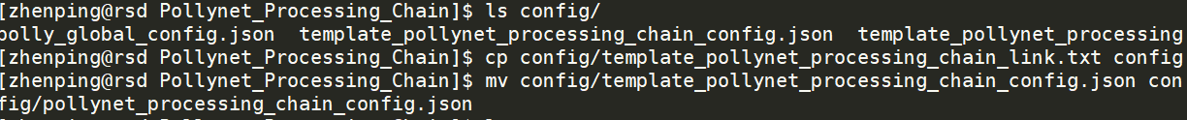
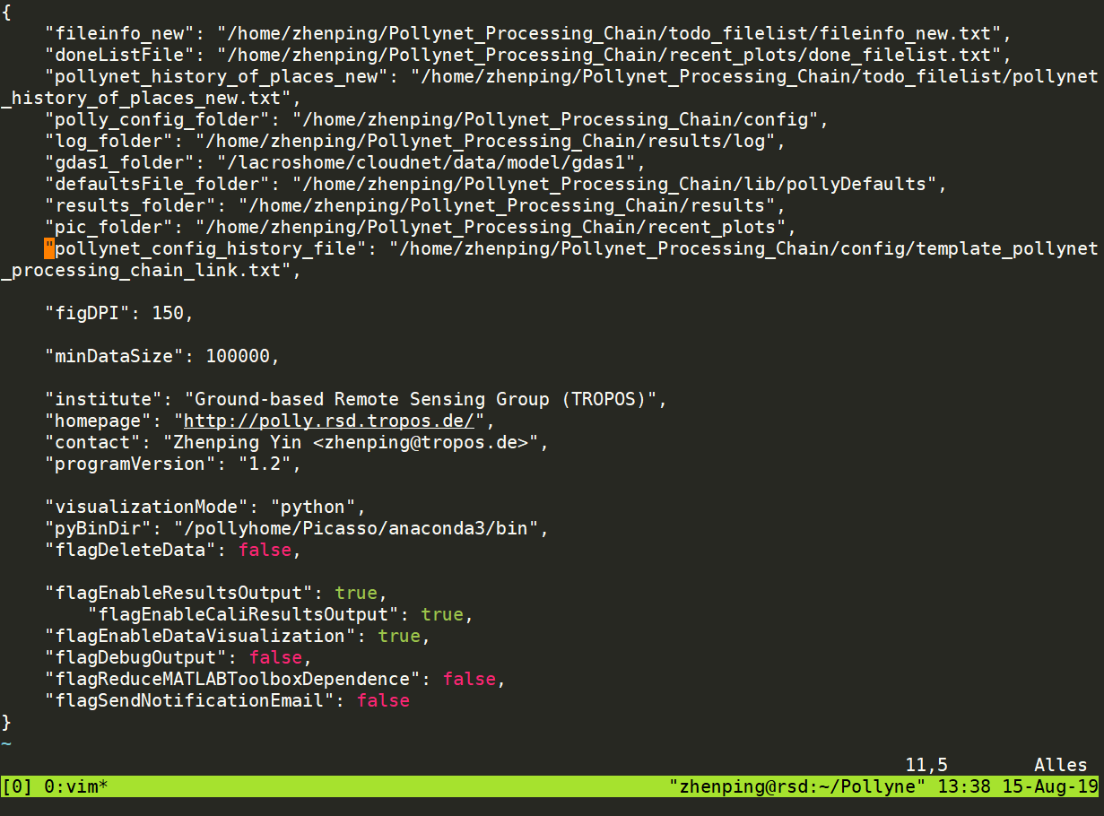
Setup
Picasso Global Config
1. setup the global config file from the template (must be renamed as ‘pollynet_processing_chain_config.json’)
2. edit the global config file
directories: according to your own requirements
‘//’ for windows path separator
python 3 folder: Picasso uses python3 for data visualization if ‘visualizationMode’was set ‘python’
to control whether to delete the unzipped polly data after each processing.
Detailed information can be found in
../doc/pollynet_processing_chain_config.pdf

Slide 10
Setup
Picasso adds campaign:
Normally, this file was generated from the database. But if there is no connection to the database, you need to add new campaign manually.
(Be careful about the character of the ‘space’, actually it consists of ‘tab’. So better way is to copy the line before and then edit it according to your own demands.

Slide 11
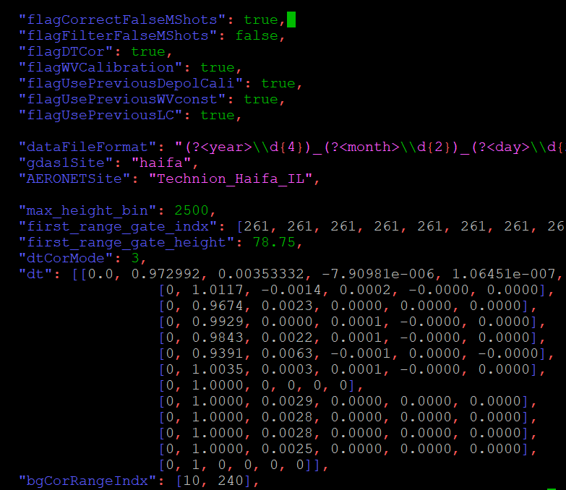
Setup
Picasso adds polly config
Copy the ‘template_config.json’ to a new polly config file with the naming of ‘{polly-type}_config_{date}.json’
You may need to change the settings of:
gdas1Site
AERONETSite
depol_cal_ang_p_time
depol_cal_ang_n_time
meteorDataSource
IWV_instrument
intNProfiles
minIntNProfiles
radiosondeFolder
logbookFile
You can find detailed info about the polly config in /doc/polly_config.md

Slide 12
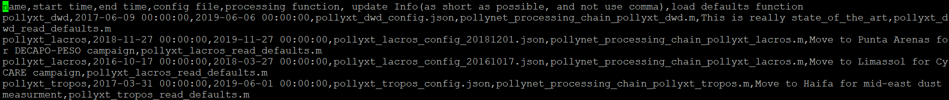
Setup
Picasso adds the link between polly config file and polly data
config history file works as a lookup table for Picasso to search the corresponding polly config file.
better way to do is to copy the line before and then edit it according to your demands.
Now, everything is really. Let’s have a try…

Slide 13
Hands on for running Picasso

Slide 14
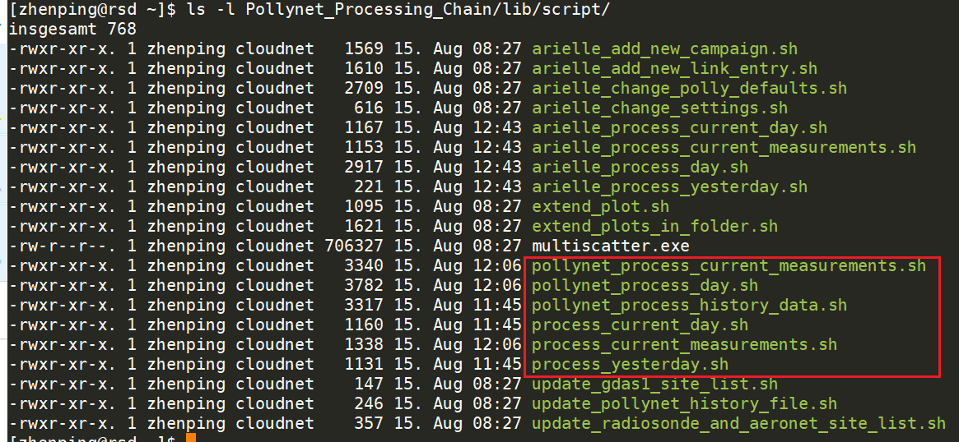
Bash Scripts for automating it

Slide 15
Add a new campaign
pollynet_history_of_places_new.txt
1. New campaign entry
pollynet_processing_chain_link.txt
3. New link entry
polly config file
2. New polly config
polly defaults
Polly processing module
For simplicity, you can copy the ‘polly_global_config.json’ and rename it according to your requirements.

Slide 16
Hands on

Slide 17
Add a new Polly
pollynet_history_of_places_new.txt
1. New campaign entry
pollynet_processing_chain_link.txt
5. New link entry
polly config file
4. New polly config
polly defaults
3. New polly defaults
Polly processing module
2. New polly modules

Slide 18
Hands on

Slide 19
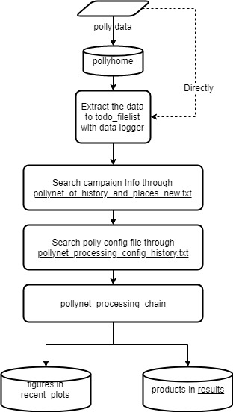
Picasso Development
Automatic calibration
lidar calibration
water vapor calibration
depolarization calibration
Integrated conventional retrieving algorithms
Extensible programming structure

Slide 20
Picasso Development
Requirements:
Be familiar with the whole structure and algorithms
Be professional with MATLAB
Take `PollyXT_LACROS` at Limassol, Cyprus as an example
(Check the polly data first)

Slide 21
TODO
Full support of data visualization with MATLAB, which can remove the dependence on Python
Uncertainty analysis
Products output (Level 1 (signal correction), Level 2 (calibration results, extensive and intensive properties))
Dual-FOV method for retrieving cloud microphysical properties

Slide 22



Version Control
Picasso
Dev
Server
GitHub
User

Slide 23
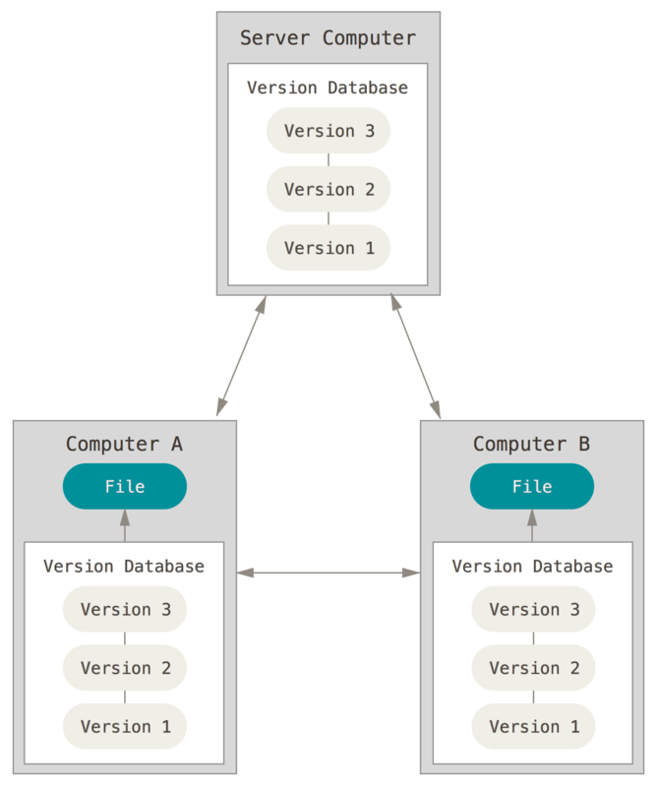
Version Control
Branch A
Branch B
Branch C

Slide 24
Hands on
Fetch the branch of `Picasso_intro` to your local machine
git fetch origin Picasso_intro:Picasso_intro # download the remote branch
git branch # list all the available branches in the repo
git checkout Picasso_intro # navigate to `Picasso_intro`
Add the whole processing function of `arielle`
Add main function
Add function libraries
Add defaults
Setup config and link file
Push to the remote branch
git status # list all the local changes
git add * # stage all the changes
git commit –m “commit message” # commit message to describe what you’ve done
git push origin Picasso_intro # Push the local changes to the remote branch

Slide 25
Backup

Slide 26
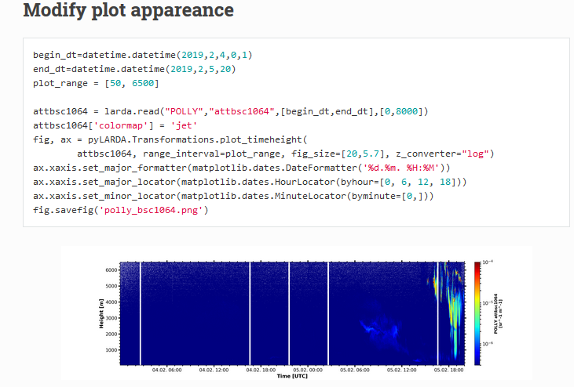
Python user? No problem!
From larda description page
https://martin-rdz.github.io/larda-doc/html/how_to_use.html

Slide 27
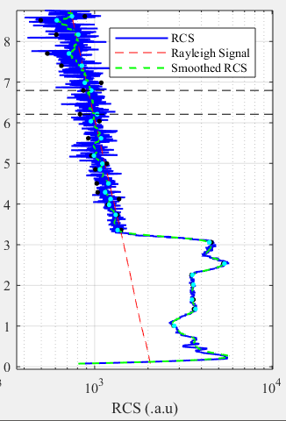
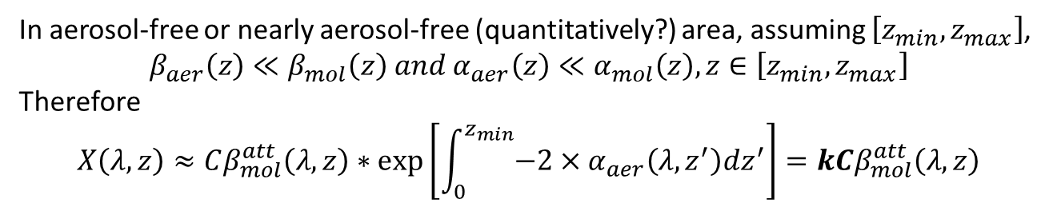
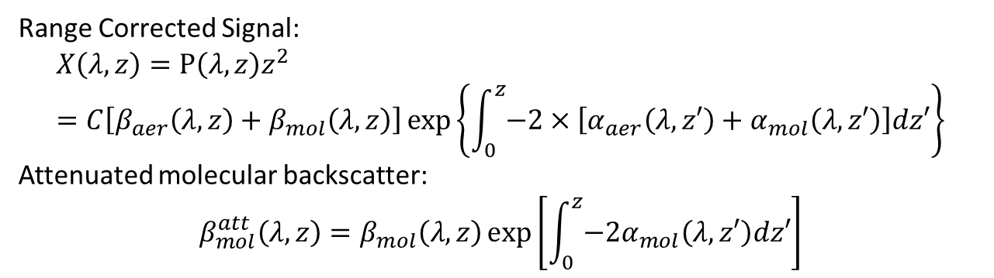
Rayleigh Fit
Range Corrected Signal:
$$X\left(λ,z\right)=P\left(λ,z\right)z^{2}=C\left[β_{aer}\left(λ,z\right)+β_{mol}\left(λ,z\right)\right]\exp\left\{\int_{0}^{z}{−2×\left[α_{aer}\left(λ,z′\right)+α_{mol}\left(λ,z′\right)\right]dz′}\right\}$$
Attenuated molecular backscatter:
$$β_{mol}^{att}\left(λ,z\right)=β_{mol}\left(λ,z\right)\exp\left[\int_{0}^{z}{{−2α}_{mol}\left(λ,z′\right)dz′}\right]$$
In aerosol-free or nearly aerosol-free (quantitatively?) area, assuming $\left[z_{min},z_{max}\right]$,
$$β_{aer}\left(z\right)≪β_{mol}\left(z\right) and α_{aer}\left(z\right)≪α_{mol}\left(z\right), z∈\left[z_{min},z_{max}\right]$$
Therefore
$$X\left(λ,z\right)≈Cβ_{mol}^{att}\left(λ,z\right)∗\exp\left[\int_{0}^{z_{min}}{−2×α_{aer}\left(λ,z^{′}\right)dz^{′}}\right]=kCβ_{mol}^{att}\left(λ,z\right)$$
Main task is to search the most linear correlated area

Slide 28

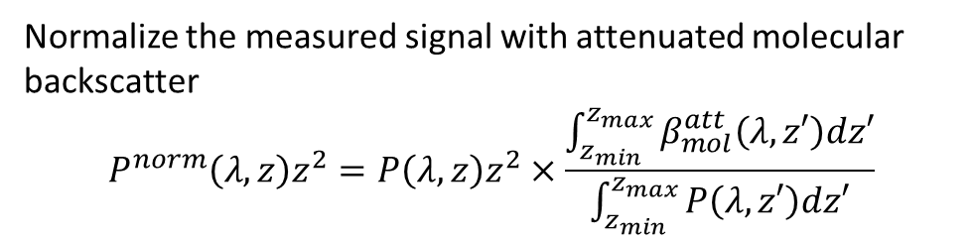
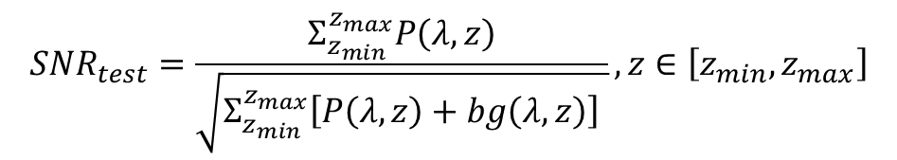
Rayleigh Fit
Normalize the measured signal with attenuated molecular backscatter
$$P^{norm}\left(λ,z\right)z^{2}=P\left(λ,z\right)z^{2}×\frac{\int_{z_{min}}^{z_{max}}{β_{mol}^{att}\left(λ,z′\right)dz′}}{\int_{z_{min}}^{z_{max}}{P\left(λ,z′\right)dz′}}$$
(Baars et al, AMT, 2016)
$$α_{aer}≈−\frac{1}{2}\frac{d}{dz}\left[\ln{\frac{P^{norm}\left(λ,z\right)}{β_{mol}^{att}\left(λ,z\right)}}\right]$$
Test 1: Pure Rayleigh Conditions
Test 2: Near and far range cross criteria
if no other absorptive aerosol layers above it
$$P^{norm}\left(λ,z\right)>β_{mol}^{att}\left(λ,z\right), z∈\left[z_{min},z_{max}\right]$$
Test 3: White-Noise criterion
$$Residual=P^{norm}\left(λ,z\right)z^{2}−β_{mol}^{att}\left(λ,z\right), z∈\left[z_{min},z_{max}\right]$$
$$SNR_{test}=\frac{Σ_{z_{min}}^{z_{max}}P\left(λ,z\right)}{\sqrt{Σ_{z_{min}}^{z_{max}}\left[P\left(λ,z\right)+bg\left(λ,z\right)\right] }}, z∈\left[z_{min},z_{max}\right]$$
Test 4: SNR constrain

Slide 29
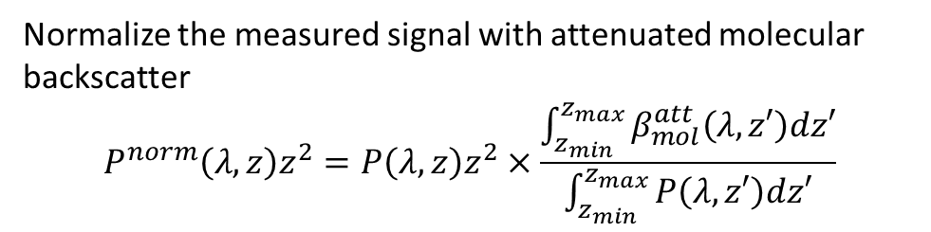

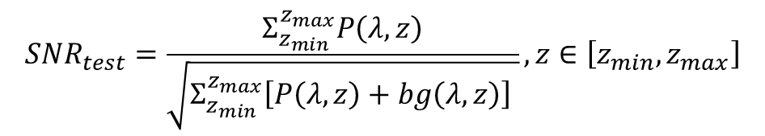
Rayleigh Fit
Normalize the measured signal with attenuated molecular backscatter
$$P^{norm}\left(λ,z\right)z^{2}=P\left(λ,z\right)z^{2}×\frac{\int_{z_{min}}^{z_{max}}{β_{mol}^{att}\left(λ,z′\right)dz′}}{\int_{z_{min}}^{z_{max}}{P\left(λ,z′\right)dz′}}$$
Smaller the mean of the residual is and more Gauss distribution alike the residual is, more possible it could be aerosol-free.
$$α_{aer}≈−\frac{1}{2}\frac{d}{dz}\left[\ln{\frac{P^{norm}\left(λ,z\right)}{β_{mol}^{att}\left(λ,z\right)}}\right]$$
Test 1: Pure Rayleigh Conditions
Test 2: Near and far range cross criteria
$$P^{norm}\left(λ,z\right)>β_{mol}^{att}\left(λ,z\right), z∈\left[z_{min},z_{max}\right]$$
Test 3: White-Noise criterion
$$Residual=P^{norm}\left(λ,z\right)z^{2}−β_{mol}^{att}\left(λ,z\right), z∈\left[z_{min},z_{max}\right]$$
$$SNR_{test}=\frac{Σ_{z_{min}}^{z_{max}}P\left(λ,z\right)}{\sqrt{Σ_{z_{min}}^{z_{max}}\left[P\left(λ,z\right)+bg\left(λ,z\right)\right] }}, z∈\left[z_{min},z_{max}\right]$$
Test 4: SNR constrain

Slide 30
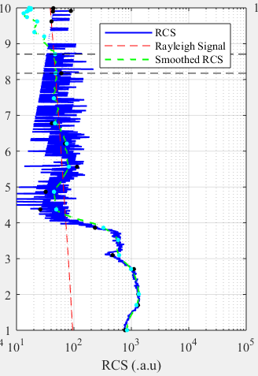
Shortage of sliding fixed window
More computation: all the sub-areas with a fixed width will be tested.
Omission: This possible interval will not be found if a large fixed window (like 1 km) was used, since the width of aerosol-free area is only 450m.

Slide 31
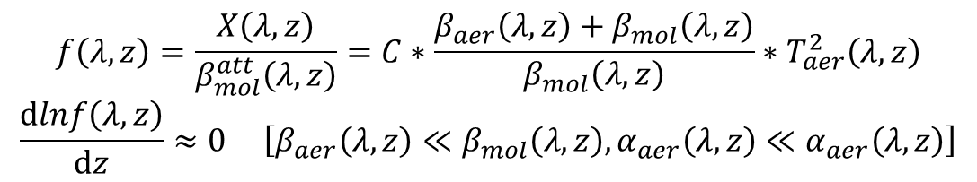
Rayleigh Fit – area decomposition
Interested area:
Not intersected
Nearly aerosol-free
$$f\left(λ,z\right)=\frac{X\left(λ,z\right)}{β_{mol}^{att}\left(λ,z\right)}=C∗\frac{β_{aer}\left(λ,z\right)+β_{mol}\left(λ,z\right)}{β_{mol}\left(λ,z\right)}∗T_{aer}^{2}\left(λ,z\right)$$
$$\frac{dlnf\left(λ,z\right)}{dz}≈0 \left[β_{aer}\left(λ,z\right)≪β_{mol}\left(λ,z\right), α_{aer}\left(λ,z\right)≪α_{aer}\left(λ,z\right)\right]$$
Which means the slope of the interested area should be 0 and the shape of interested area should be nearly linear

Slide 32
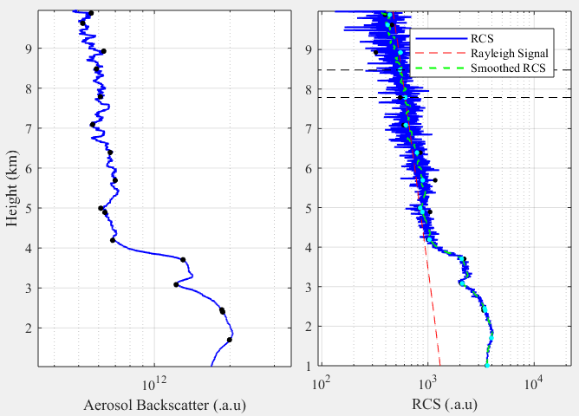
Rayleigh Fit - Douglas-Peucker Algorithm
Gifs to show how Douglas- Peucker Algorithm works
Each interval is not intersected.
Each interval is nearly linear, but slope of each interval is still varied.

Slide 33
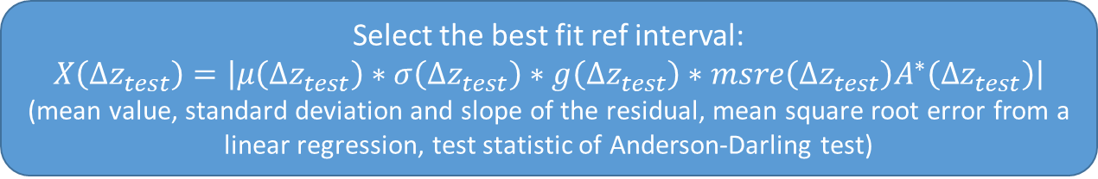
Rayleigh Fit
Douglas-Peucker Algorithm
[[z_min1, z_max1], [z_min2, z_max2], … [z_mink, z_maxk]]
Test 1: Slope check
Test 2: Near and far range cross criteria
Test 3: White-Noise criterion
Test 4: SNR constrain
Select the best fit ref interval:
$$X\left(Δz_{test}\right)=\left|μ\left(Δz_{test}\right)∗σ\left(Δz_{test}\right)∗g\left(Δz_{test}\right)∗msre\left(Δz_{test}\right)A^{∗}\left(Δz_{test}\right)\right|$$
(mean value, standard deviation and slope of the residual, mean square root error from a linear regression, test statistic of Anderson-Darling test)

