Slide 1
Configurations and file format for Meteorological data used in Pollynet_Processing_Chain
Zhenping Yin
2019-07-20

Slide 2
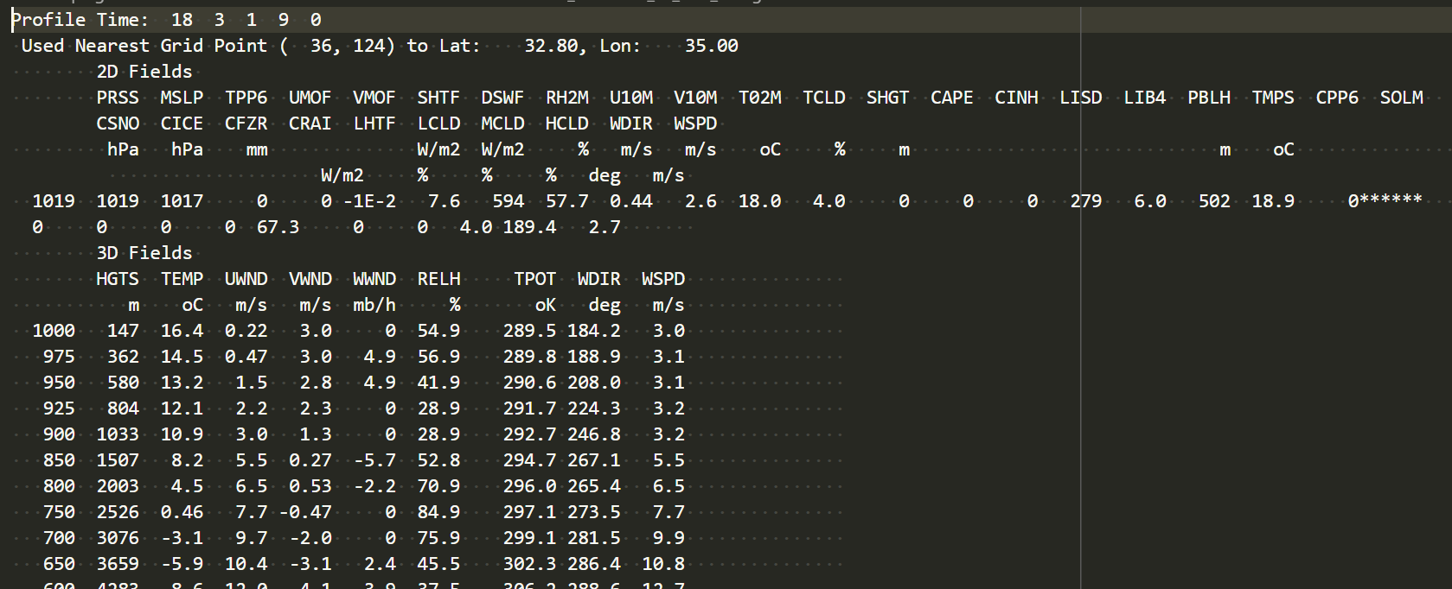
GDAS1
Configurations for the program:
pollynet_processing_chain_config.json
"gdas1_folder": "C:\\Users\\zhenping\\Documents\\Data\\GDAS“ -> root directory that holds the gdas1 files
{polly}_config.json
"gdas1Site": "davos", -> the site name
"meteorDataSource": "gdas1", -> specify to use gdas1 data as the meteorological data source
exemplified GDAS1 file

Slide 3
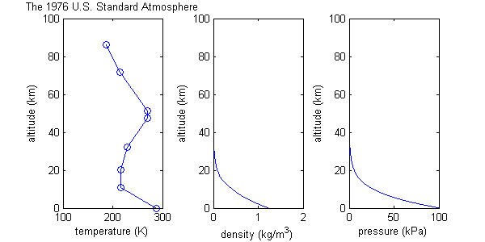
standard atmosphere US 1976
Configurations for the program:
{polly}_config.json
"meteorDataSource": "standard_atmosphere", -> specify to use standard atmosphere as the meteorological data source
Detailed information, go here

Slide 4
websonde
Configurations for the program:
{polly}_config.json
"meteorDataSource": “websonde", -> specify to use radiosonde from Wyoming web data achive as the meteorological data source
"radiosondeSitenum": 14430, -> radiosonde station number (radiosonde-station-list.txt)
Detailed information about the data format can be found here
The program will search the available radiosonde data from the web portal. If no radiosonde data was found within time lapse of 1 day, it will use the standard atmosphere as the meteorological data source.

Slide 5
radiosonde
Configurations for the program:
{polly}_config.json
"meteorDataSource": “radiosonde", -> specify to use radiosonde as the meteorological data source
"radiosondeFolder": "C:\\Users\\zhenping\\Documents\\Data\\Radiosonde\\arielle", -> the folder that holds the radiosonde files.
Since radiosonde data format is highly diverse, we choose a standardized netCDF file as a data container. A exemplified file was attached with the program, at ‘/example/convert_radiosonde_data/radiosonde_20181115_110000.nc’.
The convention of the filename must follow: radiosonde_{year:yyyy}{month:mm}{day:dd}_{hour:HH}{minute:MM}{second:SS}.nc and the variables must contain:
% variables:
% double altitude(altitude=6728);
% :unit = "m";
% :long_name = "Height of lidar above mean sea level";
% :standard_name = "altitude";
% :axis = "Z";
% double pressure(altitude=6728);
% :unit = "hPa";
% :long_name = "air pressure";
% :standard_name = "pressure";
% :_FillValue = -999.0; // double
% double temperature(altitude=6728);
% :unit = "degree celsius";
% :long_name = "air temperature";
% :standard_name = "temperature";
% :_FillValue = -999.0; // double
% double RH(altitude=6728);
% :unit = "%";
% :long_name = "relative humidity";
% :standard_name = "RH";
% :_FillValue = -999.0; // double

