Slide 1
Improved Rayleigh Fit Algorithm
Zhenping Yin
Jun 18, 2021

Slide 2
Content
Drawbacks of current Rayleigh fit
Improved Rayleigh fit
Comparison

Slide 3
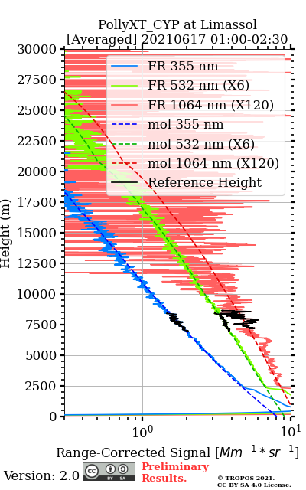
Rayleigh fit algorithm
Reference height refers to a height with well-known scattering properties that can be applied for lidar calibration.
Usually, molecular Rayleigh signal is used as reference signal to select a region of aerosol-free height.
Reference height

Slide 4
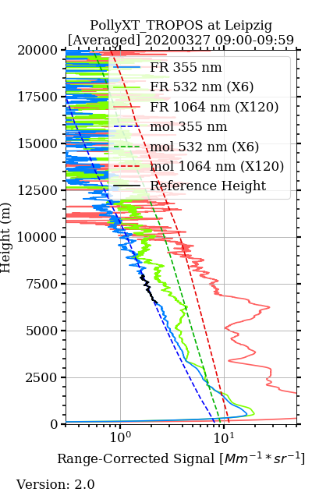
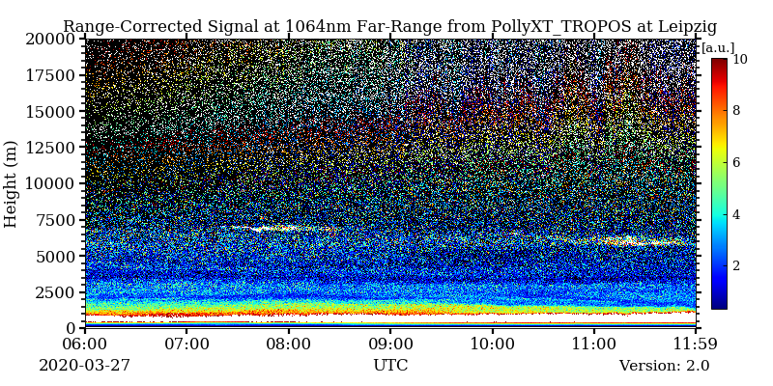
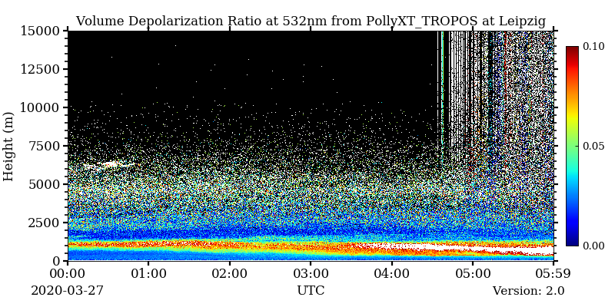
Rayleigh fit algorithm
Not an easy task due to signal noise and complex aerosol vertical structures
Multiple criteria should be applied to ensure a good similarities between lidar signal and molecular signal
Rayleigh fit score should be implemented for selecting the optimum reference height

Slide 5
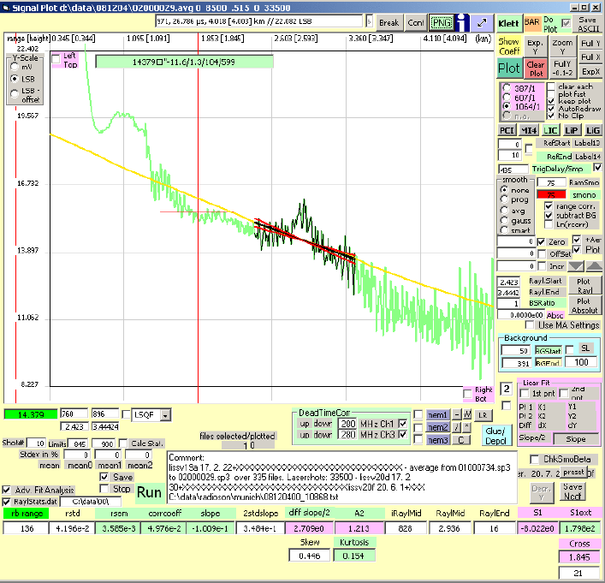
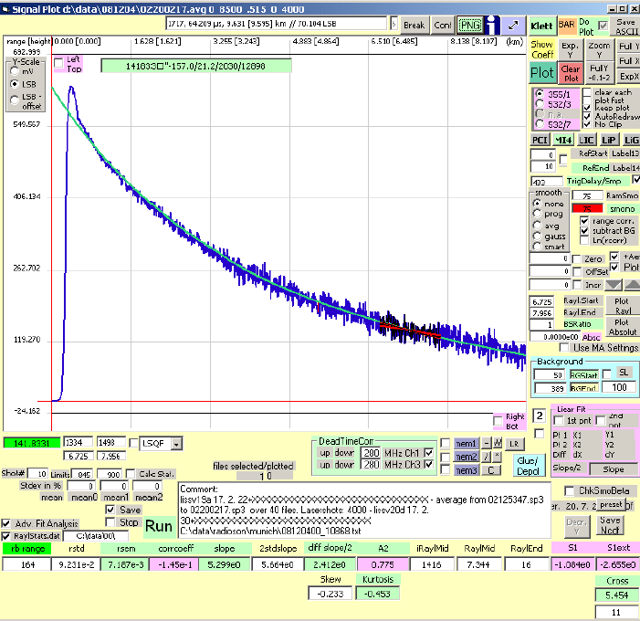
Rayleigh fit algorithm
Criteria and score proposed by Volker Freudenthaler (2009)
Criteria (local estimators)
Score (Global estimator)
Anderson-Darling-Test, Kurtosis, Skewness… for test of normal noise distribution
Slope of signal residuals (approaching 0)
Curvature
Relative standard error of the mean
Lowest Good Fit of all
Cross (below the fitting range, signal residuals must be positive)
Curvature
Cross
(Freudenthaler, 2009)
(Freudenthaler, 2009)
Freudenthaler, V.: Lidar Rayleigh-fit criteria, EARLINET-ASOS 7th Workshop, Madrid, Spain, 10.5282/ubm/epub.12970, 2009.

Slide 6
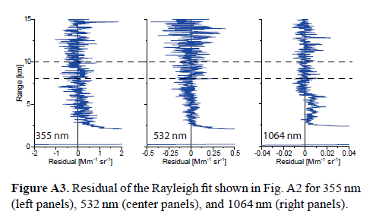
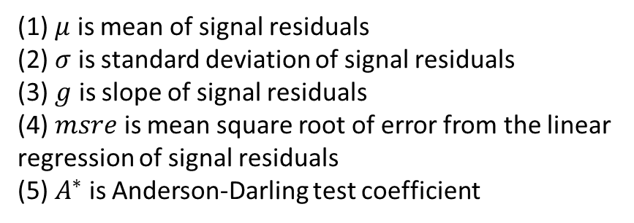
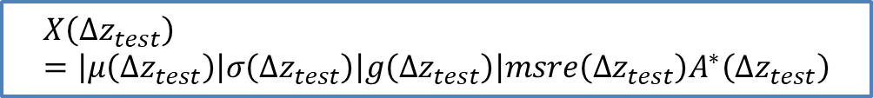
Rayleigh fit algorithm
Criteria and score applied by Holger Baars (2016)
Criteria
Score
Pure Rayleigh conditions
Near- and far-range cross test
White-noise test
SNR check
$$X\left(Δz_{test}\right)=\left|μ\left({Δz}_{test}\right)\right|σ\left(Δz_{test}\right)\left|g\left(Δz_{test}\right)\right|msre\left(Δz_{test}\right)A^{∗}\left(Δz_{test}\right)$$
(1) $μ$ is mean of signal residuals
(2) $σ$ is standard deviation of signal residuals
(3) $g$ is slope of signal residuals
(4) $msre$ is mean square root of error from the linear
regression of signal residuals
(5) $A^{∗}$ is Anderson-Darling test coefficient
Baars, H. et al. An overview of the first decade of Polly(NET): an emerging network of automated Raman-polarization lidars for continuous aerosol profiling. Atmospheric Chemistry and Physics 16, 5111-5137, doi:10.5194/acp-16-5111-2016 (2016).

Slide 7
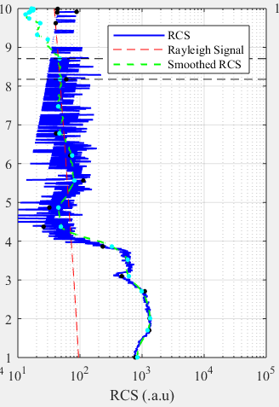
Drawbacks
Curvature test cannot be easily implemented
Fixed search window is not feasible for narrow aerosol-free regions
Using 1 km search window will miss this possible aerosol-free region
Signal decomposition is suitable for resolving these two issue.

Slide 8
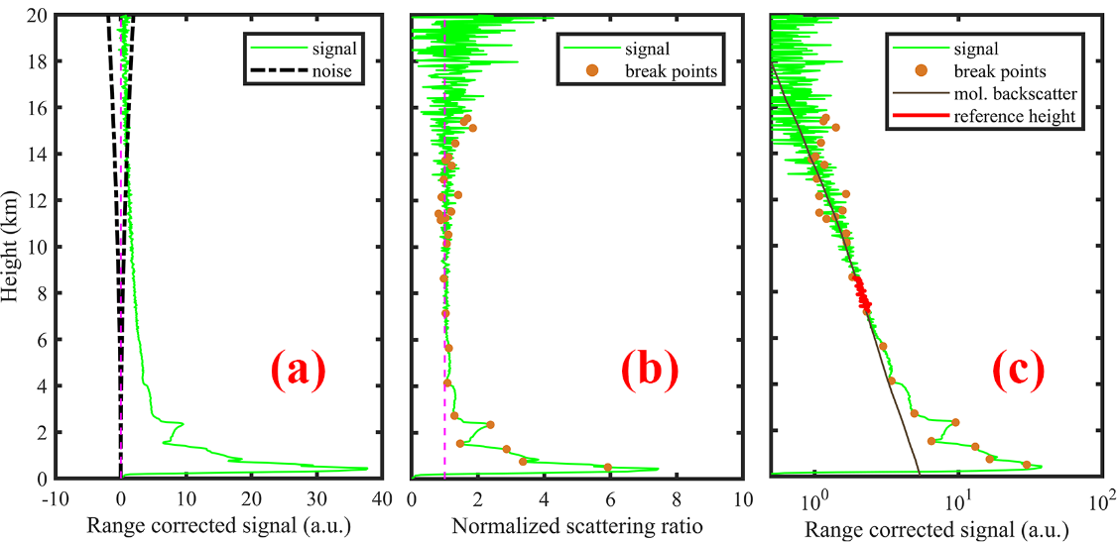
Improved Rayleigh fit
Signal De-composition
Rayleigh fit
Douglas-Peucker algorithm on lidar signal de-composition
Douglas-Peucker Algorithm for signal de-composition
https://en.wikipedia.org/wiki/Ramer%E2%80%93Douglas%E2%80%93Peucker_algorithm
Each segment is not intersected.
Each segment is nearly linear
Matlab program can be found at: https://github.com/PollyNET/Pollynet_Processing_Chain/blob/v3.0/lib/calibration/DouglasPeucker.m

Slide 9
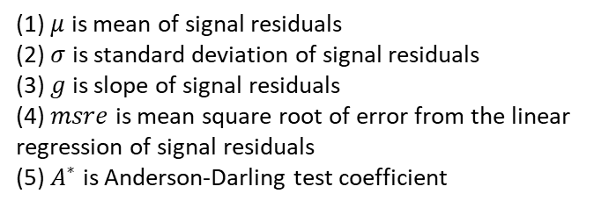

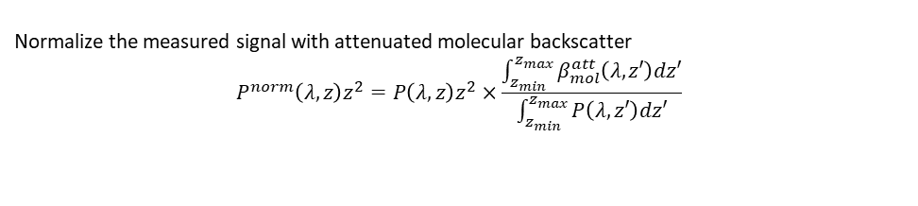
Improved Rayleigh fit
Maltab program can be found at: https://github.com/PollyNET/Pollynet_Processing_Chain/blob/v3.0/lib/calibration/rayleighfit.m
Criteria
Score
Near- and far-range cross test
White-noise test
SNR check
Slope test
$$X\left(Δz_{test}\right)=\left|μ\left({Δz}_{test}\right)\right|σ\left(Δz_{test}\right)\left|g\left(Δz_{test}\right)\right|msre\left(Δz_{test}\right)A^{∗}\left(Δz_{test}\right)$$
(1) $μ$ is mean of signal residuals
(2) $σ$ is standard deviation of signal residuals
(3) $g$ is slope of signal residuals
(4) $msre$ is mean square root of error from the linear
regression of signal residuals
(5) $A^{∗}$ is Anderson-Darling test coefficient
Normalize the measured signal with attenuated molecular backscatter
$$P^{norm}\left(λ,z\right)z^{2}=P\left(λ,z\right)z^{2}×\frac{\int_{z_{min}}^{z_{max}}{β_{mol}^{att}\left(λ,z′\right)dz′}}{\int_{z_{min}}^{z_{max}}{P\left(λ,z′\right)dz′}}$$
$$P^{norm}\left(λ,z\right)>β_{mol}^{att}\left(λ,z\right), z∈\left[z_{min},z_{max}\right]$$
Test 1: Near and far range cross criteria
$$Residual=P^{norm}\left(λ,z\right)z^{2}−β_{mol}^{att}\left(λ,z\right), z∈\left[z_{min},z_{max}\right]$$
Test 2: White-Noise criterion
$$SNR_{test}=\frac{Σ_{z_{min}}^{z_{max}}P\left(λ,z\right)}{\sqrt{Σ_{z_{min}}^{z_{max}}\left[P\left(λ,z\right)+bg\left(λ,z\right)\right] }}, z∈\left[z_{min},z_{max}\right]$$
Test 3: SNR constrain
$$\left|g_{P^{norm}}−g_{β_{mol}^{att}}\right|<Δg_{P^{norm}}+Δg_{β_{mol}^{att}}$$
Test 4: Slope test

Slide 10
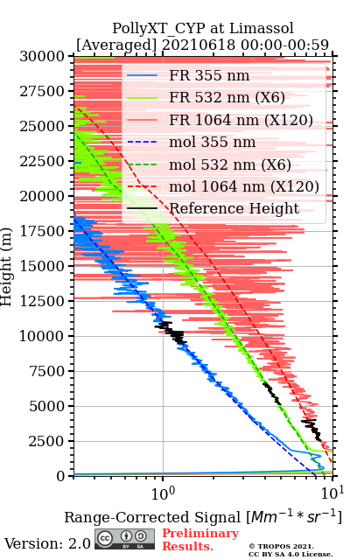
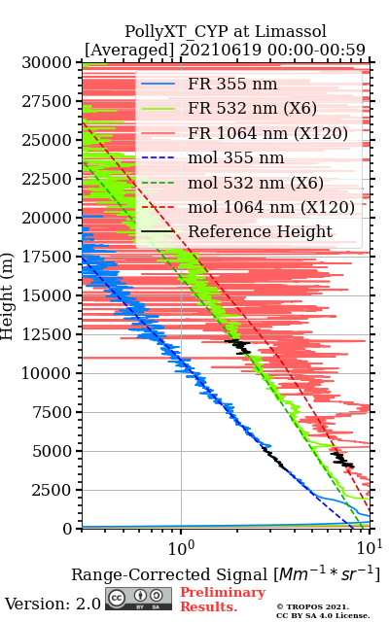
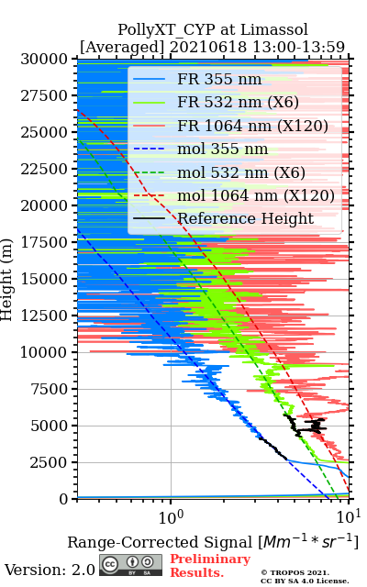
Comparisons

Slide 11
Outlook
Uncertainty of Rayleigh fit (to estimate the uncertainty of backscatter coefficient)
Determination of the best reference height from Rayleigh fit results of multiwavelength signal

Slide 12
Thank you

