Slide 1
Course Scheduler
Kevin Kuo, Raj Patel, and Mary Snyder

Slide 2
Objective
Build an interactive course scheduling web application that would serve as an interface between a institution's registar and students

Slide 3
Main Stories
Login
Student → Add/Delete Course from Schedule
Instructor → Edit Course Info
Administrator → Add/Edit/Delete Course from System

Slide 4
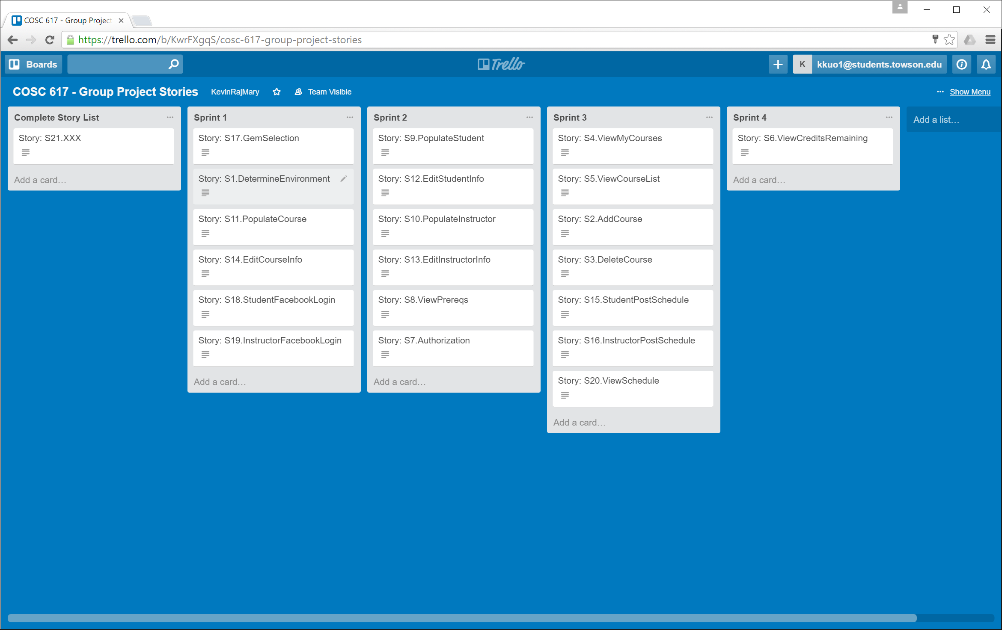
Stories/Software Process

Slide 5
Software Process
Gems
Login
Backend
User Permissions
Backend
Backend
DB/Seed Data
Testing
Git

Slide 6
Use Cases
Each presentation should explicitly contain:
Aim of project
Motivation - Why is it an interesting problem? Why did you bother? Why should we care?
Main stories for the project
Software process – How did you breakup work? Who did what? How was management done?
Lead to the solution through your user stories/Use Cases
Data models
Show us any external resources used – web services, external servers, databases, APIs, Gems, etc.
Show working demos
Mention the lessons learned from the project
What did you not complete from the original stories?
How many new stories did you add?

Slide 7
Data Models
Data models

Slide 8
External Resources Used
Each presentation should explicitly contain:
Aim of project
Motivation - Why is it an interesting problem? Why did you bother? Why should we care?
Main stories for the project
Software process – How did you breakup work? Who did what? How was management done?
Lead to the solution through your user stories/Use Cases
Data models
Show us any external resources used – web services, external servers, databases, APIs, Gems, etc.
Show working demos
Mention the lessons learned from the project
What did you not complete from the original stories?
How many new stories did you add?

Slide 9
Demo
Each presentation should explicitly contain:
Aim of project
Motivation - Why is it an interesting problem? Why did you bother? Why should we care?
Main stories for the project
Software process – How did you breakup work? Who did what? How was management done?
Lead to the solution through your user stories/Use Cases
Data models
Show us any external resources used – web services, external servers, databases, APIs, Gems, etc.
Show working demos
Mention the lessons learned from the project
What did you not complete from the original stories?
How many new stories did you add?

Slide 10
Lessons Learned
Each presentation should explicitly contain:
Aim of project
Motivation - Why is it an interesting problem? Why did you bother? Why should we care?
Main stories for the project
Software process – How did you breakup work? Who did what? How was management done?
Lead to the solution through your user stories/Use Cases
Data models
Show us any external resources used – web services, external servers, databases, APIs, Gems, etc.
Show working demos
Mention the lessons learned from the project
What did you not complete from the original stories?
How many new stories did you add?

Slide 11
Project presentation
15 minutes per group
Everybody in the group presents
The audience will ask questions in between and make you work your code
Set up beforehand. Check your devices. Check demos. Always have screen shots.
Professionalism in the presentation will be graded.

Slide 12
Presentation outline
Each presentation should explicitly contain:
Aim of project
Motivation - Why is it an interesting problem? Why did you bother? Why should we care?
Main stories for the project
Software process – How did you breakup work? Who did what? How was management done?
Lead to the solution through your user stories/Use Cases
Data models
Show us any external resources used – web services, external servers, databases, APIs, Gems, etc.
Show working demos
Mention the lessons learned from the project
What did you not complete from the original stories?
How many new stories did you add?

Slide 13
More details – presentation (cont.)
Tell people about what you've done, at a level they can use
Tools, technologies, approaches
“Implemented GoogleMaps using the GeoKit gem..”
Not
Source code examples
Figures - system diagrams – can be more useful than text
Exception: if you've done something technically snazzy, say more about it.

Slide 14
More details – presentation (cont.)
Lots of examples
Keep things specific and interesting
Scenarios
Stories of tools in action
“Jane wants to compare flight and hotel alternatives for her vacation. She starts by ....”
DEMOS! Even if they don't work, are buggy, etc.

Slide 15
Keep in mind the grading rubric
on blackboard

