Slide 1
Course Scheduler
Kevin Kuo, Raj Patel, and Mary Snyder

Slide 2
Objective
Build an interactive course scheduling web application that would serve as an interface among an institution's registrar, instructors/faculty, and students

Slide 3
Main Stories
Login
Student → Add/Delete Course from Schedule
Instructor → Edit Course Info
Administrator → Add/Edit/Delete Course from System

Slide 4
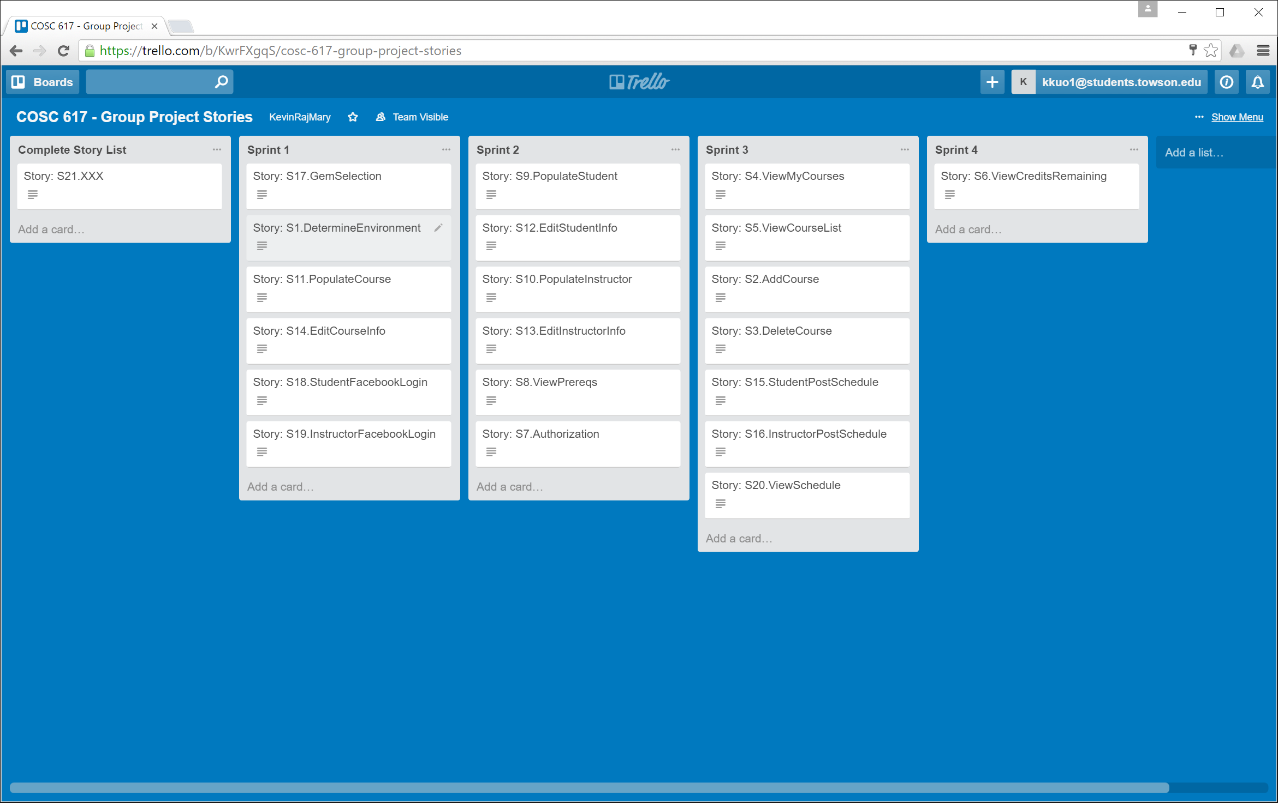
Stories/Software Process

Slide 5
Software Process
Gems
Login
User Permissions
Git
GUI/Backend
Testing
DB/Schema
DB/Seed Data

Slide 6
Use Cases
Student
Logs in
Edits his/her information
Views available courses
Adds course to schedule
Instructor
Logs in
Views students taking his/her course(s)
Edits course information

Slide 7
Use Cases (cont’d)
Admin
Logs in
Edit all user’s information
Edit schedules for any user
Add/delete/edit courses
Edit/delete users
Add/delete/edit schedules

Slide 8
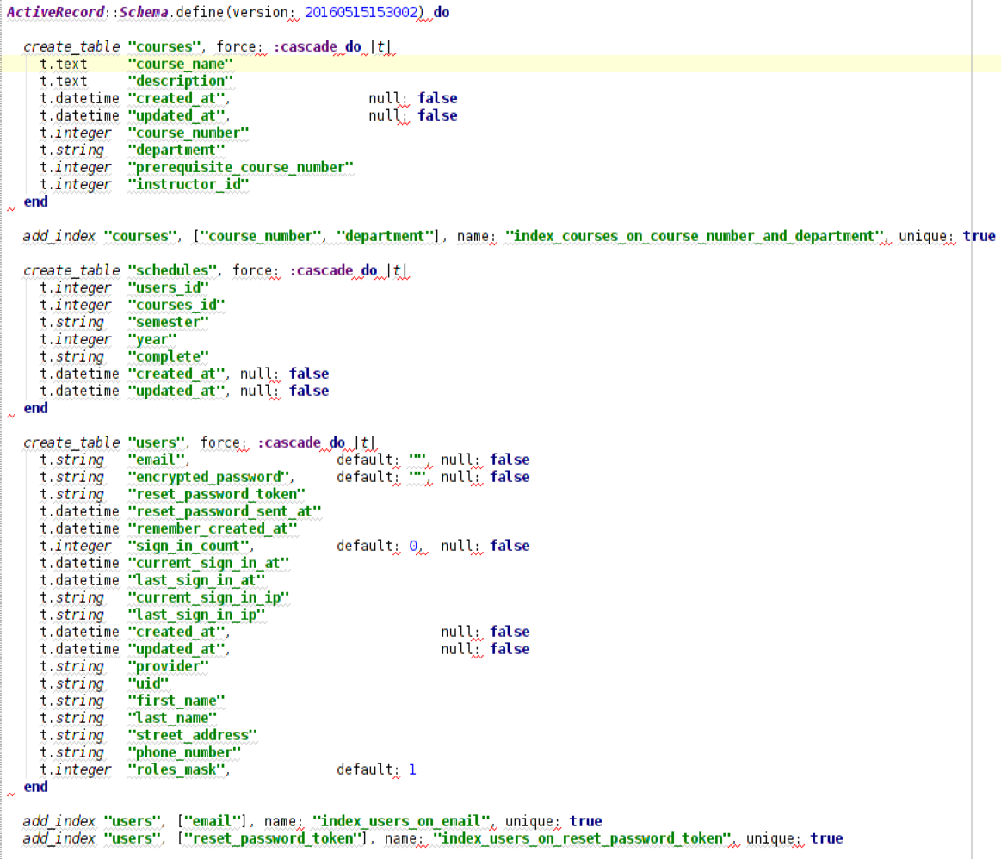
Data Models

Slide 9
Resources
Gems
Omniauth
Devise
CanCan
Bootstrap
Twitter
DB
SQLite
Version Control
Github: https://github.com/Polo08816/AdWebDevProjectRepo.git
AJAX

Slide 10
Demo
Notes:
Student
Log in as Facebook
Add course *
Add course with a pre-requisite
Instructor
Standard login at same time as student
See student’s partial update (AJAX) *
Admin
Log in
edit all values

Slide 11
Lessons Learned
Gems don’t always make things easier – particularly simple functionality
Adding functionality broke existing features. Importance of full thread/system testing in addition to unit testing.
Notes:
Which stories we did not complete
How many new stories did we add? - CanCan

