Slide 1
MessageBoard
Progress Report
Suraj Bhattarai
Michael Morrison
Sushma Shrestha
Joseph Zidell

Slide 2
Aim of our Project
To create an environment for group members to come together and manage work, set goals, communicate on project changes, notifications of updates and share project files between group members.

Slide 3
Our Motivation
We wanted to make a site that would fix issues of collaboration between group members that are unable to meet on a regular basis.
We aimed to simplify the collaboration for groups.
This is a product that can be used by many types of groups to complete their work for any kind of job.

Slide 4
Project Stories
Started with listing project features
Message Board
Calendar and Events
Notes
File Upload

Slide 5
Project Stories – cont.
Adding in core functionality
Login
Login via Facebook
Creating projects
Adding and Removing users
User Registration

Slide 6
Process Through Work
Some of the project features were completed first before we realized that we needed to get other components working as well.
Creating Users and Projects
Messages, Notes, Uploads
Login
Calendar and Events
Facebook Authentication Login
Managing users in projects

Slide 7
Coding Process
We knew the work that needed to be completed, so each member would choose the work they wanted to do.
The group would meet on weekends to complete their work, get help and discuss new work that needed to be done. A list of work for the week would be created on Monday nights and emailed to the group.

Slide 8
Who did what…
Joseph Zidell
Message board
Listing messages
Project creation
Creating test cases
Project Admin form
Sushma Shrestha
User registration
Data validation / Seeding
File Upload
Creating test cases
Michael Morrison
Message board
Notes with history
Creating test cases
Project Admin form
Suraj Bhattarai
User Login (Facebook Authentication Login)
Calendar view with events
User/Project invitation
Creating test cases
Setting up Heroku

Slide 9
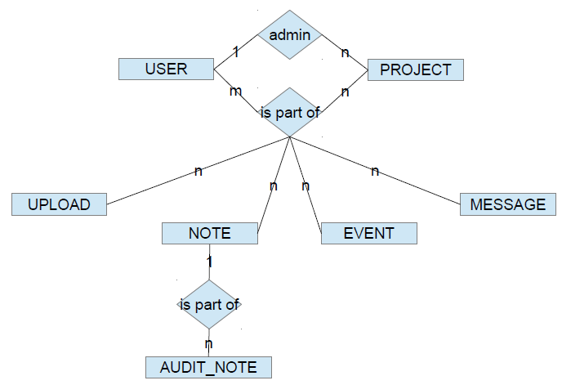
Data Model

Slide 10
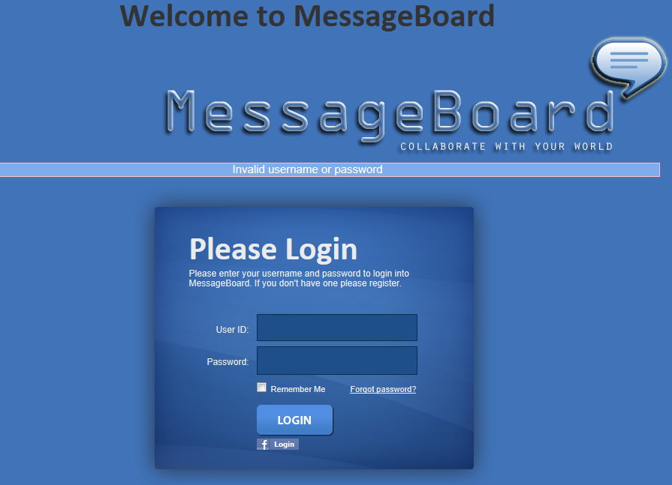
Login

Slide 11
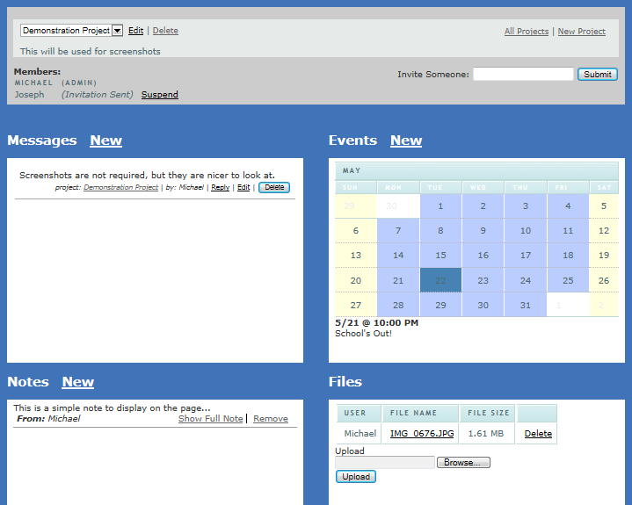
Main Project Page

Slide 12
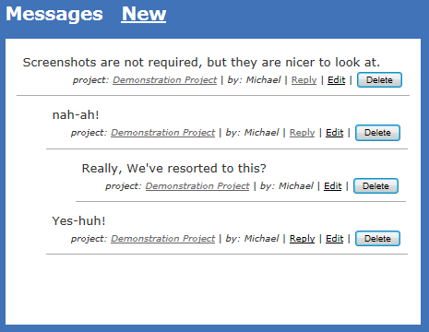
Nested Messages

Slide 13
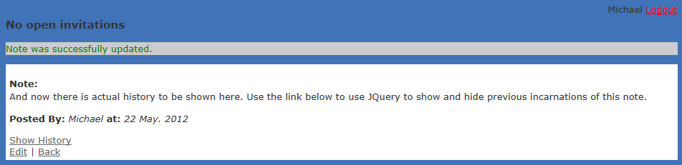
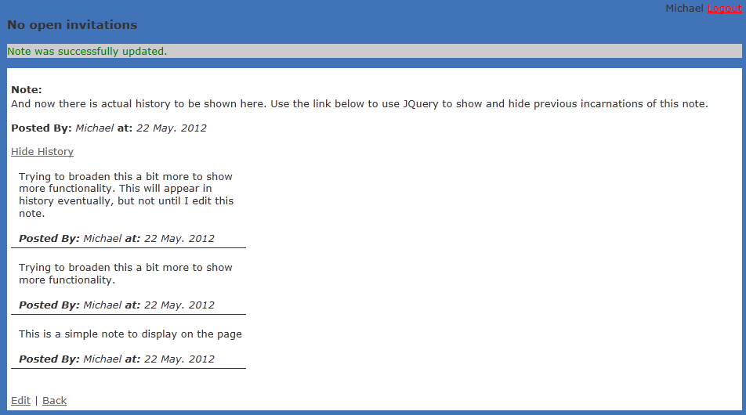
Notes, with and without History

Slide 14
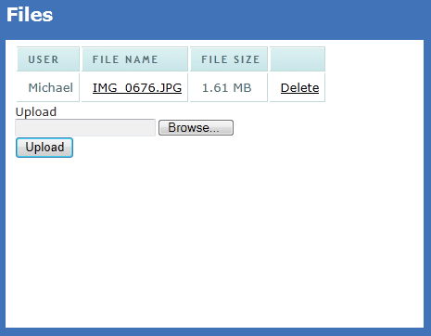
Uploading Files
Easily done by using the Browse button. Users are also able to click on the File Name link and down load the files for the project.

Slide 15
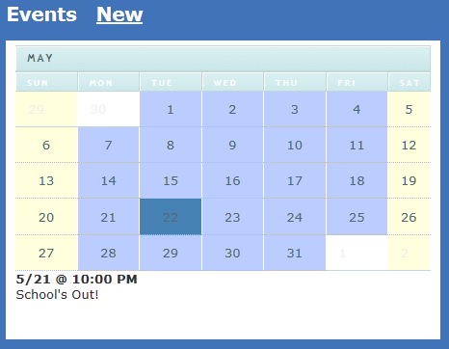
Calendar and Events

Slide 16
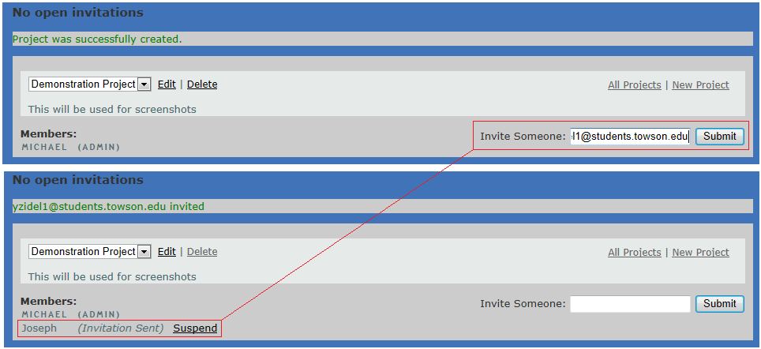
Inviting New Users to a Project

Slide 17
External Resources
omniauth-facebook - Allows users to register and login with their Facebook account.
paperclip – Used with the file upload process to allow for the uploading of files
calendar_helper – This is the gem used to create the calendars for projects.
bcrypt-ruby – This encrypts a users password.

Slide 18
Lessons Learned
Checkout from repository before doing any work
Don’t use outdated plugins
Research is someone already did work for you
RoR is easy for simple things; complex for complicated things

Slide 19
Questions?

