Slide 1
Mozoox Project
Group 3:
Rana Almakabi
Poornima Venkatakrishnan
Ehsan Eslamloueyan

Slide 2
Outline
Project Aim and Motivation
Data Models
Main Stories
Lead to the solution through your user stories/uses cases.
External Resources
Applied Rails Features
Demo
Responsibilities
Learned Lessons
Questions

Slide 3
Project Aim and Motivation
What is Mozooz?
It is an online social networking website
Targeted audience?
for musicians’ communication, collaboration, and sharing of notes, lyrics, and performances.
Domain: Music/Art
Audience/Users:
User
General public
Student user
Teacher user

Slide 4
Data models
Band_membership
Band
Education
Event
Genre
Instrument
Music_comment
Music_rate
Music
Musician
Play_instrument
Skill
Teach_instrument
User_fan
user

Slide 5
Main stories
Signing up for a profile
Logging in
Logging out
Editing a profile (Basic)
Posting a music
Friend search
Teacher search
Viewing Music
Rating a Music
Posting a comment on a music
Editing a user Profile
Education
Teaching
Password
Resetting Password
Becoming a fan
Launching a band
Becoming a band member
Adding a band member
View band photos (via flicker)

Slide 6
Lead to the solution through your user stories/uses cases.
Friend Search
Login to your Mozoox account
Enter the friend’s email address in the friend search field in the left column at the website
Click search
The results of the search are displayed in the user’s profile page.
Teacher Search
Login to your Mozoox account
Enter the teacher’s number of teaching years in the teacher search field in the left column at the website
Click search
The results of the search are displayed in the user’s profile page.

Slide 7
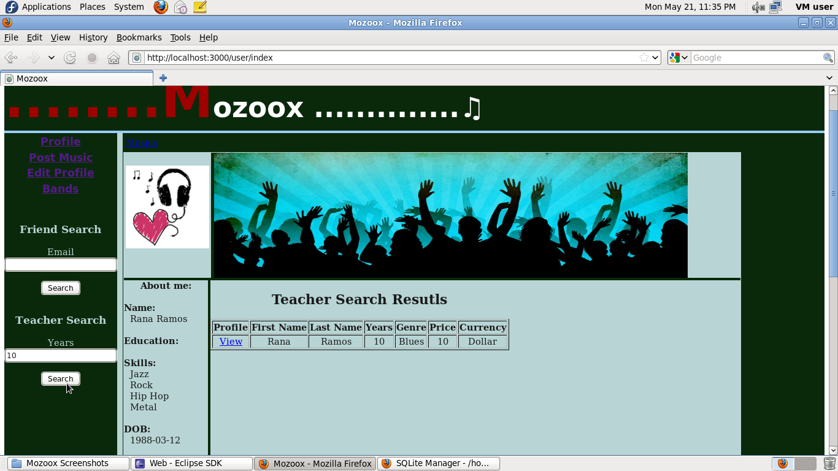
Screenshot for teacher search
Result of Teacher Search

Slide 8
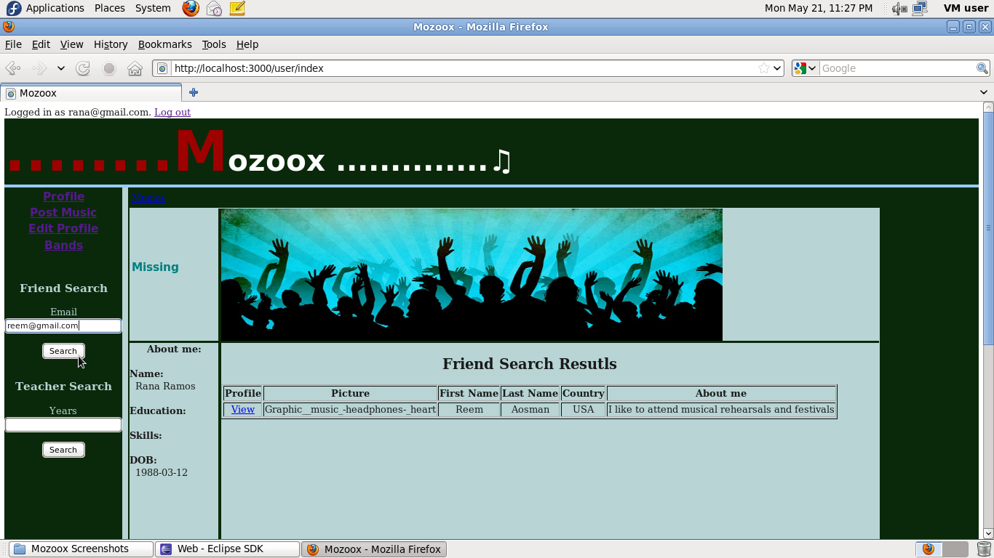
Screenshot for Friend search
Result of Friend Search

Slide 9
Lead to the solution through your user stories/uses cases.
Viewing Music
Login to your Mozoox account
Click on the link “Musics” under the banner of the website
A list of all music will be displayed In the index page of music controller.
Rating a Music
Login to your Mozoox account
Enter friend’s email address in the textbox field for the friend search in the left column of the website.
Click on the link “View” in the generated friend results in the profile page
You will be directed to the friend’s profile page
Click on the link “Musics” under the banner of the website
Select a music to rate from the music list.
Select a rating number from the provided radio buttons
Click on the button “Rate”.

Slide 10
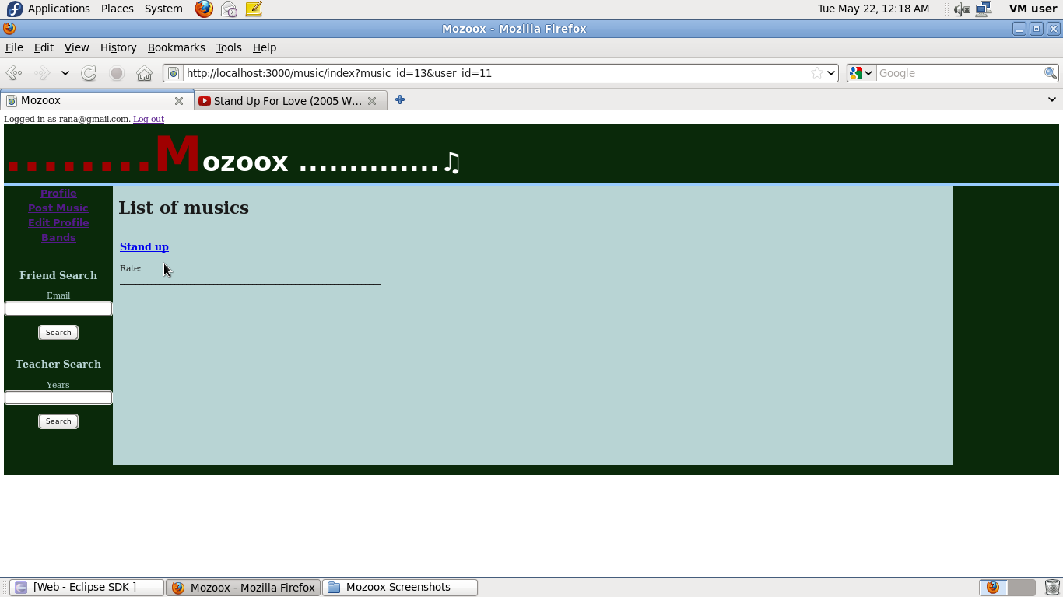
Screenshots for viewing a music
Viewing Music

Slide 11
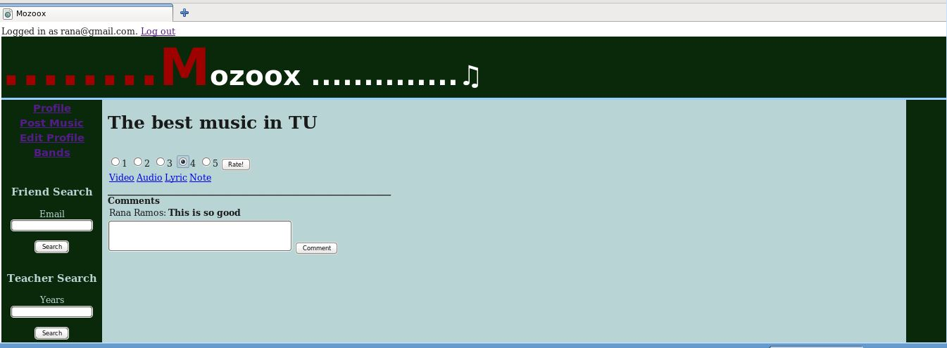
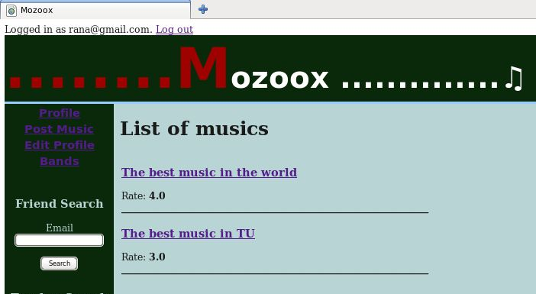
Screenshot for rating a music
1) Insert a rating
2) Display of inserted rate

Slide 12
Lead to the solution through your user stories/uses cases.
Posting a comment on a music
Login to your Mozoox account
Click on the link “Musics” under the banner of the website
Select a music from the music list.
Enter a comment in the comment field in the show view of the music controller
Click the button “comment”.
Editing a user profile (account information)
Login to your Mozoox account
Click on the link “Edit Profile” in the left column in the website
Select “account information” tab
Select “Profile settings” sub tab.
Edit user’s information (description, country, state, city, zipcode, picture, degree, schoolname, level, year) in the provided editing fields.
User can add multiple education records(degree, schoolname, level, year).
Click on button “save”

Slide 13
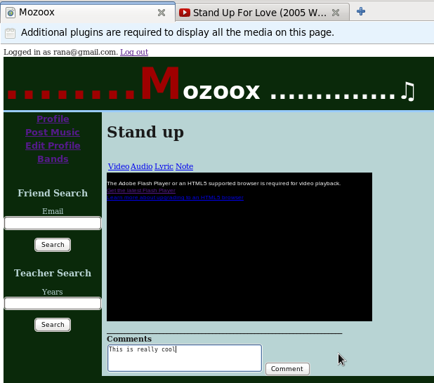
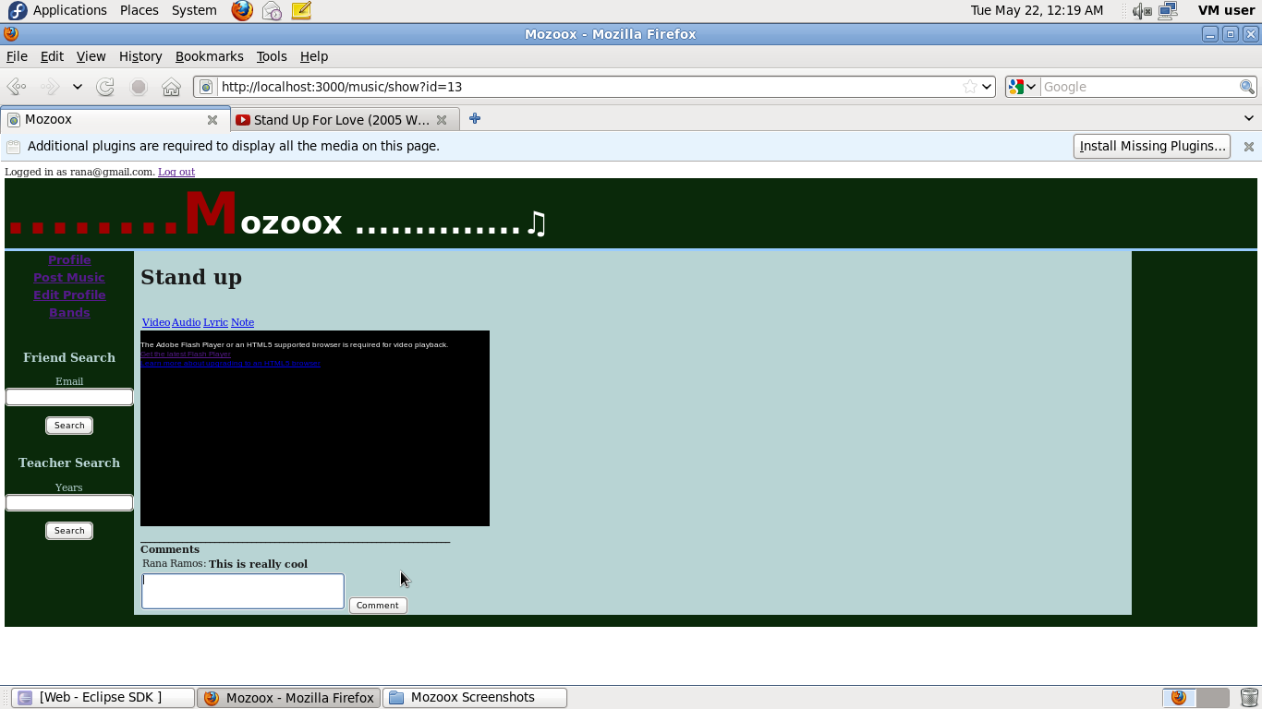
Screenshot for Posting a music comment
1) Writing the comment
2) Inserting the comment

Slide 14
Lead to the solution through your user stories/uses cases.
Editing a user profile (music preferences)
Login to your Mozoox account
Click on the link “Edit Profile” in the left column in the website
Select “Music Preferences” tab
Edit user’s music preferences by selecting music genres from the available music-taste checkboxes.
Click on the button “save preferences”
Editing a user profile (Teaching information)
Login to your Mozoox account
Click on the link “Edit Profile” in the left column in the website
Select “Teaching information” tab
Edit user’s teaching information by clicking on the “click here to add new teaching experience” bar
Enter instrument, number of years, price per hour, currency, and genre information in the provided fields
Click on the button “Add”.

Slide 15
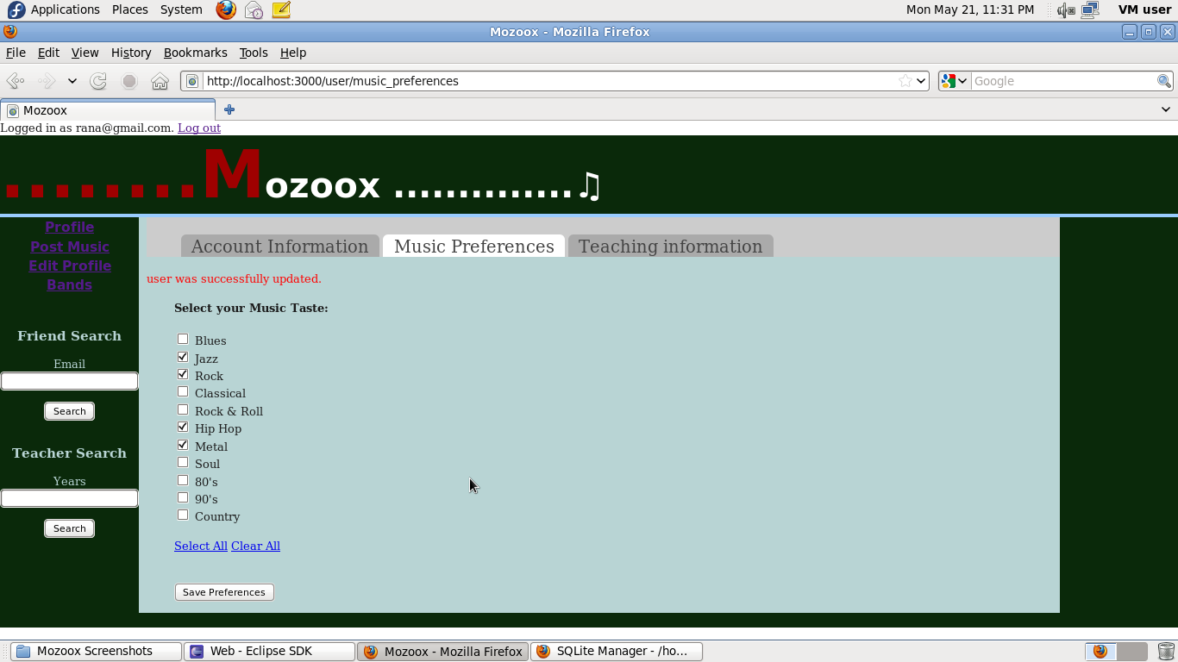
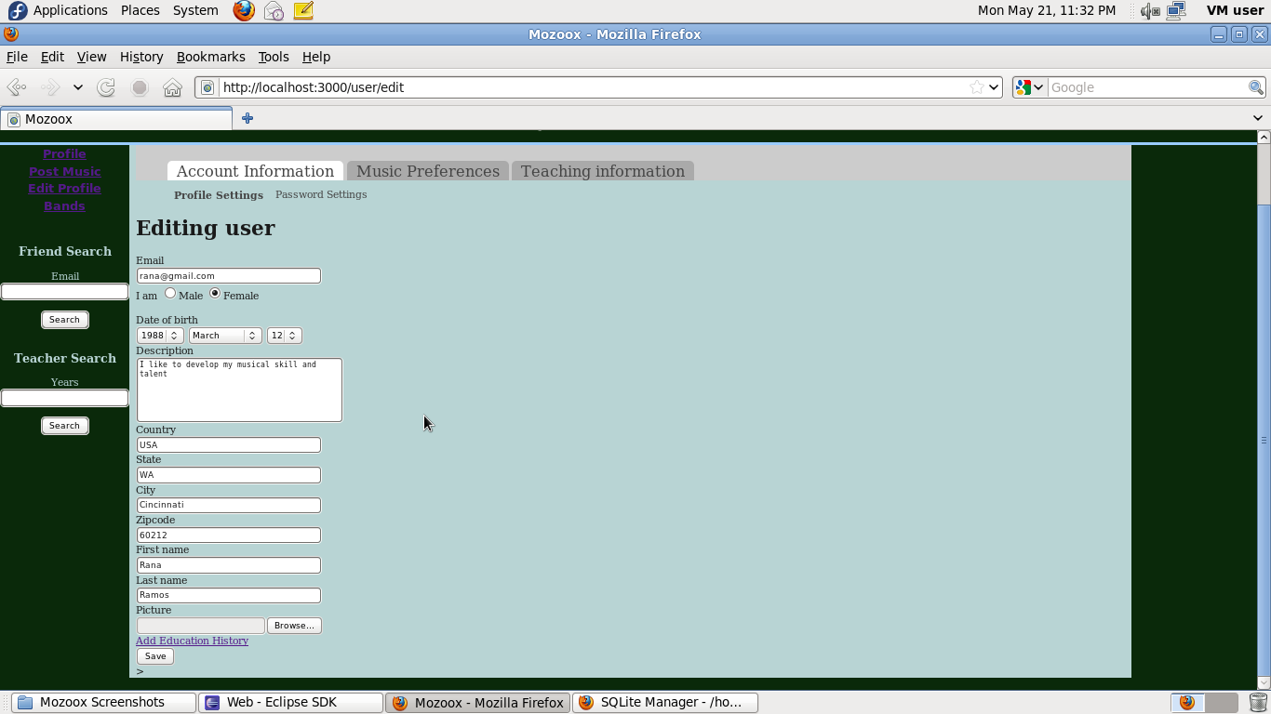
Screenshot of editing user profile (Music preferences & Account Information)
Edit Music Preferences
Editing Account Information

Slide 16
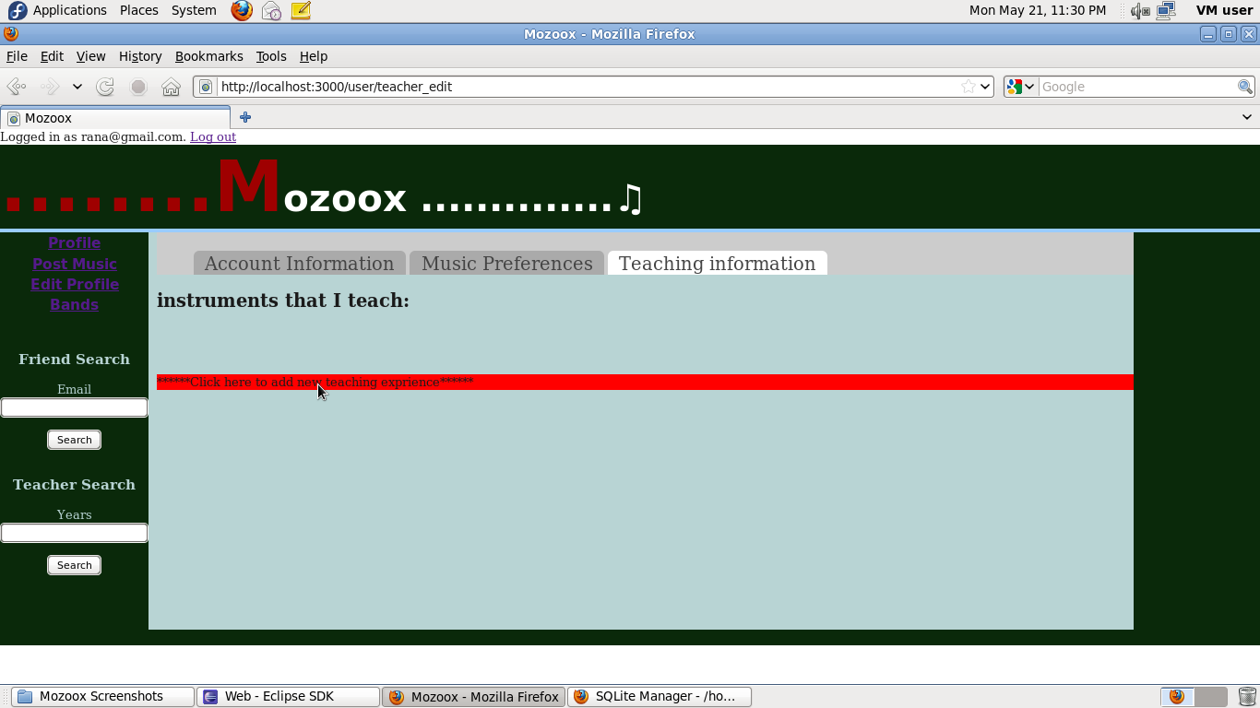
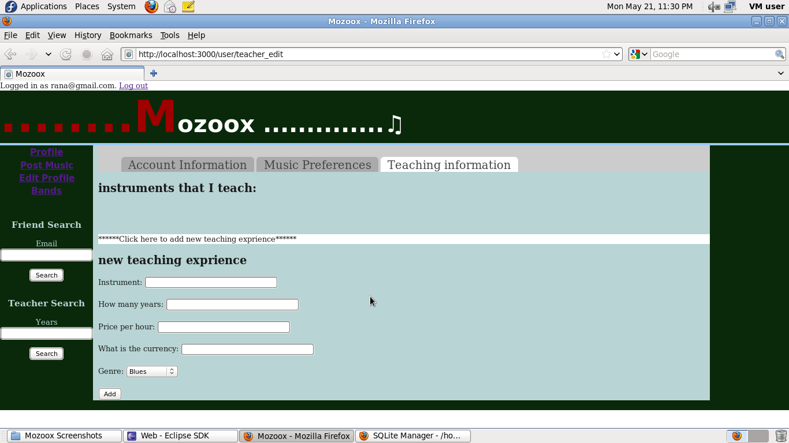
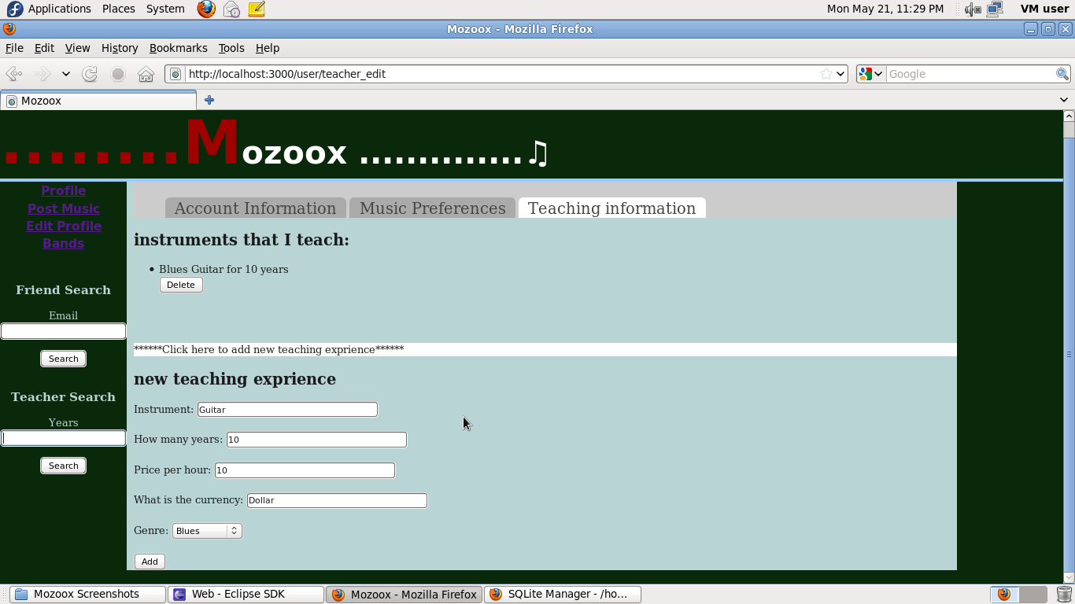
Screenshots of editing user profile (teaching)
1) Click the jQuery bar
2) Enter information
3) Save entered Information

Slide 17
Lead to the solution through your user stories/uses cases.
Resetting Password
In the login page, select the link “Did you forget your password?”
Enter your email address and your new password in the two provided textbox fields in the reset view of the login controller.
Click on the button “Rest Password”
User will be directed to the login page
A Message confirming password reset will be displayed in the index view of the login controller.
Becoming a fan
Login to your Mozoox account
Enter the friend’s email address in the friend search section in the left column at the website
Click on the button “search”
the search results are displayed in your profile page
View your friend’s profile by clicking on the link “View” that corresponds to the friend’s information.
In your friend profile page, Click on the link “Become a Fan” under the banner of the website.
A message is displayed confirming becoming a fan in the profile page.

Slide 18
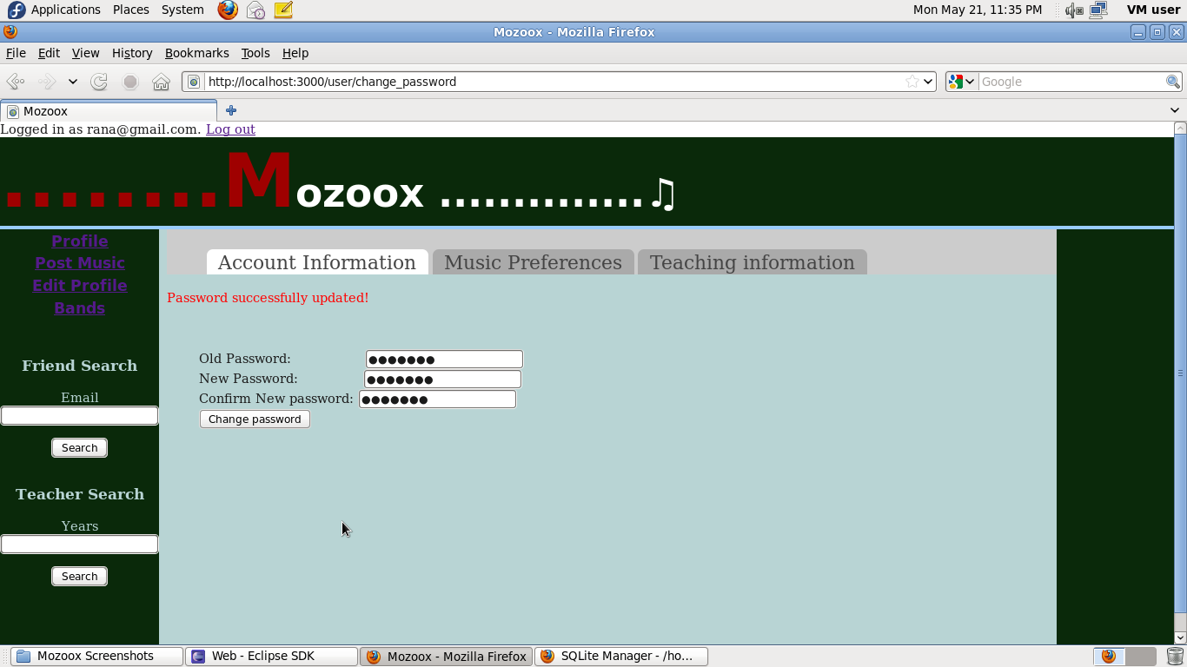
Screenshot for resetting a password
Resetting a password

Slide 19

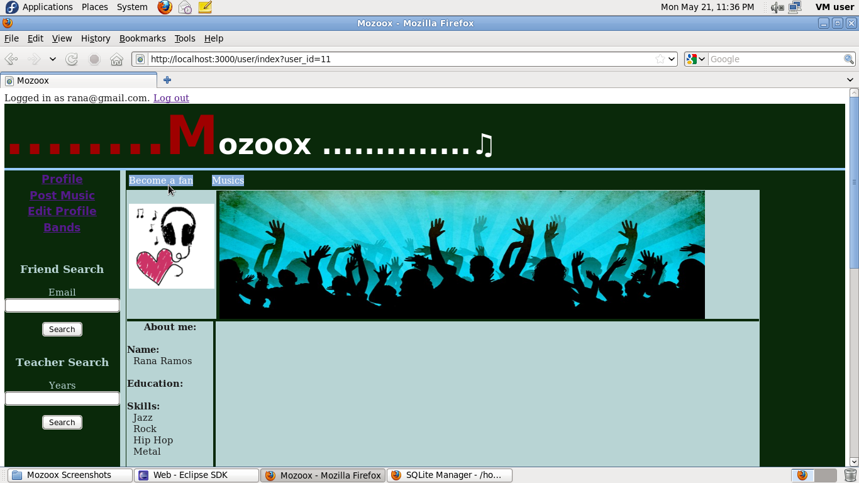
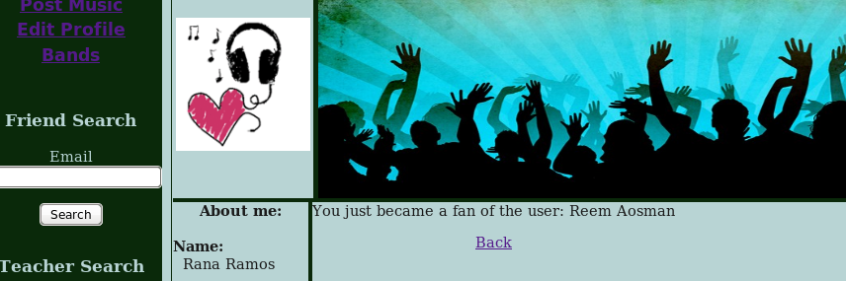
Screenshot for becoming a fan
1) Search for friend
2) View friend’s profile
3) Become a fan of User

Slide 20
Lead to the solution through your user stories/uses cases.
Launching a band
Login to your Mozoox account
Click on the link “Bands” in the left column at the website
Click on the link “Launch a band” in the index view of the band controller
Enter band name and launch year in the provided textbox fields
Click on the button “create band”
The band is crated and added to the Bands model

Slide 21
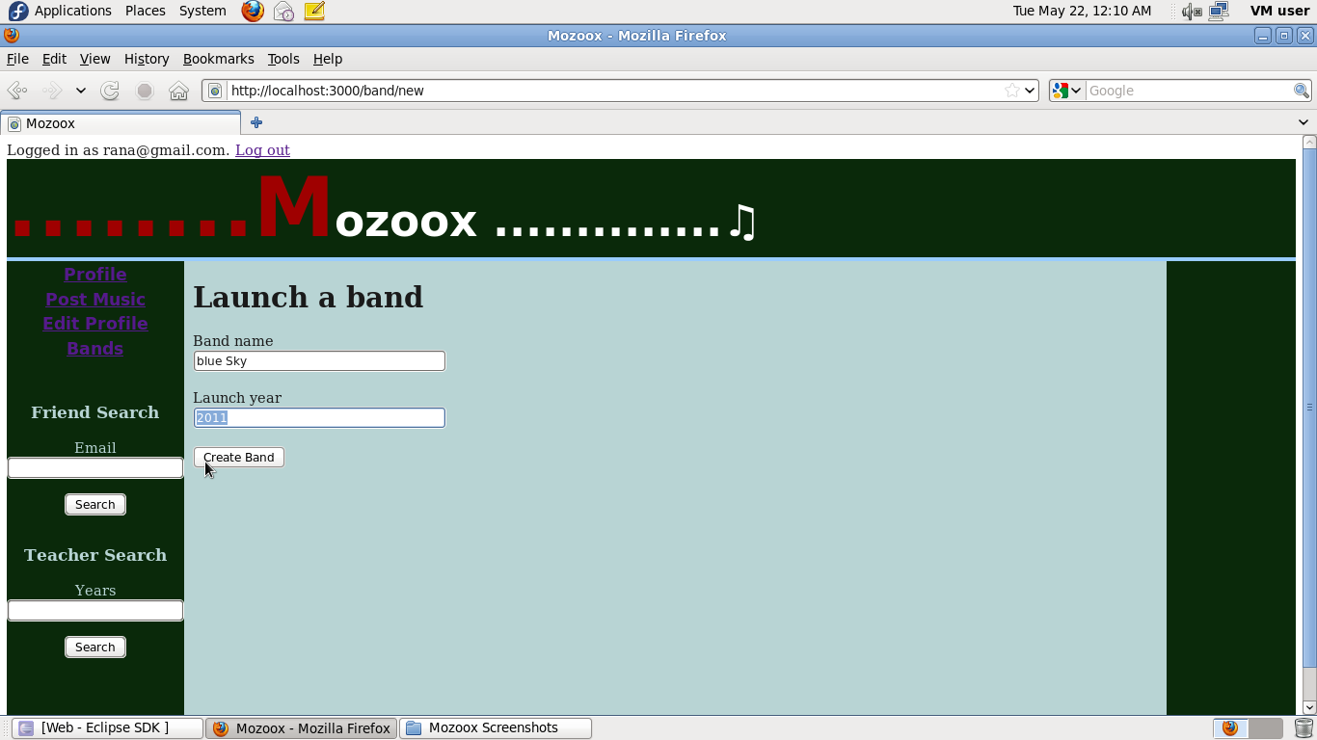
Screenshot for launching a band
Creating a band

Slide 22
Lead to the solution through your user stories/uses cases.
Adding a band member
Login to your Mozoox account
Click on the link “Bands” in the left column in the website
Click on the link “My Bands” In the index view of the band controller
Click on the link “add members” that corresponds to the band to which you want to add members at the show view of the band controller.
Enter member’s email address in the provided email textbox field
Click on the button “Add”
A message will be displayed in the same page showing that the request is pending.
Viewing band photos
Login to your Mozoox account
Click on the link “Bands” in the left columns in the website
Click on the link “View Photos” in the index view of the band controller.
A list of band’s galleries will be displayed in the show view of the photo controller
Click on the title of the gallery to view its event photos

Slide 23
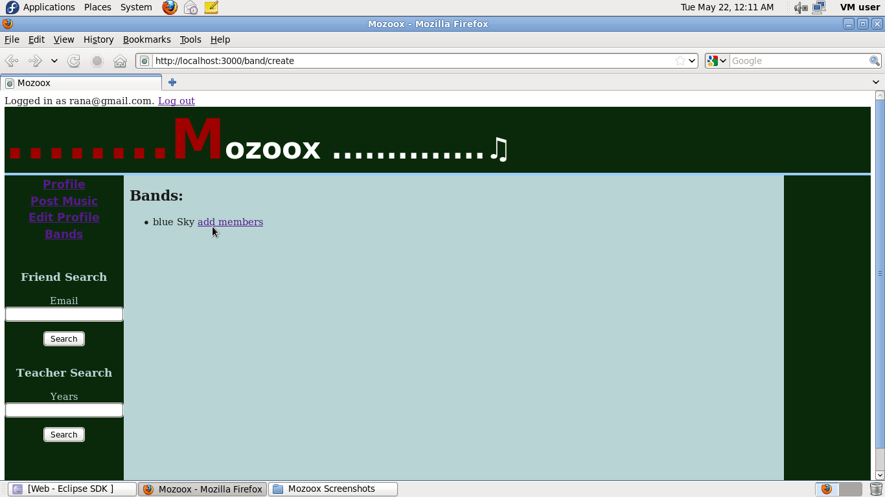
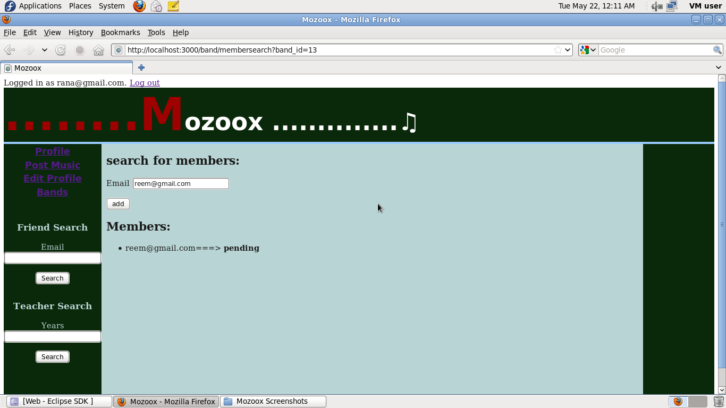
Screenshot for adding a member
1) Selecting band to which members are added
2) Adding a member by sending them an invitation

Slide 24
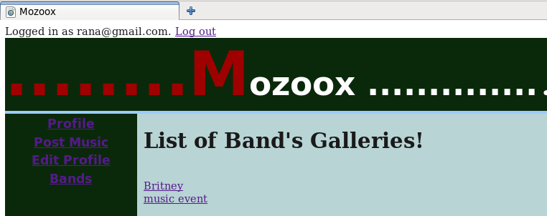
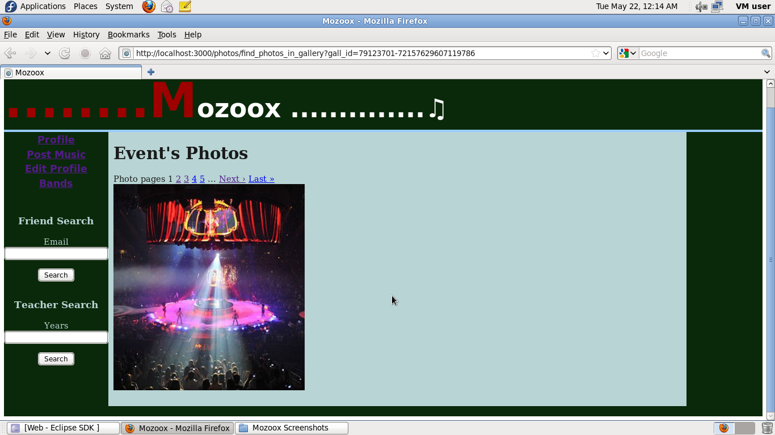
Screenshot for viewing band photos
1) List of Galleries
2) Photos of the selected gallery

Slide 25
Lead to the solution through your user stories/uses cases.
Posting a music
Login to your Mozoox account
Select link “Post Music” on the left column of the website.
Enter music title, lyrics, note, youtube video URL, sound URL, and genre in the provided fields in the new view of the music controller.
Click on the button “create music”

Slide 26
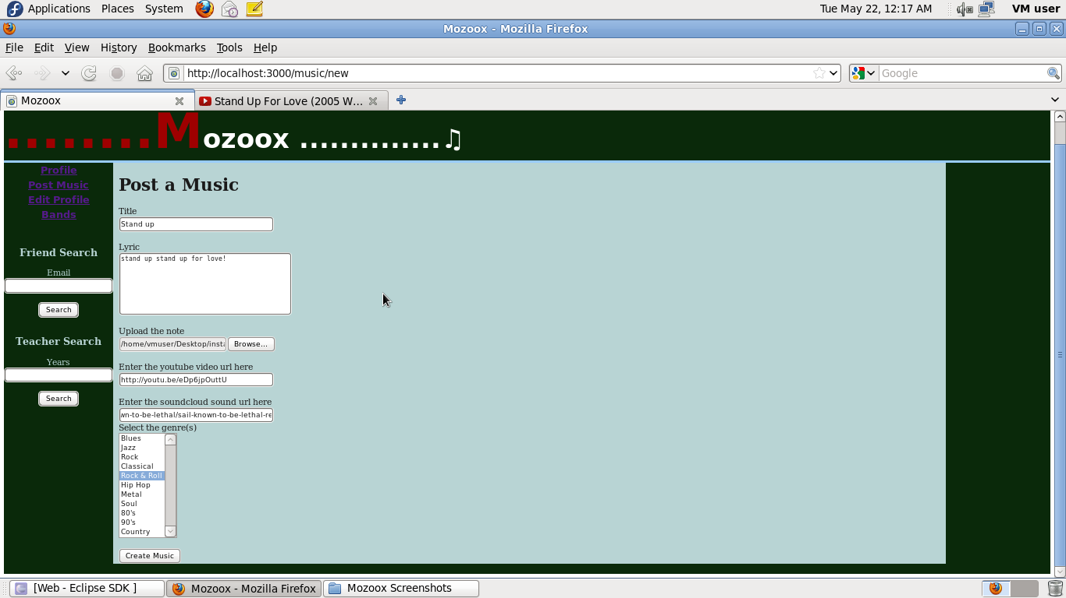
Screenshots for posting a music
Posting a music

Slide 27
EXTERNAL RESOURCES
List of used GEMS:
“paperclip", "~> 3.0“
'bcrypt-ruby', '~> 3.0.0', :require => 'bcrypt'
'tabulous‘
'flickraw‘
'kaminari‘
'soundcloud'
‘rails3-jquery-autocomplete’
"mail", "~> 2.3.3“
'tlsmail’
Webservices
Flicker
Sound cloud

Slide 28
Applied rails FEATURES
ORM
Partials & Nested Forms
Helper Methods(DRY methodology)
Session Handling
Hashing Password (Salt)
AJAX / jQuery / Javascript
Model-level Data Validation
Form Helpers
Application Layout (style sheets/CSS)
RESTful Webservices

Slide 29
Demo
Demonstrated by: Ehsan
Explained by: Poornima

Slide 30
Responsibilities
Rana
Logging in/resetting password, User/friend search, Teacher search, User profile page, Website theme(CSS), becoming a fan, developing seeds
Poornima
Profile and music preferences editing, signing up & user notification, logging out, Flicker API (Band photos), integrating tabs.
Ehsan
Developing the models structure, Music post/comment/upload/view/rate, Teaching editing, Band creation/joining

Slide 31
LEARNED LESSONS
We learned the following lessons:
how to develop a ROR web application.
object relational mapping (ORM), AJAX, jQuery, Javascript, and REST API.
how to extend the ROR application via the use of GEMS and web services.
how to debug ROR web application and deal with bugs.
how to use SVN and deal with conflicts.
how agile software development works.

Slide 32
Questions?

