Slide 1
Chapter 11 Wireless LAN Technology and the IEEE 802.11 Wireless LAN Standard

Slide 2
Introduction
Wireless LANs (WLANs)
Indispensible adjunct to wired LANs
Wireless devices use WLANs
As their only source of connectivity
Or to replace cellular coverage
Simple WLAN configuration
There is a backbone wired LAN
User modules include workstations, servers, devices
Control module (CM) interfaces to WLAN
Providing bridge or router functionality
May have control logic to regulate access
May provide wireless connectivity to other wired networks

Slide 3
11.1 Example Single-Cell Wireless LAN Configuration

Slide 4
Introduction
Multiple-cell wireless LAN
Multiple CMs connected by a wired LAN
Creates many issues for balancing cell loading and providing best connections for Ums
Wireless LAN Technology and the IEEE 802.11 Wireless LAN Standard 11-4

Slide 5
11.2 Example Multiple-Cell Wireless LAN Configuration

Slide 6
Ad Hoc Networking
Temporary peer-to-peer network set up to meet immediate need
Peer-to-peer, no centralized server
Maybe a temporary network
Wireless connectivity provided by WLAN or Bluetooth, ZigBee, etc.
Example:
Group of employees with laptops convene for a meeting; employees link computers in a temporary network for duration of meeting
Wireless LAN Technology and the IEEE 802.11 Wireless LAN Standard 11-6

Slide 7
11.3 Ad Hoc Wireless LAN Configuration

Slide 8
Wireless LAN motivations
Cellular data offloading
WLANs may provide higher data rates and more available capacity
Cellular providers may encourage this to offload demand on their networks
Sync/file transfer
Avoid use of cables
Internet access
Multimedia streaming

Slide 9
Wireless LAN Requirements
Throughput
Number of nodes
Connection to backbone LAN
Service area
Battery power consumption
Transmission robustness and security
Collocated network operation
License-free operation
Handoff/roaming
Dynamic configuration
Comparisons between WLANs, wired LANs, and mobile data networks can be visualized with Kiviat graphs.
Wireless LAN Technology and the IEEE 802.11 Wireless LAN Standard 11-9

Slide 10
11.4 Kiviat Graphs for Data Networks

Slide 11
Wireless LAN physical layer
Multi-cell arrangement
Transmission Issues
No licensing needed – Four microwave bands
902-928 MHz
2.4-2.5 GHz
5.725-5.875 GHz
58-64 GHz (60-GHz mmWave bands)
Higher capacity
Less competition
More expensive equipment
Spread spectrum
DSSS CDMA or OFDM
Over 1 Gbps possible with OFDM, channel bonding, and MIMO
Wireless LAN Technology and the IEEE 802.11 Wireless LAN Standard 11-11

Slide 12
Protocol architecture
Developed by the IEEE 802.11 working group
Uses layering of protocols
LAN protocols focus on the lower layers of the OSI model
Figure 11.5 relates OSI with 802.11
Called the IEEE 802 reference model

Slide 13
11.5 IEEE 802 Protocol Layers Compared to OSI Model

Slide 14
Protocol Architecture
Functions of physical layer:
Encoding/decoding of signals
Preamble generation/removal (for synchronization)
Bit transmission/reception
Includes specification of the transmission medium
Sublayers
Physical medium dependent sublayer (PMD)
Transmitting and receiving user data through a wireless medium
Physical layer convergence procedure (PLCP)
Mapping 802.11 MAC layer frame into a physical layer frame
Sending and receiving between stations using same PMD sublayer

Slide 15
11.6 IEEE 802 Protocols in Context
MSDU
MPDU

Slide 16
Protocol Architecture
Functions of medium access control (MAC) layer:
On transmission, assemble data into a frame with address and error detection fields
On reception, disassemble frame and perform address recognition and error detection
Govern access to the LAN transmission medium
MPDU is a MAC layer frame: MAC header+data
MSDU is payload carried in MAC frame: can be management, control or higher layer data from IP or ARP
Functions of logical link control (LLC) Layer:
Provide an interface to higher layers and perform flow and error control (LLC/SNAP header)
Wireless LAN Technology and the IEEE 802.11 Wireless LAN Standard 11-16

Slide 17
Separation of LLC and MAC
The logic required to manage access to a shared-access medium not found in traditional layer 2 data link control
For the same LLC, several MAC options may be provided (in 802.11 essentially the same MAC layer-with minor modifications in some cases-is used with different physical layer standards)
Wireless LAN Technology and the IEEE 802.11 Wireless LAN Standard 11-17

Slide 18
MAC Frame Format
MAC control
Contains MAC protocol information
Several subfields (type/subtype/control bits)
Destination MAC address
Destination physical attachment point
Source MAC address
Source physical attachment point
Up to two other addresses, duration, sequence number
CRC
Cyclic redundancy check
Frame format varies according to frame type
Wireless LAN Technology and the IEEE 802.11 Wireless LAN Standard 11-18

Slide 19
IEEE 802.11
Started in 1990
MAC and physical medium specifications
Wi-Fi Alliance
Industry consortium
Creates test suites to certify interoperability of products
May identify a subset of the standard for certification
Concerned with a range of market areas for WLANs
IEEE 802.11 has an ever expanding list of standards
Wireless LAN Technology and the IEEE 802.11 Wireless LAN Standard 11-19

Slide 20
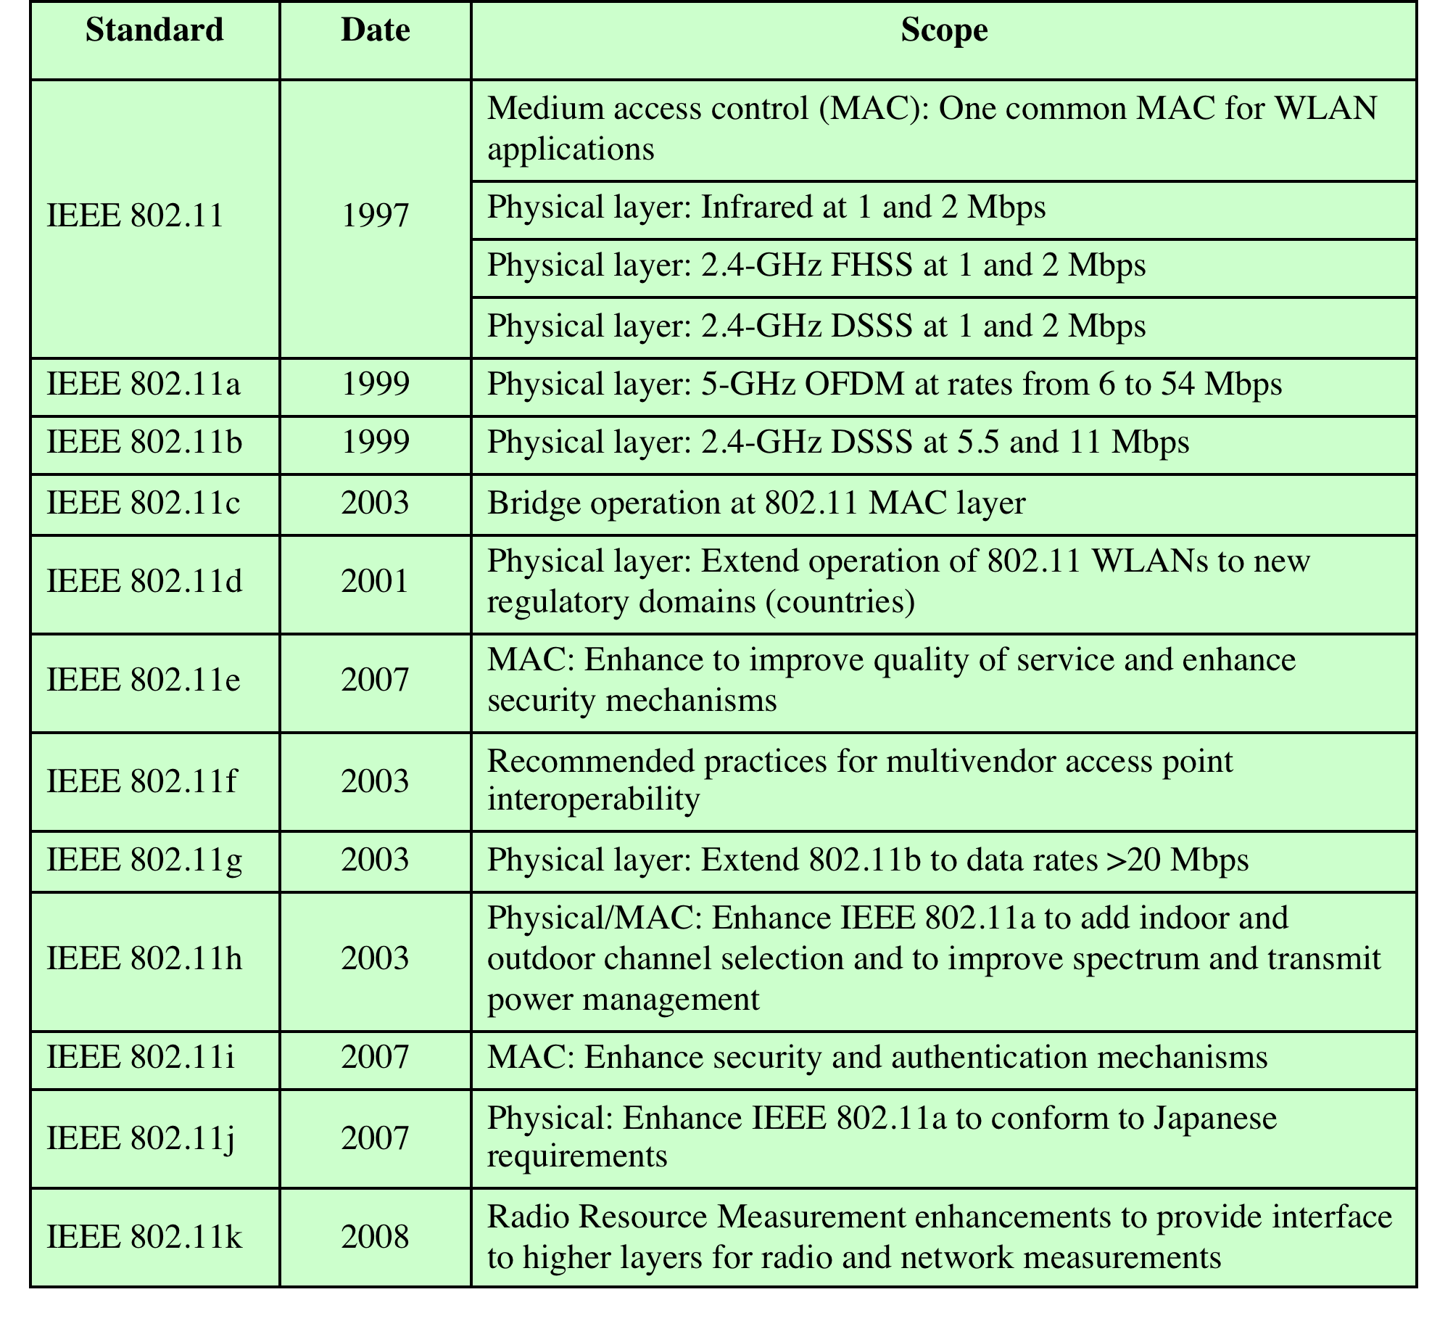
IEEE 802.11 Standards
Table 11.1 IEEE 802.11 Standards
Wireless LAN Technology and the IEEE 802.11 Wireless LAN Standard 11-20

Slide 21
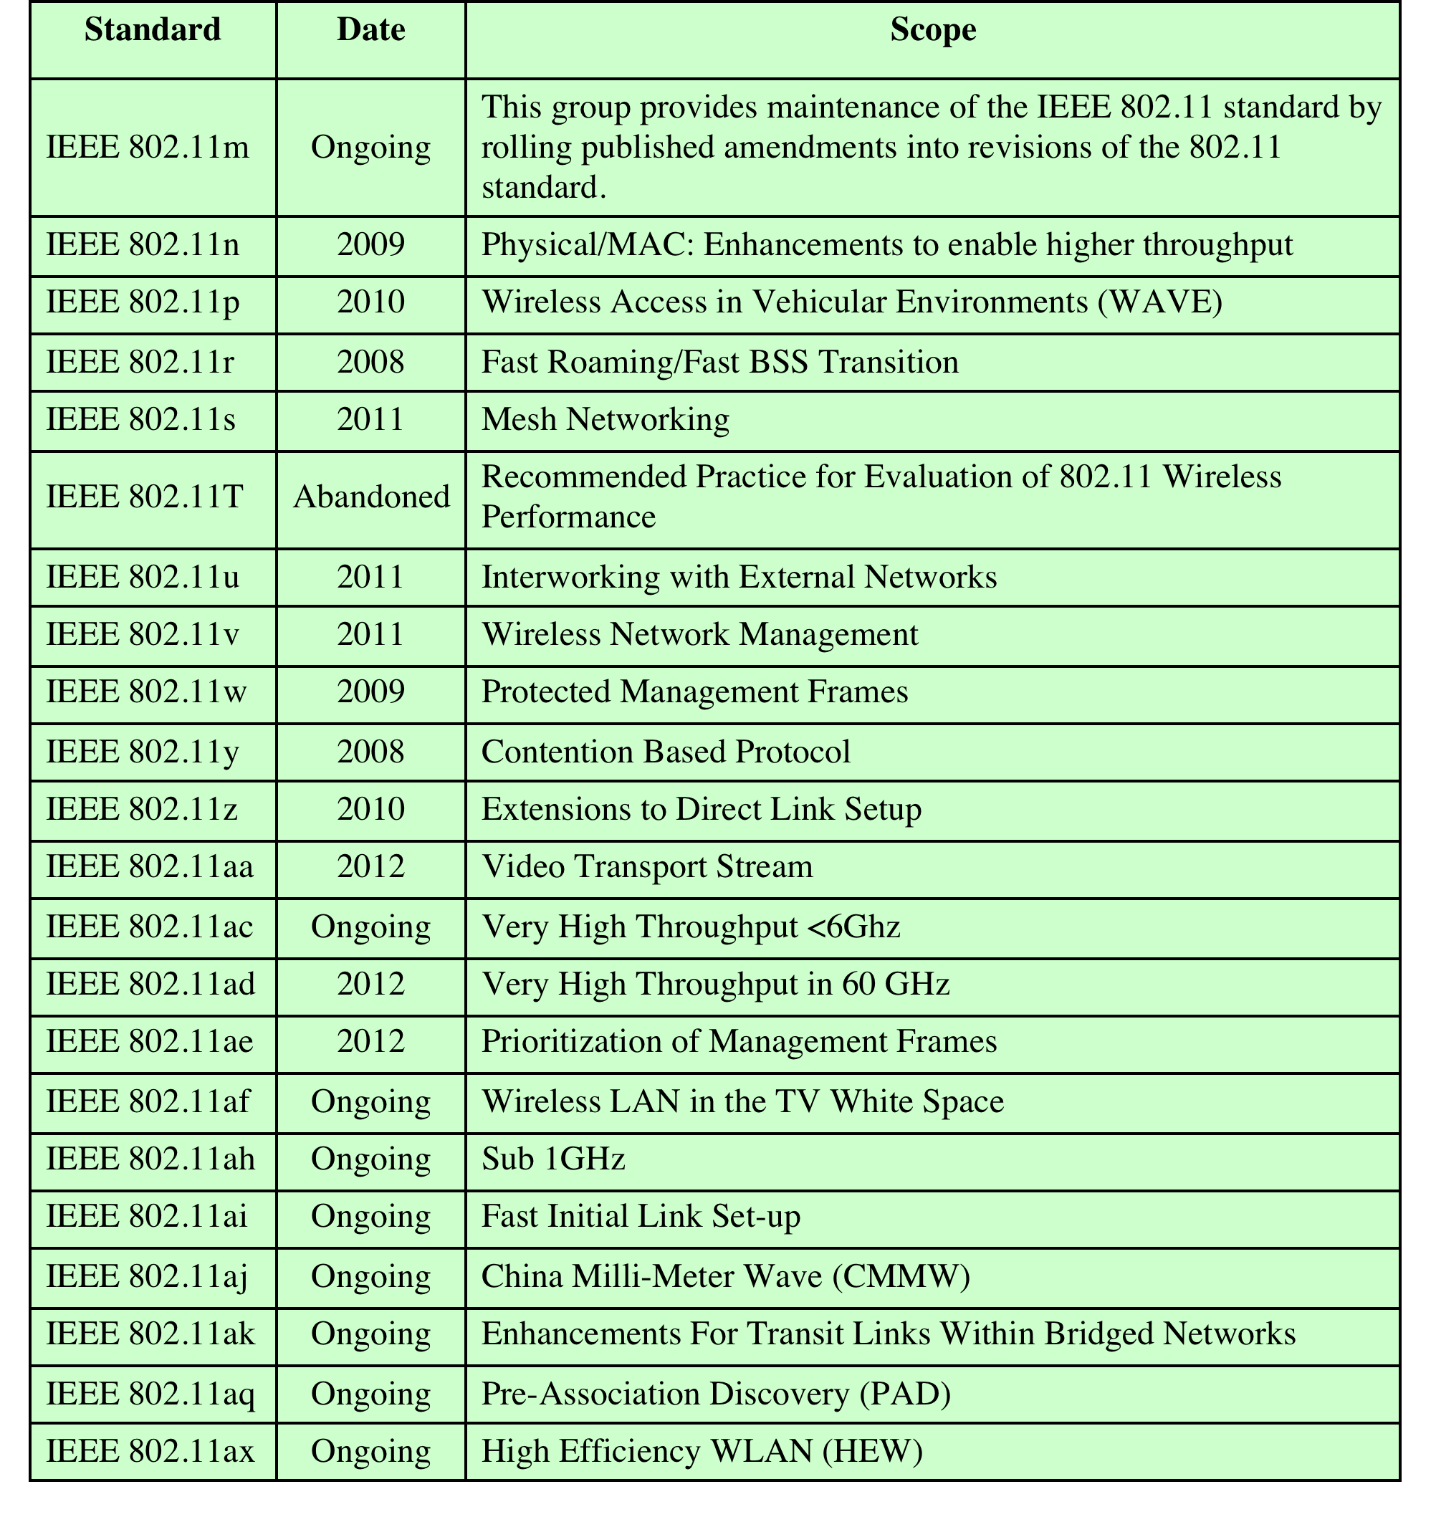
IEEE 802.11 Standards
Wireless LAN Technology and the IEEE 802.11 Wireless LAN Standard 11-21

Slide 22
IEEE 802.11 Architecture
Distribution system (DS): connects BSSs and integrated LANs (DS can be an Ethernet switch or wired/wireless network)
Access point (AP): enables stations to connect to distribution system; acts as a bridge between 802.11 and Ethernet (relays frames between stations); could be combined with a router/switch
Basic service set (BSS)
Stations competing for access to shared wireless medium
IBSS (adhoc/mesh with no AP) or connected to backbone DS through AP (infrastructure mode)
Extended service set (ESS)
Two or more basic service sets interconnected by DS
Portal: connects BSSs to an 802.x LAN via the DS (e.g., router that connects BSSs to an Ethernet)

Slide 23
11.8 IEEE 802.11 Architecture

Slide 24
Distribution of Messages Within a DS
Distribution service
Used to exchange MAC frames from station in one BSS to station in another BSS
Integration service
Transfer of data between station on IEEE 802.11 LAN and station on integrated IEEE 802.x LAN
Example: Frame from STA 2 to STA 7 must be forwarded through AP and DS
if APs connect to an Ethernet switch, how is the frame forwarded?
What MAC addresses are used?
What is the difference if a router is used instead of a switch?
Wireless LAN Technology and the IEEE 802.11 Wireless LAN Standard 11-24

Slide 25
Transition Types Based On Mobility
No transition
Stationary or moves only within BSS
BSS transition
Station moving from one BSS to another BSS in same ESS
ESS transition
Station moving from BSS in one ESS to BSS within another ESS
Wireless LAN Technology and the IEEE 802.11 Wireless LAN Standard 11-25

Slide 26
Association-Related Services
Association
Establishes initial association between station and AP
Reassociation
Enables transfer of association from one AP to another, allowing station to move from one BSS to another
Disassociation
Association termination notice from station or AP
Wireless LAN Technology and the IEEE 802.11 Wireless LAN Standard 11-26

Slide 27
IEEE 802.11 Medium Access Control
MAC layer covers three functional areas:
Reliable data delivery
Access control
Security
Wireless LAN Technology and the IEEE 802.11 Wireless LAN Standard 11-27

Slide 28
Reliable Data Delivery
More efficient to deal with errors at the MAC level than higher layer (such as TCP) to avoid delays
Frame exchange protocol
Source station transmits data
Destination responds with acknowledgment (ACK)
If source doesn‘t receive ACK, it retransmits frame
Can use the default basic access algorithm (discussed later) or an optional RTS/CTS exchange
RTS/CTS exchange
Source issues request to send (RTS)
Destination responds with clear to send (CTS)
Source transmits data
Destination responds with ACK
If an ACK is not received (data or ack had collision), source retransmits after exponential backoff (discussed later)
RTS/CTS are short frames; to avoid collisions with ongoing exchange, other stations receiving the RTS or CTS must wait till all four frames are sent; RTS/CTS contain a duration field that enable these stations to determine time to wait; if station gets RTS but not CTS, it can transmit
Wireless LAN Technology and the IEEE 802.11 Wireless LAN Standard 11-28

Slide 29
Access control
Centralized and decentralized mechanisms together
Distributed foundation wireless MAC (DFWMAC)
Distributed coordination function (DCF)
Decentralized
Point coordination function (PCF)
Centralized
Both are available to the LLC layer
Wireless LAN Technology and the IEEE 802.11 Wireless LAN Standard 11-29

Slide 30
Hidden Station Problem
Frames can collide at AP without senders being aware because they are out of range of each other
Example: Signals from A and B cannot reach each other, but can reach the AP; if A and B sense an idle medium and transmit, signals from frames collide at the AP, but neither A nor B detect the collision A----AP----B
Collision avoidance: Basic access method avoids but does not prevent collisions
Optional RTS/CTS exchange attempts to solve the hidden station problem

Slide 31
RTS/CTS exchange
Example: A---AP---B
A sends RTS, AP sends CTS, B sees CTS and waits till exchange is done
Even though B is hidden from A, it now does not cause a collision
If RTSs from A and B collide, they will attempt to retransmit after backoff (described later)

Slide 32
MAC Protocols
MAC algorithm is called DFWMAC (distributed foundation wireless MAC)
Protocol architecture (Figure 14.5)
Ignore point coordination function (PCF); not implemented by vendors
DCF is distributed coordination function that has contention algorithm to control access
Method it uses is called CSMA/CA (carrier sense multiple access with collision avoidance)
No collision detection since it is hard to distinguish weak signals from noise during transmission; also typical hardware is unable to send and receive signals at same time

Slide 33
11.9 IEEE 802.11 Protocol Architecture

Slide 34
Distributed coordination function
Decentralized
Carrier sense multiple access (CSMA/CA)
Listen to the medium
If idle, then transmit
If not, wait a random time and then send frame
The delay counter is decremented only when medium is idle
Binary exponential backoff is used if a collision occurs
Double the size of the interval from which random delay is chosen
Mean random waiting times get exponentially larger
By a factor of 2 each time, hence the term binary.
This process responds to heavy loads
Since nodes do not know the loads of other nodes trying to send.

Slide 35
MAC Protocols (cont.)
Figure 11.10 illustrates the CSMA/CA (basic access) MAC algorithm (IFS is a short period of time-actually DIFS as seen later):
To send a frame, sense medium
if (idle for IFS), send frame
else (if medium busy or becomes busy during IFS), choose a random delay time from an interval known as the collision window CW (a preset initial value) and set counter to delay
while medium is idle, decrement counter (if medium becomes busy, count down is halted and resumed when medium becomes idle again)
when counter is 0, send frame
if (no ack), till frame is successfully sent,
double CW and choose a random delay again (this is exponential backoff) to wait as before and retransmit frame
Note: Figure 11.10 does not show using binary exponential backoff to retransmit after a collision

Slide 36
11.10 IEEE 802.11 Medium Access Control Logic
Wireless LAN Technology and the IEEE 802.11 Wireless LAN Standard 11-36

