Slide 1
Violent Crime in Communities
Kevin Kuo & Mary Snyder

Slide 2
Data Set
Author: Michael Redmond
Title: Communities and Crime
Sources:
1995 Federal Bureau of Investigation Uniform Crime Report
1990 US Census
1990 LEMAS Survey
https://archive.ics.uci.edu/ml/datasets/Communities+and+Crime

Slide 3
Data Set (cont’d)
Attributes
Selected from larger databases of Census and crime information
Focus attribute: Per Capita Violent Crimes
127 other attributes
Limitations
Violent crime definition differs among jurisdictions, police departments with at least 100 police officers, etc.
Notes:
Many cities in the Midwest were dropped because of differ definition of rape
Other cities dropped because no LEMAS data

Slide 4
Data Set (cont’d)
Pre-processing
Already normalized (numeric fields between 0.00 and 1.00)
Equal Width Binning (for Classification and Frequent Itemset analysis)
Holdout Method (for Classification)

Slide 5
Background
Objective:
Explore other indicators/attributes of communities along with incidences of violent crime to determine what relationships exist and suggest further areas of study.

Slide 6
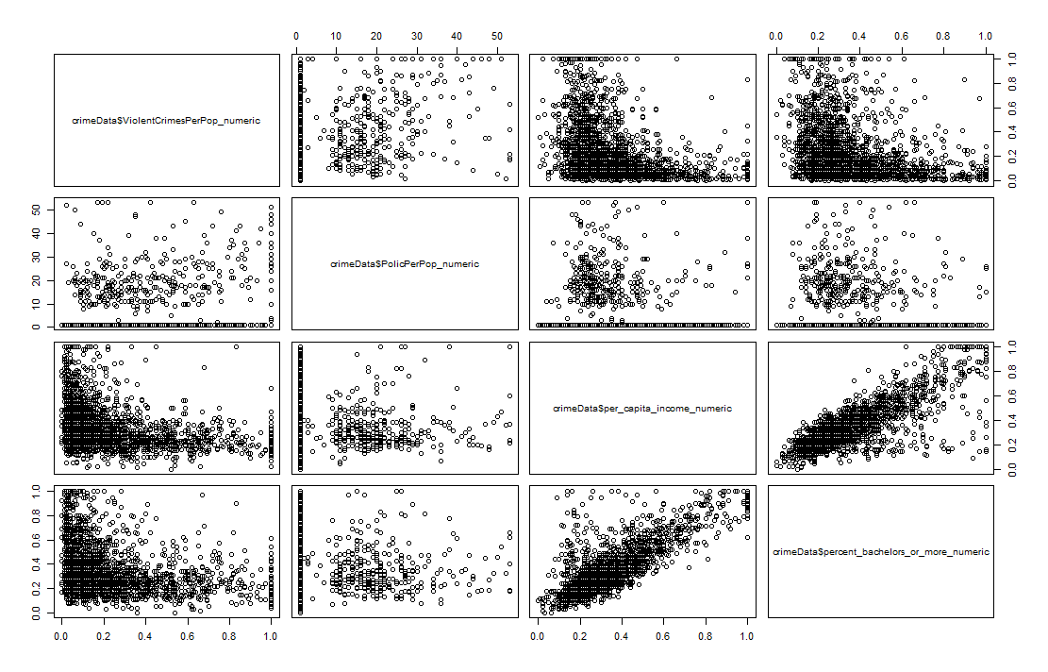
Exploratory Data Analysis
Attributes most commonly believed to influence incidents of Violent Crime:
% Police per capita
Per Capita Income
% with Bachelor’s or higher degree
Notes:
racePctWhite: percentage of population that is Caucasian (numeric - decimal)
Every other race was inverse of this (African American, Asian, and Hispanic)
pctWInvInc: percentage of households with investment / rent income in 1989 (numeric - decimal)
PctNotHSGrad: percentage of people 25 and over that are not high school graduates (numeric - decimal)
TotalPctDiv: percentage of population who are divorced (numeric - decimal)

Slide 7
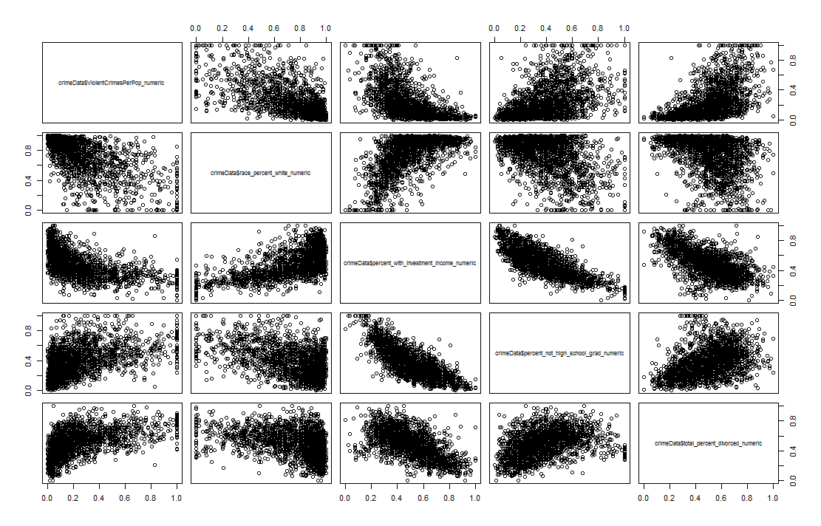
Exploratory Data Analysis (cont’d)
Most Significant Attributes out of 122 plausible attributes:
% Caucasian
Investment Income
High school graduates
% Divorced
Notes:
racePctWhite: percentage of population that is caucasian (numeric - decimal)
Every other race was inverse of this (African American, Asian, and Hispanic)
pctWInvInc: percentage of households with investment / rent income in 1989 (numeric - decimal)
PctNotHSGrad: percentage of people 25 and over that are not high school graduates (numeric - decimal)
TotalPctDiv: percentage of population who are divorced (numeric - decimal)

Slide 8
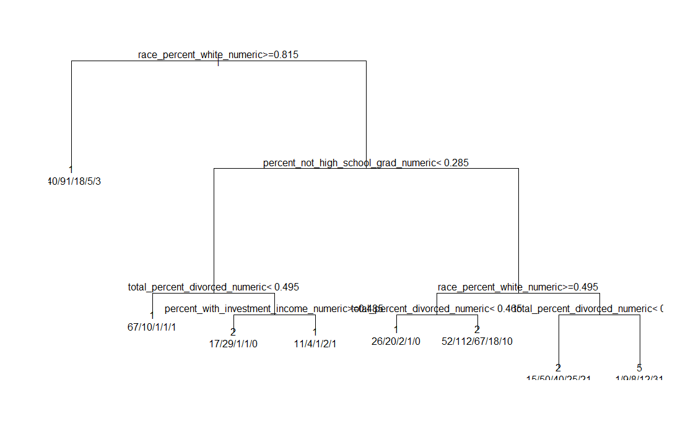
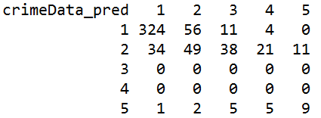
Results - Classification
Decision Tree
Figure 6. Confusion Matrix – Binning k = 5
Figure 5. Classification Decision Tree – Binning k = 5
Notes:
Performed decision tree when k = 5
Similar results -> 3 levels
Overall accuracy: 47%
Overall error rate: 53%

Slide 9
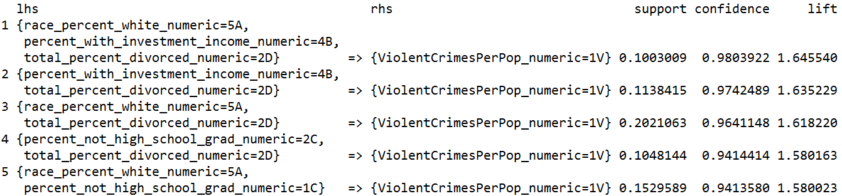
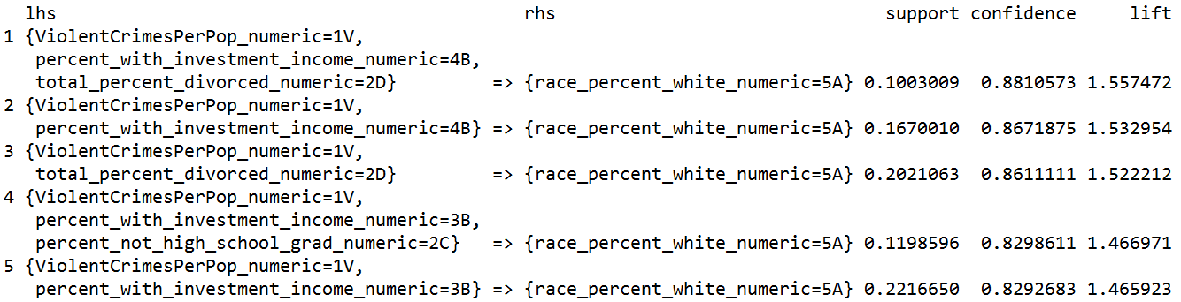
Results – Frequent Itemsets
Apriori
Table 5. Apriori ViolentCrimesPerPop RHS Confidence Sort
Table 6. Apriori ViolentCrimesPerPop LHS Confidence Sort
Notes:
Right Hand Side vs. Left Hand Side Apriori comparison

Slide 10
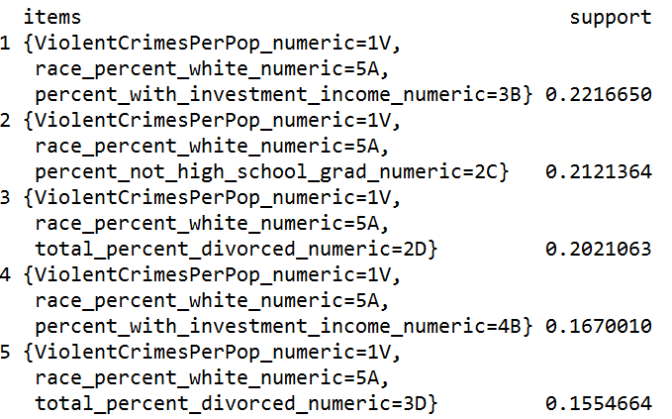
Results – Frequent Itemsets (cont’d)
Eclat
Table 7. Eclat ViolentCrimesPerPop Support Sort
Notes:
No confidence value; used support instead
Same results as Apriori

Slide 11
Conclusions
Violent Crime relationships:
Proportional relationship:
Higher percentage of divorcees
Large percentage of population who do not have a high school degree
Inversely Proportional relationship:
Communities with higher percentage of investment income
Largely Caucasian communities

Slide 12
Conclusions (cont’d)
Attribute relationships:
Lower percentage of population without high school diploma frequently found with lower percentage of divorcees and higher percentage of Caucasians
Higher percentage of Caucasians in the community frequently associated with higher percentage of population with investment income
Higher percentage of Caucasians were frequently found with low to mid percentage of divorcees

Slide 13
Proposed Future Analysis
Additional studies to analyze how changes in any specific attribute is correlated with a change in violent crime per capita
Will require additional data sets in preceding and succeeding years.
Would help to determine outliers for improved results

Slide 14
Questions/Comments

