Slide 1
Violent Crime in Communities
Kevin Kuo & Mary Snyder

Slide 2
Data Set
Author: Michael Redmond
Title: Communities and Crime
Source: 1995 Federal Bureau of Investigation Uniform Crime Report

Slide 3
Data Set (cont’d)
Attributes
Selected from larger databases of Census and crime information
Focus attribute: Per Capita Violent Crimes
127 other attributes
Limitations
Violent crime definition differences among jurisdictions, police departments with at least 100 police officers, etc.

Slide 4
Background
Objective:
Explore other indicators/attributes of communities along with the incidence of violent crime to determine what relationships exist and suggest further areas of study.

Slide 5
Pre-Processing
1994 instances + 128 attributes!
Already normalized
Classification - Holdout Method
Binning (equal width)
Scatterplots

Slide 6
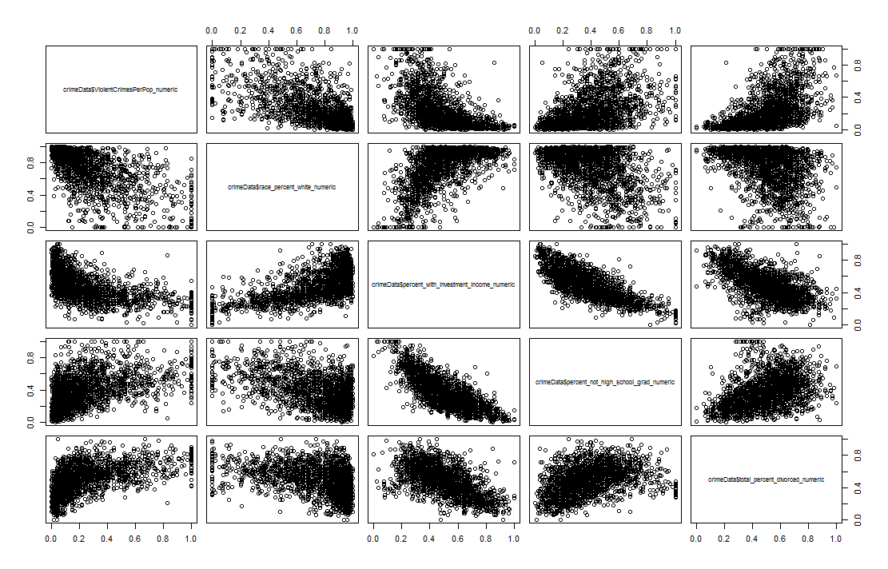
Exploratory Data Analysis
Most Significant Attributes out of 122 plausible attirbutes:
% Caucasian
Investment Income
High school graduates
% Divorced
Notes:
racePctWhite: percentage of population that is caucasian (numeric - decimal)
Every other race was inverse of this (African American, Asian, and Hispanic)
pctWInvInc: percentage of households with investment / rent income in 1989 (numeric - decimal)
PctNotHSGrad: percentage of people 25 and over that are not high school graduates (numeric - decimal)
TotalPctDiv: percentage of population who are divorced (numeric - decimal)

Slide 7
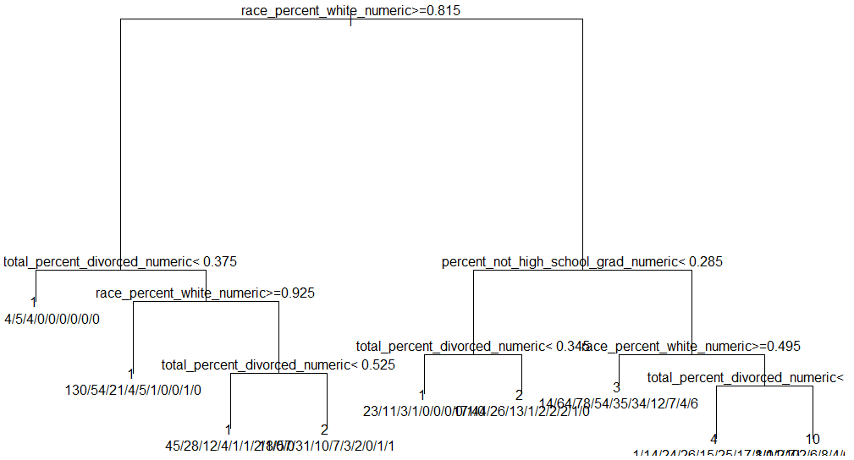
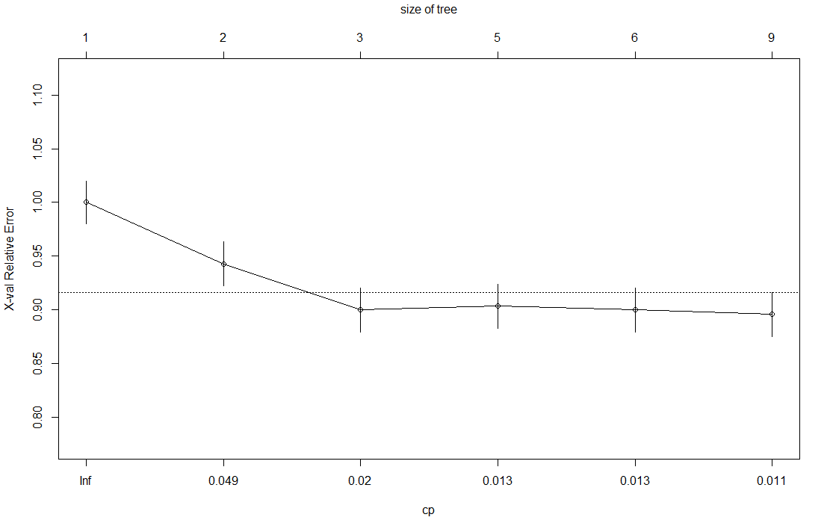
Results - Classification
Decision Tree
Figure 5. Classification Decision Tree – Binning k = 10
Figure 6. Relative Error and CP – Binning k = 10
Notes:
Performed decision tree when k = 5
Similar results -> 3 levels
Overall accuracy: 47%
Overall error rate: 53%

Slide 8
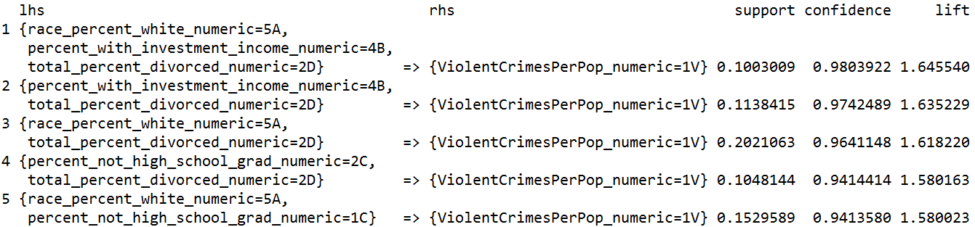
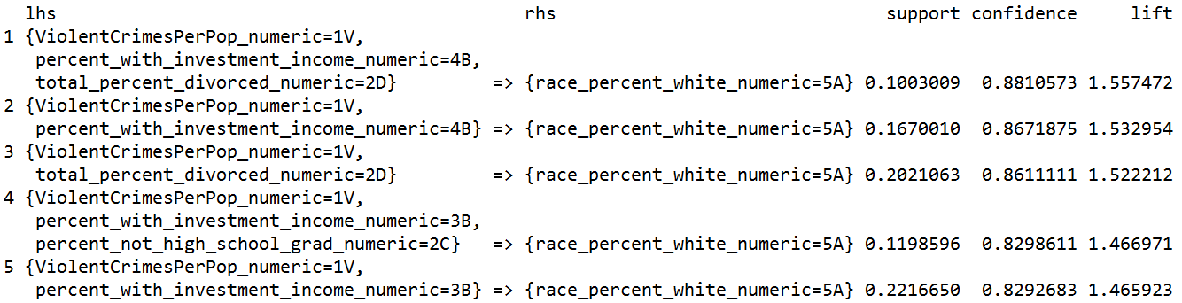
Results – Frequent Item Sets
Apriori
Table 5. Apriori ViolentCrimesPerPop RHS Confidence Sort
Table 6. Apriori ViolentCrimesPerPop LHS Confidence Sort
Notes:
Right Hand Side vs. Left Hand Side Apriori comparison

Slide 9
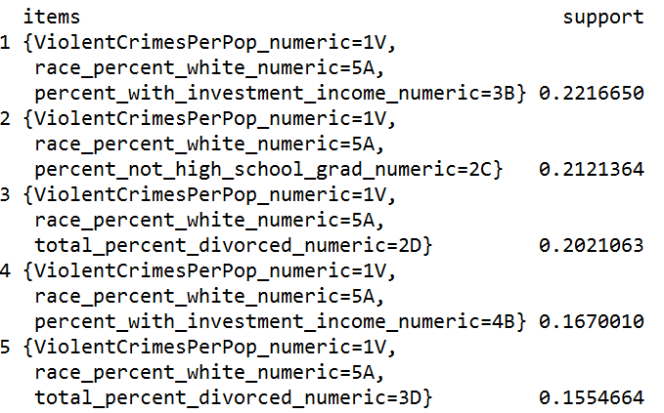
Results – Frequent Item Sets
Eclat
Table 7. Eclat ViolentCrimesPerPop Support Sort
Notes:
No confidence value; used support instead
Same results as Apriori

Slide 10
Conclusions
Initial findings from scatterplots were consistent with decision trees, frequent item sets
High correlation among violent crime, primarily Caucasian communities, investment income, and parental marriage status

Slide 11
Proposed Solution
Additional studies to analyze how changes in any specific attribute is correlated with a change in violent crime per capita
Will require additional data sets in preceding and succeeding years.

Slide 12
Questions/Comments
Was Google Flu Trend’s model too simple?
CDC uses models to predict spread of disease
Should that model have been built into algorithm to determine whether
Additional comments…

