Slide 1
Violent Crime in Communities
Kevin Kuo & Mary Snyder

Slide 2
Data Set
Author: Michael Redmond
Title: Communities and Crime
Source: 1995 Federal Bureau of Investigation Uniform Crime Report

Slide 3
Data Set (cont’d)
Attributes
Selected from larger databases of Census and crime information
Major attribute: Per Capita Violent Crimes
Other attributes: Racial composition, socioeconomics, education, family(married, divorced, etc)., immigration, housing, etc.
Limitations
Violent crime definitions, police departments with at least 100 police officers, etc.

Slide 4
Background
Objective:
Explore other indicators/attributes of communities along with its prevalence of violent crime to determine what relationships exist and suggest further areas of study.

Slide 5
Pre-Processing
1994 instances + 128 attributes!
Already normalized
Binning (equal width)
Scatterplots

Slide 6
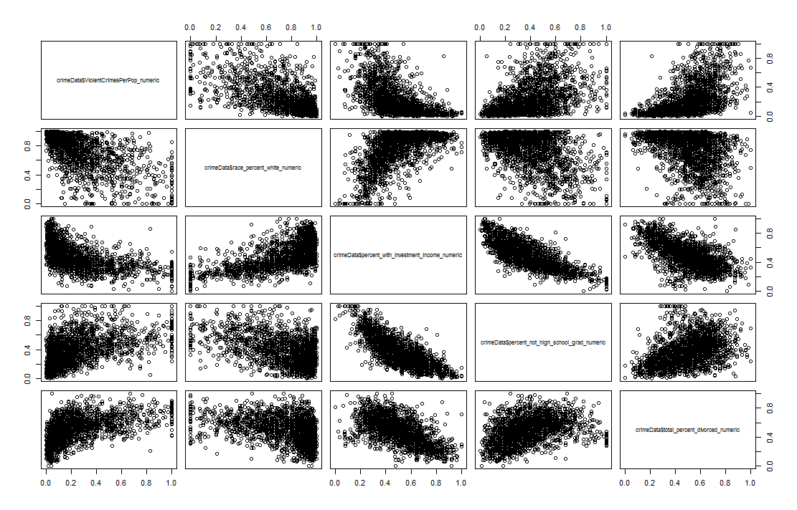
Exploratory Data Analysis
Significant Attributes
% Caucasian
Investment Income
High school graduates
% Divorced
Notes:
racePctWhite: percentage of population that is caucasian (numeric - decimal)
Every other race was inverse of this (African American, Asian, and Hispanic)
pctWInvInc: percentage of households with investment / rent income in 1989 (numeric - decimal)
PctNotHSGrad: percentage of people 25 and over that are not high school graduates (numeric - decimal)
TotalPctDiv: percentage of population who are divorced (numeric - decimal)

Slide 7
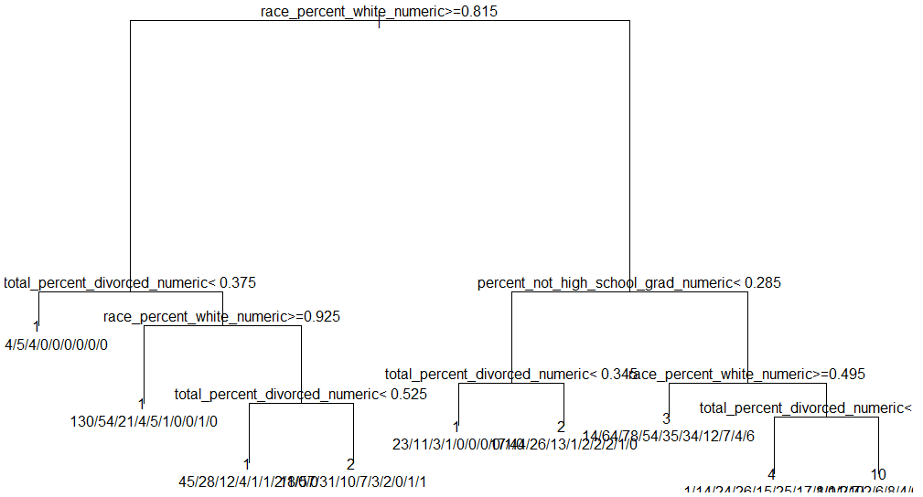
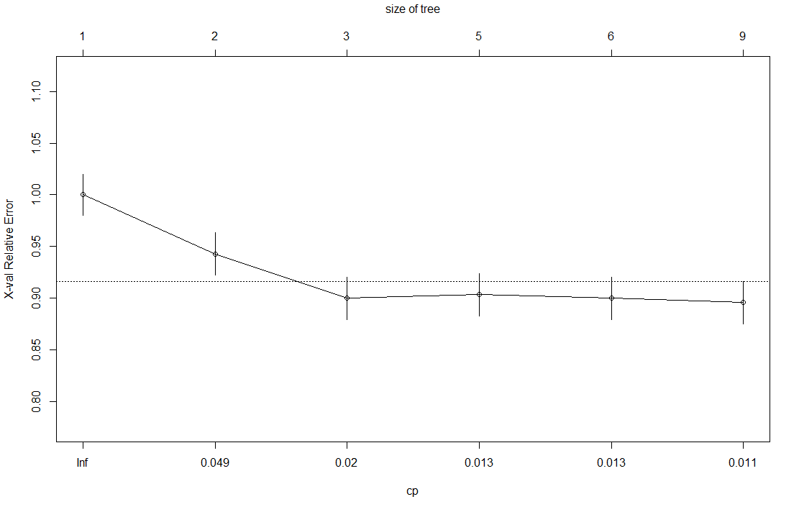
Results - Classification
Decision Tree
Figure 5. Classification Decision Tree – Binning k = 10
Figure 6. Relative Error and CP – Binning k = 10

Slide 8
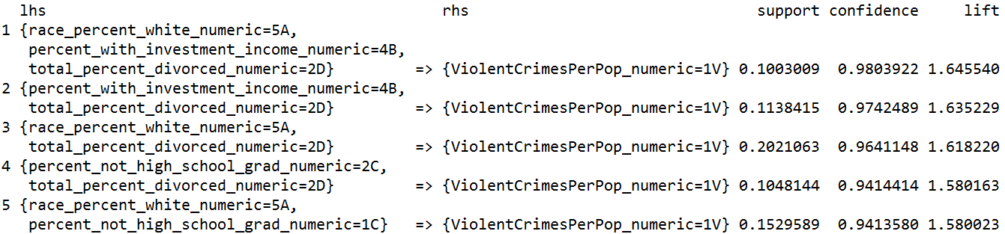
Results – Frequent Item Sets
Apriori
Table 5. Apriori ViolentCrimesPerPop RHS Confidence Sort

Slide 9
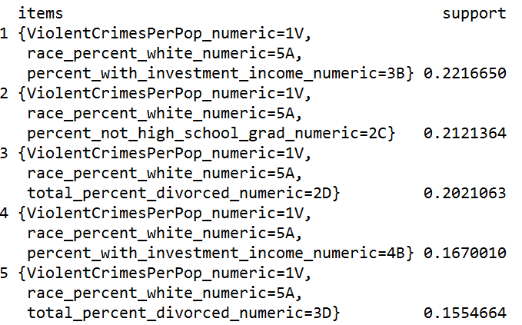
Results – Frequent Item Sets
Eclat
Table 7. Eclat ViolentCrimesPerPop Support Sort

Slide 10
What went wrong?
Users over-reacted to media reports
Unexpected spike in query volume
Overestimated in January 2013
CDC incidence rate: 4.52%
Google Flu Trends predicted rate: 10.56%
Google shut down Google Flu Trends (quietly)

Slide 11
Proposed Solution
Dampen anomalous media spikes
Media spikes are usually short term 3-7 days
Remove them from the model
Use ElasticNet model
Results were better than:
Current model
Lasso model
BSTS model

Slide 12
Questions/Comments
Was Google Flu Trend’s model too simple?
CDC uses models to predict spread of disease
Should that model have been built into algorithm to determine whether
Additional comments…

