Slide 1

Home Automation with Raspberry Pi
Kevin Kuo
Advisor: Professor Wei Yu

Slide 2
Topics of Discussion
Introduction
Platform Selection
Wireless Protocol
Hardware
Software
Project Stages
Future Work/Considerations
Conclusions

Slide 3
Introduction
About Me
Raspberry Pi
Project Objective/Goal
Design and integrate a Raspberry Pi as a “smart home” device and determine how a small use case can be applied to larger home automated networks.

Slide 4
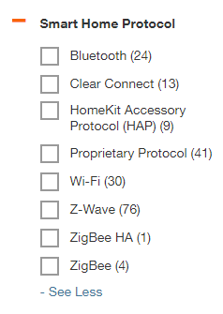
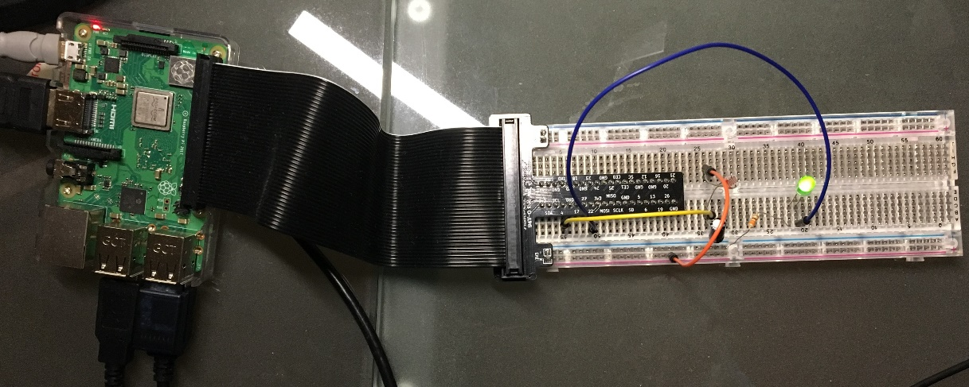
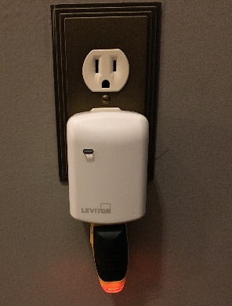
Platform Selection
Wireless Protocol
WiFi (Google Home, Amazon Alexa, other proprietary WiFi based protocols)
ZigBee
ZWave
Hardware
Raspberry Pi GPIO Accessories
5mm LED diode
Light Sensor
Z-Wave Transceiver (Raspberry GPIO Daughter Card vs. UZB1
Leviton Plug-In Outlet with Z-Wave Technology

Slide 5
Platform Selection (cont’d)
Software
Z-Way Smart Home Controller Software
Web User Interface
Z-Way Essentials: Development API
Python 2.7.13
GPIO
pandas
numpy

Slide 6
Project Stages
GPIO Breadboard and LED
Familiarization with GPIO functions and breadboard
Write and execute simple Python code to turn LED on and off
Light Sensor
Set up light sensor and capacitor and then read light sensor input
Python code for this allows user to calibrate the sensor readout for the environment
Z-Wave Setup
No project code involved
ZWay – Smart Home Controller
ZWave Controller USB Dongle
Leviton Plug-In Outlet + Outlet Tester

Slide 7
Project Stages
Leviton Plug-In Outlet Activation/Deactivation
Accomplish programmatically using an open URL request to Zway
Moving/Rolling Averages
Python pandas and numpy
Smooth out light sensor reading
Turn on/off ZWave Outlet based on light sensor reading

Slide 8
Future Work/Considerations
ZWave sensor input and GPIO output
ZWay API supports this
ZWave project testing over WiFi network
Instead of just 1 Raspberry Pi serving as both GPIO
Market options and cost for smart home solutions
~$80 for Raspberry Pi kit
~$35 for ZWave outlet
~$30 USB dongle license
May be viable interfacing/implementing custom sensors using GPIO
Increased processing power of next Raspberry Pi 4

Slide 9
Conclusion/Questions?

