Slide 1

1
Project Management Concepts
Notes:
Let the students know that this course is not only for project managers. Anyone who is involved in working on a project will benefit from this course.
Stress to them that what makes projects successful are the people involved. In order for this class to be successful they must be involved actively.
Encourage all students to participate by asking them to identify different projects in which they have been involved.
For each project ask them what the objective was, what the constraints were, what the schedule was, and what resources were used.
Ask them if they can identify any project managers in the real world. If they get stuck, give them some hints. For example, have them think about sports or music, or some other area of interest.
Ask your students to discuss something they did during the past summer or winter break, such as take a vacation, go to a concert, or watch a play.
Ask them how those activities relate to project management.
The Internet exercises in this chapter are very important. They involve having students peruse the Project Management Institute’s website. ( See Premium Deck for Slides.)
Since it was founded in 1969, the Project Management Institute (PMI) has grown to over 350,000 members in more than 170 countries.
Pennsylvania-based PMI is, by far, the leading nonprofit professional association in the area of project management. It establishes standards, sponsors seminars, develops educational programs, has a professional certification program, and publishes Project Management Journal and PM Network.
It has an excellent website for project management. The students can have some fun with this site.
Optional Supplemental Activities
Have students contact a local not-for-profit organization in your community. Tell them that they are interested in learning about their operations. Ask them to describe a project that they are currently working on. What is the objective? The constraints? The resources? The budget? The schedule? If possible, have teams contribute a few hours to the project. Through this process they will be helping someone in need and learn about a real-world project at the same time. Have each group prepare a report that summarizes the project and what they learned from this experience. Give students about three weeks for this effort
Have a project manager be a guest lecturer in class to present the benefits of project management techniques. If the project manager has had international experience, have the project manager discuss the complexity of managing an international project.

Slide 2
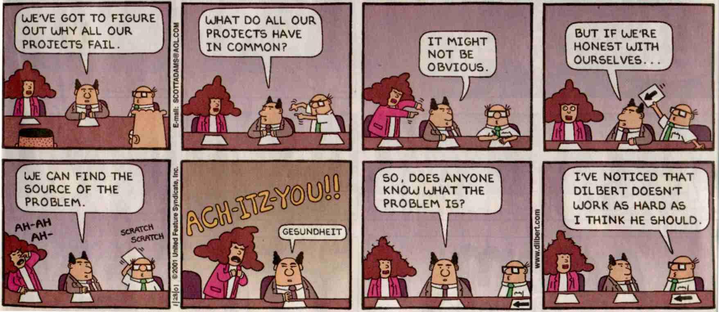

Slide 3

Chapter Concepts
Definition of a project and its attributes
Key constraints within which a project must be managed
Life cycle of a project
Definition of project management
Elements of the project management process
Implications of global project management
Project Management Institute
Benefits of project management
Notes:
Chapter Concepts
This chapter presents an overview of project management concepts. This chapter will help students to become familiar with the following concepts:
Definition of a project and its attributes
Key constraints within which a project must be managed
Life cycle of a project
Definition of project management
Elements of the project management process
Implications of global project management
Project Management Institute
Benefits of project management

Slide 4

Learning Outcomes
Define what a project is
List and discuss the attributes of a project
Explain what is meant by project objective
Define what is meant by project deliverable
Provide examples of projects
Discuss project constraints
Describe the phases of the project life cycle
Define and apply project management
Discuss the steps of the planning process
Identify the three elements of the executing process
Discuss some implications of global project management
Discuss the Project Management Institute
List benefits of project management techniques
Notes:
Learning Outcomes
After studying this chapter, students should be able to:
Define what a project is
List and discuss the attributes of a project
Explain what is meant by project objective
Define what is meant by project deliverable
Provide examples of projects
Discuss project constraints
Describe the phases of the project life cycle
Define and apply project management
Discuss the steps of the planning process
Identify the three elements of the executing process
Discuss some implications of global project management
Discuss the Project Management Institute
List benefits of project management techniques

Slide 5
Project Integration Management
Project Management Knowledge Areas from PMBOK® Guide
Notes:
Project Management Knowledge Areas from PMBOK® Guide
Concepts in this chapter support the following Project Management Knowledge Areas of the PMI Guide to the Project Management Body of Knowledge (PMBOK® Guide):
Project Integration Management

Slide 6

Feds and Contractor Share Blame for Afghan Power Plant Delays
Background
Outcomes
Initial plant costs $125 million
Similar plants cost $105 million
Scope and budget changes drove estimated cost to $260 million
Planned completion date delayed more than a year
15 Modifications and issues
Final cost ~ $300 million
Contractor had cost-plus contract
Subcontractors had fixed price contracts
The plant may not be used
  Operation costs three times similar plants
Mistakes were made
  Not pay attention to lessons learned
  Failure related to needs, resources, risks, and schedules
  Lack of critical project management components
Planners ignored local officials' alternative recommendations
Notes:
Vignette A: Feds and Contractor Share Blame for Afghan Plant Delays
The 105-megawatt, dual-fuel Tarakhil Power Plant project near Kabul has experienced many delays and cost overruns.
Initial costs were estimated at $125 million for 18 diesel generators in an existing plant.
Typical costs estimates for similar plants are $105 million, or $1 million per megawatt planned.
Scope and budget changes were estimated at $260 million, with an initial completion date of April 2009.
Modifications and issues have resulted in more delays and cost overruns.
A January 2010 report had the scheduled completion date at April 2010.
At that time, costs were nearing $300 million.
Fast tracking required turbines built in Germany and flown to site.
Outcomes:
The plant may not be used due to high costs of operation, which is three times the cost to Afghan taxpayers as similar plants.
Similar mistakes were made on this project as other projects due to not paying attention to lessons learned from the previous projects.
Planners ignored local officials' alternative recommendations.
Subcontractors had fixed price contracts and may not be fully reimbursed for costs.
The original contractor had a cost-plus contract for the project, which we will learn about later in the text. It is a kind of contract that can result in higher pay for the contractor.
The contractor failed to identify needs, examine and secure resources, manage risks, and secure a performance schedule.
Failures occurred in the critical components of planning, scheduling, organization, teamwork, communication, and leadership.

Slide 7
Causal Inferences on the Cost Overruns and Schedule Delays of Large-Scale U.S. Federal Defense and Intelligence Acquisition Programs
- Per 2008 GAO report on 95 weapon systems
- Total overruns: $295B Avg delay: 21 months
Causes for Delays
Solutions
Failures to translate customer needs into specific capabilities
Incorrect commercial products selected
Delays cost $12 million a week in personnel costs
Non-existent succession planning for new PMs
Communication with stakeholders
Mentoring of junior project personnel
Adoption and execution of project management skills and techniques
Notes:
Vignette B: Causal Inferences on the Cost Overruns and Schedule Delays of Large-Scale U.S. Federal Defense and Intelligence Acquisition Programs
Cost overruns and schedule slips have plagued large-scale U.S. federal defense and intelligence acquisition programs.
National security is impacted by delays.
Other innovative programs could be using the cost overrun funds.
In 2008, 95 weapon systems projects were overrun by $295 billion with an average delay of 21 months.
Causes:
There was improper evaluation of contractor proposals and a lack of experience translating customer needs into specific capabilities.
Incorrect commercial products were selected, resulting in a $130 million overrun.
Delays cost $12 million a week in personnel costs.
The organizations in question had non-existent succession planning that would have allow for smooth growth and to retain good personnel.
Solutions:
Better communication with stakeholders
Mentoring of junior project personnel
Adoption and execution of project management skills and techniques
These vignettes occur in every chapter and are great short stories that can get the class discussion moving forward. Each of these projects (successful or failures) should have included serious planning, scheduling, organization, teamwork, communications, and leadership—all of which will be discussed in detail in this course.

Slide 8

Project, Defined
A project is:
  an endeavor to accomplish a specific objective
  through a unique set of interrelated tasks
  and the effective utilization of resources.
5
Notes:
5
5
5
5
5
5
7
7
7

Slide 9
Project Attributes
Clear objective
Series of interdependent tasks
Various resources
Specific time frame
May be a unique, one-time endeavor
Sponsor or customer
Degree of uncertainty
Notes:
Project Attributes
A project is an endeavor to accomplish a specific objective through a unique set of interrelated tasks and the effective utilization of resources. The following attributes help define a project:
A project has a clear objective that establishes what is to be accomplished. It is the tangible end product that the project team must produce and deliver. The project objective is usually defined in terms of end product or deliverable, schedule, and budget. Furthermore, it is expected that the work scope will be accomplished in a quality manner and to the customer’s satisfaction.
A project is carried out through a series of interdependent tasks in a certain sequence in order to achieve the project objective.
A project utilizes various resources to carry out the tasks.
A project has a specific time frame, or finite life span - a start time and a date by which the objective must be accomplished.
A project may be a unique or one-time endeavor such as developing a new product, building a house, or planning a wedding.
A project has a sponsor or customer that provides the funds necessary to accomplish the project. In a business setting, the customer can be internal or external to your organization.
Finally, a project involves a degree of uncertainty and is based on certain assumptions and estimates for the project budget, schedule, and work scope.

Slide 10
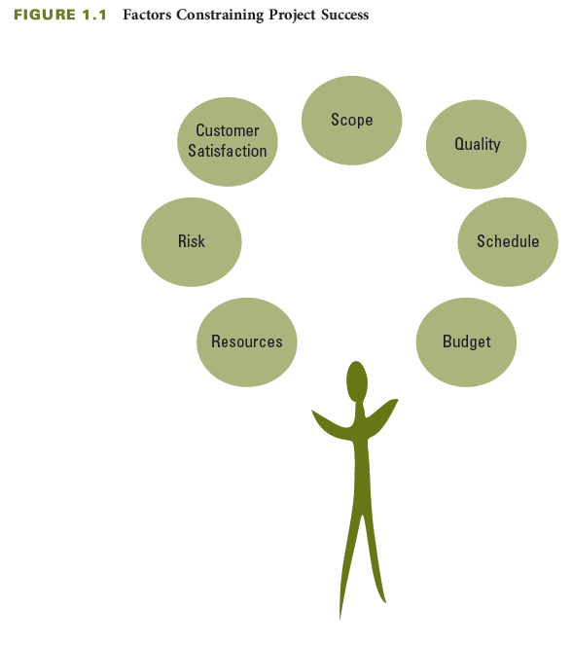
Balancing Project Constraints
Notes:
Balancing Project Constraints
The successful accomplishment of the project objective is usually constrained by many factors, including scope, quality, schedule, budget, resources, risks, and customer satisfaction.
Various resources are needed to perform the project tasks and accomplish the project objective. Resources include people, materials, equipment, facilities, and so on.
Risks adversely affect accomplishing the project objective.
Customer satisfaction goes beyond just completing the project scope within budget and on schedule or asking if the customer is satisfied at the end of the project. It means not only meeting the customer’s expectations but also developing and maintaining an excellent working relationship throughout the project.
Project scope is all the work that must be done in order to produce the project deliverables (the tangible product or items to be provided), satisfy the customer that the deliverables meet the requirements or acceptance criteria, and accomplish the project objective.
Quality expectations must be defined from the onset of the project. The project work scope must be accomplished in a quality manner and meet specifications.
The schedule for a project is the timetable that specifies when each task or activity should start and finish. The project objective usually states the time by which the project scope must be completed in terms of a specific date agreed upon by the sponsor and the organization performing the project.
The budget of a project is the amount the sponsor or customer has agreed to pay for acceptable project deliverables. The project budget is based on estimated costs associated with the quantities of various resources that will be used to perform the project.
During the project, it is sometimes challenging to balance these factors, which often constrain one another and can jeopardize accomplishing the project objective. To help assure the achievement of the project objective, it is important to develop a plan before starting the project work rather than starting without a plan. Lack of a plan decreases the chances of successfully accomplishing the full project scope within budget and on schedule.

Slide 11
Project Manager Actions
Prevent, anticipate, overcome
Have good planning and communication
Be responsible
Notes:
Project Manager Actions
The project manager must perform a number of actions throughout the duration of a project.
Prevent, anticipate, and/or overcome problems and limitations in order to complete the project scope on schedule, within budget, and to the customer’s satisfaction.
Have good planning and communication – they are essential to preventing problems from occurring and to minimize their impact.
Be responsible to make sure the customer is satisfied. This goes beyond merely completing the project within budget and on schedule. It requires ongoing communication with the customer.

Slide 12
The Project Life Cycle
Projects are “born” when a need is identified by the customer.
Project life cycles vary in length, from a few weeks to several years.
Not all projects formally go through all four phases of the project life cycle.
10
Notes:
10
10
10
10
10
10
16
16
16

Slide 13
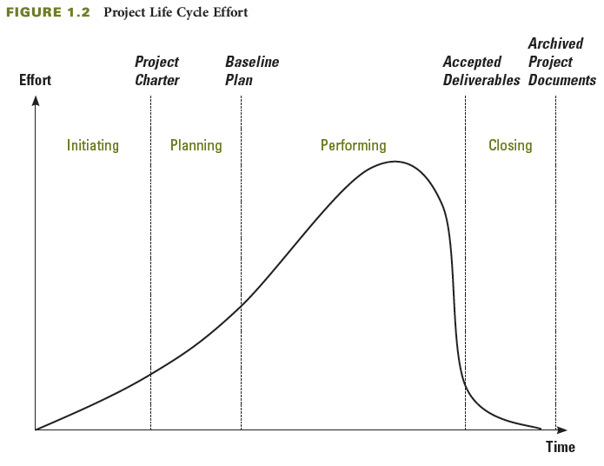
The Project Life Cycle
Notes:
The Project Life Cycle
The project life cycle has four general phases: initiating, planning, performing, and closing the project, which you can see in the figure on this slide.
The time span of each phase and the associated level of effort will vary depending on the specific project.
Project life cycles can vary in length from a few weeks to several years, depending on the content, complexity, and magnitude of the project in question.

Slide 14
Initiating Phase
Identify need, problem, or opportunity
Possibly do project selection
Develop project charter
  Rationale
  Project objective
  Expected benefits
  General requirements and conditions
Decide if RFP needed
  Proposal Evaluation
  Sign contract
Notes:
Initiating Phase
In the initiating phase, projects are identified and selected and then authorized using a document referred to as a project charter.
The first phase of the project life cycle:
Involves the identification of a need, problem, or opportunity and can result in the sponsor authorizing a project to address the identified need or solve the problem
May take several months to identify the need, gather data, and define the project objective
It is very important to define the right need. Needs are often defined as part of an organization's strategic planning process.
Organizations must have a project selection process to determine what projects to pursue
The project charter includes:
Rationale, or justification, for the project
Project objective and expected benefits
General requirements and conditions such as amount of funds authorized, required completion date, major deliverables, and required reviews and approvals; and key assumptions
If it decides to use external resources, an organization develops a request for proposals, or RFP, asking contractors to submit proposals describing how to address the need, associated costs, and schedule.

Slide 15

Planning Phase
How to accomplish scope
Plan the work and work the plan
Develop baseline plan
  What -- scope, deliverable
  How -- activities, sequence
  Who -- resources, responsibilities
  How long -- durations, schedule
  How much -- budget
  Risks
Have actual resources plan the work
Notes:
Planning Phase
The planning phase is the second phase of the project life cycle, It includes defining the project scope, identifying resources, developing a schedule and budget, and identifying risks, all of which make up the baseline plan for doing the project work.
Shows how the project scope will be accomplished within budget and on schedule
Plan the work and work the plan
The detailed plan results in a baseline plan
What needs to be done— scope, deliverable
How it will get done– activities, sequence
Who will do it– resources, responsibilities
How long it will take– durations, schedule
How much it will cost— budget
What the risks are
Benchmark the baseline plan to allow for comparison with actual progress.
Include the people that will actually do the work in the planning process.
They have knowledge of detailed activities to be done.
Participation also builds commitment.

Slide 16
Performing Phase
Accomplish project objectives
  Project manager leads
  Project team completes the project
Increase pace as more resources are added
Monitor and control progress
Take corrective action as needed
Manage and control changes with sponsor approval
Achieve customer satisfaction with acceptance of deliverable
Notes:
Performing Phase
In the performing phase, the project plan is executed and work tasks are carried out to produce all the project deliverables and to accomplish the project objective.
The project progress is monitored and controlled to assure the work remains on schedule and within budget, the scope is fully completed according to specifications, and all deliverables meet acceptance criteria.
Any changes need to be documented, approved, and may be incorporated into an updated baseline plan.
This is the third phase of the project life cycle.
The project manager leads the project team to complete the project.
The pace of the project increases as more and various resources are involved in the project.
It is necessary to monitor and control the project's progress by comparing accomplishments to the baseline plan.
Corrective actions are taken if a project is off track.
Changes are managed and controlled through documentation, approval, and communication with agreement between the sponsor and the contractor.
Some change is trivial
The end of the phase, customer satisfaction, is achieved when the work and deliverables are accepted by the customer and the project objective is accomplished.
Several alternative actions may be evaluated to determine the best approach to bring the project back within the scope, schedule, and budget constraints of the project.
Determine if any sacrifices to scope, budget, schedule, or quality are necessary to accomplish the project.
The costs of changes vary with the timing in the project– generally, the later in the project that changes are identified, the greater their effect on accomplishing the project objective.

Slide 17
Closing Phase
Collect and make final payments
Recognize and evaluate staff
Conduct post project evaluation
Document lessons learned
Archive project documents
Record lessons learned
Notes:
Closing Phase
In the closing phase, project evaluations are conducted, lessons learned are identified and documented to help improve performance on future projects, and project documents are organized and archived.
This is the final phase of the project life cycle
It includes a variety of actions such as:
Collecting and making final payments
Staff recognition and evaluation
Conducting a post project evaluation
Documenting lessons learned
Archiving project documents
Using a knowledge base to record lessons learned and post-project evaluation
A knowledge base is helpful to retrieve the lessons and information that can help with doing business with the customer or other customers in the future.

Slide 18
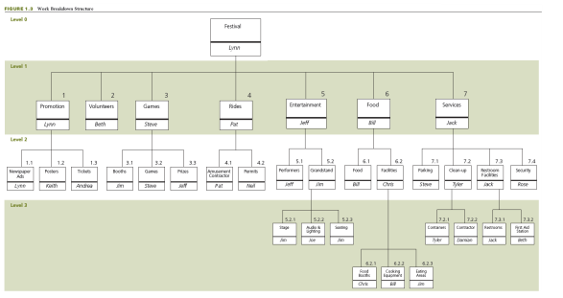
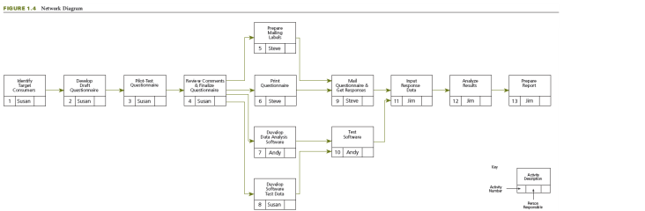
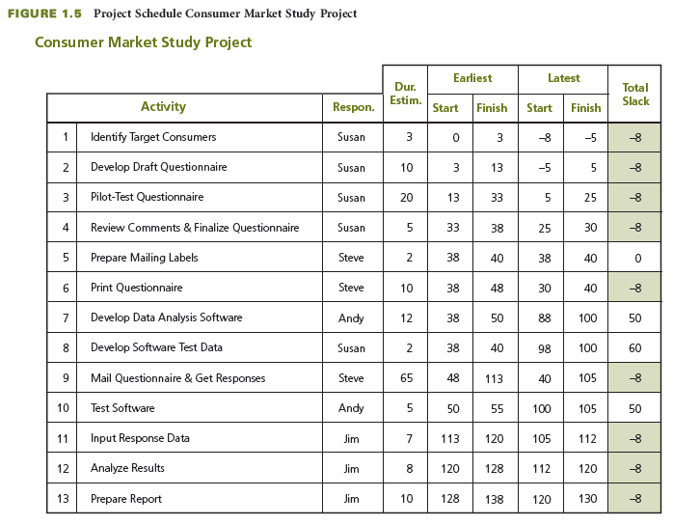
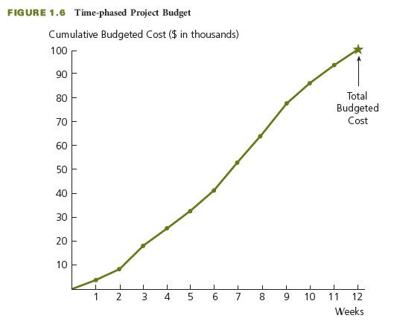
Project Planning Process
Establish project objective
Define scope
Create WBS
Assign responsibility
Define specific activities
Sequence activities
Estimate activity resources
Estimate activity durations
Develop project schedule
Estimate activity costs
Determine budget
RESULT: BASELINE PLAN
Notes:
Project Planning Process
Project management is planning, organizing, coordinating, leading, and controlling resources to accomplish the project objective. The project management process involves planning the work (establishing the plan) and then working the plan (executing that plan).
There are many steps in the project planning process, as you can see on this slide.
Establish project objective– agreed upon by sponsor and contractor
Define scope– includes customer requirements, defines major work tasks, lists deliverables and associated acceptance criteria
Create a work breakdown structure, or WBS– a hierarchical decomposition of the project scope into work elements to be executed by the project team and produce the project deliverables
Assign responsibility–the person or organization responsible for each work item is identified
Define specific activities– develop a list of detailed activities needed to perform each work package and produce any required documents
Sequence activities–create a network diagram that shows the necessary sequence and dependent relationships
Estimate activity resources–determine the types of resources needed for each activity. These may include people, materials, or equipment that are internal or external to the contractor.
Estimate activity durations– time estimates for how long each activity will take to be completed based on the estimate of resources available applied to each activity
Develop project schedule– determine the start and finish times for each activity to complete the project by its required completion date
Estimate activity costs– use the appropriate labor cost or unit cost rate for each type of resource to determine the cost of each activity
Determine budget– aggregate the costs associated with each activity and each work package and add indirect costs and profits to determine the costs of completing the project. Allocate the costs over time to determine the time-phased budget.

Slide 19
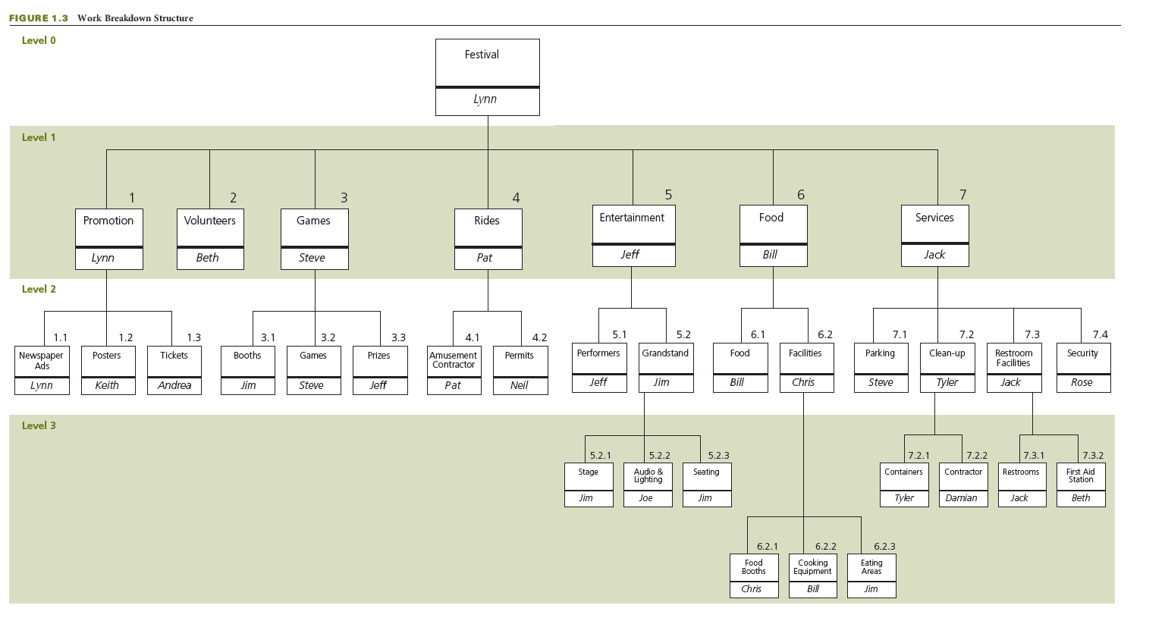
Create WBS and Assign Responsibility
Notes:
Create WBS and Assign Responsibility
A work breakdown structure, or WBS, is a hierarchical decomposition of the project scope into work elements to be executed by the project team and produce the project deliverables.
You can see a WBS in this slide.
Assigning responsibility involves determining who will be the person or organization responsible for each work item in the WBS.

Slide 20
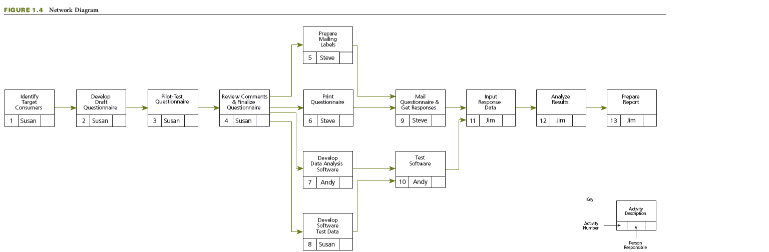
Sequence Activities
Notes:
Sequence Activities
The figure on this slide shows a network diagram that reveals the sequence of activities for a project.
Sequencing activities involves creating a network diagram that shows the necessary sequence and dependent relationships in a project.

Slide 21
Develop the Project Schedule
Notes:
Develop the Project Schedule
This table shows the project schedule for a consumer market study project.
Developing project schedule involves determining the start and finish times for each activity in order to complete the project by its required completion date.

Slide 22
Determine Budget
Notes:
Determine Budget
Here we see a time-phased project budget.
Determining the budget involves aggregating all the costs associated with each activity and each work package and adding indirect costs and profits to determine the costs of completing the project.
Allocate the costs over time to determine the time-phased project budget.

Slide 23
Execute the Project Plan
Perform the work
Monitor and control progress
Control changes
Notes:
Execute the Project Plan
Once a baseline plan has been established, the plan must be executed. The executing process involves performing the work according to the plan, monitoring and controlling the work, and controlling for changes so that the project scope is achieved within the budget and schedule, to the customer’s satisfaction.
Perform the work— all activities are performed to produce the deliverables and meet their acceptance criteria with regular communication with stakeholders and the customers
Monitor and control progress– regularly monitor the project to see if progress is going according to plan, measure the actual progress, and take corrective action if activities are behind schedule
Control changes— change to the work activities and to the project scope will occur for a variety of reasons. Changes need to be agreed upon by the sponsor and the contractor.

Slide 24
Global Project Management
Globalization
Helpful Competencies
Adds a dimension of complexity
Changes project dynamics
Requires awareness of factors
  Cultural differences
  Currency
  Codes and regulations
  Business organization
  Political relations
  Workforce availability
Foreign language skills
Knowledge of
  Cultures
  Geography
  World history and contemporary events
  International economics
Awareness of
  Customs and etiquette
  Geopolitical environment
Technology adoption and translation software
Notes:
Global Project Management
Globalization adds a unique dimension to managing projects.
It changes the dynamics of the project and adds a layer of complexity that can adversely affect the project outcome if the project participants are not aware of what they might encounter regarding cultural differences and multinational economic transactions.
Different factors can create a dynamic, and even unstable environment, over the life of a project and include:
Cultural differences
Currency fluctuations and exchange rates
Country-specific work codes and regulations, such as hours per day, holidays, and religious observances
Corporate joint ventures and partnerships create entities with a presence and facilities in multiple countries and can make international business more complication
Political relations between countries
Availability of high-demand workforce skills
Some competencies can be helpful, even required, for global project management success:
Foreign language skills
Knowledge and understanding of other countries and cultures, geography, world history and contemporary events, and international economics
Awareness and understanding of cultures, customs, and etiquette and of the geopolitical environment are also very important to international project success.
Finally, technology adoption to international environments and use of good language translation software is also very important for international project management.

Slide 25
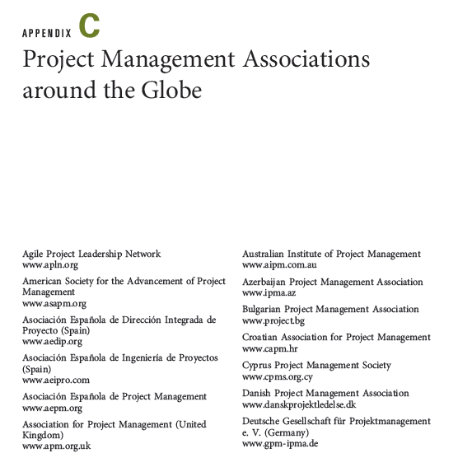
Project Management Associations
Project Management Institute
Global Associations
Worldwide not-for-profit association of practitioners
  350,000 members in >170 countries
  250 chapters in >70 countries
Online communities for collaboration
PMBOK® Guide
PMI Code of Ethics and Professional Conduct
Certifications
www.pmi.org
Links available at www.cengagebrain.com
Notes:
Project Management Associations
The Project Management Institute (PMI) is a premier worldwide not-for-profit association for practitioners in the project management profession and individuals who want to learn more about the profession.
Founded in 1969, PMI has approximately 350,000 members in more than 170 countries and about 250 chapters in over 70 countries
Has a number of online communities where peers can collaborate on specific topics of interest
Publishes A Guide to the Project Management Body of Knowledge (PMBOK® Guide), which provides a framework of processes and guidelines for the application of project management concepts, practices, and techniques
Created the PMI Code of Ethics and Professional Conduct, which sets standards and establishes expectations for professional behavior
Offers a certification program that provides the opportunity to earn credentials in various project management disciplines
Additional and current information about the Project Management Institute can be found at http://www.pmi.org.
Many other project management associations exist around the globe.
Appendix C provides a list of approximately 60 such associations.
Website addresses can be found on this book’s student companion website, www.cengagebrain.com,and the link found through a search for the ISBN of Successful Project Management 5e (from the back cover of your book) using the search box at the top of the page.

Slide 26
Critical Success Factors
Planning and communication are critical to successful project management. They prevent problems from occurring or minimize their impact on the achievement of the project objective when they do occur.
Taking the time to develop a well thought-out plan before the start of the project is critical to the successful accomplishment of any project.
A project must have a clear objective of what is to be accomplished and defined in terms of end product or deliverable, schedule, and budget; and is agreed upon by the customer.
Involve the sponsor or customer as a partner in the successful outcome of the project through active participation during the project.
Achieving customer satisfaction requires ongoing communication with the customer to keep the customer informed and to determine whether expectations have changed.
The key to effective project control is measuring actual progress and comparing it to planned progress on a timely and regular basis and taking any needed corrective action immediately.
After the conclusion of a project, the project performance should be evaluated to learn what could be improved if a similar project were to be undertaken in the future. Feedback should be obtained from the sponsor or customer and the project team.
Learning and understanding the culture and customs of other project participants will demonstrate respect, help build trust, and aid in developing an effective project team; and it is critical for successful global project management.
Notes:
Critical Success Factors
Planning and communication are critical to successful project management. They prevent problems from occurring or minimize their impact on the achievement of the project objective when they do occur.
Taking the time to develop a well thought-out plan before the start of the project is critical to the successful accomplishment of any project.
A project must have a clear objective of what is to be accomplished and defined in terms of end product or deliverable, schedule, and budget, and agreed upon by the customer.
Involve the sponsor or customer as a partner in the successful outcome of the project through active participation during the project.
Achieving customer satisfaction requires ongoing communication with the customer to keep the customer informed and to determine whether expectations have changed.
The key to effective project control is measuring actual progress and comparing it to planned progress on a timely and regular basis and taking any needed corrective action immediately.
After the conclusion of a project, the project performance should be evaluated to learn what could be improved if a similar project were to be done in the future. Feedback should be obtained from the sponsor or customer and the project team.
Learning and understanding the culture and customs of other project participants will demonstrate respect, help build trust, and aid in developing an effective project team; and it is critical for successful global project management.

Slide 27
Summary
A project is an endeavor to accomplish a specific objective through a unique set of interrelated tasks and the effective utilization of resources.
The successful accomplishment of the project objective could be constrained by many factors, including scope, quality, schedule, budget, resources, risks, and customer satisfaction.
The project life cycle has four phases: initiating, planning, performing, and closing the project.
Project management is planning, organizing, coordinating, leading, and controlling resources to accomplish the project objective. The project management process involves two major functions: first establishing a plan and then executing that plan to accomplish the project objective.
Globalization changes the dynamics of a project and adds a layer of complexity that can adversely affect the project outcome if the project participants are not aware of what they can encounter regarding cultural differences and multinational economic transactions.
The Project Management Institute is a premier worldwide not-for-profit association for practitioners in the project management profession.
The ultimate benefit of implementing project management techniques is having a satisfied customer—whether you are the customer of your own project or a business (contractor) being paid by a customer to perform a project.
Notes:
Summary
A project is an endeavor to accomplish a specific objective through a unique set of interrelated tasks and the effective utilization of resources.
The successful accomplishment of the project objective could be constrained by many factors, including scope, quality, schedule, budget, resources, risks, and customer satisfaction.
The project life cycle has four phases: initiating, planning, performing, and closing the project.
Project management is planning, organizing, coordinating, leading, and controlling resources to accomplish the project objective. The project management process involves two major functions: first establishing a plan and then executing that plan to accomplish the project objective.
Globalization changes the dynamics of a project and adds a layer of complexity that can adversely affect the project outcome if the project participants are not aware of what they can encounter regarding cultural differences and multinational economic transactions.
The Project Management Institute is a premier worldwide not-for-profit association for practitioners in the project management profession.
The ultimate benefit of implementing project management techniques is having a satisfied customer— whether you are the customer of your own project or a business (contractor) being paid by a customer to perform a project.

Slide 28
Benefits of Project Management
Satisfied customers
Additional business
Expansion of career opportunities
Satisfaction of being on a winning team
Improved knowledge and skills
When projects are successful, everybody WINS
20
Notes:
19
19
19
19
19
19
28
28
28

Slide 29
Dice.com
Monster.com

