Slide 1

12
Project Communication and Documentation
Notes:
Teaching Strategies
The two vignettes in this chapter reinforce the skills necessary for communicating with their project team and with stakeholders. (See Premium Deck for Slides.)
The first vignette contains suggestions from project managers on how to interact with their team.
The second vignette describes how project managers handle communications when the project is performed away from the office and out of the direct site of the management team for the organization.
Meeting time can be a notable expense.
Have students:
Calculate the cost per hour of members of a project team meeting
Identify the problems of the meeting starting late
Describe techniques to have meetings start on time
Watch videos on YouTube or another media source
Comment on presentation style and visual aids used. Ask them to think about how the presentations could be improved.
Evaluate online reports for progress updates and final project reports.
Optional Supplemental Activities
Have students read the real-world vignettes and discuss the communication strategies presented.
Assign each student to write a one-page description naming someone they think is an effective communicator. They should give the reasons why they feel this is true. Have them also write a one page description (no names) of someone they feel is a poor communicator along with the reasons why they feel this is the case.
Have students read the chapter and answer all of the Reinforce Your Learning questions and the questions at the end of the chapter. (See Premium Deck for Slides.)
Have students watch a video of a meeting and then evaluate the presentations and the meeting progress.
Have students use the meeting evaluation form and suggest ways to improve the meeting.
Have them discuss ways that they can avoid the same problems as in the meeting and have them comment on the positive aspects of the meeting.

Slide 2

Chapter Concepts
Suggestions for enhancing personal communication, such as face-to-face discussions and written communications
Effective listening
Various types of project meetings and suggestions for effective meetings
Formal project presentations and suggestions for effective presentations
Project reports and suggestions for preparing useful reports
A project communication plan
Tracking changes to project documents
Collaborative communication tools
Notes:
Chapter Concepts
This chapter discusses an element vital to the effective performance of a project: communication.
Communication takes place between the project team and the customer or sponsor, among the project team members, and between the project team and its organization’s upper management.
Communication may involve two people or a group of people.
It can be verbal or written.
It can be face-to-face or involve some medium, such as telephones, voice mail, e-mail, text messages, letters, memos, videoconferencing, or groupware.
It can be formal, such as a report or a presentation at a meeting, or informal, such as a hallway conversation or a text message.
This chapter covers various types of communication used during the project.
Based on the information contained in this chapter, students will become familiar with:
Suggestions for enhancing personal communication, such as face-to-face discussions and written communications
Effective listening
Various types of project meetings and suggestions for effective meetings
Formal project presentations and suggestions for effective presentations
Project reports and suggestions for preparing useful reports
A project communication plan
Tracking changes to project documents
Collaborative communication tools

Slide 3
Learning Outcomes
Discuss and apply techniques to enhance personal verbal and written communication
Describe four barriers to effective listening and apply techniques to improve listening and understanding
Prepare for and facilitate effective project meetings
Prepare for and make informative and interesting presentations
Prepare useful, readable, and understandable reports
Explain how to track changes to project documents
Create a project communication plan
Describe collaborative tools used to enhance communication on projects
Notes:
Learning Outcomes
After studying this chapter, students should be able to:
Discuss and apply techniques to enhance personal verbal and written communication
Describe four barriers to effective listening and apply techniques to improve listening and understanding
Prepare for and facilitate effective project meetings
Prepare for and make informative and interesting presentations
Prepare useful, readable, and understandable reports
Explain how to track changes to project documents
Create a project communication plan
Describe collaborative tools used to enhance communication on projects

Slide 4
Project Communications Management
Project Integration Management
Project Human Resource Management
Project Management Knowledge Areas from PMBOK® Guide
Notes:
Project Management Knowledge Areas from PMBOK® Guide
Concepts in this chapter support the following Project Management Knowledge Areas of the PMI Guide to the Project Management Body of Knowledge (PMBOK® Guide):
Project Communications Management
Project Integration Management
Project Human Resource Management

Slide 5

All Ears
Recommendations from Project Managers
  Talk and listen to the project team
  Build trust by listening and sharing thought processes
  Use active listening techniques to listen and absorb
  Elicit responses from all team members
  Ask direct question that seek team member input
  Keep the discussion on a productive track
Build your team and gather their input. Be all ears for your project team members!
Notes:
Vignette A: All Ears
There are a number of common factors between successful project managers.
Much of successful project management is about talking and listening to the project team.
Project managers have to find a way to take into consideration all the opinions of the project team, including their own, to determine a solution to the project.
“When we hit a roadblock, the project manager doesn’t come in and tell everyone what to do. He talks to everyone and pools their ideas for going forward. Once you develop that kind of dynamic, it becomes habit and the team will expect this kind of participation." Says Kris Arvind, PMP, managing director for the Asia Pacific region of management consultancy CGN.
Project managers build trust with their team by listening and sharing thought processes.
“As you work with people, you find that the key to facilitating and guiding communication is keeping your eye on the deliverable." “You have to be very open with everybody all the time. The minute you don’t have time to talk to your team is the minute your project will fail.” Says Tom Nieukirk, director of knowledge management at CGN’s Peoria, Illinois, office
Use active listening techniques to listen and absorb what the team members are saying.
“People on my team know I’m not an expert in every area, and I give them a lot of room to express themselves and share their own experiences." Giora Lavy, PMP, quality director for Amdocs in Israel
The project manager must learn how to elicit responses from all team members.
“As a project manager, it takes a while to learn the different styles of people on your team and what works effectively to draw them out." Kathy Bromead, PMP, of the State of North Carolina’s enterprise project management office in Raleigh, North Carolina
Informal opportunities to communicate with quiet team members might be the best time to get them to respond. Asking them a direct question that seeks their input on an aspect of the project encourages their response.
“On a large team it can help to use an informal means of gathering information, such as going out for coffee or lunch. This gives the team member some confidence that they might not have in front of a large group of people.” Carlos Urrea, PMP, of Proyekta“
The project manager must work to keep the discussion on a productive track.
"Organizations are not democracies. We still have a hierarchy to answer to, and the project manager ultimately has to make decisions based on a chain of command and other circumstances.” Kris Arvind, PMP, managing director for the Asia Pacific region of management consultancy CGN
Build your team and gather their input. Be all ears for your project team members!

Slide 6

Out of Office
Communication Plans
Conclusions
Marsh in Qatar
  Manage consistent message
  Single point of contact
  Technology use plan
Jahnke and Dispersed Team
  Weekly internal report of progress
  Direct communication with team member managers
Not every project is completed in the office
Managing the communication plan is as important as having a good communication plan for project success!
Notes:
Vignette B: Out of Office
Projects do not always occur in the office. Sometimes, the project manager is required to be onsite, which can be located thousands of miles away from the home office. Being out of the office requires a communication plan that keeps the project manager in touch with upper management, team members, and the client. This vignette discusses examples of communication plans.
An example of a project in a foreign country
Joss Marsh worked as a management consultant for Sovereign Business International, an IT consulting firm based in London, England. Marsh was assigned as project manager to lead several projects for the International Bank of Qatar.
He developed a process for managing a consistent message by being the single point of contact for communications from the client to the head office and from management to the client.
“I talk to one person at headquarters about everything, and likewise any management communication from headquarters to the customer comes through me first. That has been really important for managing the customer account and the overall project.”
Marsh and his team made extensive use of e-mail and had their own backup and storage in Qatar to manage the technology glitches and loss of data through instant communication tools.
An example of a project involving a dispersed team
Karen Jahnke, of PMP, delivered a major IT and operational process implementation for Rockwell Automation.
Triumvirate was headquartered in Dallas, Texas, with Jahnke’s direct manager in Boston, Massachusetts. Rockwell Automation’s global headquarters was in Milwaukee, Wisconsin. The two decision makers for the project were in Cleveland, Ohio, and Argentina. Jahnke’s communication plan helped to overcome the difficulties presented by multiple time zones and geographical barriers.
Each week, Jahnke created an internal report card of the project’s progress to share with management.
Jahnke sent e-mails directly to a team member’s functional manager to acknowledge the team member’s efforts to make sure that others knew about their accomplishments.
“An effective component of a project communication plan is continually bringing forward the business value delivered.”
While these are two very different cases, we can draw a couple of conclusions from them
Not every project is completed in the office with a closely-connected team.
Managing the communication plan is as important as having a good communication plan for project success!

Slide 7
Personal Communication
Written Communication
Verbal Communication
  Effective Listening
Notes:
Personal Communication
Effective and frequent personal communication is crucial to keep the project moving, identify potential problems, solicit suggestions for improving project performance, keep abreast of whether the customer is satisfied, and avoid surprises.
Personal communication can occur a number of different ways:
Through nonverbal behavior, such as body language
Face-to-face or through some medium like telephone, voice mail, e-mail, texting, letters, memos, videoconferencing, or groupware
It can be verbal or written
When verbal, it requires effective listening skills in order to interpret the message properly

Slide 8
Verbal Communication
How it takes place
  Face-to-face, via telephone, voicemail, videoconferencing
What provides
  Discussion, clarification, understanding, immediate feedback
Elements affecting communication
  Body language
  Cultural differences
When to use
  Early in project, especially face-to-face
  Provide timely communications
Notes:
Verbal Communication
Verbal communication can take place face-to-face, via telephone, voicemail, or videoconferencing.
Verbal communication provides a forum for discussion, clarification, understanding, and immediate feedback.
Body language (in face-to-face communications) and tone (inflection and emotion of the voice) are important elements that enrich verbal communication.
Body language can be used not only by the person talking, but also by the listener, as a way of providing feedback to the person talking.
Positive body language can include direct eye contact, a smile, hand gestures, leaning forward, and nodding acknowledgment or agreement.
Negative body language can be a frown, crossed arms, slouching, fidgeting, gazing or looking away, doodling, or yawning.
When communicating with individuals from other cultures or countries, you need to be aware of their customs regarding greetings, gestures, eye contact, and proper protocol.
When communicating verbally, a person must be careful not to use remarks, words, or phrases that can be construed to be sexist, racist, prejudicial, or offensive.
A high degree of face-to-face communication is especially important early in a project to foster team building, develop good working relationships, and establish mutual expectations.
Project team members need to be proactive in initiating timely communication with other team members and the project manager to get and give information.
Verbal communication should be straightforward and unambiguous.
The timing of verbal communication is very important.

Slide 9
Written Communication
How it takes place
  Through e-mail or can be sent hardcopy
What it provides
  Information, confirmation, requests
Elements affecting communication
  Length and word choice important
  Media selected – electronic or hard copy
When to use
  When impractical to meet
  Disseminate information in a timely manner
Notes:
Written Communication
Written communication is generally carried out through internal correspondence to or among the project team and external correspondence to the customer or others external to the firm, such as subcontractors.
Written correspondence is increasingly transmitted through e-mail, but can also be sent as a hardcopy.
Formal project documents that require signatures, such as contracts and amendments, are usually sent as hardcopies.
Memos and letters are ways to efficiently communicate with a group of people when it is impractical to have a meeting or when the information needs to be disseminated in a timely manner.
Written communication should be used only when necessary.
Project participants are usually very busy and do not have time to read trivial messages or irrelevant documents containing information that could be communicated verbally at the next project meeting.
An e-mail may be appropriate as a follow-up to a face-to-face conversation or a phone call confirming decisions or actions, rather than relying on a person’s memory.
Written communication should be used mostly to inform, confirm, and request information.
Memos and letters should be clear and concise and should not include lengthy dissertations or voluminous extraneous attachments.
Project managers want to avoid a perception of being flooded with emails or electronic messages, which is more of a hindrance than a help.
Work related e-mail should not include emoticons or text message abbreviations. It is considered unprofessional, and not all recipients may understand the abbreviations or may misinterpret them. KWIM :-)

Slide 10
Effective Listening
Heart of Communication: Understanding
Barriers to Effective Listening
How Improve Listening Skills
Pretending to listen
Distractions
Bias and closed-mindedness
Impatience
Jumping to conclusions
Focus on the person talking
Engage in active listening
  provide verbal and nonverbal feedback
Ask questions
Do not interrupt
Most people do not listen with the intent to understand; they listen with the intent to reply.
Stephen R. Covey
Notes:
Effective Listening
The heart of communication is not words, but understanding. The source of the communication wants to be understood, and the receiver needs to understand.
Half of making communication effective is listening.
Here are some common barriers to effective listening:
Only pretending to listen
Distractions
Bias and closed-mindedness
Impatience
Jumping to conclusions
Listening involves a lot more than just letting the other person talk. It must be an active process.
Here are some suggestions for improving listening skills:
Focus on the person talking
Engage in active listening—provide verbal and nonverbal feedback.
Ask questions
Do not interrupt
Good listening skills are important if project team members are to be effective in communicating with one another and with the customer.

Slide 11

Meetings
Most common types
  Project kickoff meeting (Chap 11)
  Status review meetings
  Problem-solving meetings
  Design review meetings
  Post-project evaluation meeting (Chap 9)
Notes:
Types of Project Meetings
Projects require a number of different types of meetings. We will discuss all of them in upcoming slides. The most common types of project meetings are:
Project kickoff meeting
Status review meetings
Problem-solving meetings
Design review meetings
Post-project evaluation meeting

Slide 12
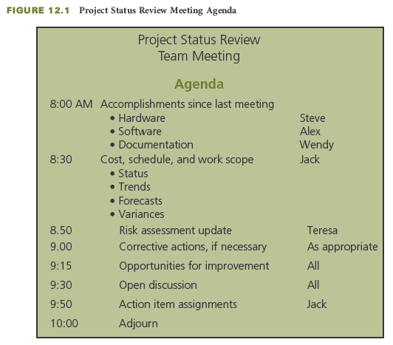
Status Review Meetings
Purpose
  Inform
  Identify problems
  Identify action items
Frequency
  Regularly scheduled
Notes:
Status Review Meetings
A project status review meeting is usually called and led by the project manager.
The primary purposes are to inform, to identify problems, and to identify action items.
Project status meetings should be held on a regularly scheduled basis.
You can see a sample agenda for a project status review meeting on this slide.
As you may note, there are many possible subjects to be discussed under each of the agenda items:
Accomplishments since last meeting: Key project milestones that were reached.
Cost, schedule, and work scope—status: Performance should be compared to the baseline plan.
Cost, schedule, and work scope—trends: Any positive or negative trends in project performance should be identified.
Cost, schedule, and work scope—forecasts: The forecasted project completion date and forecasted cost at completion should be reviewed and compared to the project objective and the baseline plan.
Cost, schedule, and work scope—variances: Any differences should be identified between actual progress and planned progress with respect to cost and schedule for project work packages and tasks. These variances can be positive or negative.
Risk assessment update: Particular attention should be given to reviewing the trigger points for each risk to determine if any risk response plans are on the verge of having to be implemented.
Corrective actions: Corrective actions to address problems and potential problems might take place right at the status review meeting.
Opportunities for improvement: These should also be identified, along with problem areas and associated corrective actions.
Action item assignment: Specific action items should be identified and assigned to specific team members.

Slide 13
Problem-Solving Meetings
Purpose
  Address problems that have been identified
Frequency
  When a potential problem is identified
Follow problem solving approach
  Develop a problem statement
  Identify potential causes of the problem
  Gather data and verify the most likely causes
  Identify possible solutions
  Evaluate the alternative solutions
  Determine the best solution
  Revise the project plan
  Implement the solution
  Determine whether the problem has been solved
Notes:
Problem-Solving Meetings
When a problem or potential problem is identified by an individual project team member, that person should promptly call a problem-solving meeting with other appropriate individuals
He or she should not wait for a future status review meeting.
Problem-solving meetings should follow a good problem-solving approach, such as the following:
Develop a problem statement
Identify potential causes of the problem
Gather data and verify the most likely causes of the problem
Identify possible solutions
Evaluate the alternative solutions
Determine the best solution
Revise the project plan
Implement the solution
Determine whether the problem has been solved

Slide 14
Design Review Meetings
Purpose
  Review design plans
  Confirm customer approval
Types of Design Reviews
  Preliminary design review
    Get agreement to approach
  Final design review
    Gain approval before build, assemble, produce, etc.
Not every project has design review
Required to ensure customer approval
Notes:
Design Review Meetings
Projects that involve a design phase, such as an information system project, may require one or more technical design review meetings to ensure that the customer agrees with and approves the design.
Not every project requires a design review.
Design review meetings are required to ensure customer approval.
In many projects there are two types of design review meetings:
A preliminary design review meeting occurs when the contractor has completed the initial conceptual specifications, drawings, or flowcharts.
The purpose of this preliminary design review meeting is to get the customer’s agreement.
A final design review meeting happens when the contractor has completed the detailed specifications, drawings, screen and report formats.
The purpose of this final design review meeting is to gain approval from the customer.

Slide 15
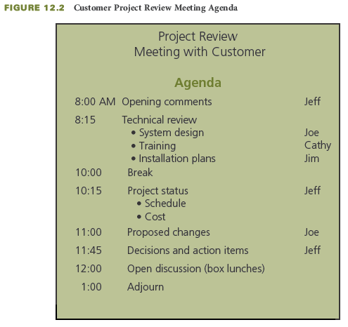
Before the Meeting
Necessary?
Purpose?
Participants?
Distribute agenda
Prepare materials
Notes:
Before the Meeting
The project manager should ask him or herself a series of questions before deciding to hold a meeting.
Is the meeting necessary?
What is the purpose?
Who are the participants going to be?
After deciding to hold a meeting, managers need to distribute the meeting’s agenda and prepare all the necessary materials.

Slide 16
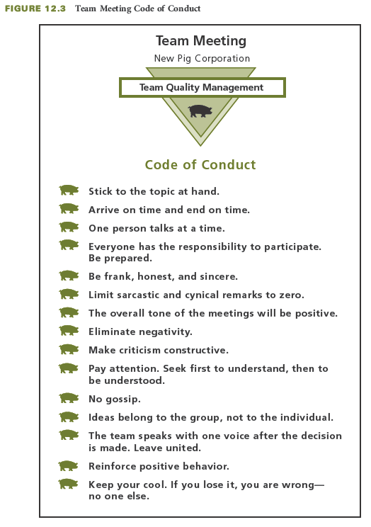
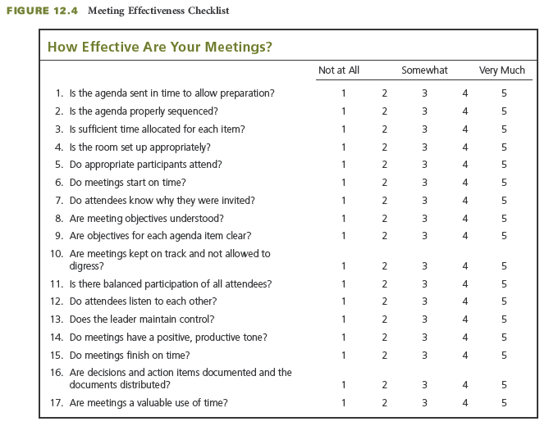
During the Meeting
Start on time
Designate note taker
Reduce distractions
Review purpose
Facilitate discussion
Summarize
Evaluate process
Notes:
During the Meeting
Once a manager calls the meeting, he or she needs to take some steps to make sure that the meeting goes smoothly.
It is important to start the meeting on time.
Designate a note-taker.
Reduce the likelihood for distractions by asking all participants to turn off their cell phones, iPods, and other electronic communication devices.
Review the purpose of the meeting and the agenda.
Facilitate—don’t dominate—the discussion.
Keep the meeting moving and within the scheduled time frame.
Encourage participation.
Limit discussion by participants.
Control interruptions.
Clarify points that are made.
A the end of the meeting, summarize the discussion and the meeting results.
Evaluate the meeting process.
The top figure on this slide depicts the expected code of conduct for a team meeting.
The bottom figure illustrates a checklist for rating the effectiveness of a meeting.

Slide 17
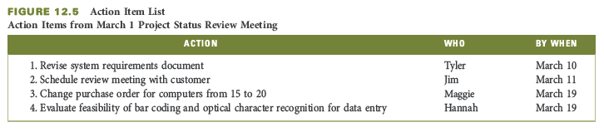
After the Meeting
Publish minutes
Summarize to one page if possible
Confirm decisions
List action items
Notes:
After the Meeting
The manager’s work is not done once the meeting has been held. There are a few follow-up steps that are very important.
Publish the meeting minutes within 24 hours while the discussion is still fresh in everyone’s minds.
Provide a summary document, which should be concise and kept to one page if possible.
The document should confirm decisions that were made and list the action items, including who is responsible, the estimated completion date, and expected deliverables.
The figure on this slide depicts the action items from a meeting.

Slide 18
Presentations
Prepare
Deliver
What is the purpose?
Know the audience
Make outline
Use clear language
Prepare notes and materials
Practice, practice, practice
Copy handouts
Request audiovisuals
Visit meeting room
Expect nervousness
Remove distractions
Memorize opening lines
Use 3-T approach
Present professionally
Summarize points
Memorize closing lines
Interact with audience when appropriate
Notes:
Presentations
Often the project manager or members of the project team are called on to give a formal presentation. The audience may be representatives of the customer’s organization, the project organization’s upper management, or the project team itself.
There are many steps that go into preparing for a presentation.
Determine the purpose of the presentation. Is it to inform or to persuade?
Know the audience. What is their level of knowledge or familiarity with the subject?
Make an outline of the presentation.
Use clear language that the audience will understand.
Prepare notes or a final outline that you can refer to during your presentation.
Prepare visual aids and test them.
Make sure the visual aids are readable from the most distant seat in the room where the presentation will be given. They should be simple and not too busy.
Practice, practice, practice.
Make copies of handout materials.
Request the audiovisual equipment well in advance.
Go into the meeting room when it is not in use and get a feel for your surroundings.
This slide also lists some tips for delivering presentations
Expect a bit of nervousness; all speakers experience it.
Turn off your cell phone and other distractions and ask the audience to do the same.
Memorize the first two or three sentences of your presentation.
Use the 3-T approach in your presentation:
Tell them what you are going to tell them (your outline)
Tell them (the body of your presentation)
Tell them what you told them (your summary)
Be professional
Talk to the audience, not at it.
Speak clearly and confidently.
Use appropriate gestures to help make a point.
Do not read the slides. Elaborate on the ideas illustrated on the slides.
Do not stand in front of your visual aids.
Build interest in your presentation.
Keep to the key points in your outline and explain to the audience why they are important.
Sum up your points on a particular item before moving on to the next item on your outline.
Know your closing lines.
Allow time for interaction with the audience, if appropriate.
When responding to questions, be sincere, candid, and confident.

Slide 19
Reports
Progress Reports
Final Report
Not an activity report
Covers a specific period, the reporting period
Might include
  Accomplishments
  Current status
  Progress toward resolution of problems
  Problems or potential problems and corrective actions
  Milestones for next period
Should not be a surprise
Summary of the project
Might include
  Original need, objective, requirements
  Description
  Degree met
  Actual benefits
  Future considerations
  Deliverables
  Test data from the final-acceptance testing
Notes:
1. Progress Reports
It is important to keep in mind that a progress report is not an activity report.
Do not confuse activity or busyness with progress and accomplishment.
Progress reports usually cover a specified period, called the reporting period.
This period could be a week, a month, a quarter, or whatever best fits the project.
A project progress report might include the following:
Accomplishments since prior report
Current status of project performance
Progress toward resolution of previously identified problems
Problems or potential problems since prior report
Planned corrective actions
Milestones expected to be reached during next reporting period.
None of the information in the progress report should be a surprise.
The project final report is usually a summary of the project.
It is not an accumulation of the progress reports, nor is it a blow-by-blow story of what happened throughout the project.
The final report might include the following:
Customer’s original need, original project objective, or the customer’s original requirements
Description of the project
Degree to which the original project objective was met
Actual versus anticipated benefits to the customer as a result of the project
Future considerations.
A list of all deliverables provided to the customer
Test data from the final-acceptance testing

Slide 20
Preparing Useful Reports
Make your reports concise.
Make reports readable and understandable.
  That means simple, not slang!
Put the most important points first.
Use graphics where possible.
Pay as much attention to the format of the report as to the content.

Slide 21
Track Document Changes
Revisions
  From customer or team
  Approval by customer and team
Latest version
Distribution plan
Revision summary
REV. 4. 12/29/11, ES
Notes:
Track Document Changes
In addition to project reports, many other documents may be created by either the project team or the customer during the project. All of these documents will likely be subject to revisions as the project progresses.
Revisions to project documents can result from changes initiated by the customer or by the project team.
Some changes are trivial; others are major— affecting the project work scope, cost, and schedule.
Project team members should be careful about casually agreeing to changes without knowing whether they will necessitate additional person-hours.
Throughout a project, various project documents will be revised to incorporate changes.
It is important for the project team to know which document is the latest version of a document, so that they can perform their work correctly based on the most current information and documentation.
It is good practice to put on each page of each type of document:
The date of the latest revision,
A sequential revision number
The initials of the person who made the changes
For example, a notation in the lower right corner of a floor plan for an office arrangement may indicate Rev. 4, 12/29/11, ES
This means that the latest version of the floor plan is Revision number 4, and was made on December 29, 2011, by Elisabeth Smith (ES).
Just as important as keeping up to date with revision numbers and dates on documents is timely distribution of updated documents with a summary of the revisions.

Slide 22
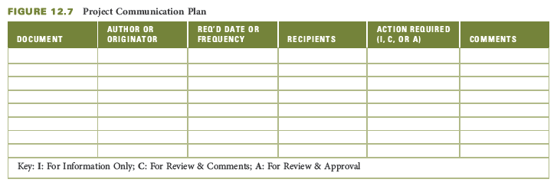
Project Communication Plan
Possible Elements
Template
Documents
Author or originator
Required date or frequency for document completion and distribution
Recipients for documents in distribution list
Actions required
Comments related to each document
Notes:
Project Communication Plan
A project communication plan defines the generation and distribution of project documents among project stakeholders throughout the project.
It identifies the various documents, who is responsible for creating each document, by when or how frequently the document must be distributed, to whom each document is to be distributed, and what action each recipient is expected to take.
The project charter, or contract, often includes sponsor or customer requirements for specific documents, including frequency, the need for customer approvals, and who in the customer organization should receive copies of which documents.
For any external resources that are used on the project, such as subcontractors, consultants, or vendors, the project organization will define requirements regarding documentation, approvals required, and distribution and include such requirements in subcontracts or purchase orders.
The figure on this slide depicts a generic template for a project communication plan. Each row in the matrix would include information related to a specific project document.
There are a number of possible elements to a communication plan:
Documents
Author or originator (the person responsible for creating the documents)
Required date or frequency for document completion and distribution
Recipients for documents in the distribution list
Actions required
Comments related to each document
The project communication plan needs to be updated as stakeholders or their information needs change, or if new people or new documents are identified.

Slide 23
Collaborative Communication Tools
Why Use?
Collaboration tools
Face-to-face not always feasible
Dispersed teams
Involve others in decision making
Document management
Dedicated storage space
Share documents and data
Email
Teleconferencing and videoconferencing
Groupware
Document and content management systems
Extranets
Collaborative project workspaces on the web
Notes:
Collaborative Communication Tools
Meetings create a forum and opportunity for team collaboration, but they do not always have to be in person. Collaborative communication tools can help with remote meetings.
Face-to-face meetings are not always feasible or timely, especially when many team members are involved.
Face-to-face communication may not always be possible and practical because of constraints such as travel cost and time and distance from the home office.
Collaborative communication tools also help to:
Involve others in decision making
Provide document management
Create dedicated storage space
Share documents and data
Various collaborative communication tools allow all or some of the members of the project team, including subcontractors and the customer to communicate with each other.
Email
For project communications that are not face-to-face, email is the most utilized method for transmission and distribution of project information. Information can be distributed quickly and efficiently to the project team or various subgroups through an assortment of distribution lists.
Teleconferencing and videoconferencing
Teleconferencing allows the live exchange of information among members of the project team. It includes tools such as conference calls and videoconferencing. It can help facilitate the sharing of information in a more interactive way than email.
Web videoconferencing, where each participant is connected using their own personal computer and webcam, is another tool used to conduct live meetings over the Internet.
Groupware
Groupware is another collaborative tool. It is software that helps people involved in a common task. Groupware can support team idea generation, brainstorming, problem solving and decision making.
Document and content management systems
Document management systems are another collaboration tool that can provide a central repository for project information that captures the efforts of team members in a managed content environment.
A content management system is used to manage the content of a website, documents, or files.
Extranets
An extranet is a “private” network that uses the Internet to securely share a repository of project information among the project team, subcontractors and customer. It can be a restricted part of a website where registered users need to login to access project information and documents.
Collaborative project workspaces on the web
These tools facilitate the sharing of project information and can enhance the communication, collaboration, teamwork, productivity and performance of the project team.

Slide 24
Critical Success Factors
Effective and frequent personal communication is crucial to successful project management.
A high degree of face-to-face communication is important early in the project to foster team building, develop good working relationships, and establish mutual expectations.
Body language and customs reflective of cultural diversity must be considered in communications.
Be careful not to use remarks, words, or phrases that can be construed to be sexist, racist, prejudicial, or offensive.
The heart of communication is understanding—not only to be understood, but to understand. Half of making communication effective is listening. Failure to listen can cause a breakdown in communication.
Communication should be clear, concise, honest, unambiguous, free of jargon, and not offensive.
Achieving customer satisfaction requires ongoing communication with the customer to keep him or her informed and to determine whether expectations have changed. Regularly ask customers about their level of satisfaction with the progress of the project.
Keep the customer and project team informed of the project status and potential problems in a timely manner.
Notes:
Critical Success Factors
Effective and frequent personal communication is crucial to successful project management.
A high degree of face-to-face communication is important early in the project to foster team building, develop good working relationships, and establish mutual expectations.
Body language and customs reflective of cultural diversity must be considered in communications.
Be careful not to use remarks, words, or phrases that can be construed to be sexist, racist, prejudicial, or offensive.
The heart of communication is understanding—not only to be understood, but to understand. Half of making communication effective is listening. Failure to listen can cause a breakdown in communication.
Communication should be clear, concise, honest, unambiguous, free of jargon, and not offensive.
Achieving customer satisfaction requires ongoing communication with the customer to keep him or her informed and to determine whether expectations have changed. Regularly ask customers about their level of satisfaction with the progress of the project.
Keep the customer and project team informed of the project status and potential problems in a timely manner.

Slide 25
Critical Success Factors (continued)
Project status meetings should be held on a regular basis. Have the team develop meeting guidelines at the project kickoff meeting at the beginning of the project so that everyone understands and is committed to what behavior is expected during project meetings.
Do not confuse busyness and activity with accomplishment when communicating project progress.
Reports must be written to address what is of interest to the readers, not what is of interest to the person writing the report.
Make reports concise, readable, and understandable. Pay as much attention to format, organization, appearance, and readability as you do to the content.
At the beginning of the project, prepare a project communication plan to ensure that all stakeholders will receive the information and documents they need.
At the start of the project, a document tracking system needs to be established regarding how changes to documents will be documented, approved, and communicated.
When documents are updated, they should immediately be distributed to all team members whose work will be affected.
Notes:
Critical Success Factors
Project status meetings should be held on a regular basis. Have the team develop meeting guidelines at the project kickoff meeting at the beginning of the project so that everyone understands and is committed to what behavior is expected during project meetings.
Do not confuse busyness and activity with accomplishment when communicating project progress.
Reports must be written to address what is of interest to the readers, not what is of interest to the person writing the report.
Make reports concise, readable, and understandable. Pay as much attention to format, organization, appearance, and readability as you do to the content.
At the beginning of the project, prepare a project communication plan to ensure that all stakeholders will receive the information and documents they need.
At the start of the project, a document tracking system needs to be established regarding how changes to documents will be documented, approved, and communicated.
When documents are updated, they should immediately be distributed to all team members whose work will be affected.

Slide 26
Summary
Project communication takes various forms.
  Face-to-face or via some medium
  Verbal or written
  Internal or external correspondence
Body language and tone are important elements in verbal communication.
Failure to listen can cause a breakdown in communication.
The three most common types of project meetings are status review, problem-solving, and design review meetings.
Before any meeting, the purpose of the meeting and the people who need to participate should be determined, an agenda drawn up and distributed, materials prepared, and room arrangements made.
Notes:
Summary
Project communication takes various forms.
Face-to-face or via some medium
Verbal or written
Internal or external correspondence
Body language and tone are important elements in verbal communication.
Failure to listen can cause a breakdown in communication.
The three most common types of project meetings are status review, problem-solving, and design review meetings.
Before any meeting, the purpose of the meeting and the people who need to participate should be determined, an agenda drawn up and distributed, materials prepared, and room arrangements made.

Slide 27
Summary (continued)
In preparing for the presentation, it is important to determine the purpose of the presentation, find out about the target audience, make an outline, develop notes and visual aids, make copies of handout materials, and practice.
Written progress reports and final reports are often required during a project.
At the start of the project, a document tracking system needs to be established regarding how changes to documents will be documented, approved, and communicated.
A project communication plan defines the generation and distribution of project documents among stakeholders throughout the project.
Collaborative communication tools allow all or some of the members of the project team, including subcontractors and the customer to communicate with each other.
Notes:
Summary (continued)
In preparing for the presentation, it is important to determine the purpose of the presentation, find out about the target audience, make an outline, develop notes and visual aids, make copies of handout materials, and practice.
Written progress reports and final reports are often required during a project.
At the start of the project, a document tracking system needs to be established regarding how changes to documents will be documented, approved, and communicated.
A project communication plan defines the generation and distribution of project documents among stakeholders throughout the project.
Collaborative communication tools allow all or some of the members of the project team, including subcontractors and the customer to communicate with each other.

