Slide 1

13
Project Management
Organizational Structures
Notes:
Teaching Strategies
The two vignettes in this chapter present information about the success of project management organizations. Both organizations in these vignettes value having employees be familiar with project management techniques and processes. (See Premium Deck for Slides. )
Have students search for additional information about the companies to see how each has advanced their project management organization.
Have students examine the organizational structure of an organization of their choice.
Have them determine if the size of the organization influences the type of organizational structure.
Have students brainstorm ways in which a team could be structured and then have them evaluate the resulting structures to identify the advantages and disadvantages of each.
Have a guest speaker from a local organization present information about the organization's structure and how they manage projects.
Optional Supplemental Activities
Have the students read the real-world vignettes.
Have each student interview someone in business who is involved in a project.
Get them to present on their findings, summarize the project, and provide a discussion of the specific organizational structure that is used.
Have the students read the chapter and answer all of the Reinforce Your Learning questions and the questions at the end of the chapter.
Have students interview the organizer for an event from the PMI website and present the results of the interview to the class.

Slide 2

Chapter Concepts
The characteristics of the three types of organizational structures
The advantages and disadvantages of each
The role of a project management office
Notes:
Chapter Concepts
Although there are various configurations in which people can be organized to work on projects, the most common types of organizational structures are:
Functional
Autonomous project
Matrix
The concepts presented in this chapter are applicable to many sectors, such as industrial companies, service businesses, government and public agencies, and not-for-profit organizations, including educational institutions, healthcare organizations, and charitable foundations.
This chapter will help students become familiar with:
The characteristics of the three types of organizational structures
The advantages and disadvantages of each structural type
The role of a project management office

Slide 3
Learning Outcomes
Explain the three types of project management organizational structures
Discuss the advantages and disadvantages of each type of project management organizational structure
Describe the role of a project management office in a matrix organizational structure
Notes:
Learning Outcomes
After studying this chapter, students should be able to:
Explain the three types of project management organizational structures
Discuss the advantages and disadvantages of each type of project management organizational structure
Describe the role of a project management office in a matrix organizational structure

Slide 4
Project Integration Management
Project Human Resource Management
Project Management Knowledge Areas from PMBOK® Guide
Notes:
Project Management Knowledge Areas from PMBOK® Guide
Concepts in this chapter support the following Project Management Knowledge Areas of the PMI Guide to the Project Management Body of Knowledge (PMBOK® Guide):
Project Integration Management
Project Human Resource Management

Slide 5

Common Ground
Comau – Industrial Automation
11,000 employees; 14 countries
Corporate Project and Contract Management Office
Lessons Learned
Industrial automation operation
  Highly focused on providing customers with quality products, projects, and services
Manage multinational projects
  Set up above office and 4 PMOs: Europe, Asia, N. Am., S. Am.
Harmonize PM procedures
  Set up processes, tools, templates for *all* PM activities
Invite all project team personnel to attend training
Annual info exchange mtgs
Build a strong vision aligned with company’s overall strategy
Create an implementation strategy to achieve the vision
Design a detailed roadmap of ways to attain short-term quick wins
Continually share the vision, strategy, and roadmap with all employees
Foster a positive attitude about the adoption and use of project management
Notes:
Vignette A: Common Ground
With operations in Europe, Asia, and America, Comau provides flexible, modular, and innovative solutions to a number of industrial sectors, including aerospace, trains, naval, safety, solar power, and automotive.
The four divisions of Comau—body welding and assembly, powertrain machining and assembly, robotics and service, and aerospace production—focus on industrial automation.
Comau is part of the Fiat Group.
In an effort to have employees in the multiple global locations performing common project management processes, Comau launched its Project, Program, and Leadership Academy to improve portfolio management and governance by targeting its organization, employee skills, project management processes, and communication.
It developed the Corporate Project and Contract Management Office at the corporate level and four geographical project management offices—Corporate PMO Europe, PMO North America, PMO South America, and PMO Asia.
Comau is highly focused on providing customers with quality products, projects, and services.
It manages multinational projects, provides contractual specialists during the project execution phase, harmonizes project management procedures, and leads the Comau PM Academy for training.
All personnel working on project teams were invited to attend the in-house training sessions taught by project managers within the company.
Comau holds annual meetings and, through a dedicated portal, exchanges information, know-how, and lessons learned to its staff.
Comau offers lessons learned to other organizations as well through its project management office and company project management training program.
Lessons Comau has learned over the years are:
Build a strong vision that is aligned with the company’s overall strategy
Create an implementation strategy to achieve the vision by conducting a maturity assessment and gap analysis
Secure commitment and sponsorship
Define functions, roles, and responsibilities
Identify processes and tools
Estimate resources and costs
Outline priorities
Design a detailed roadmap of ways to attain short-term quick implementation wins
Continually share the vision, strategy, and roadmap with all employees to communicate best practices and achievements
Foster a positive attitude about the adoption and use of project management, then have the early adopters be champions for the projects and work as change agents for the other employees

Slide 6

A Closer Look: Churchill Downs, Inc., Louisville, Kentucky, USA
History of Projects
New Project Management Office
Poor history of completing projects on time and under budget
Only used Microsoft Excel spreadsheets to help manage projects
Each project had been a specialized effort
No learning had been shared across the organization
Develop lean processes to manage approval, prioritization, oversight, and measurement of results for major IT department projects
Used the metaphor of a race track to model the processes
Identify what was saved and the cost and value of a project
Continually demonstrate benefits of the PMO to the organization
Notes:
Vignette B: A Closer Look: Churchill Downs, Inc., Louisville, Kentucky, USA
Churchill Downs racetrack is world famous for its annual Kentucky Derby, “the most exciting two minutes in sports.” Projects at Churchill Downs and its four other racing facilities have historically been highly informal. They lacked oversight and proper benchmarking of results.
Because of their informality and lack of oversight and benchmarking, the track had a poor history of completing projects on time and under budget
They only used Microsoft Excel spreadsheets to help manage projects
Each project had been a specialized effort– with no learning from previous projects
No learning was shared across the organization
A new project management office for the IT department was created to deal with many of Churchill Downs’ problems. This team came up with many different solutions.
Developed lean processes to manage approval, prioritization, oversight, and measurement of results for major IT department projects
Used the metaphor of a race track to model the processes
Management decided that the IT department PMO should become an enterprise PMO
Identify what was saved and the cost and value of a project
Continually demonstrated the benefits of the PMO to the organization

Slide 7

Functional Organizational Structure
Typically used in businesses that primarily sell and produce standard products
Work groups consist of individuals who perform the same function
Team members may be assigned to the project either full-time or part-time
The project manager does not have complete authority over the project team
Project manager regularly updates the other functional managers in the company on the status of the project
Notes:
Functional Organizational Structure
A functional organizational structure is typically used in businesses that primarily sell and produce standard products.
For example, a company that manufactures and sells digital recording devices.
Work groups consist of individuals who all perform the same function, such as engineering or manufacturing.
Each functional group concentrates on performing its own activities in support of the company’s business mission.
A company with a functional structure may periodically undertake projects, but these are typically in-house projects rather than projects for external customers.
For such projects, a multifunctional project team or task force is formed.
Team members may be assigned to the project either full-time or part-time.
In most cases, if an individual serves part-time on a project task force, the individual continues to perform his or her regular functional job.
One of the team members is designated as the project leader or manager.
In a functional-type organization, the project manager does not have complete authority over the project team because administratively the members still work for their respective functional managers.
The project manager needs to take the time to regularly update the other functional managers in the company on the status of the project and thank them for the support of their people assigned to the task force.

Slide 8
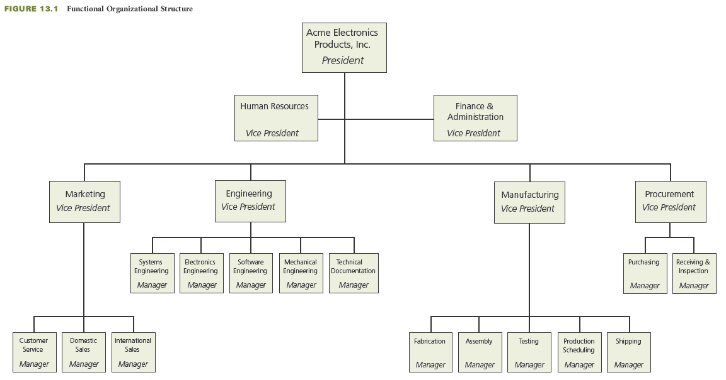
Industrial Business Example: Functional Organizational Structure
Notes:
Industrial Business Example: Functional Organizational Structure
The figure on this slide depicts a functional organizational structure for an industrial business that sells standard electronics products.

Slide 9
Autonomous Project Organizational Structure
Companies with this organization are in the projects business; they do not produce standard products
Company works on multiple projects at any given time; usually high dollar value and long term projects
As projects are completed, the company hopes to get new contracts for projects
Each project team is dedicated to only one project
Each project is operated like a mini-company
There is little opportunity for members of different project teams to share knowledge or technical expertise
Notes:
Autonomous Project Organizational Structure
Companies with an autonomous organizational structure are in the projects business; they do not produce standard products.
They typically work on multiple projects at any given time.
As projects are completed, the company continually hopes to get new contracts for projects.
Each project team is dedicated to only one project.
In the project-type organization, each project operates like a mini-company.
All the resources needed to accomplish each project are assigned full-time to that project.
A full-time project manager has complete project and administrative authority over the project team.
A project-type organization can be cost-inefficient both for individual projects and for the company.
Each project must pay the salaries of its dedicated project team, even during parts of the project when they are not busy.
There is little opportunity for members of different project teams to share knowledge or technical expertise, because each project team tends to be isolated.
Project organization structures are found primarily in companies that are involved in very large projects.
Such projects can be of high (multimillion) dollar value and long (several years) duration.
Project organization structures are prevalent in the construction and aerospace industries.
They are also used in the nonbusiness environment, such as for volunteer-managed projects.

Slide 10
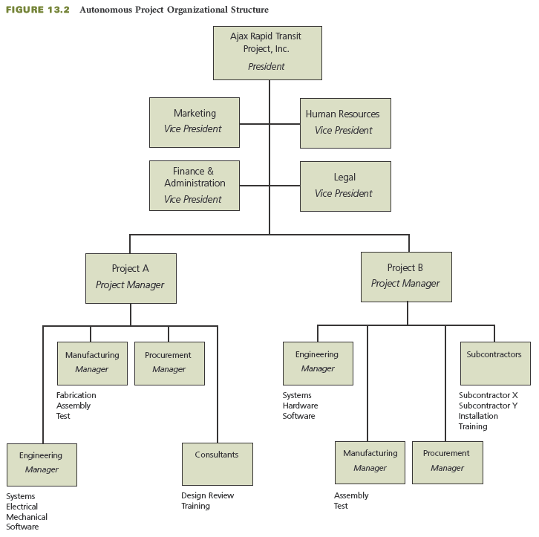
Rapid Transit Project Business Example: Autonomous Project Organizational Structure
Notes:
Rapid Transit Project Business Example: Autonomous Project Organizational Structure
The figure on this slide depicts an autonomous project organizational structure for a business that sells rapid transit projects to cities and counties.

Slide 11
Matrix Organizational Structure
Multiple projects are in progress at any given time, and these projects vary in size and complexity
Hybrid structure—a mix of both the functional and autonomous project organizational structures
Provides for effective utilization of company resources
  Employees assigned to the project for the length of time they are needed
  Pursue career development through assignment to various types of projects
  Have a dual reporting relationship—a (temporary) project manager and a (permanent) functional manager
Project manager is the intermediary between the company and the customer
Checks-and-balances and fast response upon problem identification
Notes:
Matrix Organizational Structure
With the matrix organizational structure, multiple projects are being worked on at any one time and these projects can vary greatly in size and complexity.
Projects are continually begun and finished
The matrix organization is a hybrid—a mix of both the functional and project organization structures.
It provides the project and customer focus of the project structure, but it retains the functional expertise of the functional structure.
The project manager is responsible for the project results, while the functional managers are responsible for providing the resources needed to achieve the results.
The matrix organization provides for effective utilization of company resources.
Project managers come under the projects component of the organization.
When the company receives an order for a new system, the vice president of projects assigns a project manager to the project.
A small project may be assigned to a project manager who is already managing several other small projects.
A large project may be assigned a full-time project manager.
Individuals are assigned to the project for the length of time they are needed.
Some individuals may be assigned to the project full-time, while others may be assigned only part-time.
Some people may be assigned to a project for its entire duration; others may work on only one part of the project.
Sharing of individuals’ time across several projects results in effective utilization of resources and minimizes the overall costs for each project.
The objective is to maximize the number of functional person-hours applied to work on projects and minimize the unapplied time.
The company always needs to have new projects coming in as other projects are completed in order to maintain a high applied-time rate for the functional staff.
Individuals can pursue career development through assignment to various types of projects.
As they broaden their experience, individuals become more valuable for future assignments.
Each member of a project team has a dual reporting relationship; in a sense, each member has two managers—a (temporary) project manager and a (permanent) functional manager.
The project manager is the intermediary between the company and the customer.
She or he is responsible for leading the development of the project plan, establishing the project schedule and budget, and allocating specific tasks and budgets.
Each functional manager in a matrix organization structure is responsible for how the assigned work tasks will be accomplished and who (which specific people) will do each task.
The matrix organization provides checks-and-balances and a fast response upon problem identification because it has both a horizontal (project) and a vertical (functional) path for the flow of information.

Slide 12
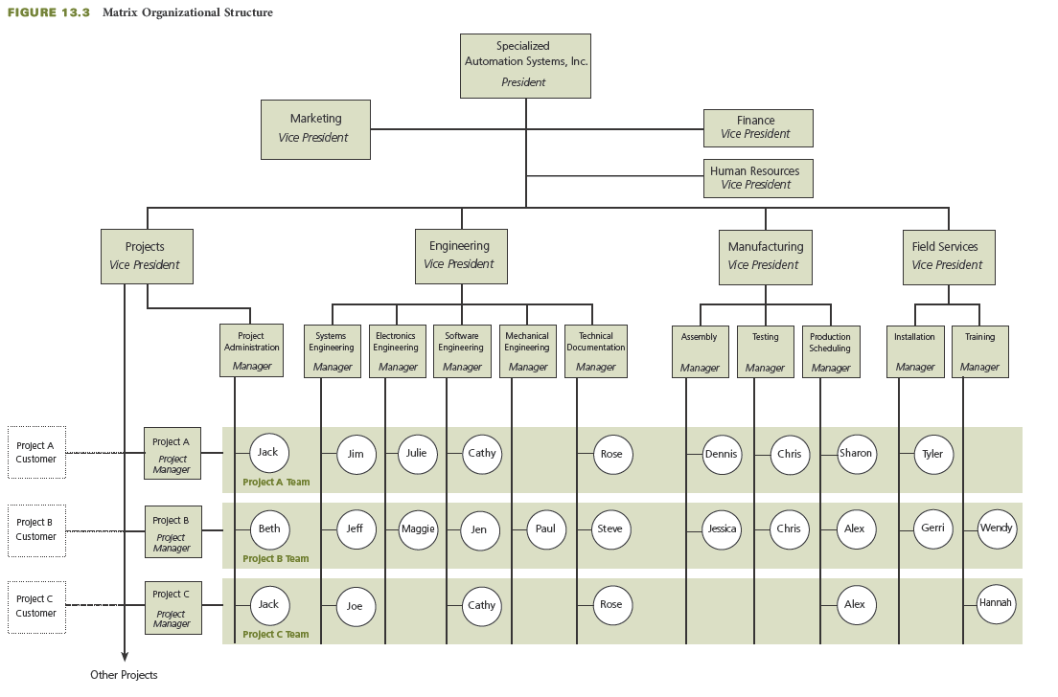
Custom Computer-Based Automation Systems Example: Matrix Organizational Structure
Notes:
Custom Computer-Based Automation Systems Example: Matrix Organizational Structure
The figure on this slide depicts a matrix organizational structure for a business that sells custom computer-based automation systems.

Slide 13
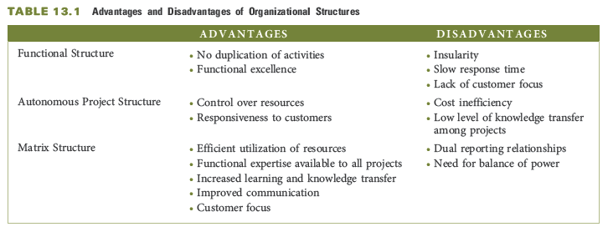
Advantages and Disadvantages of Organizational Structures
Notes:
Advantages and Disadvantages of Organizational Structures
Here you see a table that depicts the advantages and disadvantages of the different types of organizational structures.
Functional Organizational Structure:
Advantages:
A functional-type organization removes potential for duplication and overlap of activities.
It provides the benefits associated with specialization and functional excellence.
Disadvantages:
Functional-type organizations can be insular, with each component only concerned about its own performance.
Teamwork is not emphasized; there is little cross-fertilization of ideas.
Decisions may be parochial rather than in the best interests of the overall project.
The hierarchical structure causes communication and problem resolution problems, and decision making can be slow.
There is a lack of customer focus.
There is a stronger allegiance to the function than to the project or the customer.
Autonomous Project Organizational Structure
Advantages:
The project team has full control over the resources, including authority over how the work gets completed and by whom.
The project organization is highly responsive to the customer.
Disadvantages:
This structure can be cost-inefficient because of underutilization of resources. When things are slow, individuals have a tendency to stretch out their work to fill up the time available or if they do not have any tasks to do for temporary periods, they still must be paid by the company.
There is a potential for duplication of activities on several concurrent projects.
There is a low level of knowledge transfer between projects.
Individuals are dedicated to working on one project.
At the end of a project, people may be laid off if there is no new project to which they can be assigned, leading to team members to experience high anxiety about reassignment.
Matrix Organizational Structure
Advantages:
It allows efficient utilization of resources by assigning individuals from various functions to work on specific projects.
Because they have a functional home, individuals can be moved between projects.
It provides a core of functional expertise that is available to all projects.
Knowledge stays with the company, ready to be used on future projects.
People experience greater learning and growth, and their knowledge and skills are transferred from project to project.
The matrix structure also facilitates information flow.
Project team members can inform the project manager and the functional manager.
The matrix organization is customer focused.
Disadvantages:
Members of a project team in a matrix organization structure have a dual reporting relationship, which can cause anxiety and conflict over work priorities.
A company that uses a matrix organization structure must establish operating guidelines to assure a proper balance of power between project managers and functional managers.
Conflicts are likely to arise between project managers and functional managers regarding priorities.

Slide 14
Critical Success Factors
In a matrix organization, it is important to delineate the project management responsibilities and the functional management responsibilities.
When implementing a matrix organizational structure, operating guidelines should be established to assure proper balance of power between project managers and functional managers.
Project teams should be kept as small as feasible throughout the project.
Notes:
Critical Success Factors
In a matrix organization, it is important to delineate the project management responsibilities and the functional management responsibilities.
When implementing a matrix organizational structure, operating guidelines should be established to assure proper balance of power between project managers and functional managers.
Project teams should be kept as small as feasible throughout the project.

Slide 15
Summary
The three most common structures used to organize people to work on projects:
  The functional organizational structure is typically used in businesses that primarily sell and produce standard products. The advantages of a functional organizational structure are no duplication of activities and functional excellence. Disadvantages include insularity, slow response time, and lack of customer focus.
  The autonomous project organizational structure is used by companies that are working on multiple projects at any one time and do not produce standardized products. The advantages of the autonomous project organizational structure are control over resources and responsiveness to customers . Cost inefficiency and low level of knowledge transfer among projects are its disadvantages.
Notes:
Summary
The three most common structures used to organize people to work on projects are functional, autonomous project, and matrix organizational structures.
The functional organizational structure is typically used in businesses that primarily sell and produce standard products. The advantages of a functional organizational structure are no duplication of activities and functional excellence. Disadvantages include insularity, slow response time, and lack of customer focus.
The autonomous project organizational structure is used by companies that are working on multiple projects at any one time and do not produce standardized products. The advantages of the autonomous project organizational structure are control over resources and responsiveness to customers. Cost inefficiency and low level of knowledge transfer among projects are its disadvantages.

Slide 16
Summary (continued)
  The matrix organization is a hybrid of both the functional and the autonomous project organizational structures. The advantages of a matrix organizational structure include efficient utilization of resources, functional expertise available to all projects, increased learning and knowledge transfer, improved communication, and customer focus. Its disadvantages are the dual reporting relationships and the need for a balance of power.
In the matrix structure, the project manager is the intermediary between the company and the customer.
The project management office in the matrix organizational structure oversees and coordinates multiple projects.
Notes:
Summary (continued)
The matrix organization is a hybrid of both the functional and the autonomous project organizational structures. The advantages of a matrix organizational structure include efficient utilization of resources, functional expertise available to all projects, increased learning and knowledge transfer, improved communication, and customer focus. Its disadvantages are the dual reporting relationships and the need for a balance of power.
In the matrix structure, the project manager is the intermediary between the company and the customer.
The project management office in the matrix organizational structure oversees and coordinates multiple projects.

