Slide 1
Health Hub Web Application Testing
Prepared By: Poulomi Roy Code :- fs39_330518

Slide 2
Table of Contents
Project Overview
Manual Testing
Automation Framework
Project Modules
Project Structure
How to Run

Slide 3
Project Overview
Project: Health Hub Web Application Testing
Goal: Ensure application quality via Manual + Automation Testing
Manual Testing: Test Plan, Scenarios, Bug Reports, Summary
Automation Testing: Selenium Framework with Java + TestNG + ExtentReports

Slide 4
Manual Testing
Test Plan: Testing Strategy Document
Test Scenarios & Test Cases: Cover Login, Cart, Checkout, Search
Bug Report: Defects tracked in Excel
Test Summary Report: Overall test results
Mindmap: Visual test plan overview

Slide 5
Automation Framework
Selenium WebDriver for automation
TestNG for test management
ExtentReports for reporting
Page Object Model (POM) structure
ConfigReader for dynamic configs
Screenshots captured on failure

Slide 6
Project Modules
Login Module
Cart and Checkout Module
Contact Us Module
Product Search and Account Page
End-to-End workflow coverage

Slide 7
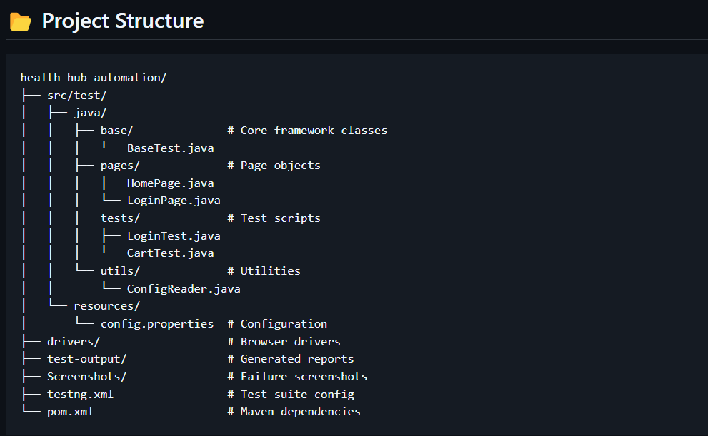
Project Structure

Slide 8
How to Run
Install Java JDK 11+, Maven, Browser Drivers
Clone the repository
Update config.properties for browser, URL
Run tests: mvn clean test
View reports in test-output/
Analyze ExtentReports

