Slide 1
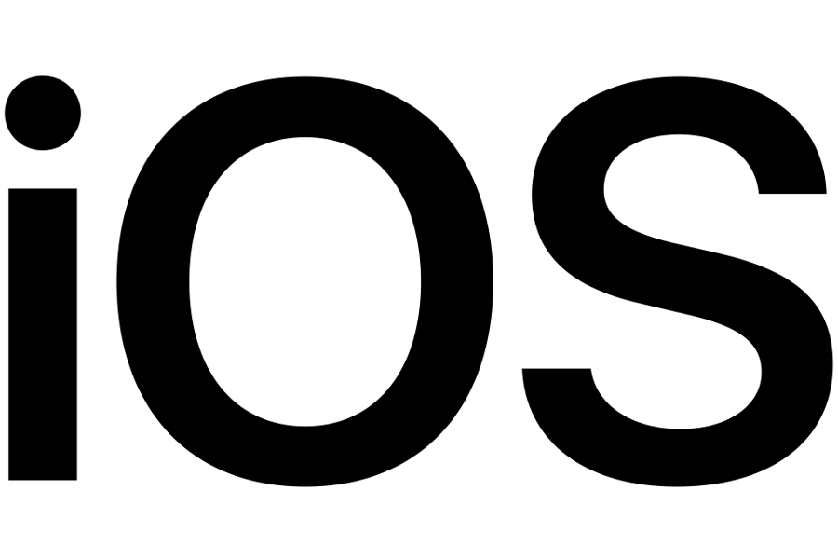
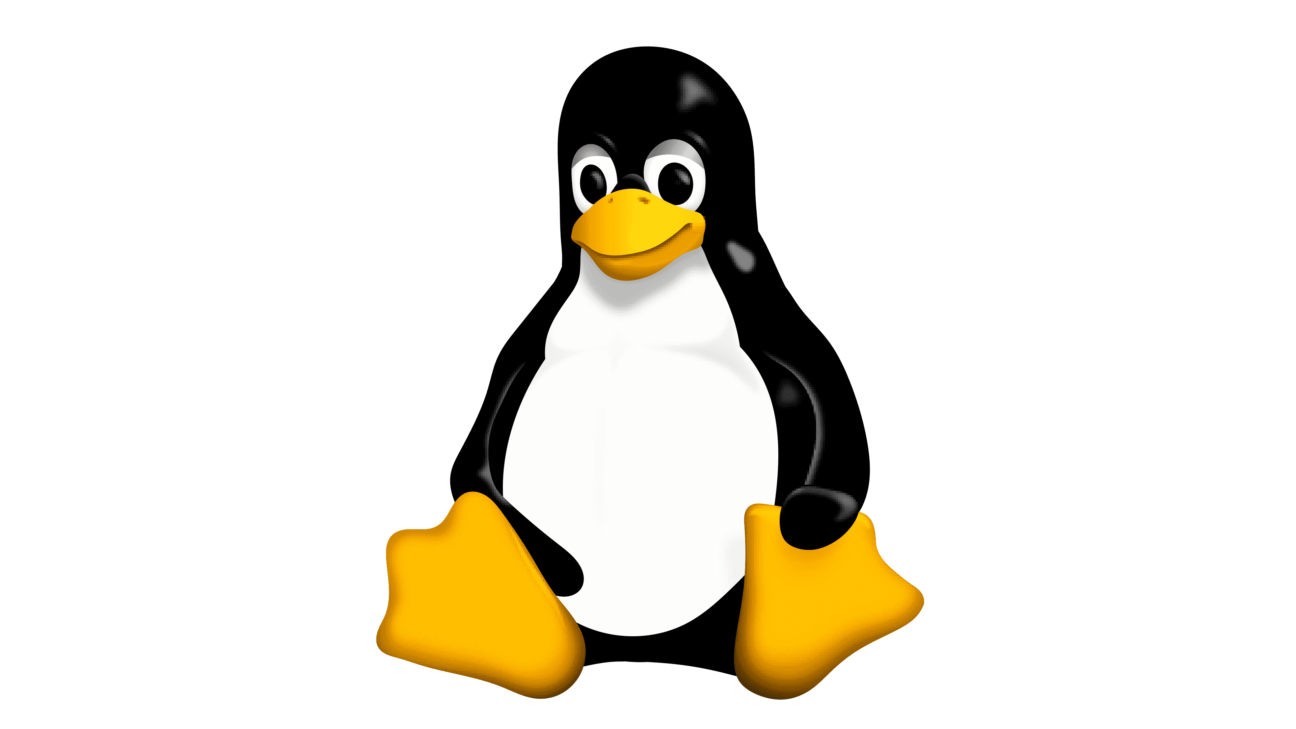

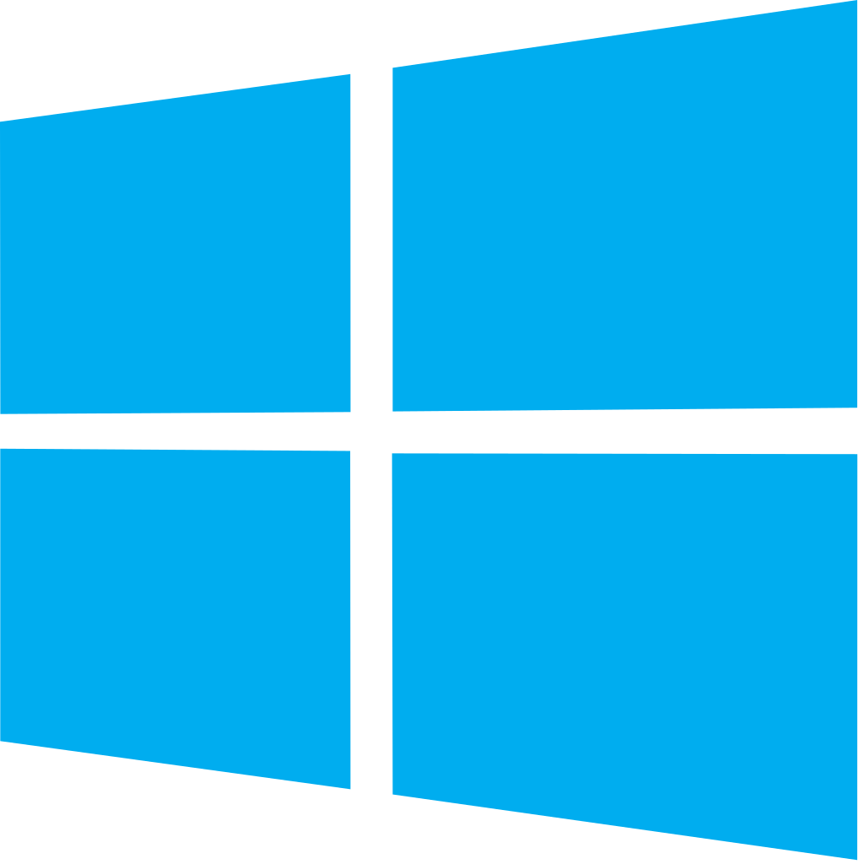

Operating Systems

Slide 2
Introduction to Operating Systems The Foundation of Computing

Slide 3
What is an Operating System?
A software program that acts as an intermediary between a computer's user and the computer hardware.
Manages computer resources such as memory, processors, and storage.
Provides an environment for executing application programs.

Slide 4
Importance of an OS
Acts as the foundation for all other software programs.
Controls and coordinates the use of hardware resources.
Ensures stability and reliability of the computer system.

Slide 5
Key Functions of an OS
Resource management (e.g., memory, processors, storage)
Security (e.g., access control, user authentication)
Interfacing with hardware and software components.

Slide 6
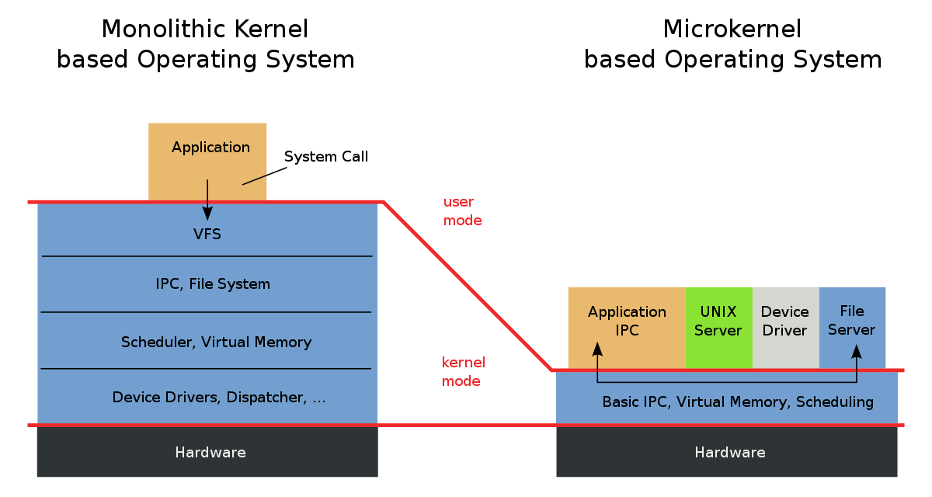
Operating System architectures
Monolithic Kernel based Operating System
Large, integrated system call handler.
Microkernel
Minimal core responsible for basic functions.

Slide 7
Brief History of Operating Systems From Mainframes to Mobile Devices

Slide 8
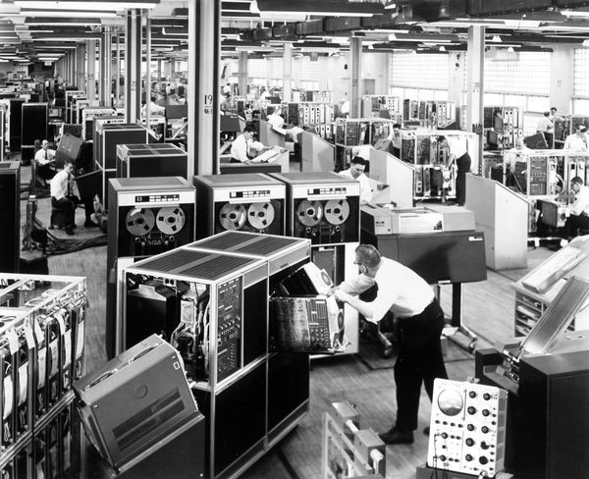
Early computer systems (1940s-1960s)
Mainframe computers, batch processing
First OS: IBM's OS/360 (1964)

Slide 9
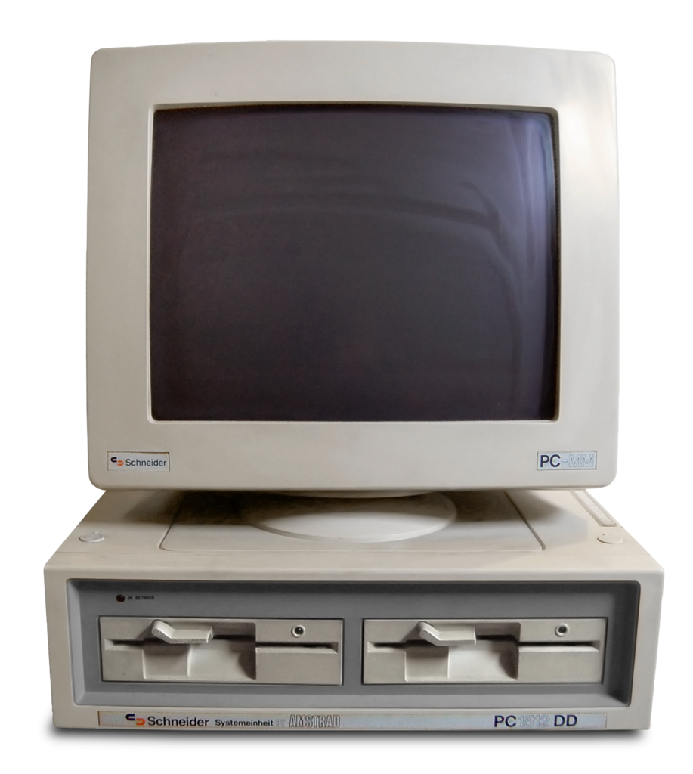
Personal computers (1970s-1980s)
Development of microprocessors, single-user operating systems.
Popular OS: Microsoft's MS-DOS (1981)

Slide 10
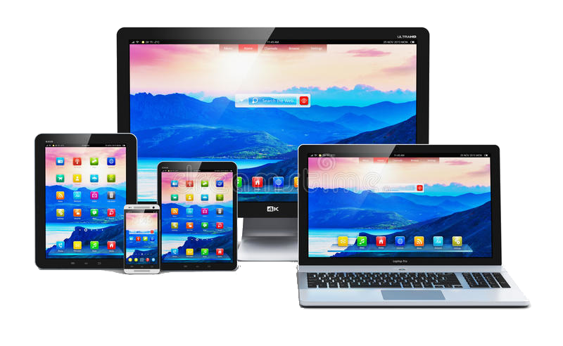
Modern operating systems (1980s-present)
Advancements in hardware, multi-user, multitasking operating systems.
Examples: Windows, MacOS, Linux, Android.

Slide 11
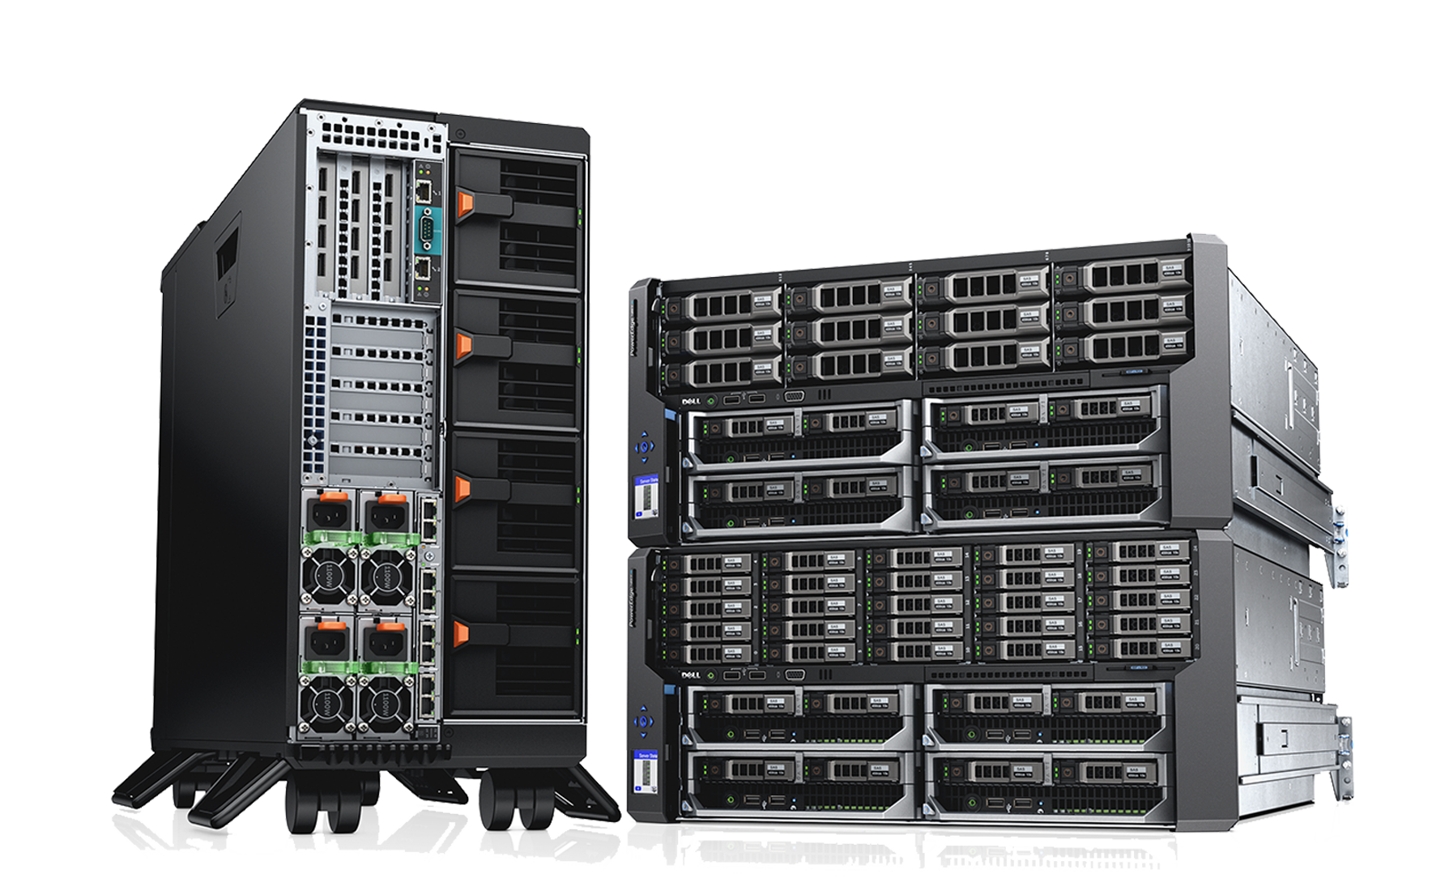
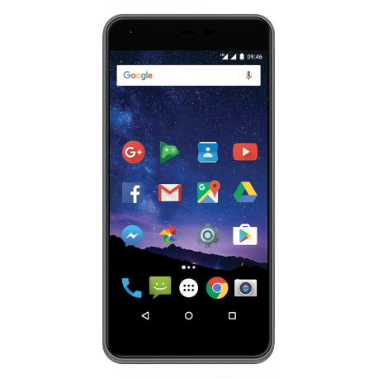
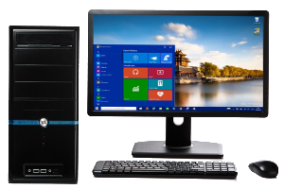
Current Operating Systems in Use
Desktop
Windows
MacOS
Linux
Mobile
Android
iOS
Server OS
Windows Server
Linux Server

Slide 12
Thank you for attention!

