Slide 1
Approvers Help Guide
Approve or Return Task - Overview
View task details
Receive approval notification
Approve or return task
Task types and Approvers
Task Name | Stop 0* | Stop 1 | Stop 2 | Stop 3
Accepting LOA | PI* | SDC | HOD | GM
Ethics Approval | PI* | SDC | HOD | GM
Budget Scrubbing | PI* | SDC | HOD | GM
LOA/Ethics/Budget Phasing | PI* | SDC | HOD | GM
Confirm Project Details (Account Type = External funding (non-RSO), External Funding (RSO), External talent award (TRACS), RCA ) |  | HOD | RSO | DRSO
Confirm Project Details (Account Type = Internal funding Internal talent award (TRACS) ) |  | HOD
DMP | PI* | No Routing
Fianance Account Creation | No Routing
* PI will be the first person to approve the tasks if the tasks are not submitted by PI

Slide 2
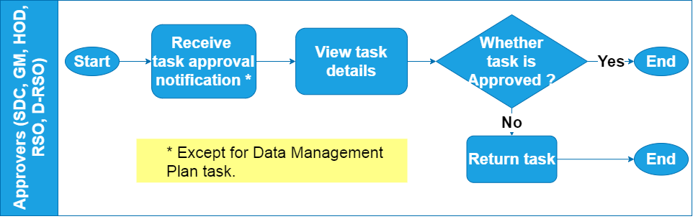
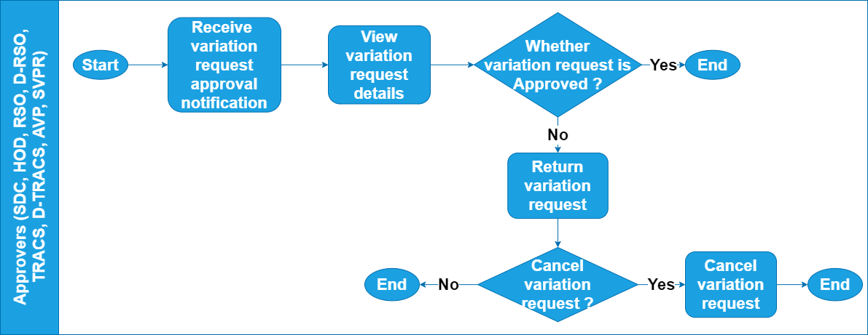
Task Completion Workflow by Approvers
Variation Request Completion workflow by Approvers

Slide 3
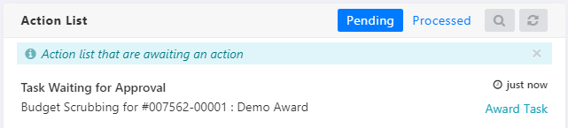
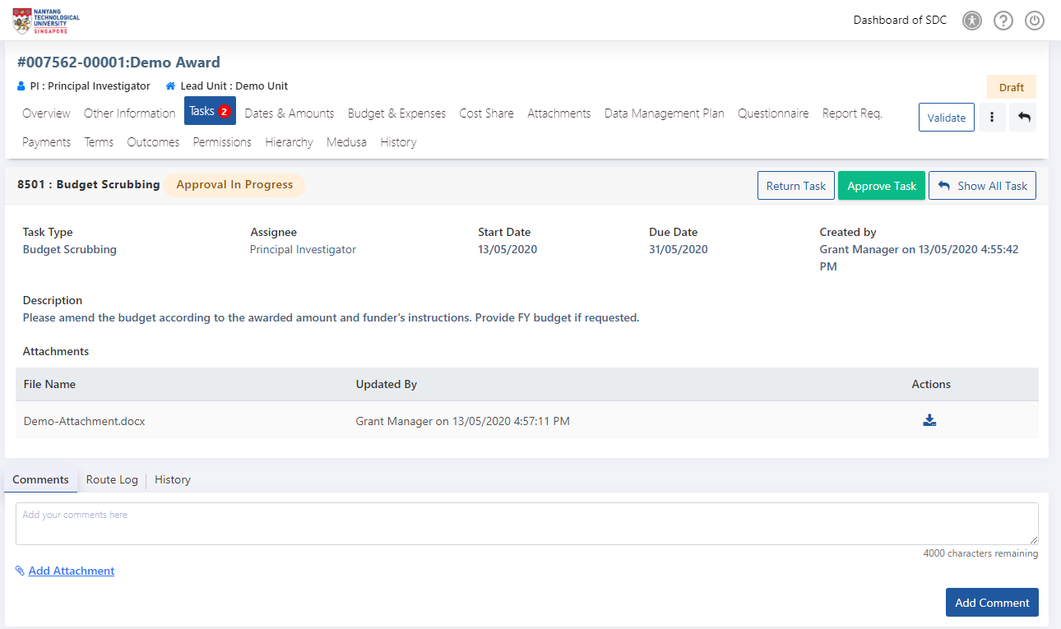
Finance Officer Help Guide
Steps for Finance Account Creation Task - Continued
Steps to Approve a Task
1
Click the Task approval notification.
2
Click Approve task button in the task details page.
2
2
Review the task details and decide to Approve or Return the task.

Slide 4
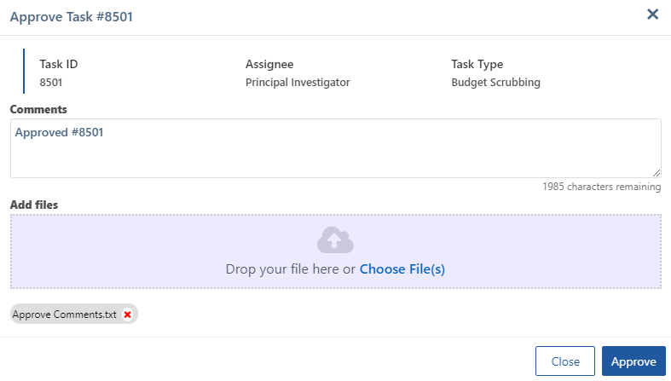
Finance Officer Help Guide
Steps for Finance Account Creation Task - Continued
Steps to Approve a Task
Below ‘Approve task’ pop-up is displayed upon user clicks the Approve Task button in the task details.
2.a
Enter the approval Comments.
2.a
2.b
Upload attachments if any.
2.b
2.c
2.c
Click Approve button

Slide 5
Finance Officer Help Guide
Steps for Finance Account Creation Task - Continued
Steps to Return a Task
1
Click the Task approval notification.
2
Click Return task button in the task details page.
2
2
Review the task details and decide to Approve or Return the task.

Slide 6
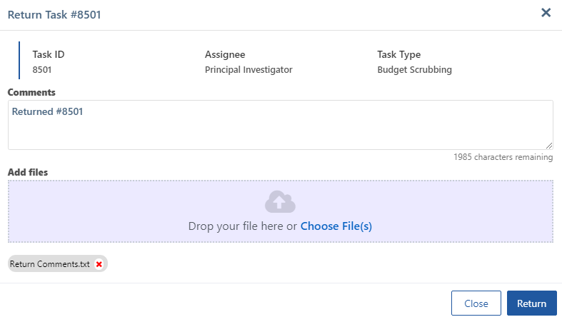
Steps to Return a Task
Below ‘Return task’ pop-up is displayed upon user clicks the Return Task button in the task details.
2.a
Enter the return Comments.
2.a
2.b
Upload attachments if any.
2.b
2.c
2.c
Click Return button

Slide 7
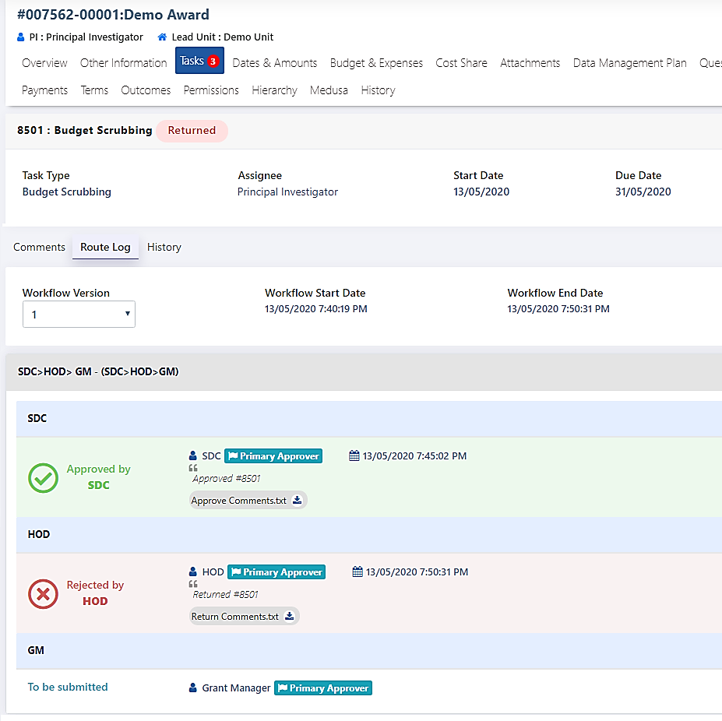
View Task Approve or Return Comments and Previous Workflow Version(s)
1
1
Click the Tasks Tab.
2
2
Click the Route Log tab. Route log details with the approval/return comments and attachments will be displayed.
3
3
By default the current workflow version is displayed. Click the Workflow Version dropdown. Select the required previous version from the dropdown.
4
4
Users can view the comments and download attachments.

Slide 8
Approvers Help Guide
Variation Request Approval Process - Overview
Receive variation request approval
notification
View variation request details
Approve or return variation request
Variation Request Approvers

Slide 9
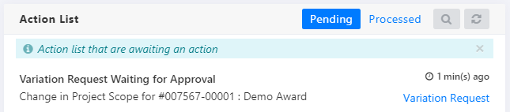
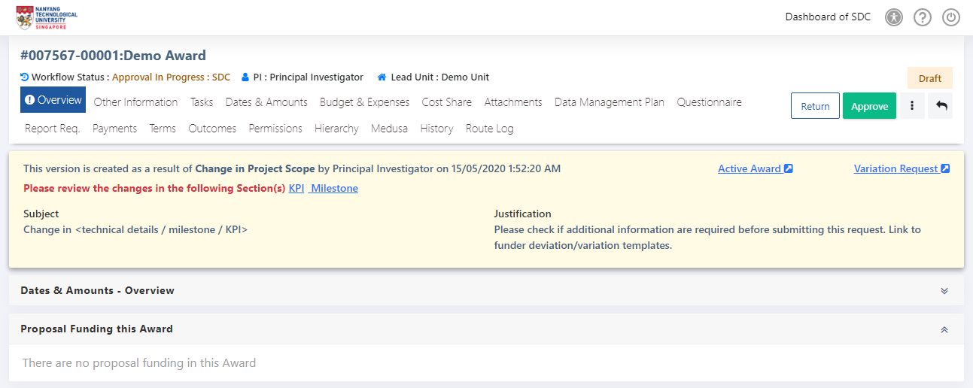
Finance Officer Help Guide
Steps for Finance Account Creation Task - Continued
Steps to Approve a Variation Request
1
Click the Variation request approval notification.
1
2
Click Approve button in the Award details page.
2
Review the variation request details and decide to Approve or Return the variation request.
2

Slide 10
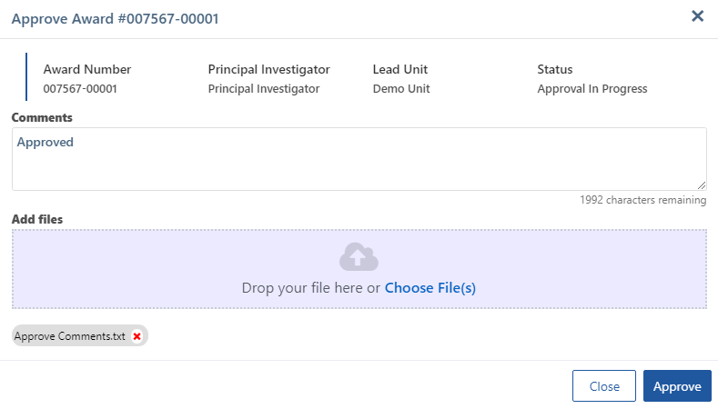
Finance Officer Help Guide
Steps for Finance Account Creation Task - Continued
Steps to Approve a Variation Request
Below ‘Approve Award’ pop-up is displayed upon user clicks the Approve button in the variation award details.
2.a
Enter the approval Comments.
2.a
2.b
2.b
Upload attachments if any.
2.c
2.c
Click Approve button

Slide 11
Finance Officer Help Guide
Steps for Finance Account Creation Task - Continued
Steps to Return a Variation Request
1
Click the Variation request approval notification.
1
2
Click Return button in the Award details page.
2
Review the variation request details and decide to Approve or Return the variation request.
2

Slide 12
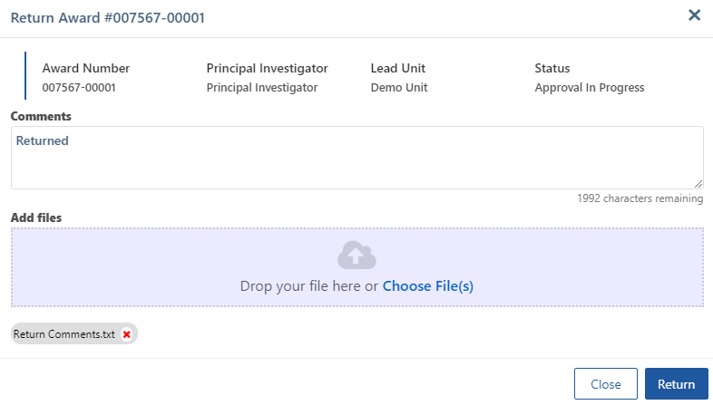
Finance Officer Help Guide
Steps for Finance Account Creation Task - Continued
Steps to Return a Variation Request
Below ‘Return Award’ pop-up is displayed upon user clicks the Return button in the variation award details.
2.a
Enter the return Comments.
2.a
2.b
Upload attachments if any.
2.b
2.c
2.c
Click Return button

Slide 13
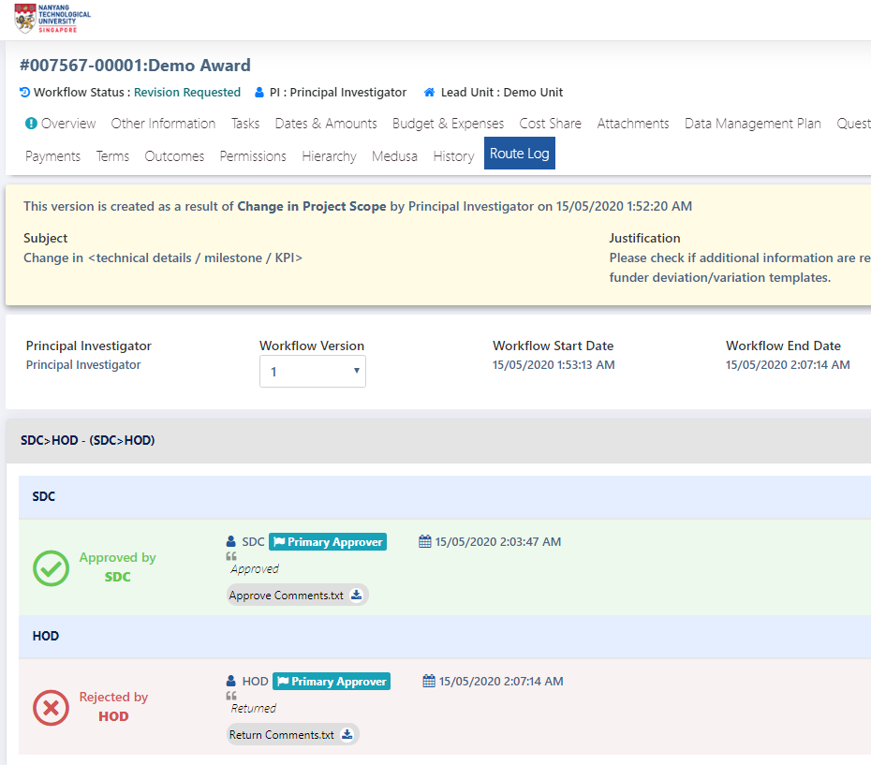
Finance Officer Help Guide
Steps for Finance Account Creation Task - Continued
View Variation Request Approve or Return Comments and
Previous Workflow Version(s)
1
1
Click the Route Log tab.
3
2
Route log details with the approval/return comments and attachments will be displayed.
Click download button to download the attachments if needed.
2
3
Click the Workflow Version dropdown. Select the required previous version from the dropdown.

Slide 14
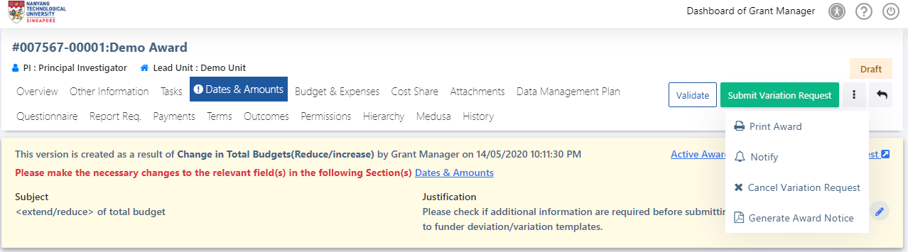
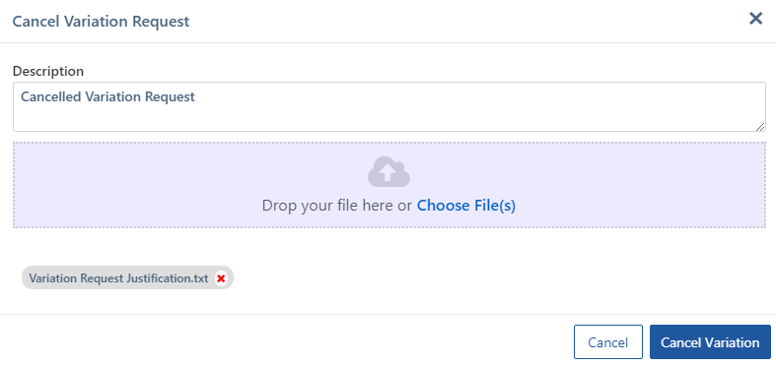
Cancel Variation Request
1
Click More Action button and select the Cancel Variation Request option
1
2
Enter the cancel variation description/Comments.
2
3
3
Upload attachments if any.
4
4
Click Cancel Variation button
Cancel Variation is possible when the award workflow status in Draft or Revision requested status.

