Slide 1

Session 2: How does QA work?
™ Enlilt Inc.

Slide 2
What are we learning today?
™ Enlilt Inc.

Slide 3
Software engineering org structure
Software releases
SDLC
Waterfall vs AGILE
Adhoc vs Regression testing
Blackbox vs Whitebox testing
™ Enlilt Inc.

Slide 4
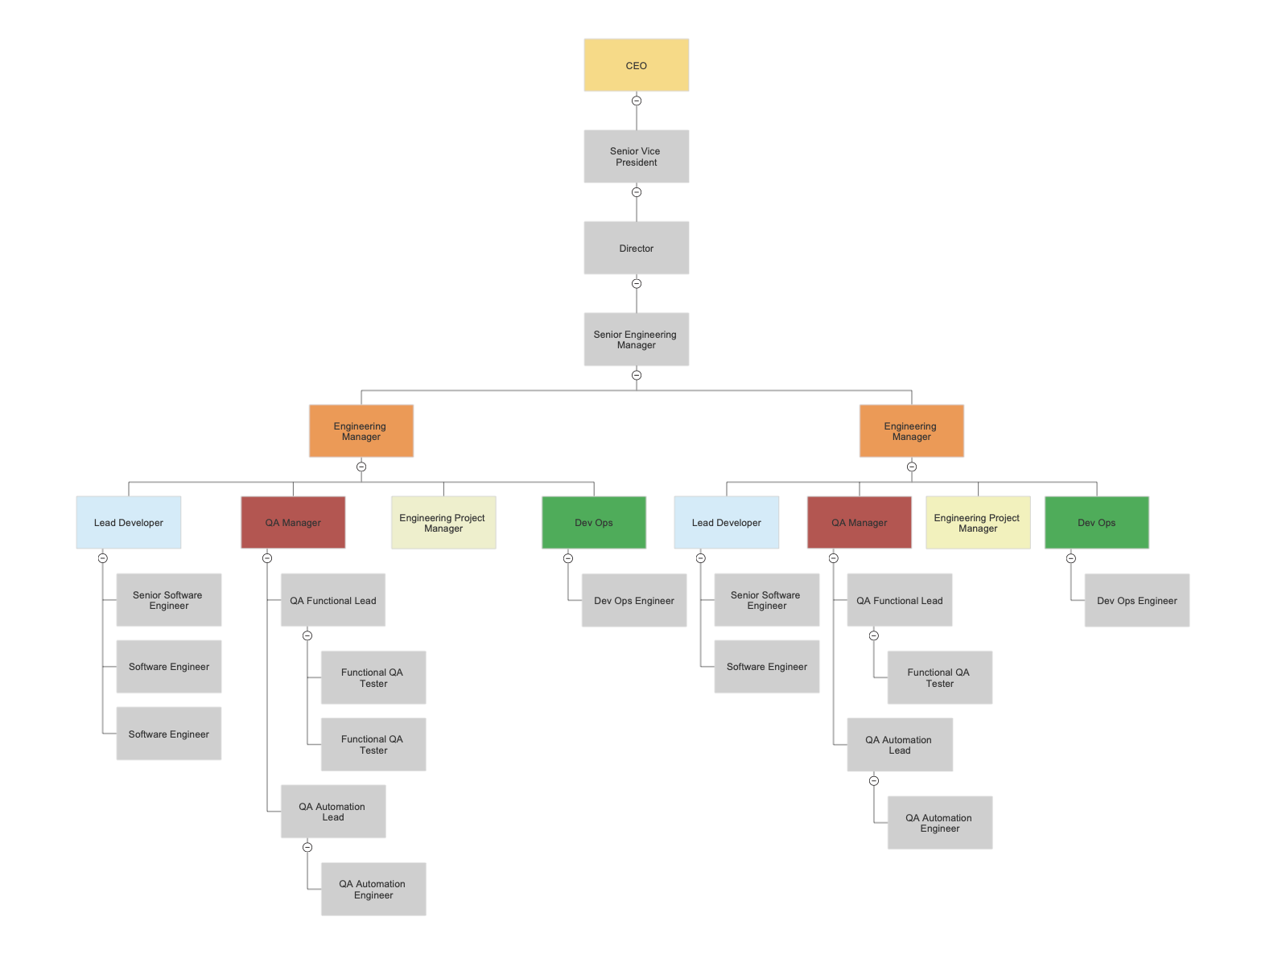
Software Engineering Org Structure
™ Enlilt Inc.

Slide 5
Software Releases
™ Enlilt Inc.

Slide 6
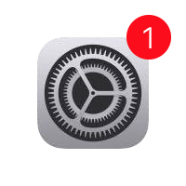
What is a software release?
New version of an app or operating system (OS)
Every new version of a software release follows SDLC before it is shipped to customers
™ Enlilt Inc.

Slide 7
SDLC
™ Enlilt Inc.

Slide 8
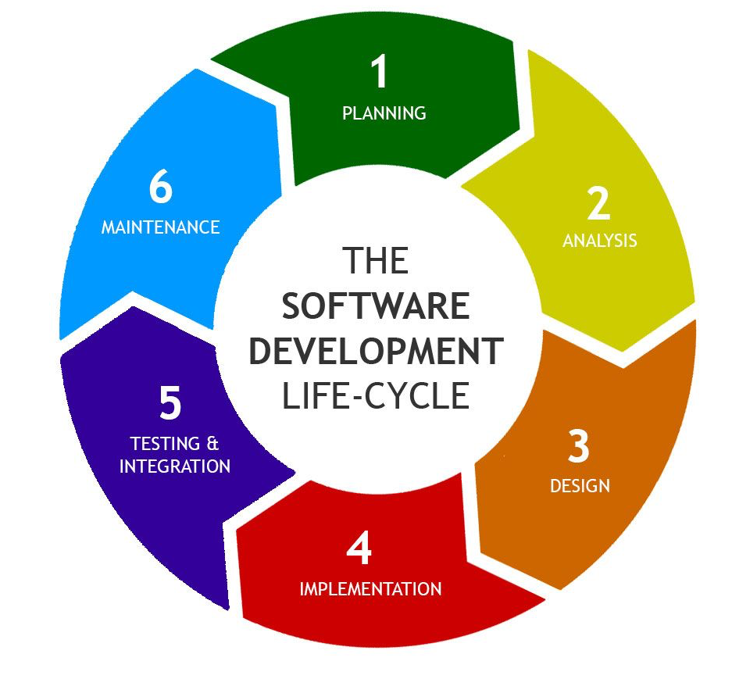
What is SDLC?
SDLC = Software Development Life Cycle
The process used in the software industry to develop software
Phases of SDLC -
Planning, Analysis, Design, & Implementation, Testing, & Maintenance
™ Enlilt Inc.

Slide 9
Planning Phase
Project goals are determined for the software project
Project plans & cost estimations for software development are identified
Gather feedback from stakeholders
™ Enlilt Inc.

Slide 10
Analysis Phase
Team analyzes the project requirements
Provides feedback to stakeholders for project requirements
Analyze the needs of the end user to ensure new software meets their expectations
™ Enlilt Inc.

Slide 11
Design Phase
Document in detail the specifications and features of the new software
Design how the new software is going to work
™ Enlilt Inc.

Slide 12
Implementation Phase
The phase in which the code for the software is developed
No testing is done in this phase
™ Enlilt Inc.

Slide 13
Testing & Integration Phase
This is the phase where QA gets involved
Phase in which testing is conducted
Developers find out from QA whether or not the code works according to the requirements
™ Enlilt Inc.

Slide 14
Maintenance Phase
Continuous monitoring of the new software developed
Investigate any issues reported
Upgrade developed functionality
™ Enlilt Inc.

Slide 15
Waterfall vs AGILE
™ Enlilt Inc.

Slide 16

What is Waterfall?
Waterfall is a software methodology of developing software in phases
Each phase must be completed before the next phase can begin
Linear sequential phase
Work on a large project at once
™ Enlilt Inc.

Slide 17
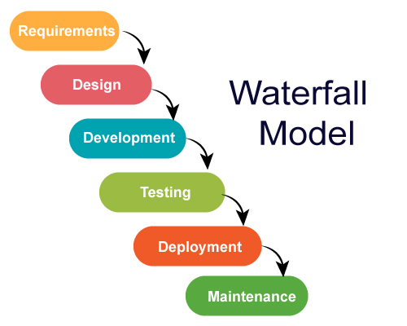
Waterfall Model
™ Enlilt Inc.

Slide 18

What is AGILE?
AGILE is a process of developing software in an iterative approach
Work in small increments vs a massive launch
Each release is categorized as Sprints
Quick and efficient
™ Enlilt Inc.

Slide 19
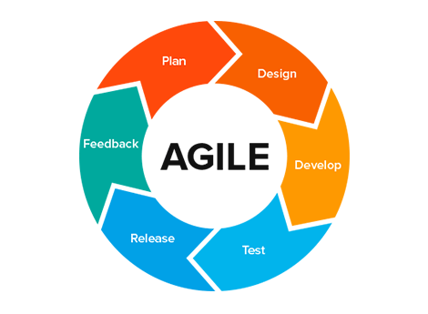
AGILE
™ Enlilt Inc.

Slide 20
Demo - AGILE vs Waterfall

Slide 21
Group Activity - AGILE vs Waterfall
10 minutes to find two examples each for AGILE & Waterfall
Share your findings
™ Enlilt Inc.

Slide 22
AGILE | Waterfall
New way of software development | Old way of software development
Allows for continuous development/testing & manageable releases | Meant for large software releases
Risk of poor code is reduced since testing starts with development | Delays testing until development is over
™ Enlilt Inc.

Slide 23
Adhoc vs Regression Testing

Slide 24
Adhoc Testing
Free form method of testing a website or mobile app
Testing the functionality in creative ways to break the system!
No documentation or process required to test
™ Enlilt Inc.

Slide 25
Regression Testing
Defined way of testing to ensure existing features after a code change still work as expected
Purpose is to ensure new code changes does not impact existing functionalities
Should be performed when code is modified
™ Enlilt Inc.

Slide 26
Demo - Adhoc Testing vs Regression Testing

Slide 27
Group Activity - Adhoc vs Regression
10 minutes to find two examples each for AGILE & Waterfall
Share your findings
™ Enlilt Inc.

Slide 28
Whitebox vs Blackbox Testing

Slide 29
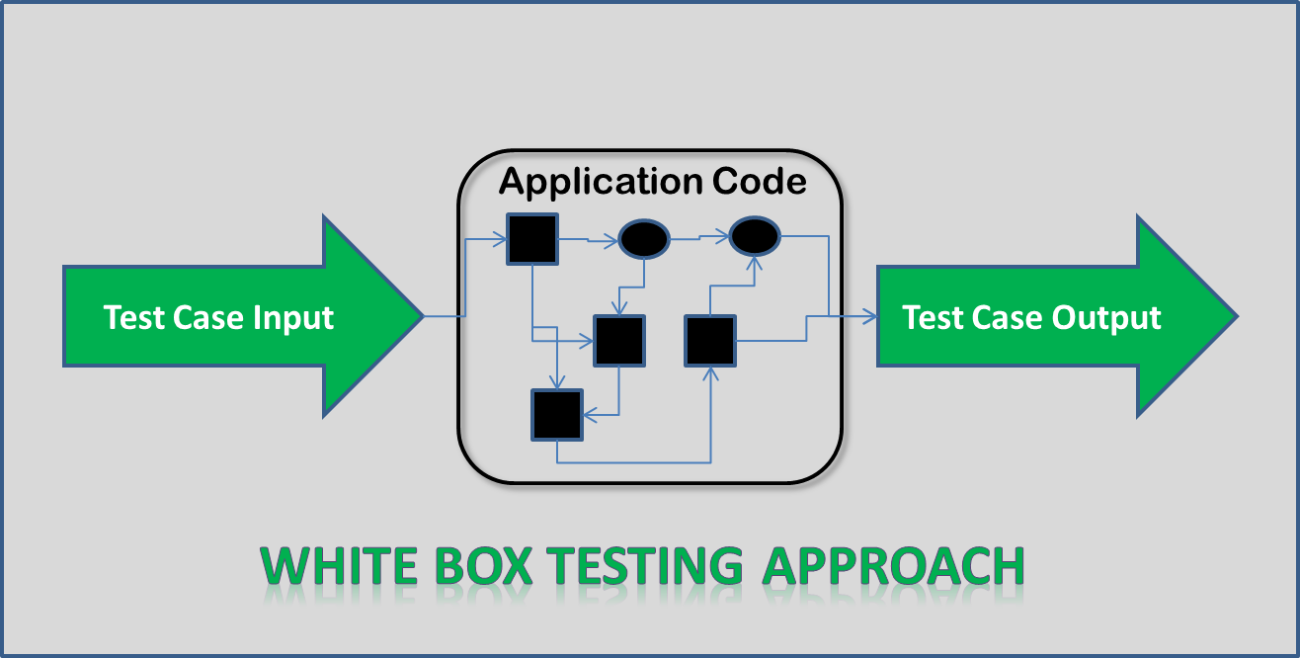
Whitebox Testing
Way of testing software in which the tester has knowledge about the internal structure/code
Internal software testing
Usually developers test
™ Enlilt Inc.

Slide 30
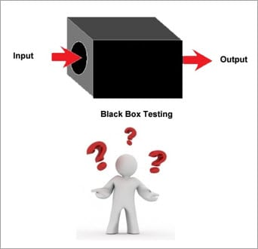
Blackbox Testing
Way of testing software where the internal structure of the program or the code is hidden
It is functional testing!
Should always be done by QA
™ Enlilt Inc.

Slide 31
Demo - Whitebox Testing vs Blackbox

Slide 32
Hands on Activity - Whitebox vs Blacbox
10 minutes to find two examples each for Whitebox and Blackbox testing
Share your findings
™ Enlilt Inc.

Slide 33
White Box | Black Box
Code remains visible to testers | Code is hidden to testers
Usually done by developers | Done by functional QA
Tests the logic and implementation of software | Tests the behavior & functionality of software
Programming knowledge is required | No programming knowledge is required
™ Enlilt Inc.

Slide 34
Personalized Activity
Research examples for Waterfall & AGILE software development
Research examples for whitebox vs blackbox testing
™ Enlilt Inc.

Slide 35

What are we going to learn next?
™ Enlilt Inc.

Slide 36
Smoke Testing
UAT Testing
Various phases of QA
Test Environments
™ Enlilt Inc.

Slide 37
Q&A
™ Enlilt Inc.

