Slide 1

Zhu Dongsheng 24038342g Li Tianye 24063117g Yu Shaoyu 24118601g Feng Yujie 24054389g Xia Yishan 24045097g
Decentralized Finance Application
COMP5521 Group04

Slide 2
Contents
01
02
03
04
Introduction
System Design
background, motivation, DApp vs centralized app
describe the process of a system framework diagram
Prototype and Technology Stack
Demonstration and Conclusion
frontend(react), backend
showcase the features, functionalities

Slide 3
01
Introduction
Introduce the background and motivation for developing the DApp. introduce the DApp and explain how it can address certain limitations of traditional financial applications.

Slide 4
What is DeFi?
Decentralised Finance (DeFi) is an emerging technology based on blockchain. It is a collective term for financial products and services that do not rely on any intermediary or centralised institution.

Slide 5
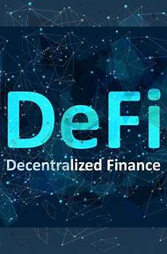
Goal of DeFi Harnessing smart contracts, it aims at providing an open, transparent and trustless financial ecosystem for everyone.

Slide 6
Background and Motivation
At present, there are many problems in centralized financial systems (such as banks and payment platforms):
High costs and low efficiency: Cross-border transfer fees are high, transaction confirmation times are long, and they rely on intermediaries, with complex processes.
Lack of transparency: Users cannot track the flow of funds in real time, and the system operation lacks openness.
Centralized risks: A single point of failure may lead to service disruptions or fund freezes.
Financial exclusion: There are still billions of people worldwide who cannot access basic financial services, especially in economically underdeveloped countries or regions.
The goal of this project is to provide us an opportunity to apply what we have learnt in class to develop DeFi applications using distributed ledger technology.

Slide 7
DApp vs Centralized app
 | DApp | Centralized app
Architecture | Based on blockchain, no central server; operates via distributed nodes | Relies on centralized servers; data and services managed centrally
Data Security | Data encrypted and stored on-chain, immutable and publicly verifiable | Data stored on private servers; risks include tampering, leaks, or single-point failures
Control | Executed by smart contracts; users fully own their assets and data | Controlled by corporations; users must trust third parties with data and permissions
Censorsip Resistance | Decentralized network resists shutdowns or censorship; globally accessible | Vulnerable to regulatory censorship; services can be restricted or terminated
Transparency | Open-source code; all transactions on-chain and auditable | Closed-source code; opaque backend operations and logic

Slide 8
02
System Design
Introduce the development process of the system using a system architecture diagram.

Slide 9
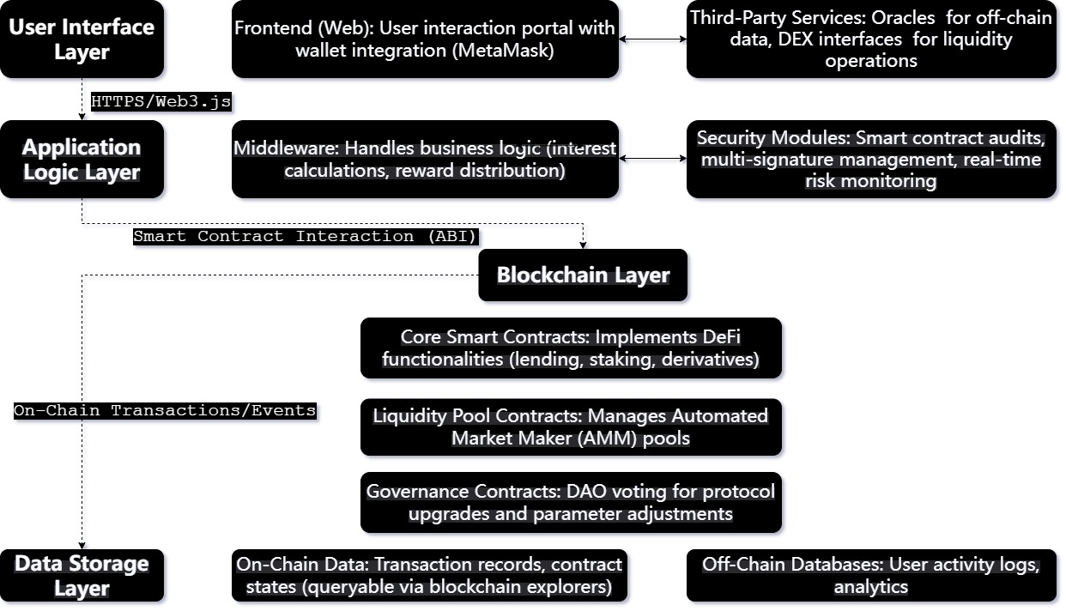
System architecture diagram

Slide 10
Where is the point?
Multi-Layered Design
Scalability & Security
Key Innovations
User Interface
Application Logic
Blockchain Core
Data Storage
Built on Ethereum/BSC for high throughput.
Audited contracts and multi-sig protocols ensure robustness.
Trustless Execution
Censorship Resistance
Transparency

Slide 11
03
Prototype and Technology Stack

Slide 12
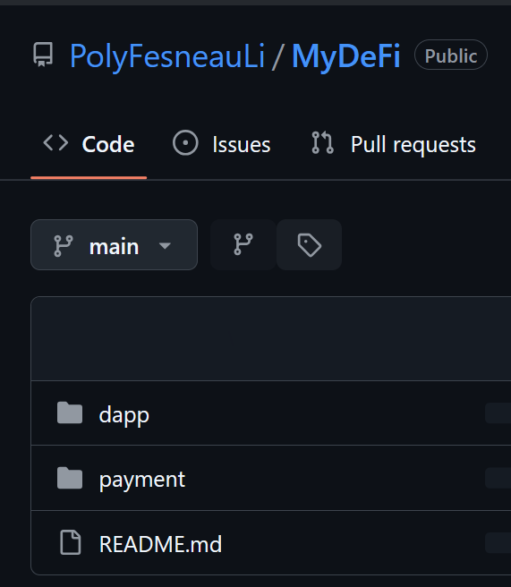
Implementation of the Prototype
Smart Contracts
Located in the dapp/contracts directory, it is responsible for defining the core logic of DeFi
Frontend
Located in the dapp/src directory, build the user interface using React.js
Backend
Located in the payment directory, processing payment logic (buying KWT tokens via PayPal)

Slide 13
Implementation of Smart Contracts
Smart contracts are at the heart of the project, defining the token (KWT) issuance, wallet management, and transaction logic.
Key Documents:
KWTToken.sol: Defines the ERC-20 standard implementation of the KWT token.
WalletManager.sol: manages the creation of user wallets and the deposit and withdrawal of ETH.
Exchange.sol: Implements the exchange logic of KWT and ETH.

Slide 14
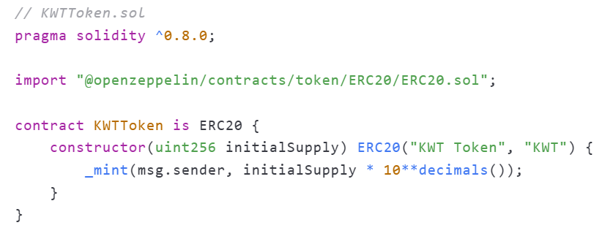
Focused Code Snippet Analysis
· Use OpenZeppelin's ERC-20 contract library to ensure the security of your tokens.
· The initialSupply parameter is used to initialize the total amount of tokens.

Slide 15
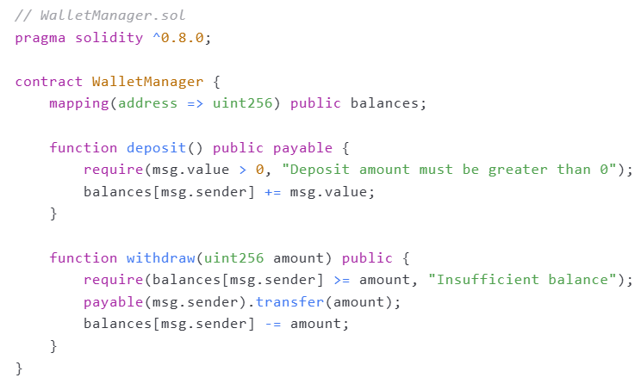
Focused Code Snippet Analysis
· The deposit and withdraw methods handle the deposit and withdrawal of ETH separately.
· Use the payable keyword to ensure that the contract can receive ETH.

Slide 16
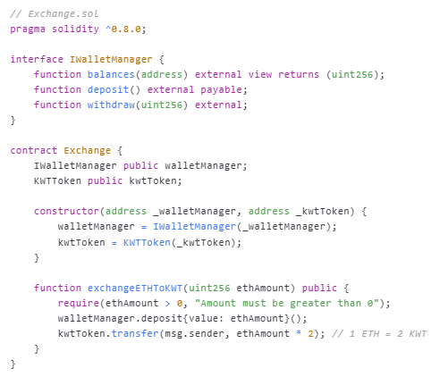
Focused Code Snippet Analysis
· The exchangeETHToKWT method implements the exchange logic of ETH and KWT.
· Use the transfer method to send KWT tokens to the user.

Slide 17
Implementation of Frontend
Front-end applications are based on React.js and provide a user interface.
Key Documents:
App.js: The main application portal, which is responsible for routing and status management.
components/Wallet.js: displays the user's wallet balance and transaction history.
components/Exchange.js: provides the exchange function of ETH and KWT.

Slide 18
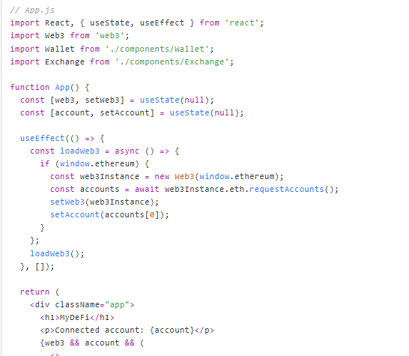
Focused Code Snippet Analysis
· Use Web3.js to connect to the user's wallet (MetaMask).
· Dynamically load user account information and display wallet and exchange components.

Slide 19
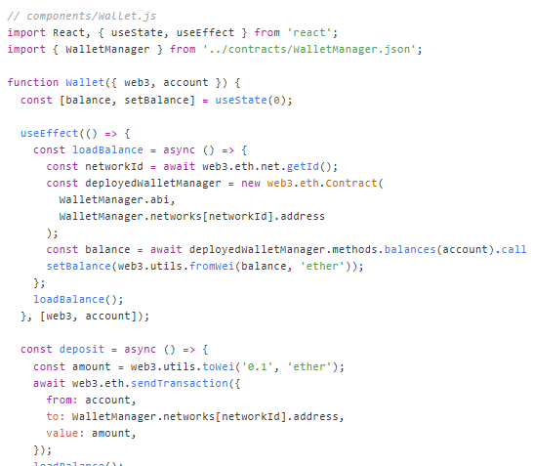
Focused Code Snippet Analysis
· Use Web3.js to call the smart contract method to get the user's ETH balance.
· A deposit button is provided that allows users to deposit ETH into their wallets.

Slide 20
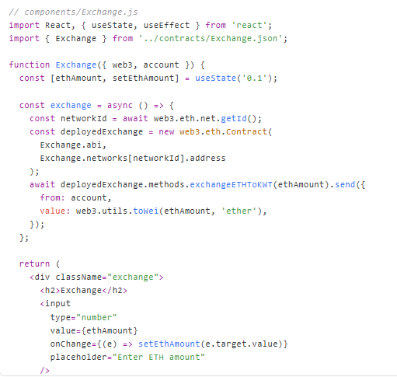
Focused Code Snippet Analysis
· Input boxes and buttons are provided that allow users to exchange ETH for KWT.
· Call the exchangeETHToKWT method of the smart contract to complete the exchange.

Slide 21
Implementation of Backend
The backend service is responsible for handling the payment logic, specifically the purchase of KWT tokens through PayPal.
Key Documents:
server.js: The main service entrance, which uses Express.js to build APIs.
routes/payment.js: Handles PayPal payment callbacks.

Slide 22
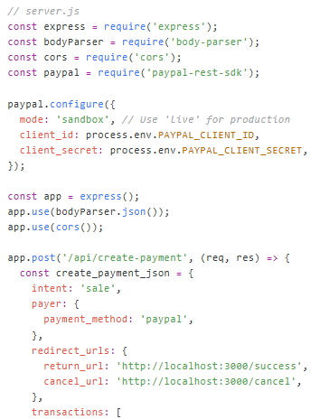
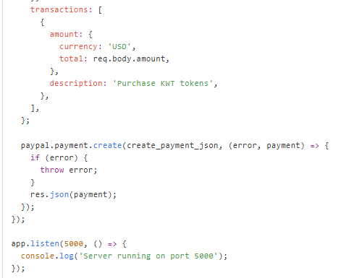
Focused Code Snippet Analysis
· Configure the PayPal SDK to process payment requests.
· Provide the /api/create-payment API to generate a payment link.

Slide 23
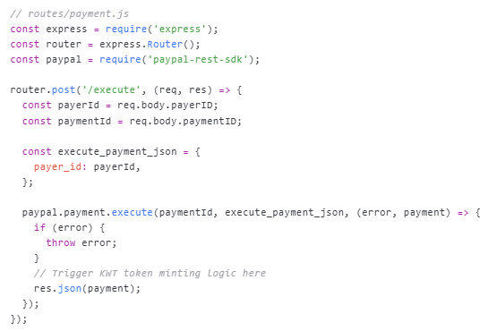
Focused Code Snippet Analysis
Process the callback after a successful PayPal payment to trigger the minting logic of KWT tokens.

Slide 24
04
Demonstration and Conclusion

Slide 25
Conclusion
Innovation and Technology:
Hybrid DeFi-Fiat Integration
Ethereum Smart Contract Backend
React.js Frontend
Truffle & Ganache Development
Enhanced User Accessibility
Functionality:
User-Friendly Wallet Management
Decentralized Smart Contract Backend
Multi-Currency Support (ETH & Fiat)
Seamless Transaction Processing
PayPal Sandbox Integration

Slide 26
Name | ID | Points
Li Tianye | 24063117g | 20%
Yu Shaoyu | 24118601g | 20%
Feng Yujie | 24054389g | 20%
Xia Yishan | 24045097g | 20%
Zhu Dongsheng | 24038342g | 20%

Slide 27
Appendix
github link:
https://github.com/PolyFesneauLi/MyDeFi.git
docker link:
https://drive.google.com/file/d/1gabfyH4NaZZ6CXFCjxCJ5sBG9mrWnNqs/view?usp=sharing
readme.md:
https://drive.google.com/drive/folders/1IfnY8UxxoW6YS9QxhMpfAEJ86jVv36F4?usp=sharing

Slide 28
Thanks
Open for questions
Group04 for COMP5521

