Slide 1
The Helvetic Coding Contest 2015
Technical presentation

Slide 2
The contest
Five problems of 3 subtasks each
+ a standalone subtask.
4h30’ to solve.
1 computer per team.
Interaction through console:
you must read from stdin & write to stdout.
We will test your code on our judge server and compare your output to ours.

Slide 3
Scoring
One point for each solved subtask.
If solved on nth attempt and t minutes after start of contest:
(n-1)*20+t penalities.
Teams ranked first by points, then by penalties.

Slide 4
Languages
C
C++ (98 and 11)
Java (7)
Scala
Python (2 and 3)
Ruby
Reference on http://doc.hc2.ch.

Slide 5
Language-specific gotchas.
C++:
- Use scanf/printf or
call std::ios::sync_with_stdio(false); before using cin/cout.
Java and Scala:
- Don't use java.util.Scanner
(instead BufferedReader & InputStreamReader).
- Work in default package (don't use package keyword).
(Eveything is explained in the team manual.)

Slide 6
Limits
Limits for C/C++:
- CPU time (a few seconds, problem dependent)
- 256 MB of memory
Limits for Java/Scala:
- More runtime than C++ (problem dependent)
- 384 MB of memory
Limits for Python/Ruby:
- More runtime than C++ (problem dependent)
- 256 MB of memory

Slide 7
Judging System
DomJudge
https://ec2.hc2.ch

Slide 8
20 steps to happiness

Slide 9
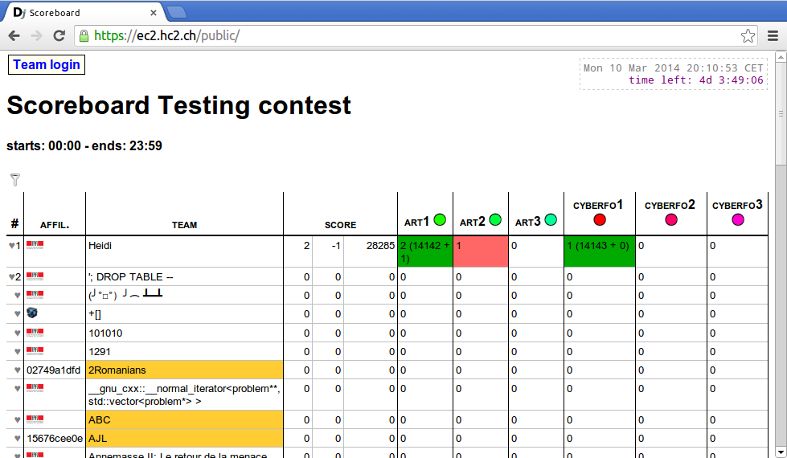
1. Go to server

Slide 10
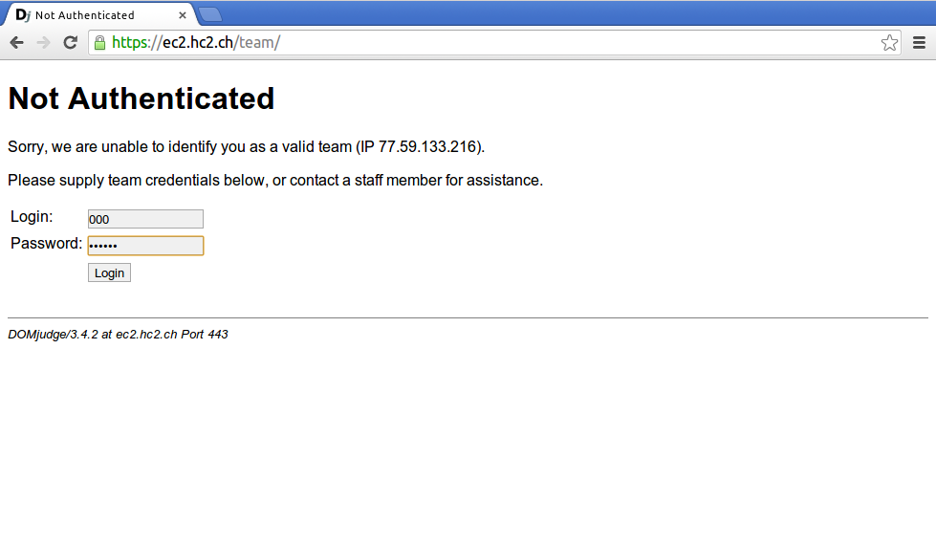
2. Login

Slide 11
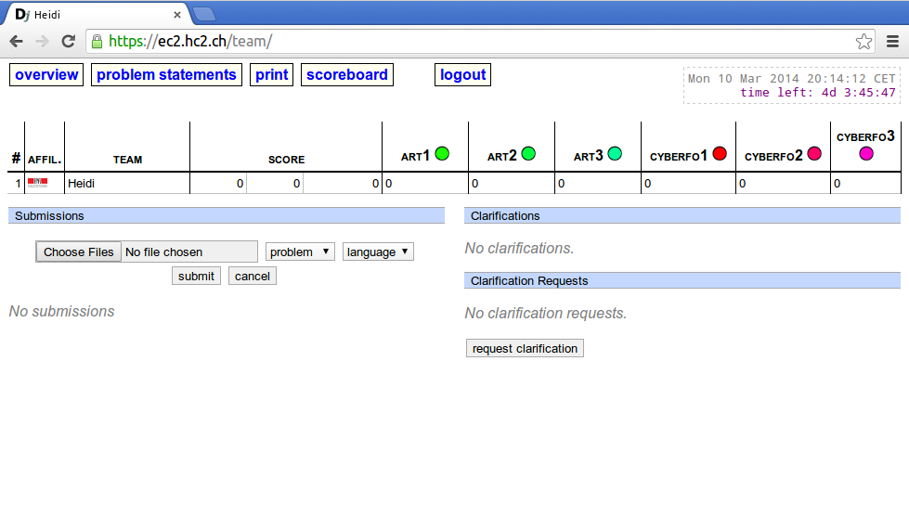
3. Overview (blank)

Slide 12
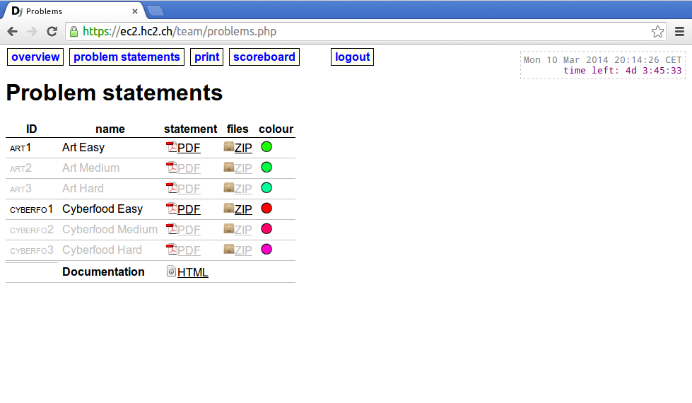
4. Problem statements

Slide 13
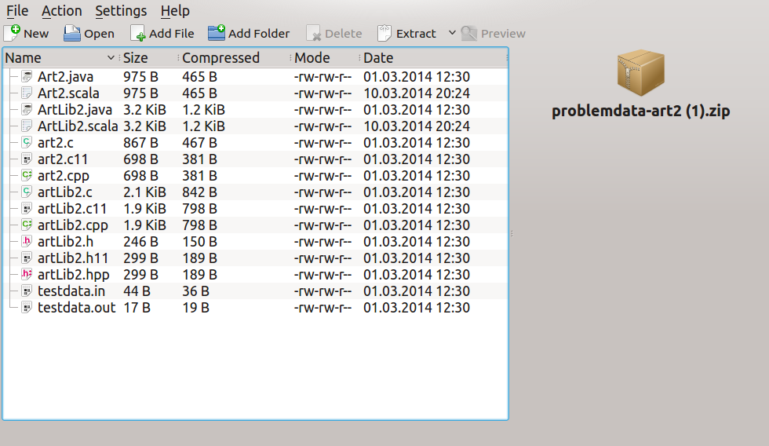
5. All you need

Slide 14
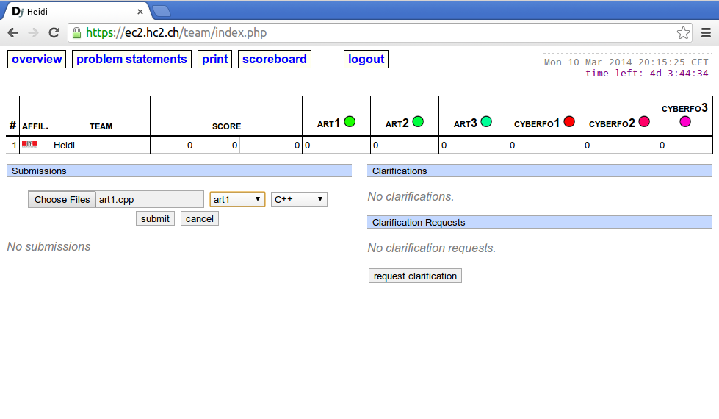
6. Submit your code

Slide 15
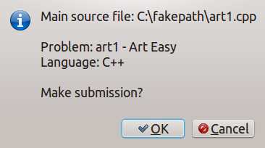
7. Confirm submission

Slide 16
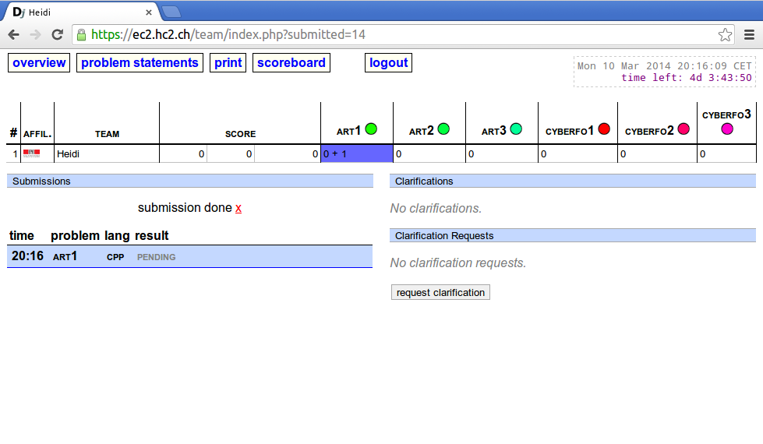
8. Feedback

Slide 17
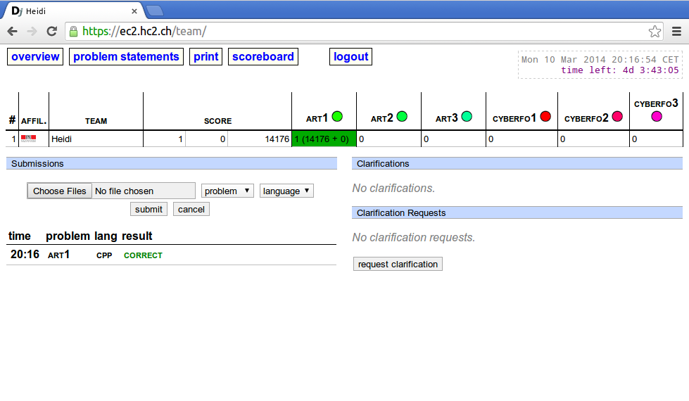
9. Correct -> great!

Slide 18
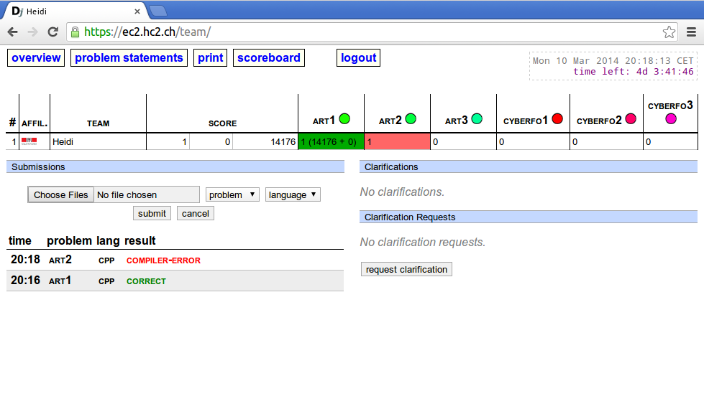
10. Error -> keep cool!

Slide 19
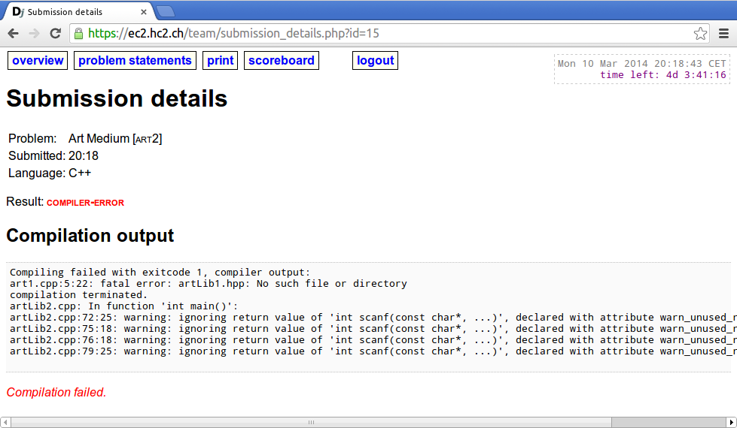
11. Error -> keep cool!

Slide 20
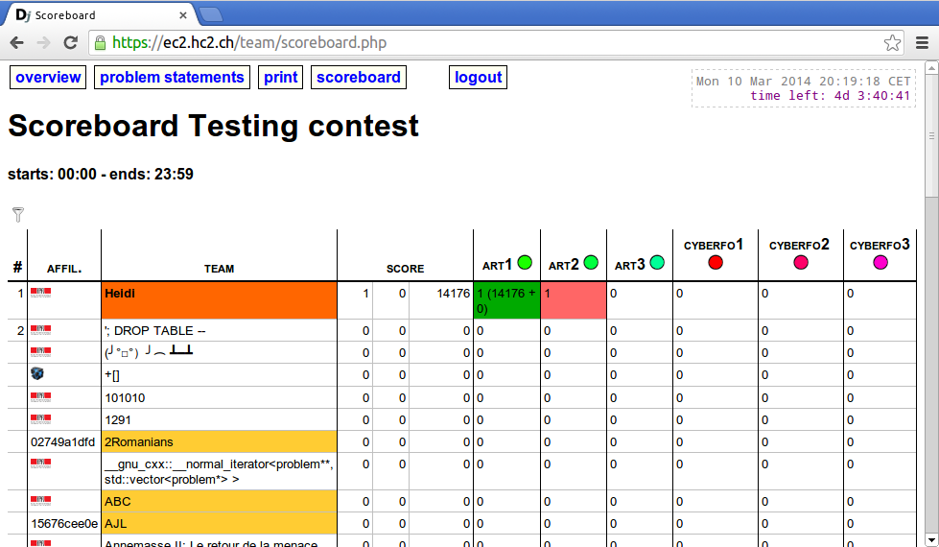
12. Ranking

Slide 21
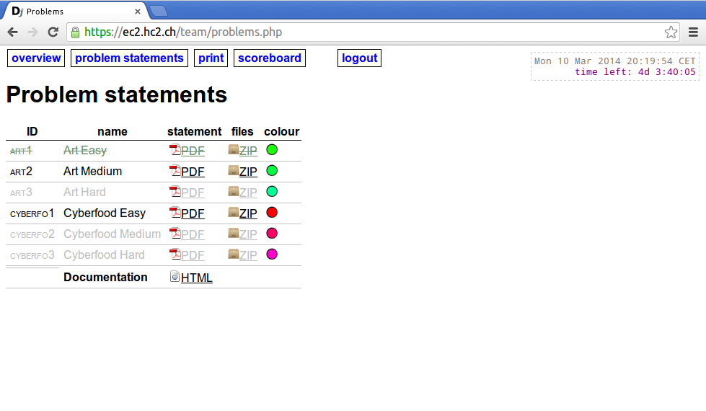
13. New subtasks

Slide 22
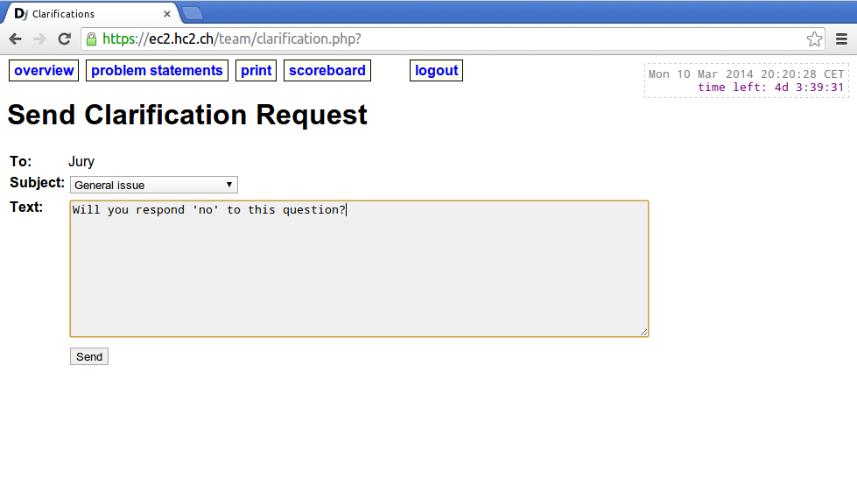
14. Ask for clarification

Slide 23
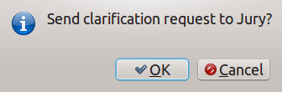
15. Confirm your request

Slide 24
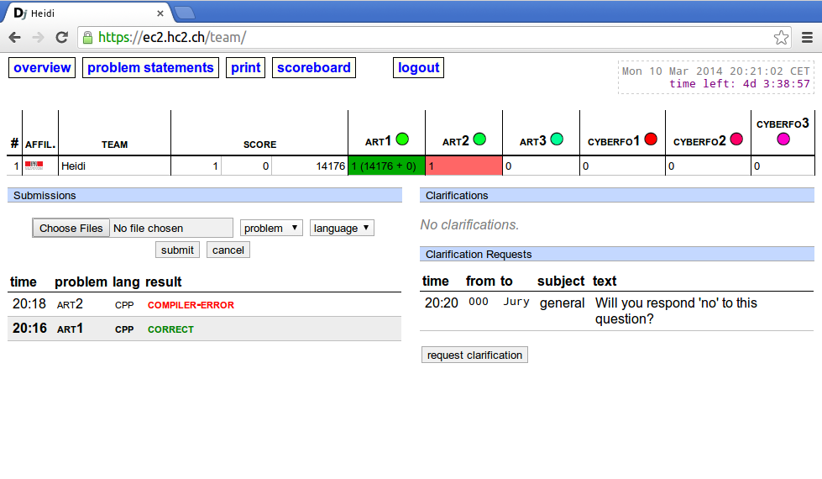
16. After you asked

Slide 25
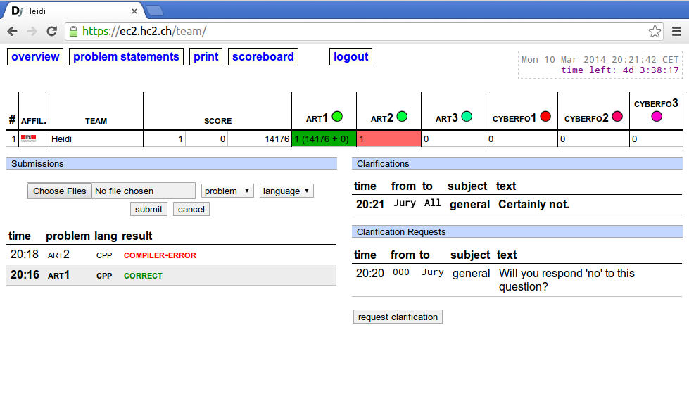
17. The judges answer

Slide 26
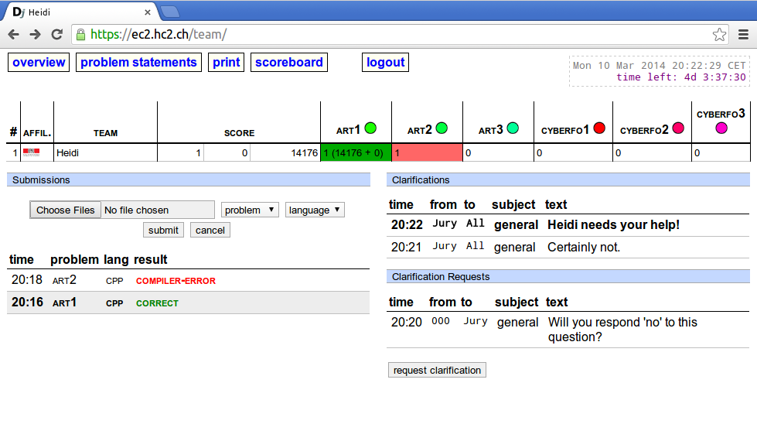
18. Announcement

Slide 27
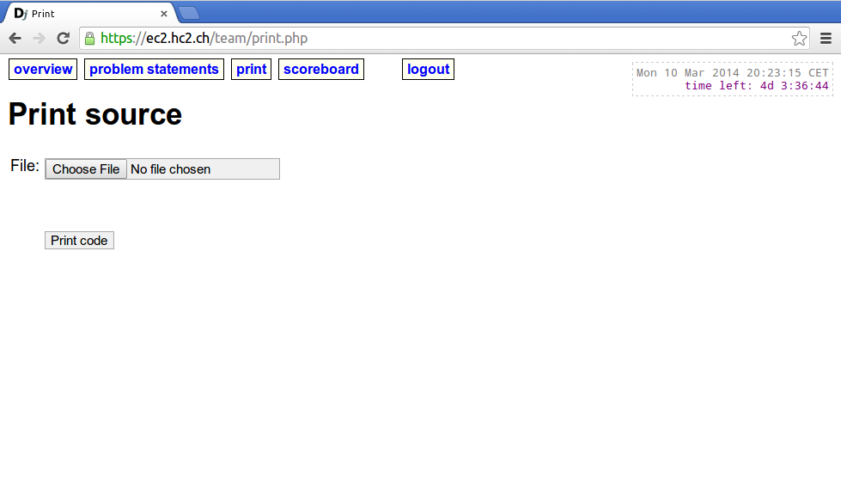
19. Print

Slide 28
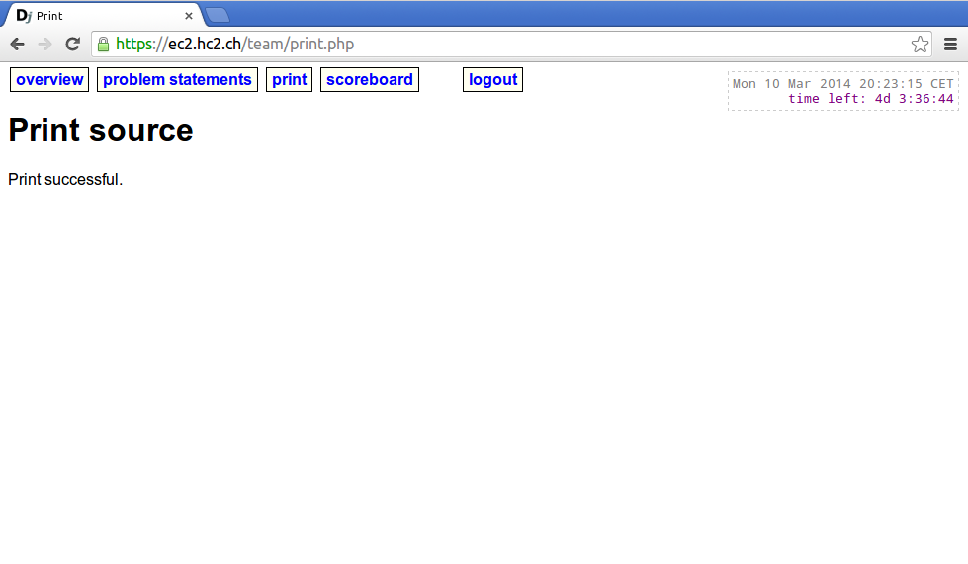
20. Your printout is on the way

Slide 29
Fancy prize algorithm
There are 18 cool prizes to win!
Each contestant of top 3 teams gets a prize, a medal, and a printed diploma.
Each contestant of the next 3 student teams do as well.
If prizes remain, they are raffled:
- Each person’s winning probability is proportional to
the number of subtasks solved by his/her team.
- Must attend ceremony in person to be eligible.
- At most 1 prize per contestant.
Diplomas can be downloaded from website & printed at home.

Slide 30
FAQ
How to configure keyboard:
setxkbmap ch fr
How to set screen resolution:
Menu > Preferences > Monitors

Slide 31
Good luck!
Please go to the computer labs in
INF2 and INF3.

