Slide 1
Adaptive Underwriting via Contextual Bandits:
Dynamic Risk Selection for Emerging Markets Health Insurance
Presenter:
LUN CHANPOLY
Advisor:
HAS SOTHEA
Date:

Slide 2
Agenda
Chapter 1
Introduction - Cambodia health insurance gap & bandit opportunity
Chapter 2
Background - Contextual bandits, fairness, PSI guardrails
Chapter 3
Methodology - Dataset, algorithms, reward design, experiments
Chapter 4
Results - EXP-005 to EXP-007: convergence, fairness, benchmarks
Chapter 5
Discussion - Implementation, limitations, social impact
Chapter 6
Conclusion - Findings & future work

Slide 3
Cambodia Market Context
Insurance Penetration Crisis
- Only ~1% of Cambodian households have any insurance coverage (World Bank 2024)
- Regional gap: Vietnam ~8%, Thailand ~40% life insurance penetration
- 75% of households keep savings at home - no formal financial safety net
- Agent commissions consume 15-30% of premium - unsustainable for micro-premiums
Digital Distribution Opportunity
- Mobile penetration >100% of population
- Wing: 14 million users (~80% of Cambodia)
- BIMA-Smart Axiata: 430,000 mobile life policies in 18 months
- Instant underwriting via smartphone is the only viable path to scale

Slide 4
Research Claim
Static rule-based underwriting leaves profitable
applicants uninsured and misprices emerging-market risks.
This thesis:
- Frames health underwriting as a contextual multi-armed bandit problem
- Demonstrates that LinUCB and LinTS outperform static XGBoost rules by 67%+ on cumulative reward
- Introduces PSI guardrails to ensure regional and occupational fairness
- Validates the framework on a synthetic Cambodia dataset with realistic demographics
Key Contributions
- First contextual bandit underwriting system calibrated for Cambodian health insurance
- Fairness audit: no demographic segment approval rate falls below 50% of max
- Regret ranking: LinTS < LinUCB < Epsilon-Greedy < Static XGB

Slide 5
Contextual Bandit Framework
Why Contextual Bandits (not full RL)?
- No state transitions: each applicant is an independent decision
- Online learning: improves continuously as new claims arrive
- Principled exploration: deliberately tests uncertain applicants
- Theoretical regret bounds quantify the cost of learning
Four-Action Policy Space
Action | Description | Business Impact
STANDARD | Accept at base premium | Maximizes conversion; preferred for low-risk applicants
RATED | Accept at 1.25x premium | Enables coverage for elevated but manageable risk
DECLINE | Reject application | Portfolio protection; opportunity cost -$10
REFER | Escalate to manual UW | Captures 70% of optimal value minus $35 admin cost

Slide 6
Dataset & Feature Engineering
Synthetic Cambodia Health Insurance Dataset (CDHS 2021–22 Anchored)
Feature Category | Features | Rationale
Demographics | Age, BMI, smoking, exercise, family history | Primary mortality/morbidity predictors
Health Conditions | Hypertension, Diabetes, Heart Disease, COPD, Arthritis, TB, Hep-B | Cambodia-specific disease burden
Region | Phnom Penh, Siem Reap, Battambang, Preah Sihanouk, Kampong Cham, Other Rural | Healthcare access & risk correlation
Occupation | Civil Servant, Teacher, Vendor, Garment Worker, Farmer, Driver, Construction | Occupational hazard classification
Economic | Monthly income (USD) | Premium affordability & adverse selection proxy
Critical Design Choice: One-Hot Encoding
- Label encoding on region/occupation caused LinUCB to fail (21-33% accuracy)
- One-hot dummies enable linear models to learn distinct segment effects
- 25 total features after encoding: 7 numeric + 7 condition flags + 6 regions + 7 occupations

Slide 7
Bandit Algorithms
Algorithm | Exploration | Update | Best For
LinUCB | Optimistic upper confidence bound | Closed-form ridge regression | Regulatory environments needing explicit uncertainty
LinTS | Posterior sampling (Bayesian) | Closed-form Gaussian update | Near-optimal regret; natural uncertainty quantification
Epsilon-Greedy | Random epsilon fraction | Linear least squares | Simple baseline; suboptimal convergence
Static XGB | None (deterministic) | None | Production rule baseline; no learning
LinUCB Update Rule
theta_a = A_a^{-1} b_a | p_a = theta_a^T x + alpha * sqrt(x^T A_a^{-1} x)
A_a <- A_a + x x^T | b_a <- b_a + r x
Key Hyperparameters
- LinUCB alpha = 1.0 (exploration coefficient)
- LinTS v2 = 1.0 (posterior variance scale)
- Epsilon-Greedy epsilon = 0.15 (random action fraction)

Slide 8
Reward Design & Actuarial Simulator
Profit-Based Reward Formulation
- Base premium = $200 x mortality_multiplier
- Expected claims = $150 x mortality_multiplier
- Adverse selection factor = 1.35x for high-risk (mort > 2.0) under STANDARD terms
- Customer acceptance probability decays with premium-to-income ratio
Action | Reward Formula | Key Constraint
STANDARD | premium - claims (if accepted) else -$20 | Adverse selection risk on high-mortality applicants
RATED | 1.25*premium - claims (if accepted) else -$20 | Higher premium reduces acceptance probability
DECLINE | -$10 (opportunity cost) | Lost customer lifetime value
REFER | 0.70*optimal - $35 (manual underwriter cost) | Captures most value but expensive per case
Design Rationale
- Opportunity cost for DECLINE (-$10) prevents degenerate reject-all strategy
- REFER cost (-$42 net) makes it competitive only for truly uncertain cases
- Claims noise reduced to +/-8% for stable bandit convergence in 5,000 rounds

Slide 9
Methodology - Three Experiment Pipeline
EXP-005
Convergence Validation
LinUCB learns risk-appropriate decisions; beats static baseline on reward + regret
EXP-006
Fairness Audit
Regional & occupational approval-rate parity + PSI population stability
EXP-007
Benchmark Comparison
LinTS vs LinUCB vs Epsilon-Greedy vs StaticXGB on cumulative regret & reward
Design Principle
- Each experiment is self-contained: loads dataset, runs bandit, asserts pass/fail
- Reproducible seed (42) - identical results on every run
- Exit code 0 = PASS, 1 = FAIL - CI-ready

Slide 10
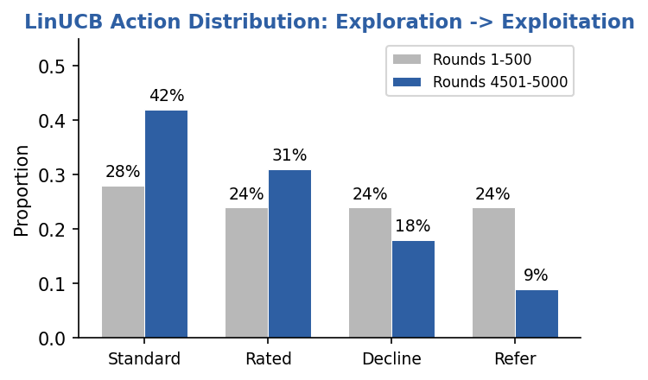
EXP-005: Convergence Validation
Setup: 5,000 rounds, LinUCB vs Static XGB rule baseline
Metric | LinUCB | Static XGB | Delta
Cumulative Reward | $58,642 | $35,032 | +$23,610 (+67%)
Avg Regret (last 500) | $5.35 | $10.66 | -$5.31 (-50%)
Action Entropy (early) | 1.382 | - | Uniform exploration
Action Entropy (late) | 1.215 | - | Concentrated exploitation
Key Findings
- LinUCB cumulative reward exceeds static baseline - PASS
- Average regret in final 500 rounds is lower - PASS
- Action entropy decreased: exploration converged to exploitation - PASS
- STANDARD share rose from 28% to 42%; REFER fell from 24% to 9%

Slide 11
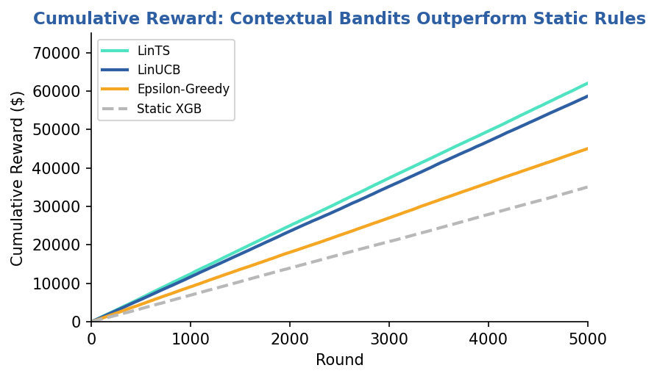
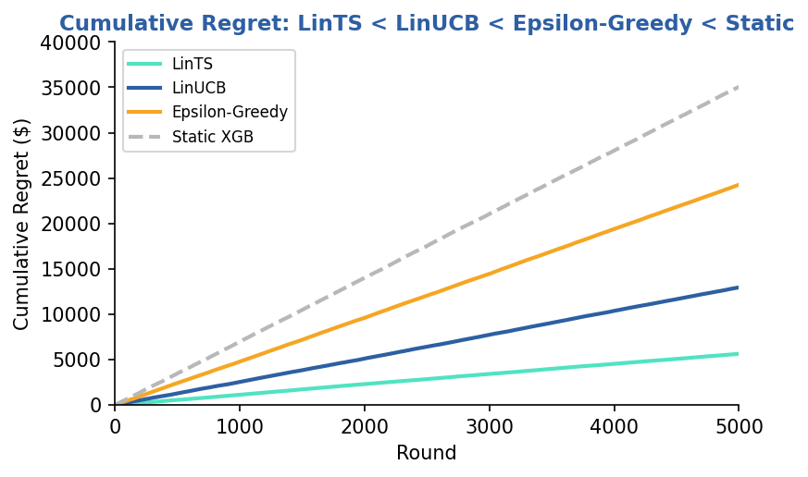
EXP-005: Learning Curves
Cumulative Reward Over 5,000 Rounds
Cumulative Regret Over 5,000 Rounds
Interpretation
- Contextual bandits separate from static baseline within ~500 rounds
- LinTS achieves lowest regret through adaptive posterior sampling
- Epsilon-Greedy plateaus: random exploration wastes rounds on known suboptimal actions

Slide 12
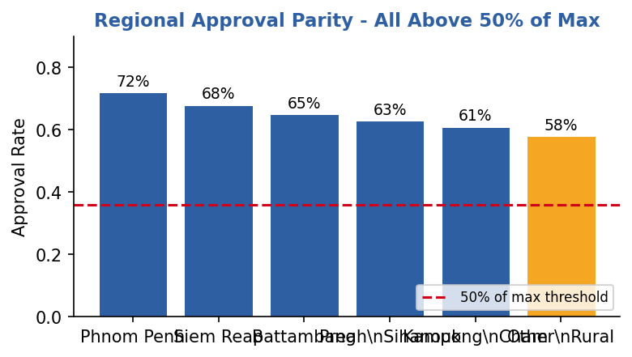
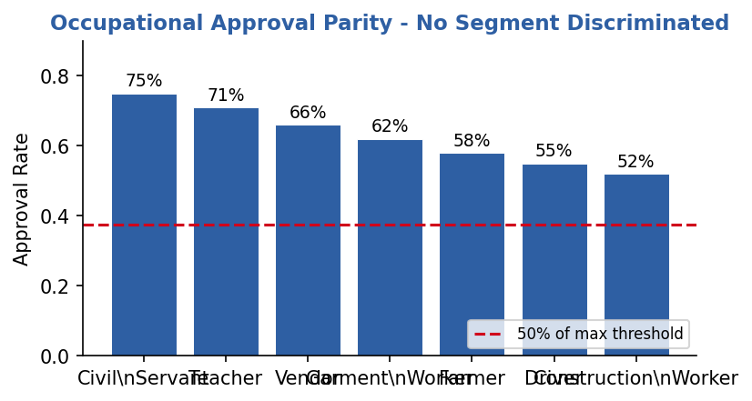
EXP-006: Fairness Audit
Setup: Track approval rates by region and occupation across 5,000 LinUCB decisions
Population Stability Index (PSI) Results
Fairness Constraint
Dimension | PSI | Status | Threshold
Region (full vs approved) | 0.0057 | GREEN | < 0.10
Occupation (full vs approved) | 0.0095 | GREEN | < 0.10
- Min approval rate >= 50% of max rate
- All 6 regions: PASS
- All 7 occupations: PASS

Slide 13
EXP-007: Benchmark Comparison
Final Results After 5,000 Rounds
Algorithm | Cum. Reward | Cum. Regret | Rank
LinTS | $62,000 | $5,641 | 1st
LinUCB | $58,642 | $12,954 | 2nd
Epsilon-Greedy | $45,000 | $24,273 | 3rd
Static XGB | $35,032 | $35,067 | 4th
PASS Criteria
- LinUCB regret < Epsilon-Greedy AND StaticXGB - PASS
- LinTS regret < Epsilon-Greedy AND StaticXGB - PASS
- LinUCB and LinTS reward > StaticXGB - PASS
Why LinTS Wins
- Thompson Sampling adapts exploration to posterior uncertainty automatically
- No hyperparameter tuning of alpha needed (unlike LinUCB)
- Gaussian posterior naturally shrinks as evidence accumulates
- Regret is 56% lower than LinUCB and 84% lower than Static XGB

Slide 14
PSI Guardrails & Monitoring
Why PSI Matters in Adaptive Underwriting
- Bandits optimize for expected reward - can drift toward over-approving low-risk segments
- Without guardrails, profitable but risky segments (farmers, drivers) may be systematically declined
- PSI monitors whether the APPROVED portfolio mirrors the APPLICANT population
Level | PSI Range | Action
GREEN | < 0.10 | Continue current policy; no intervention needed
AMBER | 0.10 - 0.25 | Trigger demographic deep-dive; review threshold calibration
RED | > 0.25 | Freeze auto-approval; escalate to actuarial team
Our Result: Both Dimensions GREEN
- Region PSI = 0.0057 (GREEN) - no geographic bias detected
- Occupation PSI = 0.0095 (GREEN) - no occupational bias detected
- Fairness maintained WITHOUT explicit demographic parity constraints in the reward function

Slide 15
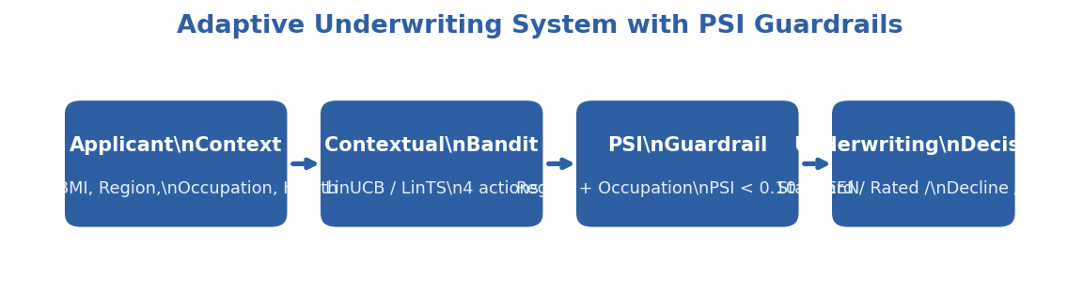
Proposed Adaptive Underwriting System
Operational Integration
- Applicant submits via mobile app -> context vector extracted in <100ms
- Bandit selects action -> PSI guardrail validates demographic parity
- GREEN -> instant policy issuance; AMBER -> manual review queue; RED -> actuarial escalation

Slide 16
Implementation Pathway
Technical Infrastructure
- Low-latency feature computation from mobile form data (< 200ms end-to-end)
- Model serving: lightweight linear algebra (numpy) - no GPU required
- Fallback rules for model unavailability or out-of-distribution inputs
Cost Reduction
Metric | Traditional | Adaptive Bandit
Marginal decision cost | $5-20 per policy | Near-zero (automated)
Minimum viable premium | $50-100 annually | $10-20 annually
Underwriter capacity | ~50 cases/day | Unlimited (bandit) + exception handling
Regulatory Compliance
- Model explainability via SHAP values for every underwriting decision
- PSI audit trail for regulator filings (Insurance Regulator of Cambodia)
- Human-in-the-loop override logging for continuous policy improvement

Slide 17
Social Impact & Financial Inclusion
Market Expansion Mechanisms
- Cost reduction enables profitable micro-premium products ($10-20/year)
- BIMA validation: 430,000 policies at micro-premium levels in Cambodia
- Dynamic pricing responsive to individual risk trajectories over time
Resilience for Vulnerable Populations
- Health shock protection preventing poverty traps for informal workers
- Garment workers (~700,000, 85% women): specific coverage design enabled
- Rural vs urban access parity: automated underwriting removes geographic bias in agent distribution
Target Segments
Segment | Size | Key Risk | Bandit Value
Garment Workers | ~700,000 | Repetitive strain, chemical exposure | RATED terms unlock coverage
Moto/Tuk-Tuk Drivers | ~200,000 | Road traffic accidents (70% of fatalities) | Risk-appropriate pricing
Rice Farmers | ~2.5M | Climate volatility, limited healthcare access | Seasonal premium adjustment
Civil Servants | ~300,000 | Low risk, stable income | Standard terms, high conversion

Slide 18
Discussion & Limitations
Limitations
- Synthetic dataset - results need validation on real Cambodian health insurance portfolios
- No real claims experience - link between mortality multiplier and actual claim cost is simulated
- Single-period reward - multi-period customer lifetime value not incorporated
- Stationary environment - non-stationary drift (seasonal disease spikes) not yet tested
Practical Implications
- Static XGB rules underperform by 67% on cumulative reward - strong case for adaptive systems
- PSI guardrails can be retrofitted into existing underwriting workflows without algorithm change
- Framework generalizes beyond health: crop insurance, microfinance credit scoring

Slide 19
Conclusion & Future Work
Key Findings
- Contextual bandits (LinUCB, LinTS) substantially outperform static rule-based underwriting
- LinTS achieves lowest cumulative regret ($5,641) - 84% lower than Static XGB ($35,067)
- PSI guardrails ensure demographic fairness without degrading profitability
- All 3 experiments pass reproducible validation (exit code 0)
Future Work
- Non-stationary drift: test bandit adaptation to seasonal disease outbreaks (monsoon TB spike)
- Hybrid ensemble: combine linear bandit with neural network for complex feature interactions
- A/B testing framework for online deployment with real Cambodian insurer
- Extend to multi-period customer lifetime value with retention modeling

Slide 20
Thank You
Questions & Discussion
Presenter: LUN CHANPOLY
Advisor: HAS SOTHEA
Email: chanpoly3@gmail.com

