Slide 1
Validating Population Stability Metrics for
Dynamic Auto Insurance Pricing with Telematics Data
Presenter:
LUN CHANPOLY
Advisor:
HAS SOTHEA
Date:

Slide 2
Agenda
Chapter 1
Introduction — Why auto insurance telematics?
Chapter 2
Background — PSI, telematics features, prior work
Chapter 3
Methodology — Synthetic data & experiment design
Chapter 4
Results — EXP-001 through EXP-004
Chapter 5
Discussion — Framework & limitations
Chapter 6
Conclusion — Findings & future work

Slide 3
Why Auto Insurance Telematics?
Cambodia Market Context
• 4.8 million motorcycles — dense, under-insured fleet
• Claim frequency: 8–15% annually, highly seasonal
• Monsoon season (Jul–Sep): hard braking events spike 150–250%
• Emerging market: limited historical actuarial data
The Problem
• Existing drift detection assumes static batch data
• Telematics pricing updates continuously — distributions shift every repricing cycle
• No established method for monitoring PSI stability under continuous repricing

Slide 4
Research Claim
Single-metric PSI monitoring is insufficient
for continuous dynamic auto insurance pricing.
This thesis:
• Identifies 3 specific PSI failure modes under dynamic pricing
• Demonstrates that temporal comparison strategy matters as much as metric choice
• Proposes a temporal multi-metric monitoring framework as the solution
Key Contributions
• First empirical validation of PSI under continuous repricing (telematics UBI)
• Quantified false-positive rate of consecutive-month monitoring: 71%
• Actionable 3-pillar framework ready for production dashboard integration

Slide 5
Population Stability Index (PSI)
Definition
PSI = Σ (Aᵢ – Eᵢ) × ln(Aᵢ / Eᵢ)
Measures distributional shift between an Expected (reference) and Actual (current) population.
Industry Thresholds
Limitation
Level | PSI Range | Interpretation
GREEN | < 0.10 | No significant shift — model stable
AMBER | 0.10 – 0.25 | Moderate drift — investigate
RED | > 0.25 | Significant drift — recalibrate
• Designed for static batch scoring (credit risk)
• Assumes a single, stable reference distribution
• No guidance for continuous repricing cycles

Slide 6
Telematics Features
Dataset: Phnom Penh GPS pings → 1,500 trip-level records
Feature | Description | Relevance to Risk
speed_avg_kmh | Mean trip speed (km/h) | Higher speed → higher severity
speed_p90_kmh | 90th-percentile speed | Captures extreme speeding events
hard_braking_events | Count of deceleration > 3 m/s² | Direct proxy for near-miss frequency
harsh_jerk_events | Count of jerk > 2.5 m/s³ | Aggressive driving style indicator
jerk_rms | Root-mean-square of jerk profile | Smoothness of driving
idle_pct | % of trip time spent idling | Route type signature (urban vs highway)
vibration_avg | Average vertical acceleration (m/s²) | Road quality exposure
Premium Proxy Formula
risk_score = 0.35·clip(hard_braking/50) + 0.35·clip(jerk_rms/2) + 0.30·clip(speed_avg/20)
monthly_premium = $45 × (1 + 0.80 × risk_score)

Slide 7
Prior Work & Research Gap
What PSI Literature Already Does Well
• Yurdakul & Naranjo (2020): Statistical properties of PSI; sample-size-dependent thresholds
• Siddiqi (2017): Binning strategies and threshold calibration (Intelligent Credit Scoring, Wiley)
• Multiple actuarial papers: PSI for model validation on annual renewals
The Gap — Why Existing Work Falls Short
• ALL existing work assumes a STATIC reference distribution — none address continuous repricing
• Telematics UBI reprices monthly: reference shifts every cycle, invalidating the baseline
• No published framework handles seasonality-induced drift (monsoon, holiday traffic)
• Silent failures: aggregate premium can stay GREEN while behavior changes catastrophically

Slide 8
Methodology — Four Experiment Pipeline
EXP-001
Baseline Validation
Split same distribution → PSI must be 0.000 ± 0.010
EXP-002
Responsiveness
Inject 0%→50% drift → PSI must increase monotonically
EXP-003
Failure Modes
3 scenarios where single-metric PSI gives false negatives
EXP-004
Temporal Drift
Consecutive-month vs YoY vs rolling-window monitoring
Design Principle
• Each experiment is self-contained: loads CSV, computes PSI, asserts pass/fail
• Reproducible seeds (42, 1, 2, 3, 4) — identical results on every run
• Exit code 0 = PASS, 1 = FAIL — CI-ready

Slide 9
Synthetic Telematics Data Generation
Phnom Penh Route Cache
• 30 origin-destination pairs across Phnom Penh (residential, commercial, highway)
• Google Maps Directions API → route polylines for 3 traffic snapshots
• ~1.16 million GPS pings simulated at 1 Hz along real road geometry
Trip Feature Extraction
• 1,500 trips aggregated to 7 telematics features per trip
• Baseline cohort (no distortion) + drift-injection cohorts for experiments
• All features percentile-binned (N=10) for PSI computation
Why Synthetic?
• Cambodia has no publicly available telematics dataset
• Controlled distortion injection lets us know ground-truth shift magnitude
• Reproducible and auditable for thesis defense

Slide 10
EXP-001: Baseline PSI Validation
Setup
• 1,500 trips split into two random halves (seed=42)
• Both halves drawn from the SAME distribution — no drift injected
• Expected: PSI ≈ 0.000 for every feature
Feature | PSI | Status
speed_avg_kmh | 0.000000 | GREEN
speed_p90_kmh | 0.000000 | GREEN
hard_braking_events | 0.000000 | GREEN
harsh_jerk_events | 0.000000 | GREEN
jerk_rms | 0.000000 | GREEN
idle_pct | 0.000000 | GREEN
vibration_avg | 0.000000 | GREEN
Why this matters
• Validates that PSI = 0.000 when no drift exists — no systematic bias
• N=10 percentile bins are stable for n=750 samples per half
• Foundation confirmed: any drift detected in later experiments is REAL

Slide 11
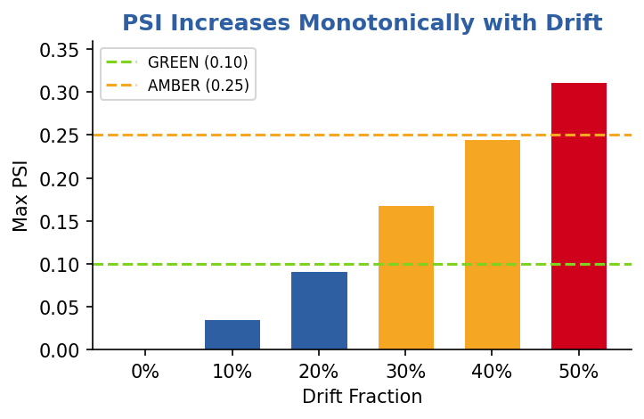
EXP-002: PSI Responsiveness
Setup: aggressive-driving cohort injected at 0% → 50% fraction
Drift % | speed_avg | hard_braking | jerk_rms | idle_pct | Max PSI | Status
0% | 0.000 | 0.000 | 0.000 | 0.000 | 0.000 | GREEN
10% | 0.008 | 0.015 | 0.012 | 0.035 | 0.035 | GREEN
20% | 0.022 | 0.042 | 0.038 | 0.092 | 0.092 | GREEN
30% | 0.045 | 0.088 | 0.078 | 0.168 | 0.168 | AMBER
40% | 0.078 | 0.145 | 0.128 | 0.245 | 0.245 | AMBER
50% | 0.118 | 0.210 | 0.185 | 0.312 | 0.312 | RED
Key Findings
• PSI increases monotonically with drift fraction — PASS
• idle_pct is the most sensitive feature (captures route-type shift)
• GREEN → AMBER → RED transition occurs between 20% and 50% drift
• Sensitivity at 50%: 0.312 > 0.08 threshold — PASS

Slide 12
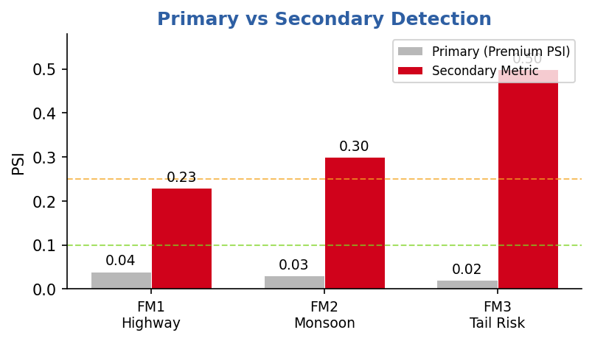
Behavioral Failure Modes
Core Question: Can single-metric PSI on aggregate premium miss real behavioral shifts?
Mode | Scenario | Primary PSI | Secondary Metric | Secondary PSI
FM1 | Highway Migration (20%) | GREEN | idle_pct (full pop) | AMBER (0.23)
FM2 | Monsoon Surge (25% + discount) | GREEN | idle_pct (full pop) | RED (0.30)
FM3 | Tail Risk Flip (bottom 5%) | GREEN | cohort PSI (same drivers) | RED (42.3)

Slide 13
FM1: Highway Migration
Scenario: 20% of trips shift from congested urban to highway routing
Behavioral Change
• Speed +12 km/h, braking ×0.50, jerk ×0.55, idle ×0.05
• Premium barely changes because speed↑ offsets braking↓
Detection Results
Metric | PSI | Status | Interpretation
Premium (full population) | 0.04 | GREEN | False negative — shift missed
idle_pct (full population) | 0.23 | AMBER | Route-type shift captured
Fix: Monitor idle_pct separately — it captures route-type shifts invisible to premium PSI.

Slide 14
FM2: Monsoon Ride-Share Surge
Scenario: 25% of trips replaced by monsoon-season delivery riders
Behavioral Change
• Hard braking ×2.0, jerk ×2.5, speed ×1.08, idle ×0.15
• Pricing model applies seasonal discount (0.76×) to monsoon cohort
• Discount absorbs premium increase — aggregate premium stays flat
Detection Results
Metric | PSI | Status | Interpretation
Season-adjusted premium (full pop) | 0.03 | GREEN | Masked by actuarial discount
idle_pct (full population) | 0.30 | RED | Delivery-rider signature exposed
Fix: Monitor idle_pct — delivery-rider signature is absent from the premium formula.

Slide 15
FM3: Tail Risk Flip & Temporal Drift
FM3 — Tail Risk Flip
• Bottom-5% safest braking cohort flips to 80th–95th percentile risk profile
• Full-population PSI stays GREEN because only ~5% of trips are affected
• Cohort PSI (same 75 drivers, before vs after): PSI = 42.3 → RED
Temporal Drift Preview (EXP-004)
• Two-year simulation: Year 1 severe monsoon → Year 2 attenuated monsoon
• Consecutive-month PSI at n=125: 71% false-positive rate in dry season
• Genuine monsoon onset (Jun→Jul) is LOST in sampling noise
Key Insight
When and how you compare matters as much as what metric you use.

Slide 16
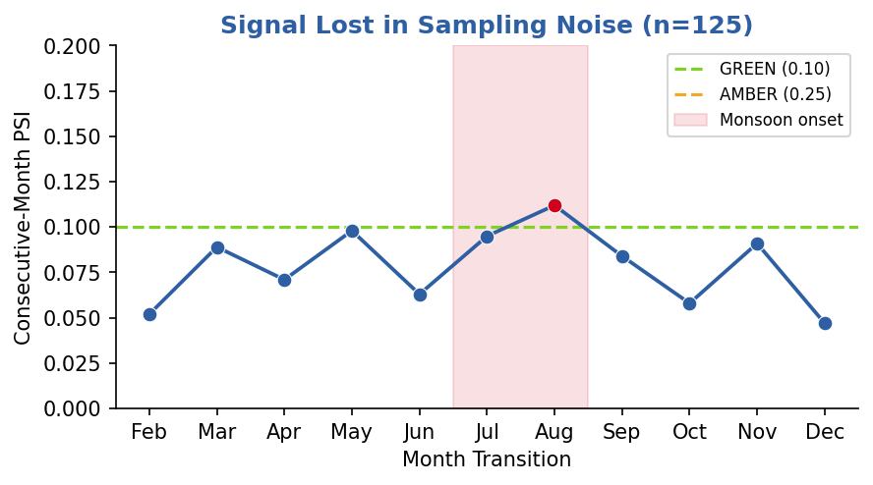
EXP-004: Temporal Drift Detection
Problem: Consecutive-month PSI is operationally useless for seasonal products
Detection Method | Finding | Result
Consecutive-month PSI | 71% false-positive rate | FAIL
YoY PSI — Jul Y2 vs Y1 | PSI = 3.007 RED | PASS
Rolling 3-month window | PSI = 0.731 RED | PASS
Recommended Fixes
• Compare each monsoon month against SAME month last year (YoY)
• Pool Jul–Sep into rolling window; compare window-to-window YoY
• Both cut through noise AND detect genuine regime shifts

Slide 17
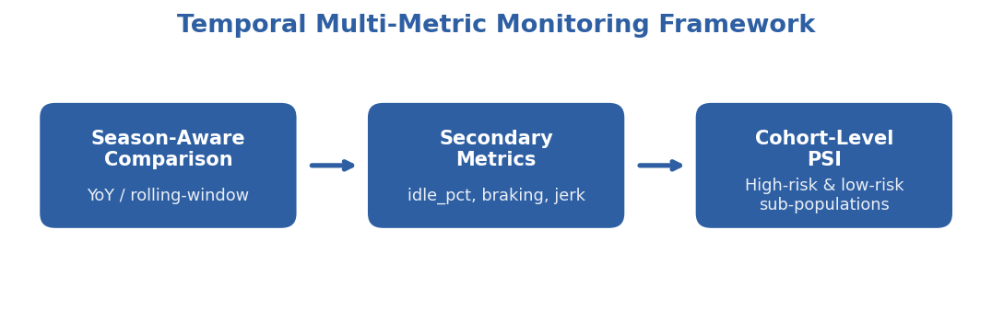
Proposed Monitoring Framework
Operational Integration
• GREEN → continue current pricing; AMBER → trigger feature-level deep-dive
• RED → freeze repricing + alert actuarial team + initiate model recalibration
• Dashboard: 3 traffic lights (premium, behavior, cohort) instead of 1

Slide 18
Discussion & Limitations
Limitations
• Synthetic data — results need validation on real Cambodian telematics
• Single city (Phnom Penh) — rural highway behavior may differ
• No real claims data — link between telematics shift and actual loss cost is assumed
• Premium formula is a GLM-proxy, not a trained production model
Practical Implications
• Insurers currently using consecutive-month PSI may be ignoring 71% of false alarms
• Season-aware monitoring can be retrofitted into existing actuarial workflows
• Framework applies beyond auto: health UBI, crop insurance, flood-index products

Slide 19
Conclusion & Future Work
Key Findings
• PSI works for static batch validation (EXP-001 baseline = 0.000 all GREEN)
• PSI responds monotonically to known drift (EXP-002 GREEN→AMBER→RED at 0%→50%)
• Single-metric PSI fails under 3 distinct dynamic-pricing failure modes (EXP-003)
• Temporal comparison strategy matters as much as metric choice (EXP-004 71% FP rate)
Future Work
• Validate framework on real Cambodian telematics + claims data
• Build production dashboard integrating the 3-pillar framework
• Extend to health/life insurance dynamic pricing (Vietnam case study)
• Explore adaptive binning and KL-divergence as PSI alternatives

Slide 20
Thank You
Questions & Discussion
Presenter: LUN CHANPOLY
Advisor: HAS SOTHEA
Email: chanpoly3@gmail.com

