Slide 1



Institute of Technology of Cambodia
Department of Applied Mathematics and Statistics
ADAPTIVE HEALTH INSURANCE UNDERWRITING VIA CONTEXTUAL BANDITS: A REINFORCEMENT LEARNING APPROACH FOR CAMBODIA
Thesis Defense — Presented by
LUN CHANPOLY
Supervisor : Dr. HAS Sothea
Organization : DAC (Decent Actuarial Consultants)
Duration : Mar 2026 – Jun 2026
July 2026
DAC · ITC-AMS
Adaptive Underwriting via Contextual Bandits
July 2026 · 1 / 28

Slide 2
TABLE OF CONTENTS
I
Introduction & Problem Background
II
Literature Review
III
Methodology & Model Design
IV
Results & Evaluation
V
Conclusion & Future Work
DAC · ITC-AMS
Adaptive Underwriting via Contextual Bandits
July 2026 · 2 / 28

Slide 3
I.
Introduction & Problem Background
DAC · ITC-AMS
Introduction & Problem Background
July 2026 · 1 / 29

Slide 4
ABOUT DECENT ACTUARIAL CONSULTANTS
DAC is a Phnom Penh actuarial consultancy
Clients: life, non-life & general insurance companies
DAC-supervised research internship (Mar–Jun 2026); advisor Mr. ON Radet
Deliverable: an adaptive underwriting prototype + this report
DAC · ITC-AMS
Introduction & Problem Background
July 2026 · 2 / 29
Notes:
Decent Actuarial Consultants is a Phnom Penh actuarial consultancy serving life, non-life and general insurance companies. The thesis is embedded in a DAC-supervised research internship, March through June 2026, advised at DAC by Mr. ON Radet; the deliverable is the end-to-end adaptive underwriting prototype plus this report. Timeline: March scoping and dataset design, April algorithms, May experiments, June writing and defense preparation.

Slide 5
INTRODUCTION
< 10 %
ALIGNMENT WITH CAMBODIA'S SDGs
HEALTH-INSURANCE PENETRATION IN CAMBODIA (2023 EST.)
SDG 3
Good Health & Well-being
Widen voluntary health-insurance access beyond the ~16% NSSF formal sector
NSSF covers formal-sector workers only (~16%)
SDG 1
No Poverty
Private underwriting is manual and rule-based
Shield households from catastrophic out-of-pocket health costs
Static rules never learn from outcomes
SDG 10
Reduced Inequalities
No demographic-parity monitoring in practice
PSI guardrail keeps underwriting demographically fair
DAC · ITC-AMS
Introduction & Problem Background
July 2026 · 3 / 29
Notes:
Cambodia context: the National Social Security Fund covers only formal-sector workers, roughly 16 percent; private voluntary insurance is nascent and underwriting is mostly manual and rule-based. Actuaries apply fixed premium rules without learning from outcomes, suboptimal decisions compound over a growing applicant pool, and penetration is below 10 percent (2023 estimate). The opportunity: a contextual bandit learns online from each decision while a PSI guardrail watches demographic fairness. This positions the work against Cambodia's Sustainable Development Goals: SDG 3 good health and well-being through wider insurance access, SDG 1 no poverty by shielding households from catastrophic health costs, and SDG 10 reduced inequalities through the PSI fairness guardrail. The thesis now develops this in a dedicated section - chapter 2 section 2.4, Significance and Alignment with Cambodia's SDGs - which maps the project to SDG 3, 1 and 10. Frame it as the project's intended societal contribution argued through the penetration gap and fairness monitoring; be ready to note this is an alignment argument, not a measured SDG impact.

Slide 6
PROBLEM STATEMENT
Static thresholds
No online adaptation
Fixed cutoffs ignore applicant context
Claims feedback never reaches the model
Demographic blindspot
No triage
No parity metric is tracked
Experts review routine, not borderline, cases
DAC · ITC-AMS
Introduction & Problem Background
July 2026 · 4 / 29
Notes:
Four concrete failures of the status quo. One: fixed age/BMI/income cutoffs ignore context, so a misclassified high-risk applicant generates uncorrected losses. Two: the claims signal is never fed back, so accuracy degrades silently as demographics shift. Three: no parity metric is tracked, so regional or occupational concentration can develop undetected. Four: there is no triage - actuaries spend time on high-volume routine cases instead of genuine edge cases.

Slide 7
PROJECT OBJECTIVE
RESEARCH GOAL
Design and evaluate an adaptive health insurance underwriting system using contextual bandit algorithms on a synthetic Cambodia applicant dataset, incorporating demographic fairness monitoring and human-in-the-loop augmentation.
OBJECTIVES
O1
Implement and adapt linear contextual bandit algorithms (LinUCB, LinTS) for multi-arm health insurance underwriting decisions.
O2
Construct a 2,000-record synthetic Cambodia applicant dataset anchored on CDHS, STEPS, ILO, and WHO demographic distributions.
O3
Evaluate bandit performance versus static rule-based baselines via 20-seed multi-run trials, bootstrap CIs, and paired Wilcoxon tests.
O4
Assess demographic fairness via PSI monitoring across region and occupation, and integrate a human-in-the-loop underwriting wrapper.
DAC · ITC-AMS
Introduction & Problem Background
July 2026 · 5 / 29
Notes:
Read the goal once, slowly. The four objectives map one-to-one onto the chapters: O1 the algorithms (Chapter IV), O2 the dataset (Chapter IV), O3 the evaluation (Chapter V), O4 fairness plus HITL (Chapter V). These are verbatim from the thesis - the examiners will check the wording.

Slide 8
II.
Literature Review
DAC · ITC-AMS
Literature Review
July 2026 · 7 / 29

Slide 9
LITERATURE REVIEW
Topic
Key authors
Contribution
Underwriting in emerging markets
NIS/CDHS (2023); ILO (2022); ADB (2023)
Cambodia: <10% penetration, manual rule-based underwriting, data anchors
Linear contextual bandits
Li et al. (2010); Agrawal & Goyal (2013)
LinUCB O(sqrt(T) d log T) regret; LinTS posterior sampling - the two policies
Neural bandits & dynamic pricing
Zhou (2020); Zhang (2021); Ban (2022)
NeuralUCB / NeuralTS / EE-Net relax the linear-reward assumption
Fairness in insurance ML
Barocas et al. (2019); Ensign et al. (2018)
Protected-attribute constraints; runaway feedback loops
Population stability (PSI)
Yurdakul & Naranjo (2020); Lin (1991)
PSI drift zones (GREEN / AMBER / RED); Jensen-Shannon basis
Full review: thesis Chapter III (25 cited sources, APA).
DAC · ITC-AMS
Literature Review
July 2026 · 6 / 29
Notes:
Five strands inform the method, mirroring Chapter III. First, underwriting in emerging markets - the Cambodia data anchors (CDHS, ILO, ADB) and the sub-10-percent penetration that motivates the work. Second, linear contextual bandits: Li et al. 2010 give the LinUCB regret bound and Agrawal and Goyal 2013 the LinTS guarantee - together they justify the two proposed policies, on the multi-armed-bandit foundations of Robbins, Sutton and Barto, and Lattimore and Szepesvari. Third, neural bandits and dynamic pricing - Zhou, Zhang and Ban relax the linear-reward assumption, scoped as future work. Fourth, fairness in insurance ML - Barocas and Ensign frame protected-attribute constraints and feedback loops. Fifth, population stability - Yurdakul and Naranjo's PSI, built on Lin's Jensen-Shannon divergence, gives the monitoring metric with the 0.10/0.25 thresholds. Every source here is cited in the thesis.

Slide 10
III.
Methodology & Model Design
DAC · ITC-AMS
Methodology & Model Design
July 2026 · 9 / 29

Slide 11
METHODOLOGY OVERVIEW
Applicant Context
Bandit Policy
Underwriting Action
Actuarial Reward
PSI Fairness + HITL
Decision
Each applicant flows left to right: their context drives a bandit policy that picks an underwriting action; the actuarial simulator returns a reward that updates the policy; a PSI guardrail and a human-in-the-loop wrapper watch fairness before the final decision.
DAC · ITC-AMS
Methodology & Model Design
July 2026 · 8 / 29
Notes:
Walk the whole pipeline once, left to right, naming each of the six stages. Tell the panel we will now zoom into three of them in turn.

Slide 12
ZOOM-IN: DATASET & CONTEXT
Applicant Context
Bandit Policy
Underwriting Action
Actuarial Reward
PSI Fairness + HITL
Decision
2,000
34
4
4
SYNTHETIC APPLICATIONS
CONTEXT FEATURES
UNDERWRITING ARMS
ANCHORING SOURCES
Anchored on CDHS, STEPS, ILO, WHO data
RATED
Accept + premium loading (+25%)
Adverse selection AF = 1.35; elasticity 3.5
STANDARD
Accept at standard premium
Fully synthetic — no real applicant PII
DECLINE
Reject application
REFER
Escalate to human underwriter
DAC · ITC-AMS
Methodology & Model Design
July 2026 · 9 / 29
Notes:
The dataset is 2,000 synthetic applicants whose raw attributes one-hot encode into a 34-dimensional standardised context vector (Table 7). Distributions are anchored on CDHS 2021-22 and STEPS 2023; income on ILO labour-force surveys; disease prevalence calibrated from WHO disease-burden reports. Adverse-selection factor 1.35 and price-elasticity slope 3.5 come from DAC actuarial priors. Four arms: RATED accepts with a 25 percent loading, STANDARD accepts at standard rate, DECLINE rejects, REFER escalates to a human. No real applicant data is used anywhere.

Slide 13
THE DATASET AT A GLANCE
2,000 synthetic applicants -> a 34-dimensional standardised context vector, from raw features organised by category (thesis Table 7). Fully synthetic — no real applicant PII.
FEATURE CATEGORIES
DATA SNAPSHOT · 4 OF 2,000 RECORDS
Category
Raw features
Dim
Age
Sex
Region
Occupation
BMI
Smoker
Demographics & vitals
age, gender, BMI
3
36
F
Other Provinces
Rice Farmer
23.2
No
Lifestyle
smoking, alcohol, exercise
3
34
F
Phnom Penh
Rice Farmer
27.0
No
Social determinants
education, wealth, self-rated health
3
39
M
Other Provinces
Civil Servant
19.0
No
Economic
income, family history
2
Clinical
7 condition flags + count
8
43
F
Other Provinces
Garment Worker
25.7
No
Region
8 regions (one-hot)
8
Occupation
7 occupations (one-hot)
7
Total
34
DAC · ITC-AMS
Methodology & Model Design
July 2026 · 10 / 29
Notes:
This is the dataset at a glance. Left, the feature catalogue from thesis Table 7: raw applicant attributes fall into demographics and vitals, lifestyle behaviours, social determinants, economic and clinical groups; after one-hot encoding region and occupation and standardising, each applicant becomes a 34-dimensional context vector. Right, a four-row snapshot of the 2,000 synthetic records - the real column values before encoding. No real applicant data is used anywhere.

Slide 14
REWARD SIMULATOR
Context x_t ∈ R^34
Action
High-risk
Low-risk
age, BMI, region & occupation one-hots, clinical flags -- standardised
RATED
+premium − claims
− adverse-sel. penalty
Action a_t
STANDARD
+premium − claims
+optimal margin
one of RATED / STANDARD / DECLINE / REFER
Reward r_t
DECLINE
0 (avoided loss)
− missed revenue
revenue minus claims, actuarial simulator
REFER
+human decision net
+human decision net
Objective: maximise cumulative reward Σ r_t over T rounds, subject to demographic PSI guardrails.
DAC · ITC-AMS
Methodology & Model Design
July 2026 · 11 / 29
Notes:
Formally: at each round the context is the standardised 34-dimensional applicant vector, the action is one of four arms, and the reward is revenue minus claims from the actuarial simulator, with adverse selection penalising premium-heavy arms on low-risk applicants. The objective is cumulative reward over T rounds subject to the PSI guardrail. The table sketches the reward structure: for a high-risk applicant DECLINE avoids a loss; for a low-risk one it forfeits revenue; REFER nets the human decision either way.

Slide 15
ZOOM-IN: BANDIT POLICY
Applicant Context
Bandit Policy
Underwriting Action
Actuarial Reward
PSI Fairness + HITL
Decision
We now build the bandit policy one component at a time — context in, value estimates, then selection — each step with a concrete output.
DAC · ITC-AMS
Methodology & Model Design
July 2026 · 12 / 29
Notes:
Signpost the build-up: three slides, each adds one box to the policy and shows what that box outputs for a single applicant.

Slide 16
BANDIT BUILD-UP: CONTEXT
Context vector x_t ∈ R^34
output:
[age 0.4, BMI 0.8, smoker 1, ... , PhnomPenh 1, RiceFarmer 0]
34 standardised dims: demographics, lifestyle, clinical flags, region & occupation one-hots
This is the bandit's only view of each applicant
DAC · ITC-AMS
Methodology & Model Design
July 2026 · 13 / 29
Notes:
Start the build-up with the input: the standardised 34-dimensional context vector — show the example slice, noting region and occupation are one-hot encoded.

Slide 17
BANDIT BUILD-UP: VALUE ESTIMATES
Context x_t
Per-arm value
(LinUCB / LinTS)
output:
[0.4, -1.1, 0, 2, 0.8]
output:
RATED 0.31 · STD 0.52 · DEC 0.10 · REF 0.28
LinUCB: θ̂ᵀx + α·√(xᵀA⁻¹x) — optimism under uncertainty
LinTS: sample θ̃ from the posterior — exploration by randomisation
DAC · ITC-AMS
Methodology & Model Design
July 2026 · 14 / 29
Notes:
Add the value-estimation box: each arm gets a score; explain the LinUCB optimism bonus and the LinTS posterior sample.

Slide 18
BANDIT BUILD-UP: SELECTION & ACTION
Context x_t
Per-arm value
argmax → action
+ reward update
output:
[0.4, -1.1, 0, 2, 0.8]
output:
RATED 0.31 · STD 0.52 · DEC 0.10 · REF 0.28
output:
STANDARD; r_t = +premium − claims; A←A+xxᵀ
LinUCB / LinTS
the two proposed admissible policies
ε-Greedy
naive explorer — provably worse O(T^2/3)
Static XGB
train-once incumbent baseline
AlwaysRATED
constant +25% loading — inadmissible ceiling
Admissibility (§5.0.1): deployable AND commercially/regulatorily viable. AlwaysRATED is the inadmissible ceiling; LinUCB/LinTS are the top-2 admissible policies.
DAC · ITC-AMS
Methodology & Model Design
July 2026 · 15 / 29
Notes:
Two proposed policies and three reference points. LinUCB plays optimism in the face of uncertainty over a linear reward model with the square-root-T regret bound; LinTS samples from the posterior and is near-optimal with naturally calibrated uncertainty. Epsilon-greedy is the naive explorer with provably worse T-to-the-two-thirds regret. Static XGB is the train-once incumbent. AlwaysRATED rates everyone at +25 percent loading - it scores highest but is neither commercially nor regulatorily viable, which is exactly the admissibility distinction in section 5.0.1 and the baseline-ladder appendix (A1).

Slide 19
ZOOM-IN: FAIRNESS GUARDRAIL & HITL
Applicant Context
Bandit Policy
Underwriting Action
Actuarial Reward
PSI Fairness + HITL
Decision
PSI DEMOGRAPHIC GUARDRAIL
HUMAN-IN-THE-LOOP WRAPPER
GREEN
PSI < 0.10
stable
Uncertainty > κ → REFER to actuary
AMBER
0.10-0.25
monitor
Conservatism κ ∈ {0.3, 0.5, 0.7}
RED
PSI ≥ 0.25
review
Human decides; reward still trains bandit
Computed on region & occupation, rolling 500-round window.
Target: review cost < 2% of reward
PSI is a monitor, not an enforcer -- constrained-action enforcement is future work.
DAC · ITC-AMS
Methodology & Model Design
July 2026 · 16 / 29
Notes:
Two safety layers. The PSI guardrail computes the Population Stability Index on region and occupation over a rolling 500-round window: GREEN below 0.10, AMBER to 0.25, RED above. It detects concentration; it does not constrain the policy - enforcement is future work, stated honestly. The HITL wrapper REFERs an applicant to the actuary whenever predicted uncertainty exceeds the conservatism threshold kappa, tested at 0.3, 0.5, 0.7; the human's decision is final and its observed reward still updates the bandit. Design target: keep review cost under two percent of gross reward.

Slide 20
IV.
Results & Evaluation
DAC · ITC-AMS
Results & Evaluation
July 2026 · 19 / 29

Slide 21
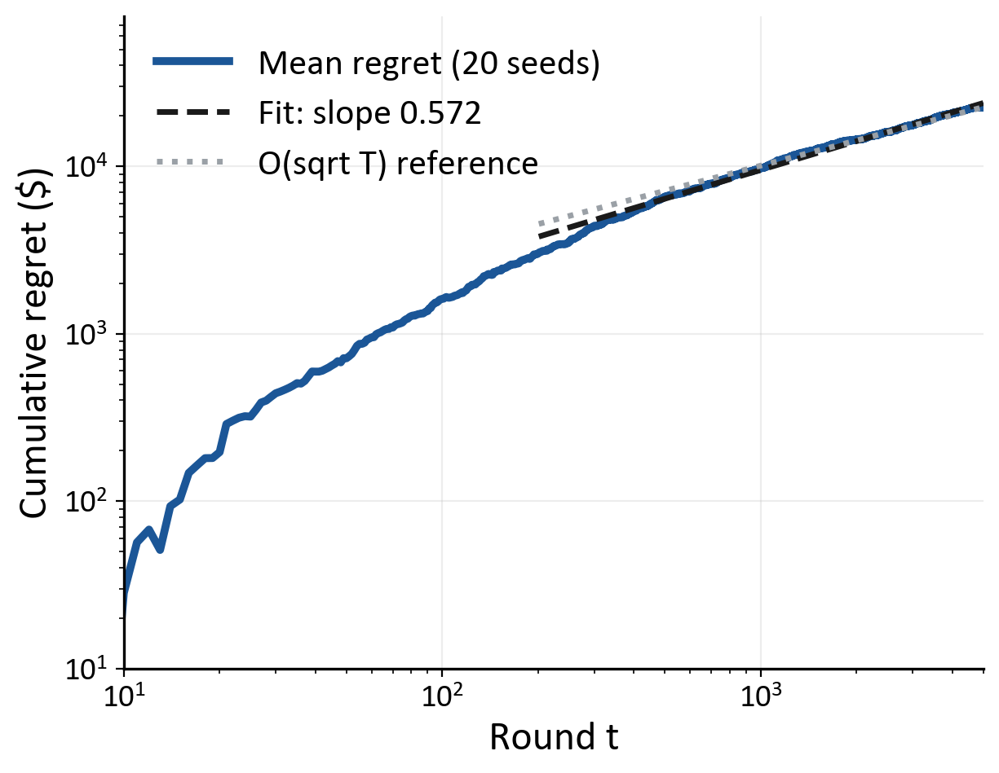
HEADLINE BENCHMARK
#
Algorithm
Reward
1
LinTS
$93,572
2
LinUCB
$91,947
3
EpsilonGreedy
$76,441
4
StaticXGB
$72,173
Log-log regret slope 0.572 (R² = 0.992) -- sub-linear, consistent with O(√T·d).
Scope: admissible policies only (§5.0.1). LinTS vs LinUCB p = 0.87 (n.s. — tied at 20 seeds); same CRN harness.
DAC · ITC-AMS
Results & Evaluation
July 2026 · 17 / 29
Notes:
All four algorithms under common random numbers. LinTS ranks first at $93,572, LinUCB second at $91,947 - statistically tied (p = 0.87). Epsilon-greedy trails, static XGB last. The log-log plot validates theory: fitted slope 0.572 with R squared 0.992, close to the 0.5 of the O(root-T d) bound - the bandit's regret really is sub-linear, it is learning, not memorising.

Slide 22
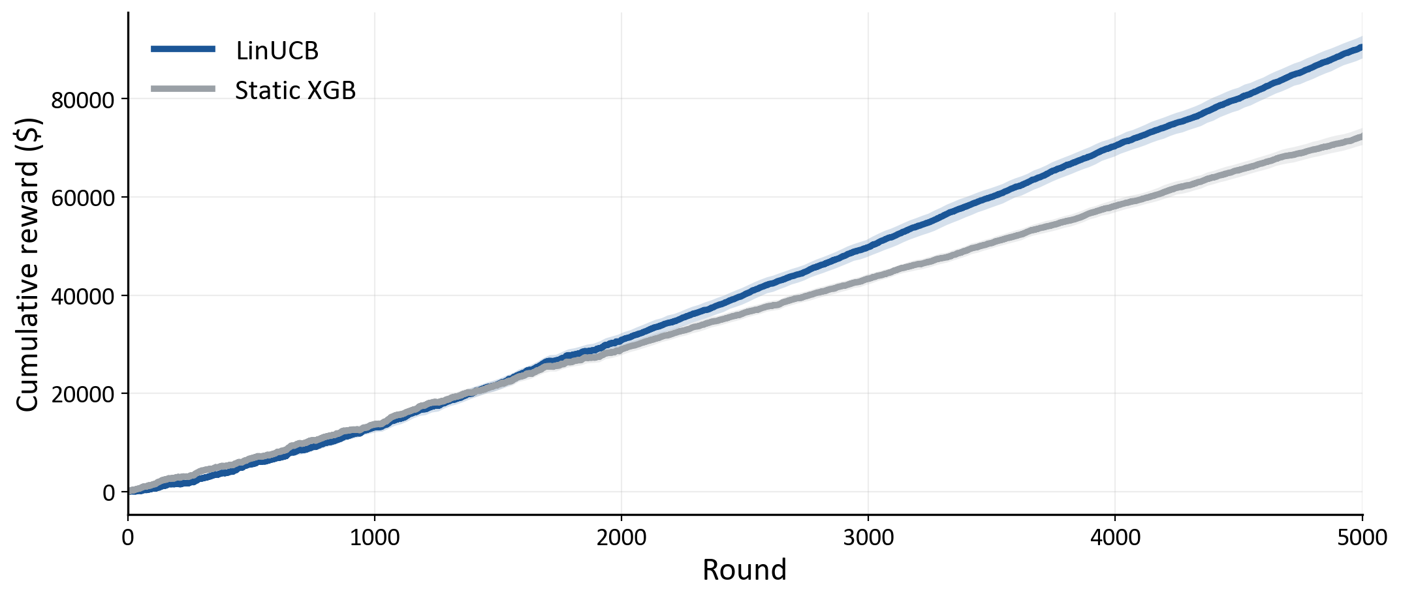
CONVERGENCE & REGRET
+25.2%
d = 2.98
p < 0.001
$90,540
REWARD LIFT VS STATIC XGB
EFFECT SIZE
PAIRED WILCOXON · 20 SEEDS
LINUCB CUMULATIVE REWARD
Scope: admissible policies only (§5.0.1). Static XGB $72,292 · Oracle $126,804 (72% recovered).
DAC · ITC-AMS
Results & Evaluation
July 2026 · 18 / 29
Notes:
The headline: LinUCB earns 25.2 percent more cumulative reward than the static XGBoost baseline over 5,000 rounds - $90,540 versus $72,292, twenty seeds, paired Wilcoxon p < 0.001, Cohen's d 2.98. The curves separate around round 1,500 once the bandit's ridge estimates converge. Critical scope: this claim is over ADMISSIBLE policies per section 5.0.1 - the inadmissible AlwaysRATED constant sits above (appendix A1). Oracle recovery is 72 percent.

Slide 23
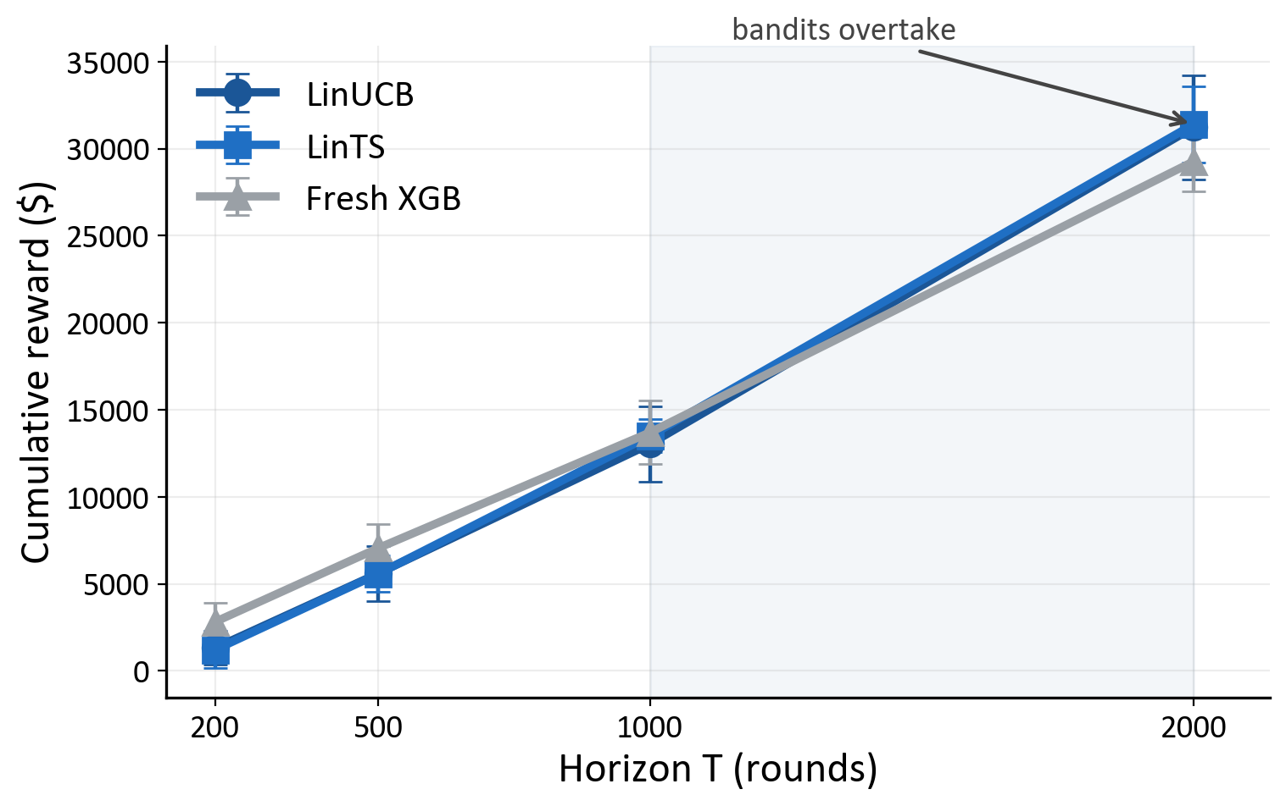
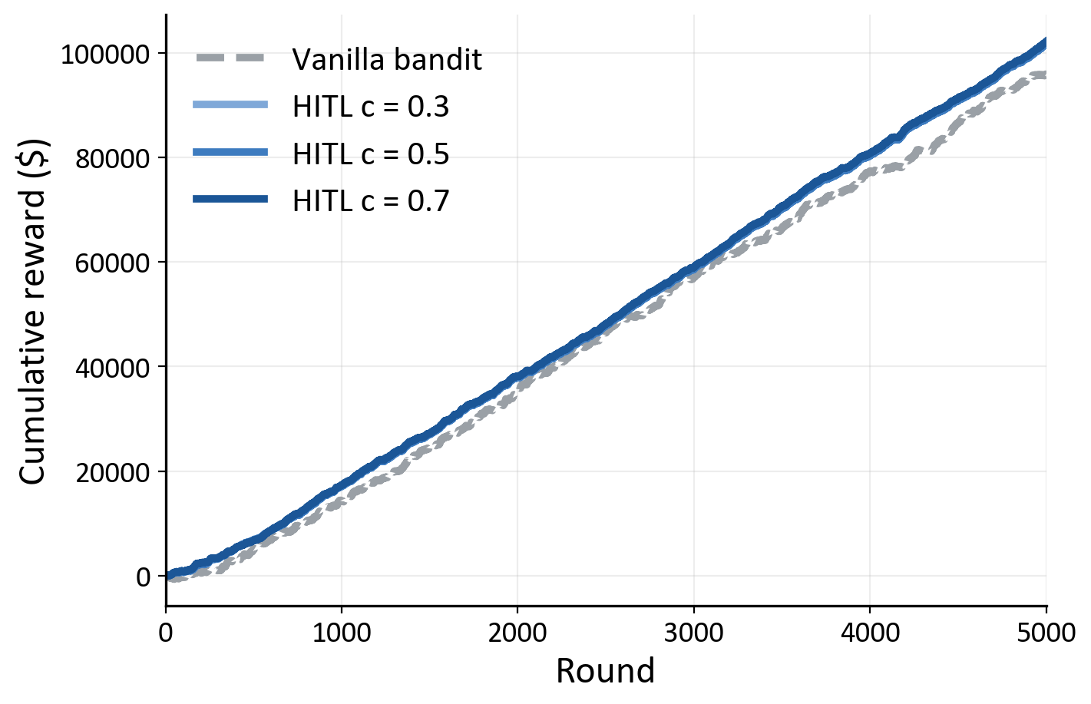
COLD-START & HUMAN-IN-THE-LOOP
p = 0.0039
p = 0.0840
+14.8%
1.3%
LINTS PASSED @ T=2,000
LINUCB DRAWS LEVEL @ T=2,000
HITL LIFT VS VANILLA BANDIT
REFERRAL RATE
Only LinTS is certified at T = 2,000 (p = 0.0039); LinUCB's lead is not significant (p = 0.0840, d = 0.55) and is reported as 'draws level'. HITL +14.8% is vs the vanilla bandit, not the AlwaysRATED ceiling (§5.4.2).
DAC · ITC-AMS
Results & Evaluation
July 2026 · 19 / 29
Notes:
Two results on one slide. Cold-start (EXP-010): below a thousand rounds a freshly trained XGBoost beats both bandits; the crossover comes between one and two thousand. At T=2,000 LinTS is significant at the Bonferroni threshold (p = 0.0039, d = 1.48); LinUCB's lead is positive but NOT significant (p = 0.0840, d = 0.55) - softened to 'draws level'. Deploy with warm-start for the first thousand applications. Human-in-the-loop (EXP-008): the wrapper lifts reward 14.8 percent over the vanilla bandit ($103,951 vs $90,540, p < 0.001, d = 2.65) at only 1.3 percent referrals and 2.2 percent review cost. Both scopes are against admissible comparators, not the AlwaysRATED ceiling.

Slide 24
FAIRNESS AUDIT & DRIFT
5 of 6 fairness criteria PASSED
Drift: post/pre regret ratio (shock @ 1,500)
Region
Occupation
Check
Result
Check
Result
Algorithm
Ratio
PSI zone
GREEN (0.0821)
PSI zone
AMBER (0.1225)
LinUCB
0.29×
EEOC parity
85.72%
EEOC parity
90.12%
LinTS
0.29×
Crit. 6
PASSED
Crit. 6
FAILED
StaticXGB
0.85×
Occupation association reflects actuarially justified risk differences (§5.2.4); no regulatory threshold (EEOC 80%, PSI 0.25) is breached.
Criterion 6 (occupation→action) FAILED-with-interpretation: p < 0.001 — statistically significant but practically small. Reported honestly.
DAC · ITC-AMS
Results & Evaluation
July 2026 · 20 / 29
Notes:
Fairness audit (EXP-006): Region PSI GREEN at 0.0821, parity 85.72 percent, PASSED (p = 0.1322). Occupation PSI AMBER at 0.1225 - within the 0.25 threshold - parity 90.12 percent, above the EEOC 80 floor. Criterion 6 is the single failure: occupation-action association is statistically significant but practically small, and occupation is an actuarially valid factor; marked FAILED-with-interpretation in the interest of honesty. Drift (EXP-009): at the round-1,500 shock both bandits re-converge toward pre-shock regret while static XGB lags; sustained-drift handling is future work.

Slide 25
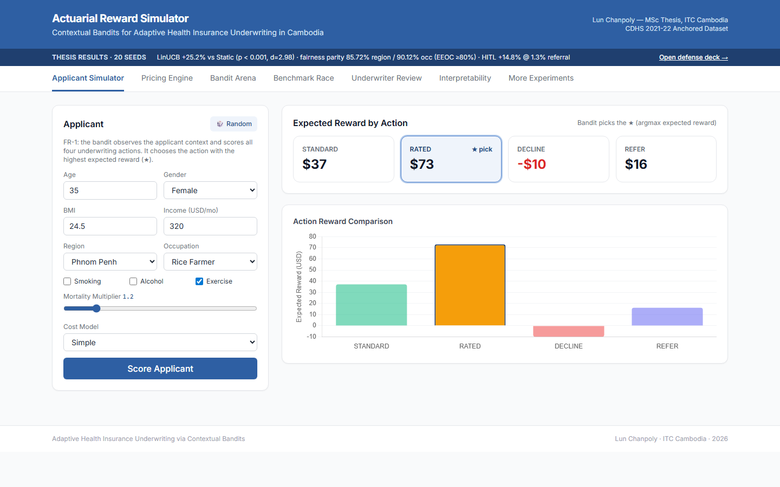
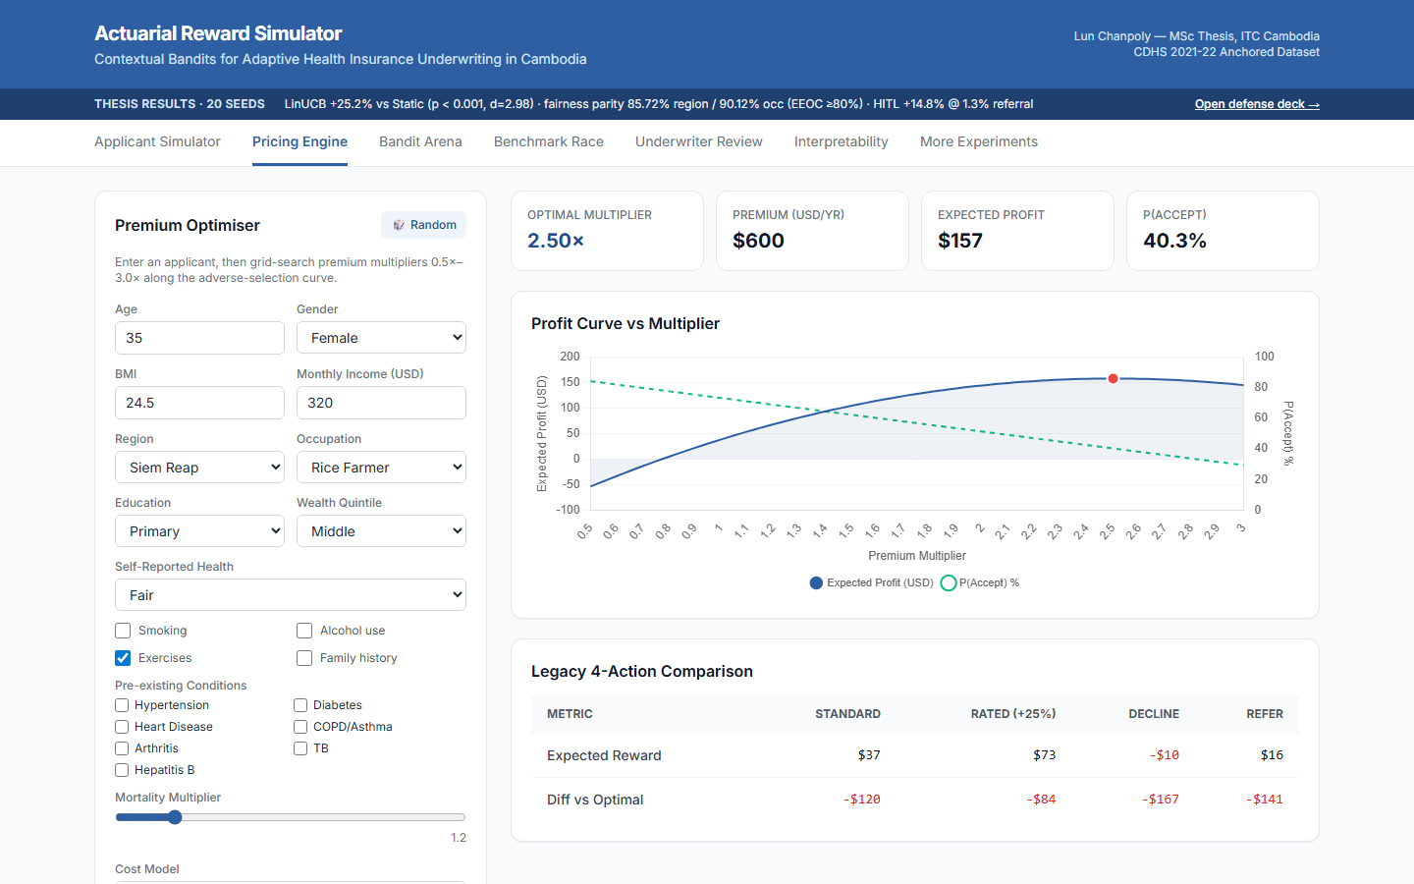
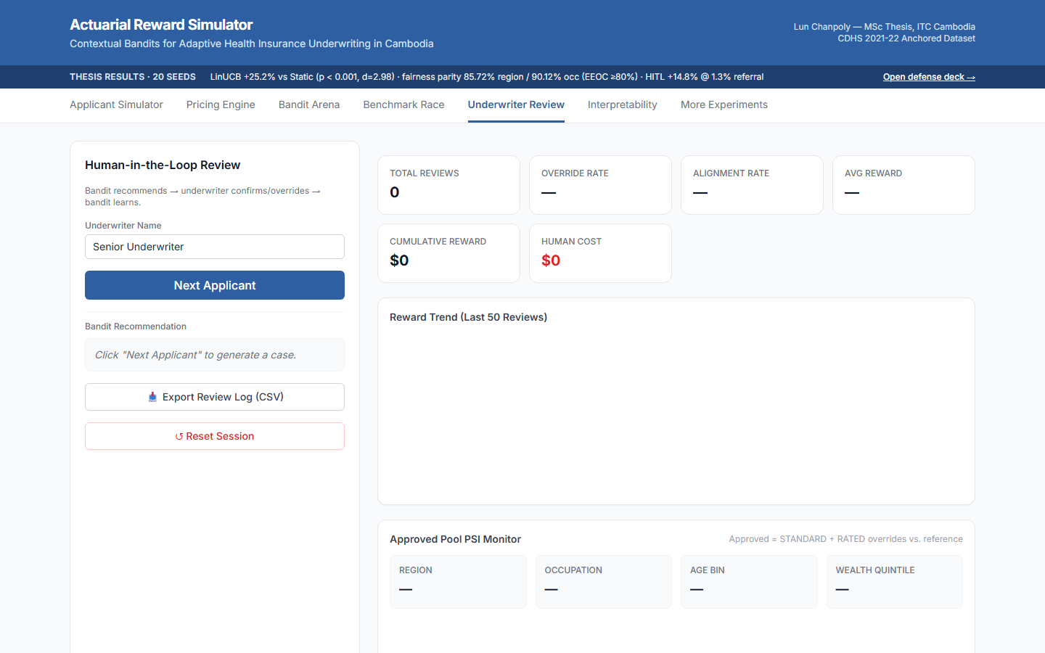
LIVE DEMONSTRATION
Same FastAPI stack as the architecture — live at localhost:8000
Applicant scoring & bandit arm selection
Premium optimiser & pricing curve
Human-in-the-loop referral queue & cost
DAC · ITC-AMS
Results & Evaluation
July 2026 · 21 / 29
Notes:
Switch to the browser and walk one applicant through scoring, the arm the bandit picks, the PSI monitor, and the HITL queue. If the live run fails, narrate over these three screenshots.

Slide 26
V.
Conclusion & Future Work
DAC · ITC-AMS
Conclusion & Future Work
July 2026 · 25 / 29

Slide 27
CONCLUSION
LinTS/LinUCB lead every admissible policy (+25.2%, d=2.98)
#
Objective outcome
Status
HITL adds +14.8% at 1.3% referrals
O1
LinUCB + LinTS implemented & adapted
ACHIEVED
5 of 6 fairness criteria PASSED; PSI within thresholds
O2
2,000-record CDHS-anchored dataset built
ACHIEVED
Honest scope: inadmissible AlwaysRATED ceiling sits above (§5.0.1)
O3
20-seed eval, bootstrap CI, Wilcoxon
ACHIEVED
O4
PSI fairness monitoring + HITL wrapper
ACHIEVED
Contextual bandits give a principled, adaptive, auditable alternative to static rule-based underwriting in the Cambodian context.
DAC · ITC-AMS
Conclusion & Future Work
July 2026 · 22 / 29
Notes:
Balance sheet. Wins: LinTS/LinUCB lead every admissible policy (+25.2%, d 2.98); HITL adds 14.8 percent at 1.3 percent referrals; five of six fairness criteria pass. Honest limits: the inadmissible AlwaysRATED constant scores higher (appendix A1); data is synthetic, proof-of-concept only; PSI monitors but does not enforce; cold-start needs warm-start below ~1,000 rounds. Future work: discounted/sliding-window UCB for sustained drift, constrained bandits for hard fairness limits, a real-insurer pilot with observed claims, multi-product portfolios. Net: adaptive, auditable, and honest about scope.

Slide 28
REFERENCES
[1] Li, L., Chu, W., Langford, J., & Schapire, R. (2010). A contextual-bandit approach to personalized news article recommendation. WWW.
[9] Ensign, D., Friedler, S. A., Neville, S., Scheidegger, C., & Venkatasubramanian, S. (2018). Runaway feedback loops in predictive policing. FAccT.
[2] Agrawal, S., & Goyal, N. (2013). Thompson sampling for contextual bandits with linear payoffs. ICML.
[10] Yurdakul, B., & Naranjo, J. (2020). Statistical properties of the population stability index. J. Risk Model Validation.
[3] Zhou, D., Li, L., & Gu, Q. (2020). Neural contextual bandits with UCB-based exploration. ICML.
[11] Lin, J. (1991). Divergence measures based on the Shannon entropy. IEEE Trans. Information Theory.
[4] Zhang, W., Zhou, D., Li, L., & Gu, Q. (2021). Neural Thompson sampling. ICLR.
[12] National Institute of Statistics, MoH, & ICF (2023). Cambodia Demographic & Health Survey 2021–22 (CDHS).
[5] Ban, Y., Yan, Y., Banerjee, A., & He, J. (2022). EE-Net: Exploitation-exploration neural networks in contextual bandits. ICLR.
[13] International Labour Organization (2022). Cambodian Garment & Footwear Sector Bulletin.
[6] Sutton, R. S., & Barto, A. G. (2018). Reinforcement Learning: An Introduction (2nd ed.). MIT Press.
[14] Asian Development Bank (2023). Asian Development Outlook: Cambodia.
[7] Lattimore, T., & Szepesvári, C. (2020). Bandit Algorithms. Cambridge Univ. Press.
[15] World Bank (2023). World Development Indicators: Cambodia.
[8] Barocas, S., Hardt, M., & Narayanan, A. (2019). Fairness and Machine Learning. fairmlbook.org.
[16] Swiss Re Institute (2023). Sigma 3/2023: World insurance.
Full bibliography: thesis Chapter III (25 cited sources, APA).
DAC · ITC-AMS
References
July 2026 · 23 / 29
Notes:
The sources actually cited across this deck, every one traceable to the thesis bibliography. Left: bandit theory and method - Li and Agrawal & Goyal for the linear policies, Zhou, Zhang and Ban for the neural extensions, Sutton & Barto and Lattimore & Szepesvari for foundations, Barocas for fairness. Right: Ensign on feedback loops, Yurdakul & Naranjo and Lin for the PSI guardrail, then the Cambodia data anchors - the CDHS, the ILO bulletin, ADB, World Bank and Swiss Re. The full APA list lives in thesis Chapter III.

Slide 29
Thank you.
Questions & Answers
LUN CHANPOLY
chanpoly3@gmail.com
Institute of Technology of Cambodia
DAC · ITC-AMS
Adaptive Underwriting via Contextual Bandits
July 2026 · 28 / 28

Slide 30
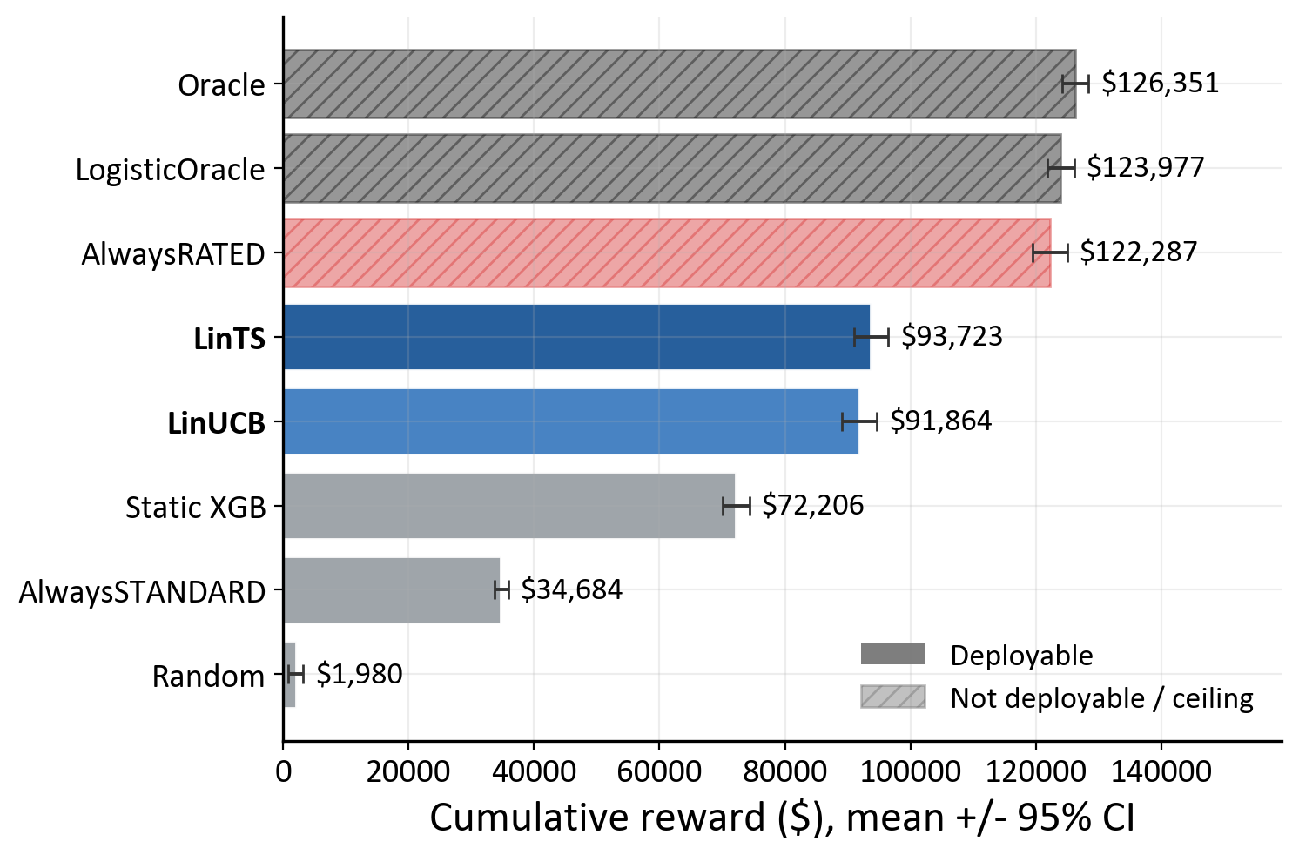
A1 BASELINE LADDER (EXP-014)
Why AlwaysRATED is inadmissible -- and why the headline claim still holds
Policy
Reward
Status
LinTS
$93,723
admissible
LinUCB
$91,864
admissible
Static XGB
$72,206
admissible
AlwaysRATED
$122,287
inadmissible
Rates 100% at flat +25% loading
Not commercially / regulatorily viable
Bandits rank 1-2 of admissible set
Pre-registered expectation FALSIFIED: AlwaysRATED $122,287 tops the ladder (§5.0.1) -- reported as the scientifically informative outcome; headline is scoped to admissible policies.
DAC · ITC-AMS
Appendix
July 2026 · A1
Notes:
This is the anticipated question, so we lead with it. The full baseline ladder shows AlwaysRATED - rate every applicant at a flat 25 percent loading - at $122,287, above LinTS $93,723 and LinUCB $91,864. Our pre-registered expectation that the bandit beats every simple baseline was FALSIFIED, and we report it. Why the thesis still stands: AlwaysRATED is inadmissible - loading every customer 25 percent collapses commercially and would not survive regulatory scrutiny - per the admissibility definition in section 5.0.1. Within the admissible set the bandits rank first and second.

Slide 31
A2 NUMBER RECONCILIATION
Comparison pair
Lift
Basis / why different
LinUCB vs Static XGB (EXP-005)
+25.2%
Paired design, standardised eval -- the pre-registered primary metric
LinUCB vs Static XGB (EXP-014 ladder)
+27.2%
CRN harness, reward-maximising policy (Table 9, §5.0.1)
LinTS vs Static XGB (EXP-014 ladder)
+29.8%
CRN harness, LinTS reward-maximising (Table 9, §5.0.1)
HITL vs vanilla LinUCB (EXP-008)
+14.8%
Augmented bandit vs vanilla bandit -- different baseline entirely
All three answer different questions and are mutually consistent. EXP-005 (+25.2%) is the conservative pre-registered primary.
DAC · ITC-AMS
Appendix
July 2026 · A2
Notes:
If asked why 25.2, 27.2 and 29.8 percent all appear: the headline uses the paired EXP-005 design; the ladder harness uses common random numbers which yields larger separations; HITL's 14.8 percent is against the vanilla bandit, a different baseline. Same code, different pre-registered questions.

Slide 32
A3 FAIRNESS CRITERIA VERDICTS
#
Pre-registered criterion
Verdict
1
Region PSI within threshold
PASSED
2
Occupation PSI within threshold
PASSED
3
Region EEOC parity ≥ 80%
PASSED
4
Occupation EEOC parity ≥ 80%
PASSED
5
Region → action independence
PASSED
6
Occupation → action independence
FAILED-with-interpretation
5 of 6 PASSED. Criterion 6: occupation→action p < 0.001 — significant but practically small; occupation is an actuarially valid factor.
DAC · ITC-AMS
Appendix
July 2026 · A3
Notes:
Criteria matrix armor: name each criterion and its verdict; criterion 6 is the single honest failure, framed as actuarial validity.

Slide 33
A4 SENSITIVITY & ABLATION
Parameter
Value / range tested
α (LinUCB exploration)
1.0 headline — regret-minimising in EXP-012 sweep
v (LinTS variance)
0.1 — posterior-width calibration
λ (ridge penalty)
1.0 — identity prior
κ (HITL conservatism)
0.7 headline; 0.3 / 0.5 also tested (EXP-008)
Price elasticity β
3.5 base; 2.5 / 4.5 stress (EXP-012)
Adverse-selection AF
1.35 (DAC actuarial prior)
Headline ranking is stable across the EXP-011 ablation and the EXP-012 sensitivity grid.
DAC · ITC-AMS
Appendix
July 2026 · A4
Notes:
Sensitivity armor: the result is not knife-edge — alpha, elasticity, and kappa were all swept and the admissible ranking held.

Slide 34
A5 BANDIT MATH & PSI MECHANICS
LinUCB (OFUL)
LinTS (Thompson)
A_a ← A_a + x_t x_tᵀ
Prior: θ_a ~ N(μ_a, λ⁻¹I)
b_a ← b_a + r_t x_t
Σ_a⁻¹ = λI + A_a ; μ_a = Σ_a b_a
θ_a = A_a⁻¹ b_a
Sample: θ̃_a ~ N(μ_a, v²Σ_a)
a* = argmax θ_aᵀx_t + α√(x_tᵀA_a⁻¹x_t)
Select: a* = argmax θ̃_aᵀ x_t
PSI = Σ (Actual% − Expected%) × ln(Actual% / Expected%)
GREEN
PSI < 0.10
stable — no action
AMBER
0.10 ≤ PSI < 0.25
monitor closely
RED
PSI ≥ 0.25
mandatory review
EXP-006: region PSI 0.0821 (GREEN) · occupation max 0.1225 (AMBER) — both within threshold.
DAC · ITC-AMS
Appendix
July 2026 · A5
Notes:
Combined math armor. LinUCB maintains a per-arm gram matrix and reward vector, solves ridge regression, and adds the alpha-scaled confidence width (optimism under uncertainty); LinTS samples theta from the posterior and picks the argmax. PSI is the symmetrised relative-entropy sum over demographic buckets comparing a rolling 500-round window to the training reference, thresholds 0.10 and 0.25; region peaks at 0.0821, occupation at 0.1225.

