Slide 1
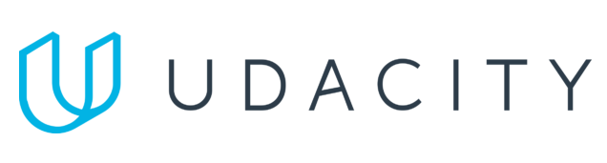
Data Lake Value Proposition
Medical Data Processing Company
Pouya Ataei
Udacity IPS Version 1.0

Slide 2
Agenda
What is a Data Lake
Components of a Data Lake
Data Lake vs Data Warehouse
Business Value of Data Lake Solution
Proposed Data Lake Architecture for Medical Data Processing system
Udacity IPS Ver. 1 2/2020

Slide 3
What is a Data Lake
Executive summary
Data lake is a centralized repository that allows for storing both structured and unstructured data at any scale. Data can be stored in raw format and can be processed later when necessary. Data lake is a flexible, sacalabe and cost-effective solution for big data analytics.

Slide 4
Components of Data Lake
Data storage: data lake stores large volume of raw data from various sources, btoh structured and unstructured
Data ingestion: data is collected from various sources and loaded into the data lake using batch or real-time ingestion methods
Data Catalog: a metadata catalog is used to manage the data in the data lake
Data Access and Analysis: the data in the data lake can be accessed and analyzed by variety of tools

Slide 5
Data Lake vs Data Warehouse
While both technologies are used for storing and analyzing large amounts of data, they have key differences.

Slide 6
Data Warehouse
Data Lake
Relational data store using structured data
Data warehouse is optimized for batch processing
Data governance is more rigorous in data warehouses
Data is stored usually structured, in tables
...
Stores large amount of structured, semi-structured and unstructured data
Data lake can support both batch and stream processing
Data governance is often relaxed
Data is stored in raw format
...
Udacity IPS Ver. 1 2/2020

Slide 7
Business Value of Data Lake
The data lake architecture can solve the scalability issues with the current SQL server. This is due to the fact that data lake is a distributed object storage in nature and can scale easily. The suggested technology, Amazon S3 can easily scale up to to meet company’s demands. This can be petabytes.
Data anlytics workloads do not need to happen in a separate database anymore, as technologies such as Hive can be used to directly read data from the data lake in a distributed manner. This is in contrast to current architecture that uses vertical scaling.
This architecture addresses data silo and duplication issues.
Data Lake can be a good enabler of machine learning, artifical inteligence and big data as it offers a scalable storage that is distributed in nature.

Slide 8
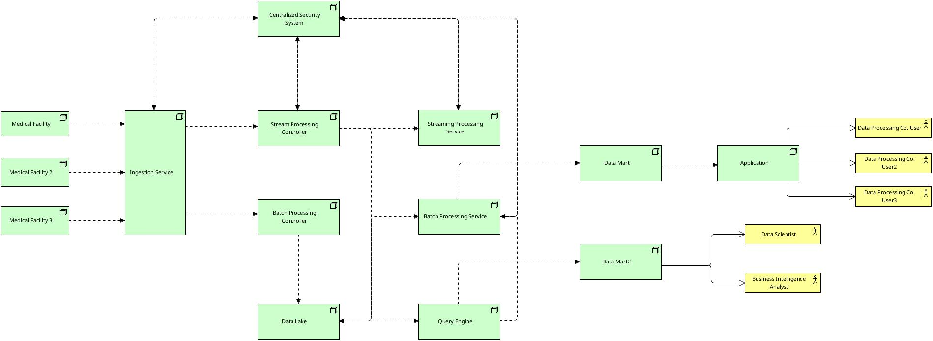
Data Lake Architecture

Slide 9
THANK YOU
Udacity IPS Version 1.0

