Slide 1
KiCAD course at PRG
Block 1: Schematics
Block 2: PCB Design
Block 3: Manufacturing process
Show how to manufacture with oven, how to use stencils. And lastly a visual inspection with the microscope.
The course is going to be focused on designing a Hello board. It should have different variations for different complexities.
* 1st is a basic badge with 2 LEDS, one Lipo battery, LDO
* 2nd Lipo Battery, a ESP32S3 with a external programmer, a [I2C screen](https://eu.mouser.com/ProductDetail/Adafruit/326?qs=GURawfaeGuAHBYAGHgNpQg%3D%3D) and a DHT11 sensor
The materials I need to prepare:
* A library with:
* LDO * Battery with JST * LED (THRU and SMD) * ESP32S3 * ESP-Prog header * i2c screen * DHT sensor

Slide 2
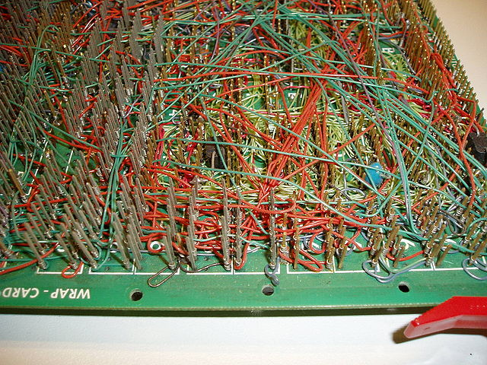
WHY PCB??
Clean and compact
Automatisation
Surface mount devices

Slide 3
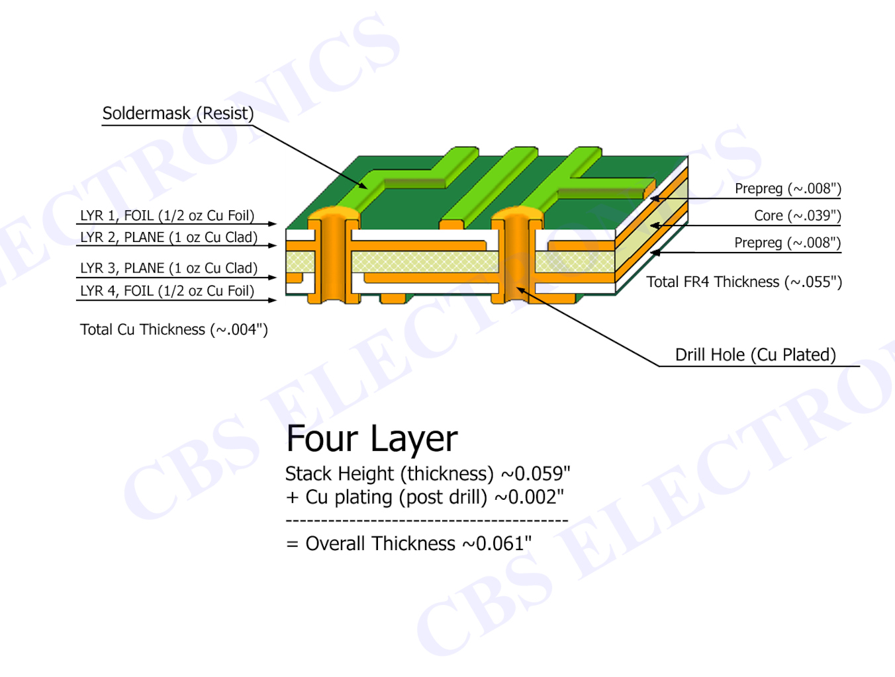
LAYERS

Slide 4
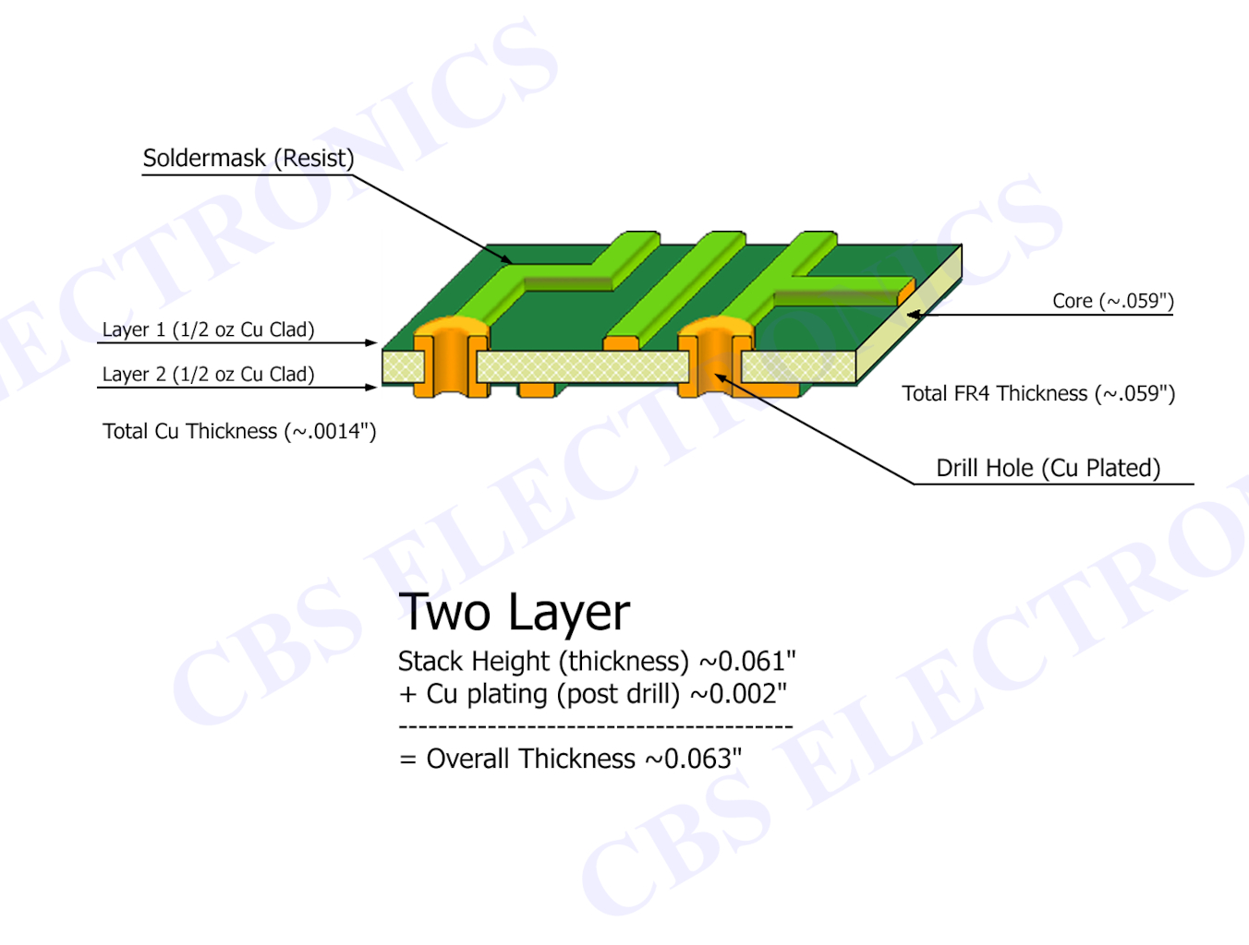
LAYERS

Slide 5
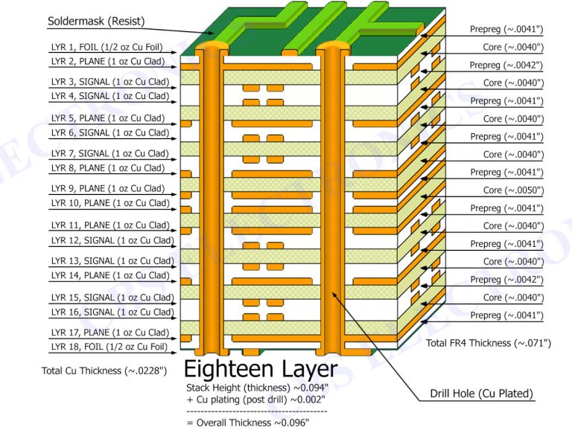
LAYERS

Slide 6
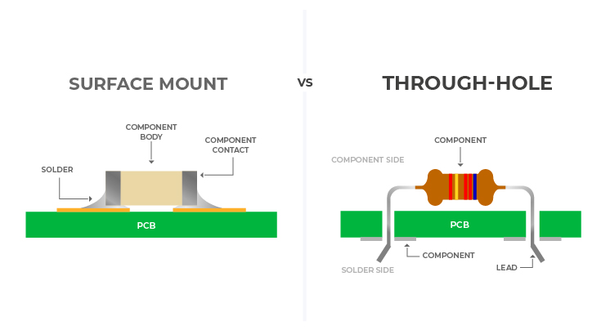
Package types

Slide 7
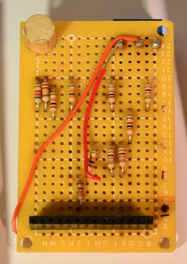
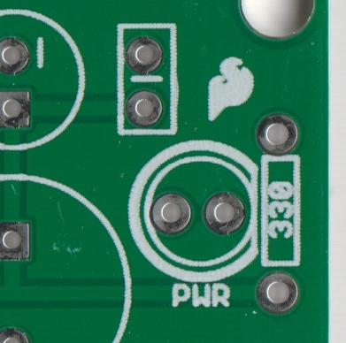
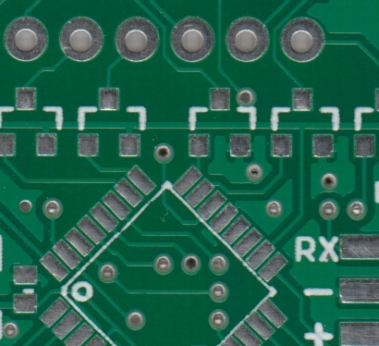

Slide 8
0. Presentation and introduction
Learning goals
Optional 2,3 or assembly
Arduino programming course or example code + individual or help from us in private
End goal: Showcase an example
Show steps/procedure
1. Choosing components
Pick LED colours (possibly multi-color?) and calculate resistor
pick a sensor from a pre-compiled list of sensors and understand how they are supposed to be wired
2.. Schematic
show them a reference design, explain to them what a schematic is (not 3D, just showing how things are connected together).
Wire sensors together
Wire LED and resistor together
We walk around here and help them put the schematic correctly together
The USB is already wire
3. 3D
Let them play with it: Highlight, that this is a learning process, and they are meant to learn by doing here.
Remember: Do it based off of your schematic. But think about the real life design constraints, like where to put silk screens and sensors and such. And which pins are used for what on the esp32
Walk around and help them
USB is already wired - but they move it
4. Routing
Easy
If it takes too long, we will help them
Quickly show them how the software works
5. Silk screen
6. Run rendering
DRC
Send it to manufacturer
7. Code:
Premade example code
Make it yourself
Worst case scenario; Use your Pin designs + ChatGPT to finish it with the added sensors

Slide 9
Workflow in KiCad
Figure out plan
Draw schematic
Create BoM
Choose footprints
Layout phase
Notes:
In the old days before computers, most designers would first quickly draw out a schematic, then create a “bill of materials” where they flesh out the specifications of the components to be used. This would then help them to choose the component footprints, leading to the board layout phase. KiCAD tries to follow this work-flow. Here’s a typical folder structure I use to organize a KiCAD project, having refined this technique over many years of working with the software.

Slide 10
File structure
doodad
↳3d_models // .STEP and .WRL model files for all footprints
↳datasheets // data sheets for components used
↳gerber // final production files
↳images // SVG images and 3D board renders
↳lib_sch // schematic symbols
↳lib_fp.pretty // footprints
↳pdf // schematics, board layouts, dimension drawings

Slide 11
How libraries work.
Show a small example of a project.
Talk about where to get the symbols and documentation of components (Mouser or Ultralibrarian).

Slide 12
Schematic tricks
Sectioning and placement (Just like when programming)
Labels and annotations (calculations, design choices, datasheet info, etc.) (Horizontal)
Good symbols (VCC up, GND down, input left, output right)
Crossings, 3-wire junctions, coloured nets.
Title Block

Slide 13
PCB 101
Show some good practices, some examples.
Would be nice to give some advices about noise.

Slide 14
PCB Tricks
Test points
JLCPCB DRC
Saturn PCB Design Toolkit

