Slide 1
Sink to Source Vulnerability Discovery System (SVDS)
Hybrid Static-Dynamic Analysis for Binary Memory Corruption Discovery
angr • DynamoRIO • Peekaboo • Python
CS5231 System Security, Group 27 • Khong Ming Kang (A0326236H) • Liu Kaiyu (A0329246Y) • Varrick Koh Wei Jun (A0318160M)

Slide 2
Problem Definition
Challenge:
Vulnerability discovery research is increasingly difficult
Manual reverse-engineering efforts do not scale well for complex software
Exhaustive analysis is computationally expensive and manpower intensive
The key challenge is accurately identifying which execution paths allow attacker-controlled input to propagate into insecure or deprecated functions – i.e., vulnerable sinks.
Goal:
To improve researcher efficiency by accurately determining sources that lead to vulnerable sinks via static and dynamic analysis.
Notes:
Discovering vulnerabilities in large binaries is increasingly difficult due to the large number of potential entry points, making exhaustive analysis computationally expensive and manpower intensive

Slide 3
Approach Overview
Control-Flow Graph (CFG) construction using angr
Identification of paths where user-controlled inputs can enter the program
Identification of potentially unsafe functions with AI analysis
Wrapper generation for binary instrumentation and fuzzing
AFL-QEMU binary-only fuzzing to surface inputs that cause crashes, as well as the suitable seeds
DynamoRIO + Peekaboo Trace generation
Taint report output for user analysis
Phase 2: Dynamic Instrumentation & Fuzzing
Phase 1: Static Analysis
Phase 3: Taint Analysis

Slide 4
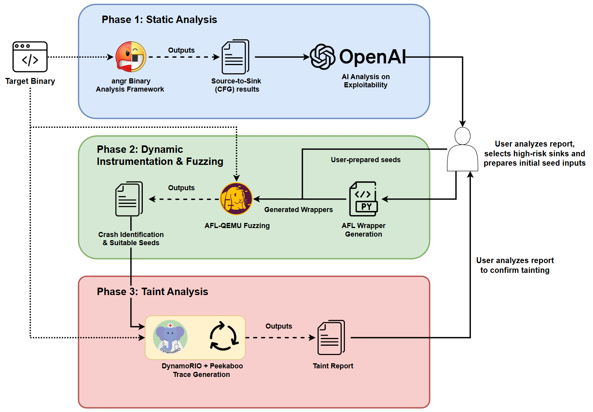
SVDS Program Flow
Tools used:
OpenAI API
angr
AFLplusplus
DynamoRIO + Peekaboo
Python

Slide 5
SVDS Demo ☺

