Slide 1


DEPARTMENT OF HEALTH
Eastern Visayas Center for Health Development
REPUBLIC OF THE PHILIPPINES

Slide 2

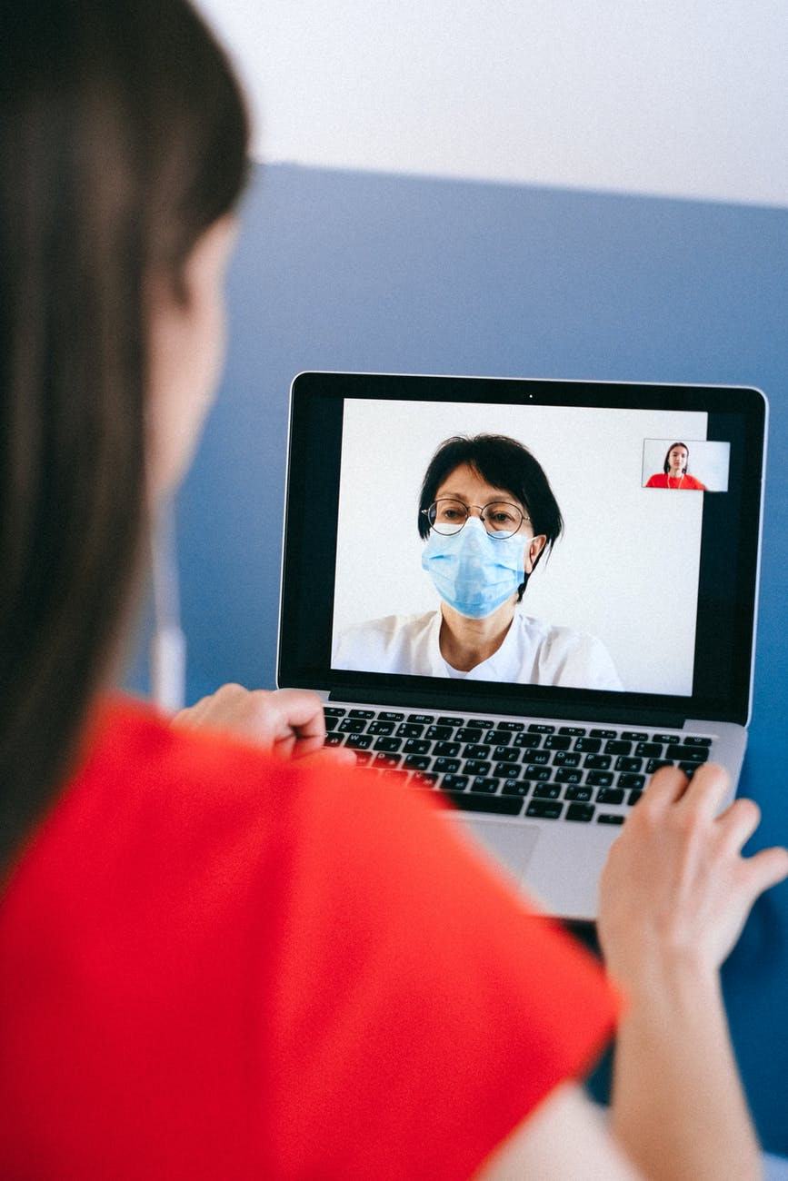
GENERAL HOUSE RULES
What to observe while the video meeting/conference is going on.

Slide 3
VIRTUAL MEETING/TRAINING RULES
Mute yourself when not speaking
Frame the camera correctly
Signal when you want to talk
Speak clearly at your normal value
Pay Attention/Stay Focused/Avoid Multitasking
Keep Reactions Short and ON POINT.

Slide 4
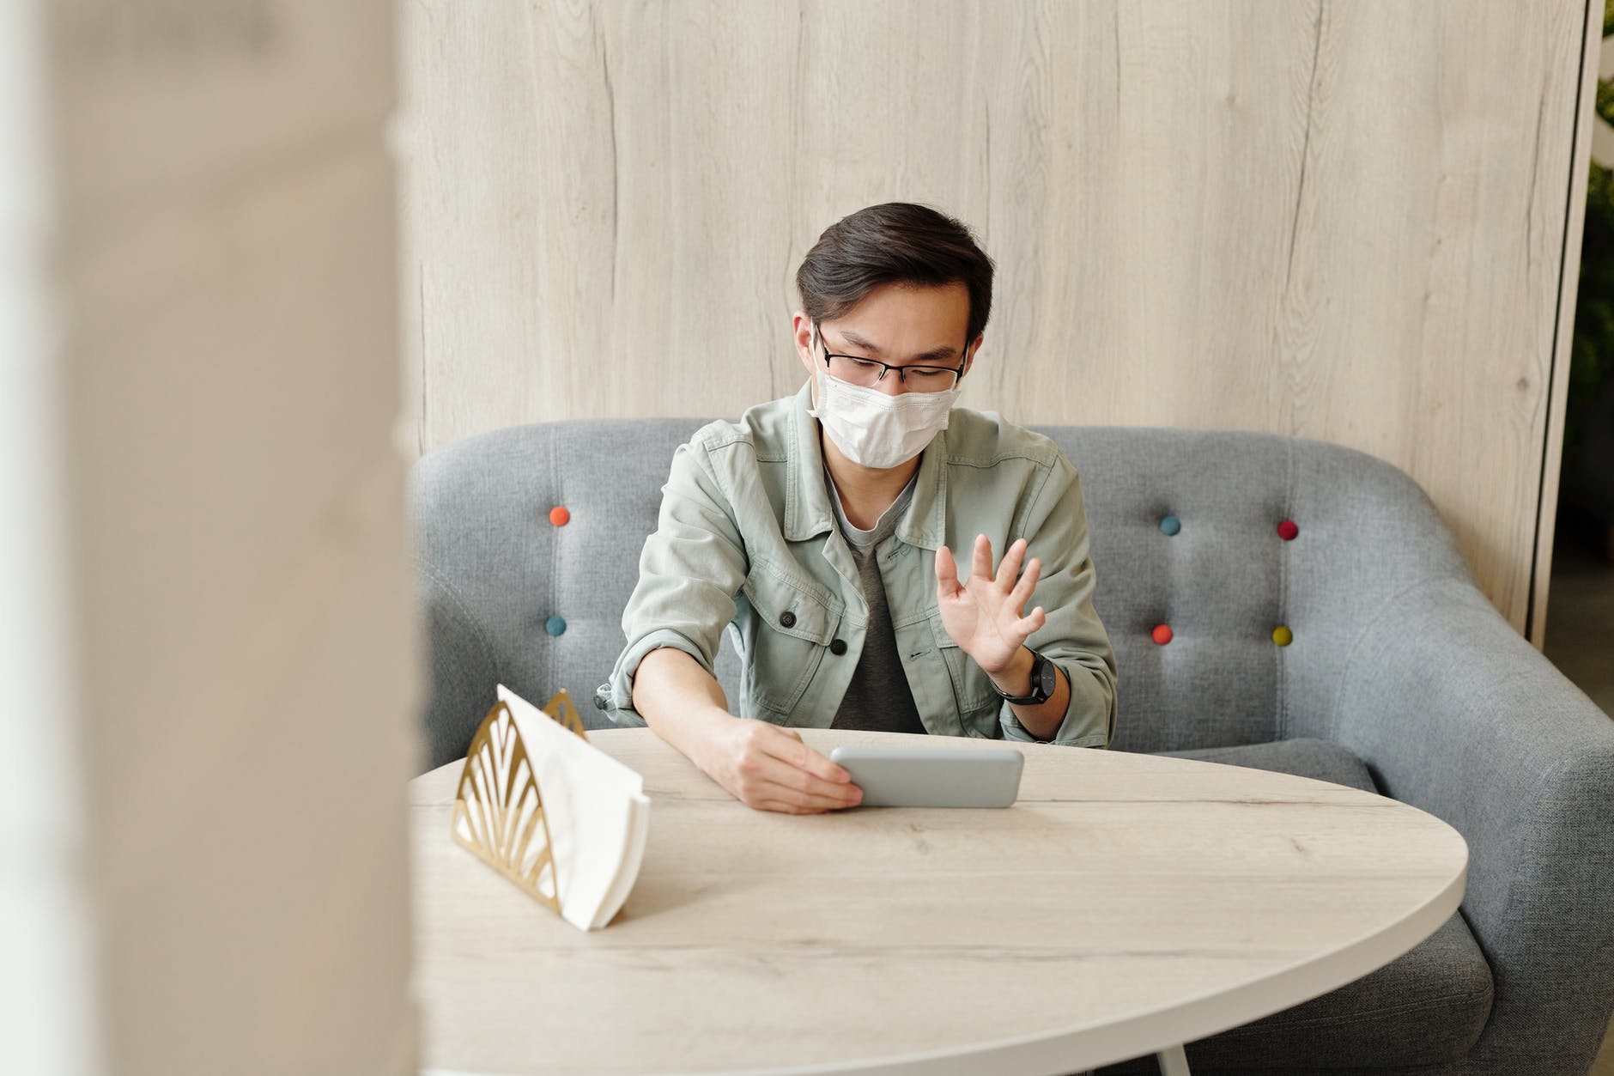


MUTE YOURSELF WHEN NOT SPEAKING
Even though you may not be speaking and think you're being quiet, most microphones can pick up minor background noises, like coughs, sneezes, or typing. These sounds can easily distract other video conferencing participants and potentially even cause annoyance.
Source: https://www.owllabs.com/blog/video-conferencing-etiquette
Eastern Visayas CHD

Slide 5

FRAME THE CAMERA CORRECTLY
Make sure your camera is on eye level, Putting a camera too low can lead to unflattering and awkward angles.
Source: https://www.owllabs.com/blog/video-conferencing-etiquette
Eastern Visayas CHD

Slide 6

SIGNAL WHEN YOU WANT TO TALK
It is a good idea to raise your hand or use chat before asking a question. This will refrain interruptions when someone is talking. You may also want to wait for a few moments of silence before speaking up in case there’s a sound delay.
https://www.theverge.com/2020/3/19/21185472/video-confere-call-tips-zoom-skype-hangouts-facetime-remote-work
Eastern Visayas CHD

Slide 7

SPEAK CLEARLY AT YOUR NORMAL VOLUME
Speak clearly and watch how fast you speak (and don’t forget to unmute yourself). But speak at your normal volume. There’s no need to shout, and if you do, your co-participants may lower their volume and then miss something else.
Source: https://www.owllabs.com/blog/video-conferencing-etiquette
Eastern Visayas CHD

Slide 8

PAY ATTENTION / STAY FOCUSED
Stop checking emails or working other activities during video conferences. It may look rude to other speakers/co-participants.
Source: https://www.owllabs.com/blog/video-conferencing-etiquette
Eastern Visayas CHD

Slide 9
Damo nga Salamat!
Thank you for listening…

