Slide 1
Java projects

Slide 2

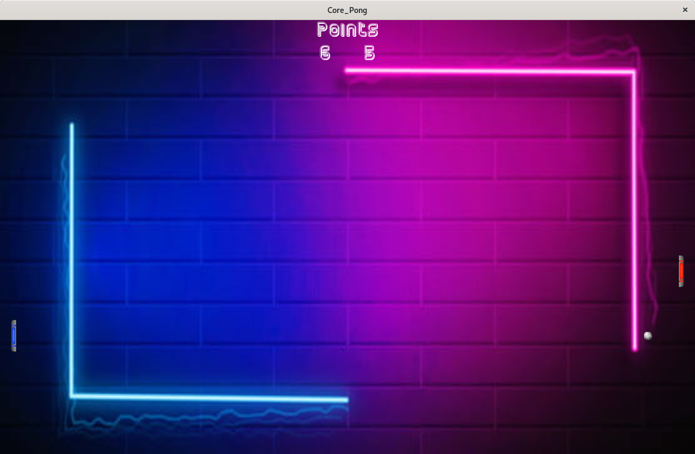
Pong
Remake the game «pong »
Add custom game mode like a mode with obstacles.
Make menu to navigate between all game modes.
Learn to code with processing without use objects.
Complete all specifications in a limited time.
Learn java programming.
Final project : playing normal game mode.

Slide 3



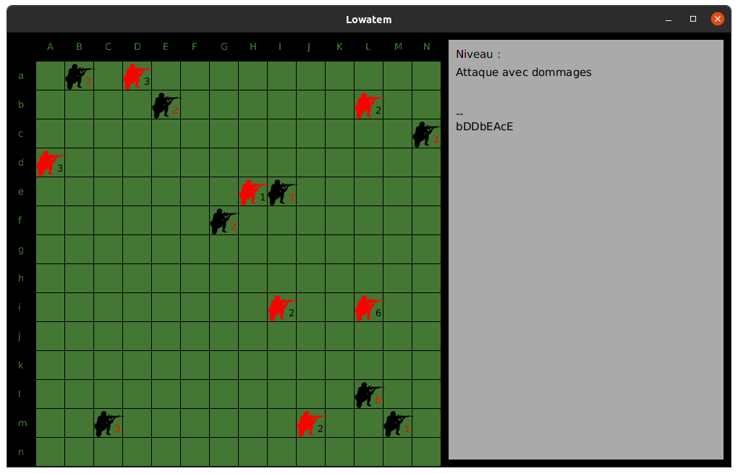
Lowatem
Develop with java on an existing project.
Implement rules step by step for a board game.
Make unit test for each new rule
Learn java programing with object concept
Write coherent tests
Use git
Code’s comprehension
The game with many rules develop

Slide 4
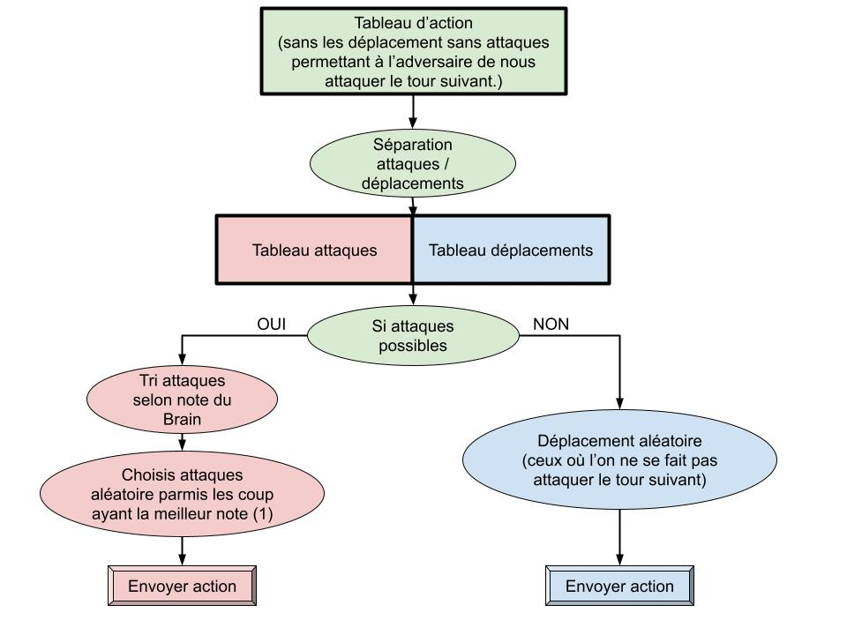
AI Lowatem
Program two AI which can play against other IA for the Lowatem game. (an other project)
The AI have to play in a limited time (2 sec)
The two AI can’t use the same strategy
Team work
Java developement
Code refractoring
Learn to use git with multiple users
Decisional tree of the Ai

Slide 5
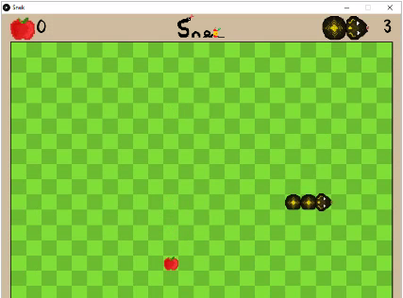
Processing game
Develop a game to teach processing’s simple concept
The « players » have to debug the code
The code may be easy to understand
Procesing developpement
Team management
Git usage with 4 people
The game without bug running

Slide 6
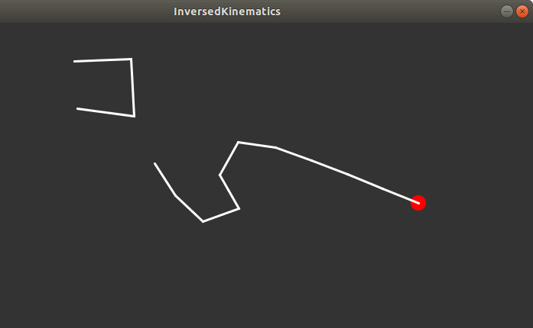
Inversed Kinematics
Challenge
Learn and understand the inversed kinematics
Make a simulation of inversed kinematics
Processing developement
Maths (vectors and inversed kinematics formula)
Self-learning
The simulation running with a body who follow the red dot and the other following the mouse

Slide 7
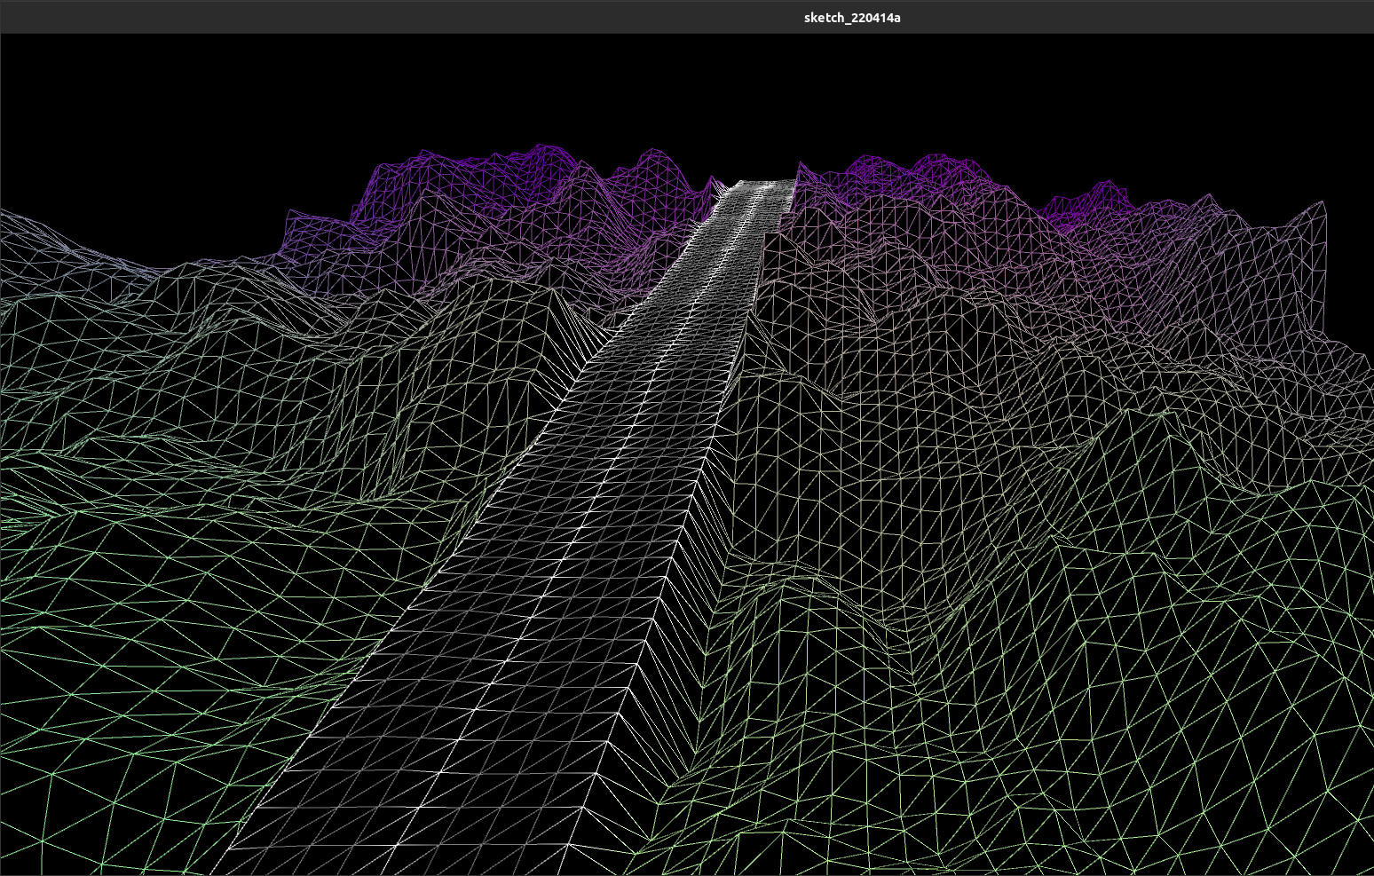
Perlin noise
Challenge
Learn and understand the Perlin noise function
Apply this formula in 2 dimensions for procedural terrain generation
Simulate a procedural terrain generation
Processing developement
Maths (Perlin noise usage and matrices)
Self-learning
The simulation of the procedural terrain generation

Slide 8
WEB projects

Slide 9

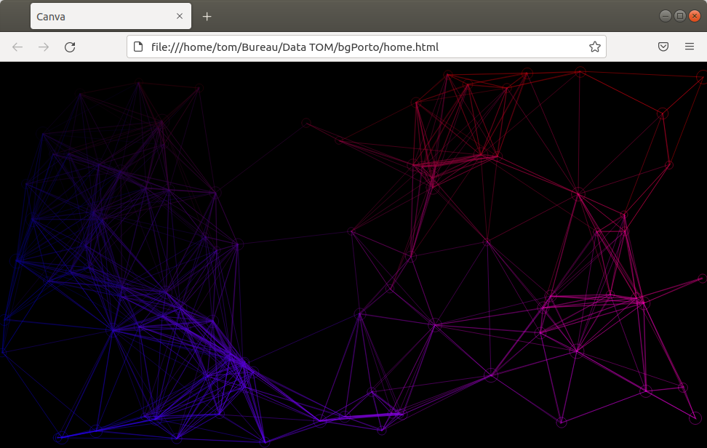
Animated JS canva
challenge
Learn to adapt a processing code in Java Script
Make an animated canva for a website background
Processing developement
Java Script developement and learning
Self-learning
The animated canva running on a website.

Slide 10


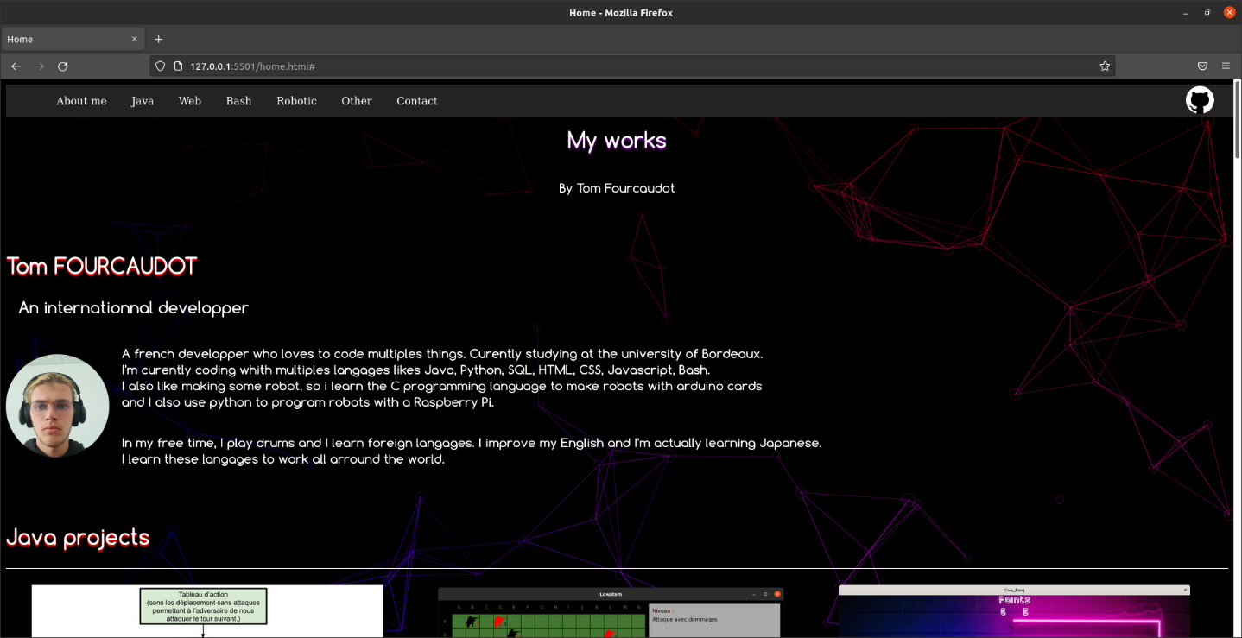
Portfolio
Develop a website to present my projects
Make RetEX for each projects
Make a contact section
The website have to be responsive
Web design
Web developement
Flex learning
Creativity
Curently improving it…
The website the 15/04/2022

Slide 11
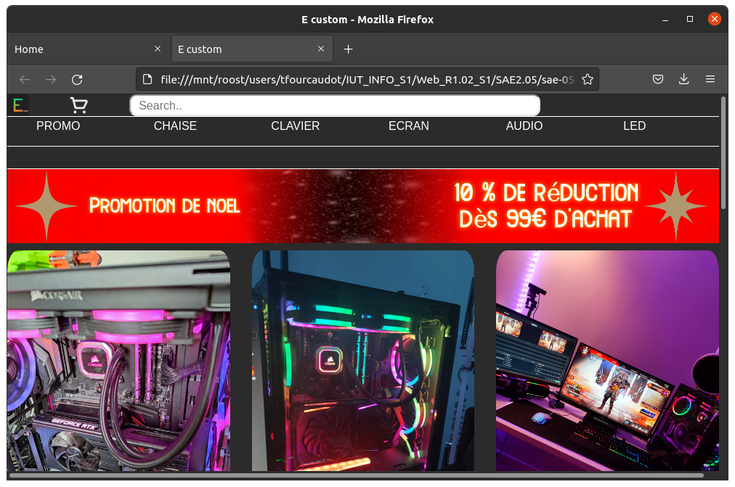
Website creation
for company
Develop a website for a company that I created
The website have to respect the web design’s rules
The website should be responsive
Web design
Web developement
Creativity
Boostrap learning
The website open on a computer

Slide 12
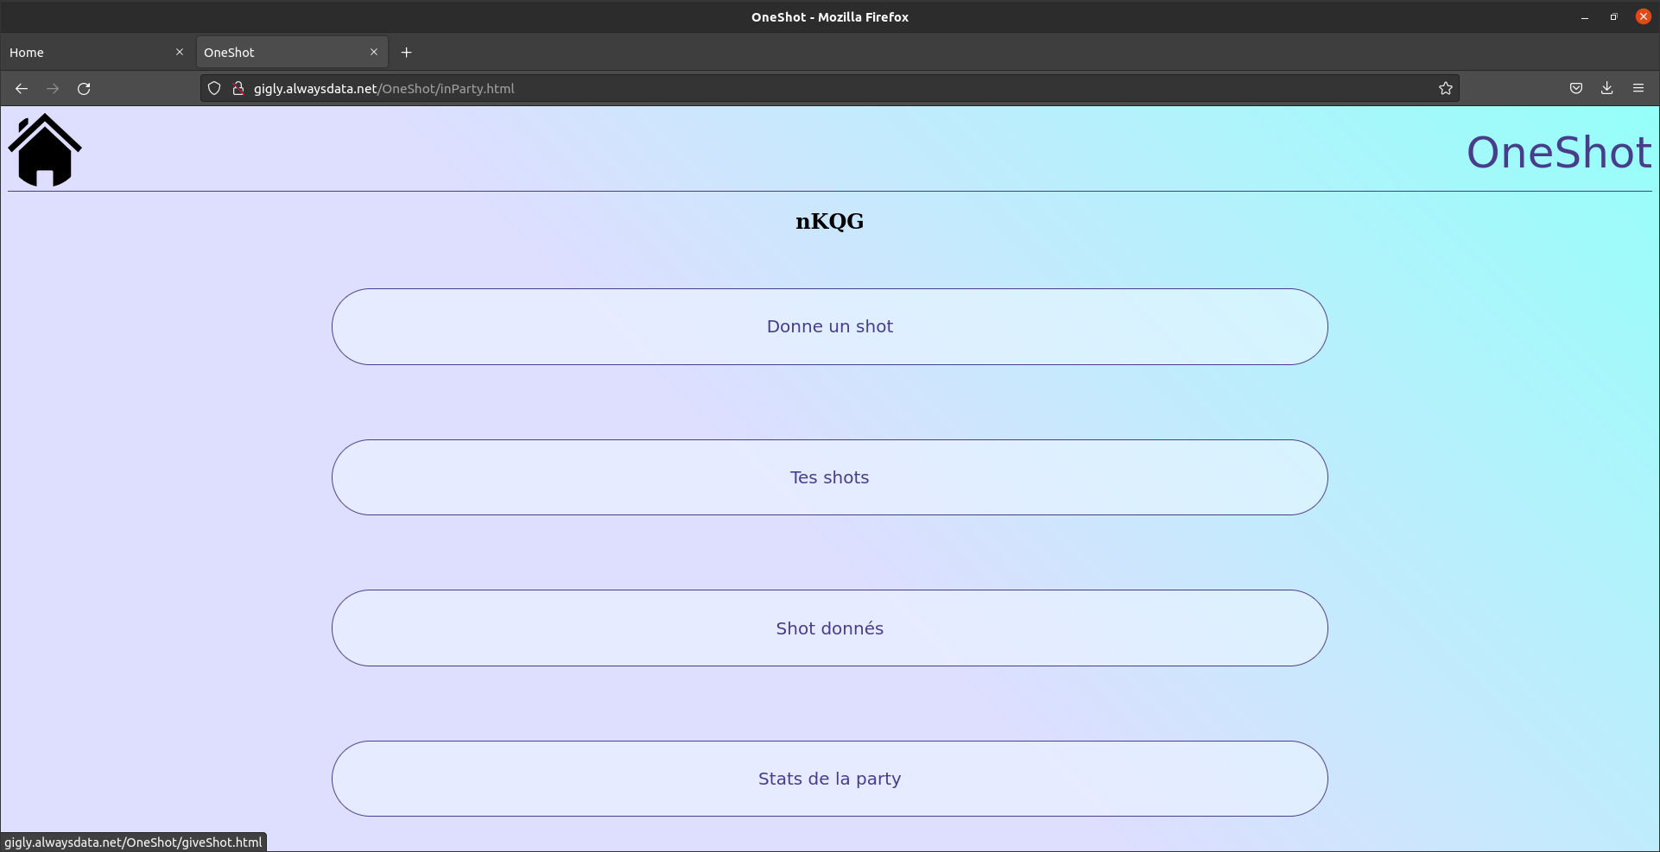
Frontend developement
for web application
Develop a web interface for a backend program who send queries to a database
Have to be responsive
Simple to use
Have to be done in a very limited time (2 days).
Web design
Web developement
Flex positionnement
Curently improving it…
The “in party” page,
open on a computer

Slide 13
Linux projects

Slide 14


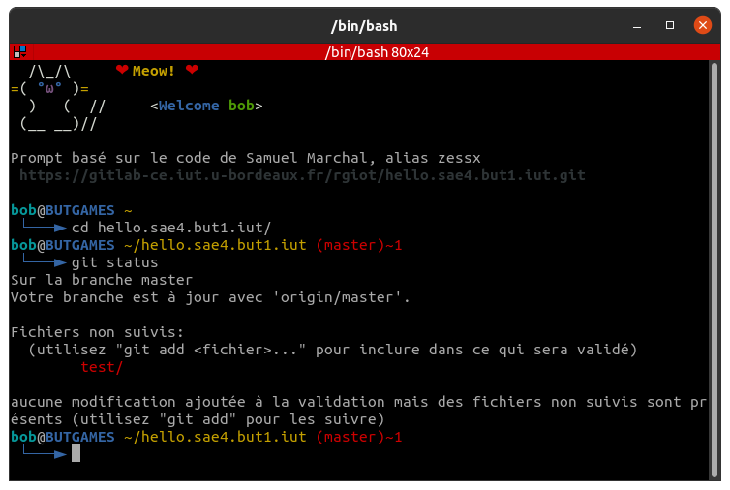
Virtual Machine
Creation
Install a virtual machine for developers
Install some application to code
Setup a nightly rust environement
Build a custom terminal prompt, with git informations
Team management
Follow strict specifications
Learn OS installation
Learn bash langages and basics linux commands
The custom terminal, running on the virtual machine.

Slide 15
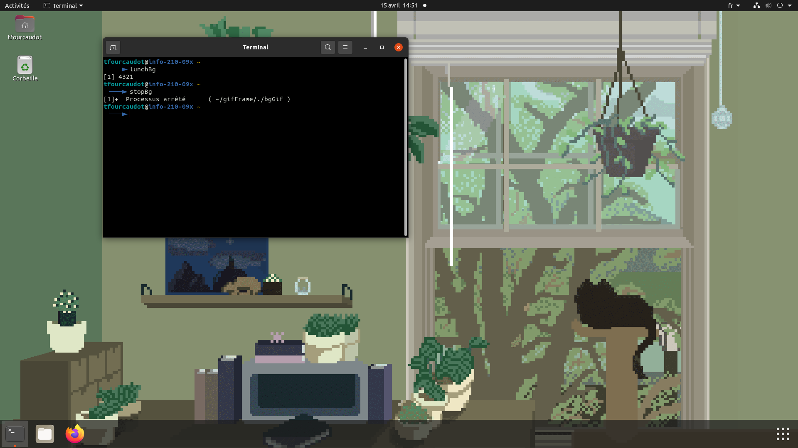
Animated desktop
background linux
Make a animated background for linux environnement
Use gif
With a terminal, we can stop the animation, restart the animation
Bash script
Alias commands
Curently improving it…
The animated background control
With the terminal

Slide 16
Robotics projects

Slide 17


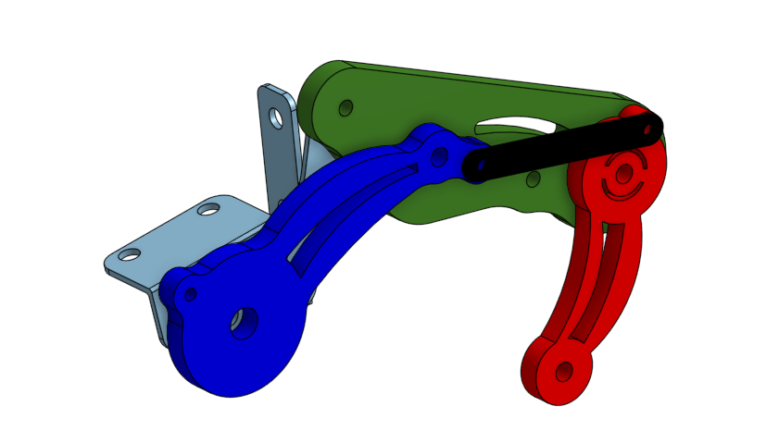
Robotique hand
control by human hand
Make a robotic hand with servo motors
Have to be controlled with human body (contraction signals)
Use an arduino card to control it
3D model conception
Mechanics
Electronics
Arduino programing
Team management
The 3D model of a finger

Slide 18


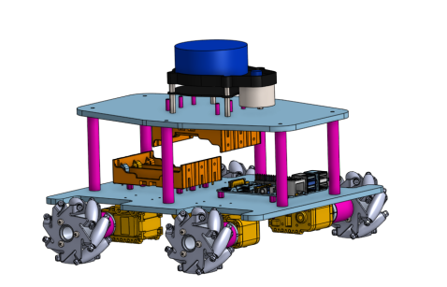
Holonomic robot
Build an holonomic robot from scratch
Can exit an unknown maze by itself
Use lidar
3D model conception
Mechanics
Electronics
Rasberry card programing
Python algorithms
Curently improving it…
The 3D model of the robot

Slide 19
Others projects

Slide 20

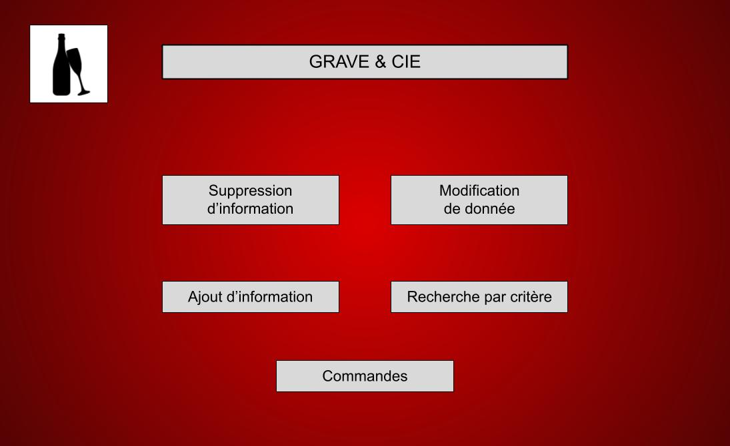
Database creation
Create a database from scratch
Imagine the interface of the application who will use the database
SQL queries
MCD creation
Creativity
The main window of the app

Slide 21

Company creation
Create a company who respect France’s rules
Make a PESTEL analysis
Make a SWOT analisys
Company rules knowledge
Company strategy
Team management
Logo of the company

