Slide 1

Bapatla Engineering College: Bapatla – 522102
(Autonomous)
Department of Computer Science and Engineering
Safeguarding Public Health Through Comprehensive Water Purity Analysis
Using ML
Presented by,
P.Neelima[Y21AC543]
T.Ramanjaneyulu[Y21ACS574]
R.Sravani Bai[Y21ACS554]
T.Siva Krishna[Y21ACS577]
Batch No - C4
Under the Guidance of
Dr.D.Kishore Babu, _{M.E.,Ph.D.}
_{Associate Professor}

Slide 2
Agenda
Abstract
Objectives
Scope of the Project
Existing System
Proposed System
Literature Review
Design Methodology
Inputs and Outputs
Analysis of Results
Hardware and Software Requirements
Conclusion and Future Scope

Slide 3
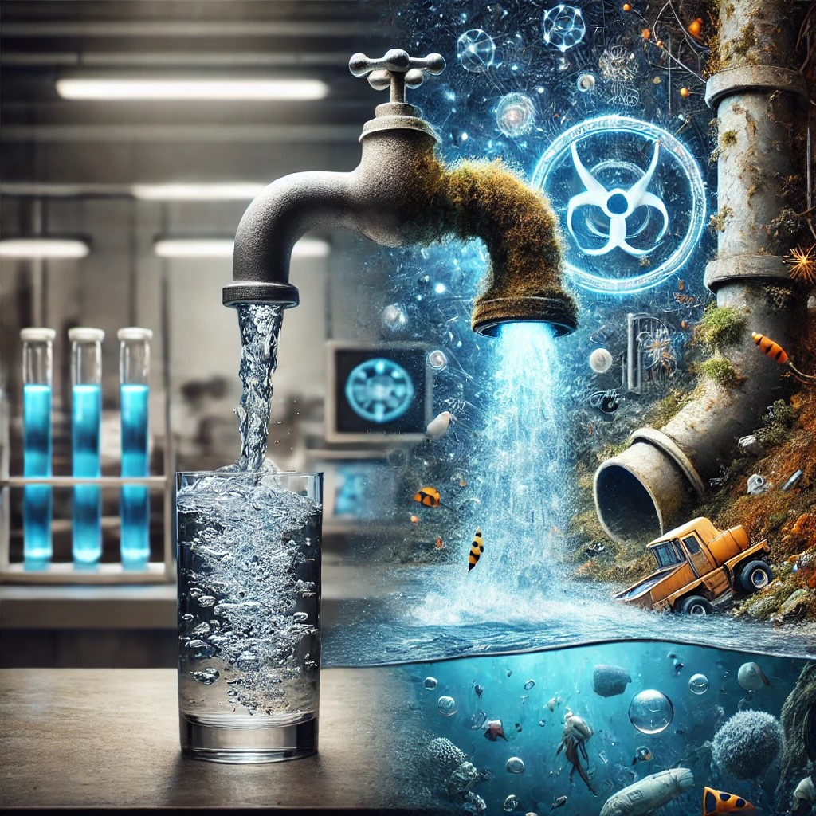
Abstract
Clean drinking water is vital for everyone's health, but many places still have water contamination. Pollutants like chemicals and bacteria can enter water supplies from various sources, such as farming, factories, and old pipes. These contaminants can cause serious health problems, including stomach issues, reproductive problems, and even cancer. Traditional methods of testing water quality are often slow and not thorough enough. As the environment and population change, we need advanced systems like ML technologies that can quickly and accurately detect contaminants and helps to make better decisions to keep our water safe and healthy.

Slide 4
Objectives
Building ML model: Using different Classificatrion algorithms that helps to detect whether the water is safe to use or not.
Ensuring Public Health: Identifying contaminants like bacteria, heavy metals or toxins, to prevent waterborne diseases and promote safe drinking water which also helps in environmental monitoring.
Cost Efficiency: ML based water testing to reduce reliance on expensive and time-consuming traditional methods.
Improved Accessibility: Making water quality testing accessible to remote or underdeveloped regions with limited laboratory facilities.
Sustainability decisions: Helps to take faster and better decisions to purify the contaminated water resources.
User-Friendly Interface: Develop an easy to use interactive user interface using Streamlit.

Slide 5
Scope of the project
Inclusions:
✅ Machine Learning-based water quality classification.
✅ Building a model that finds safe water to use.
✅ Feature importance analysis to determine the most influential water parameters.
✅ Finally displaying the results
Exclusions:
❌ IoT-based sensor implementation
(It is expensive process).
❌ Water treatment solutions
(Detection only, no purification).
❌ Manual lab-based testing
(Only ML-based classification).

Slide 6
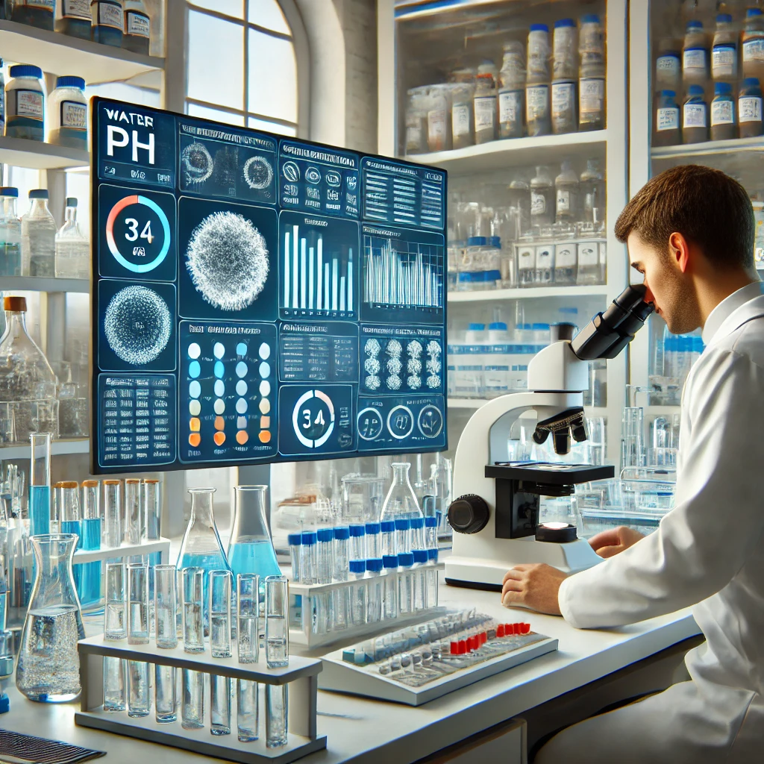
Existing System
1. Manual Lab Testing
Highly accurate but time-consuming and expensive.
Requires trained personnel and lab infrastructure.
2. Government Water Reports
Periodically published but not regularly.
Delays in detecting contamination outbreaks.
3. Basic Water Sensors
Can measure individual parameters.
It is expensive too.

Slide 7
Proposed System
Our system can be designed to be user-friendly, and does not required any specialized trained personnel unlike manual lab testing.
Unlike periodic government water reports and time-consuming lab tests, our project immediately detect whether the water is safe to use or not.
Without the need for expensive sensors our system can be more affordable, making it accessible for a wider range of users.
By using machine learning algorithms, our system can analyze a vast amount of data to identify patterns and trends that might not be detectable through basic water sensors.
Our system can be easily scaled and used in various areas whereas manual testing and basic sensors might have limitations in terms of coverage and deployment.
Our project starts by collecting datasets from Kaggle and exploratory data analysis helps to better understand the data and it’s flaws.
In preprocessing step all columns converted to numeric type and NaN values are replaced with median values.
Scaled key features are used to build a classification model using various supervised ML algorithms.
After comparing with various metrics best model is deployed to make it available for the users.

Slide 8
Literature Review:
Water purity analysis means checking if water is clean and safe to drink or use.
It looks for harmful things like germs, chemicals or dirt in the water.
A long time ago, people tested water in labs using special tools, but it took a lot of time and money.
Later, new gadgets like sensors were made to check water faster.
Now smart computer programs like machine learning, help predict water quality quickly and cheaply.
In short, it’s all about using old and new ways to make sure we have clean and safe water for everyone.
So that we can safeguard tha public health and also can monitor the environment time to time.

Slide 9
Research Paper 1:
Title: "Comparative Analysis of Filtration Techniques for Water Purity(2016)"
Authors: S. Achio, F. Kutsanedzie, E. Ameko
Publisher: Water Quality Research Journal
What They Did: This study evaluated the effectiveness of various filtration methods in removing contaminants from water.
Limitations: Focused only on physical filtration, ignoring chemical and biological contaminants.
Next Step: Later research incorporated chemical analysis to address these gaps.

Slide 10
Research Paper 2:
Title: "Multivariate Statistical Analysis for Water Quality Assessment(2019)"
Authors: Daphne H. F. Muniz, Eduardo C. Oliveira-Filho
Publisher: MDPI Hydrology
What They Did: This study reviewed the use of multivariate statistical methods, such as Principal Component Analysis (PCA) and Cluster Analysis, to assess water quality in various ecosystems.
Limitations: Focused on statistical tools without integrating real-time monitoring technologies.
Next Step: Later research incorporated IoT and machine learning for real-time water quality analysis.

Slide 11
Research Paper 3:
Title: "Water Quality Monitoring: From Conventional to Emerging Technologies(2020)"
Authors: Umair Ahmed, Rafia Mumtaz, Hirra Anwar, Sadaf Mumtaz, Ali Mustafa Qamar
Publisher: IWA Publishing
What They Did: Reviewed traditional water quality methods and proposed IoT-based systems for real-time monitoring.
Limitations: IoT systems were expensive and required significant infrastructure.
Next Step: Machine learning was introduced to make predictions and reduce costs.

Slide 12
Research Paper 4:
Title: "Water Portability Prediction Using Machine Learning(2023)"
Author: Nirmala Malagi
Publisher: IRJMETS (International Research Journal of Modernization in Engineering, Technology and Science)
What They Did: This study explored the use of machine learning techniques to predict the potability of water based on specific water quality parameters. The study highlighted the potential of algorithms like Random Forest and Decision Trees in improving prediction accuracy.
Limitations: The research used a limited datasets and gives less accuracy.
Next Step: Future studies could incorporate larger datasets and more optimization.

Slide 13
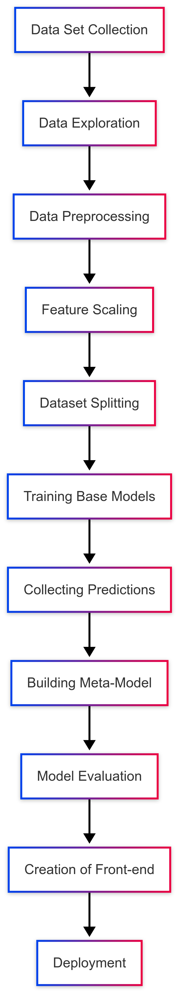
Design Methodology

Slide 14
Inputs and Outputs of the Project
Inputs:
ph
Hardness
Turbidity
Arsenic
Chloramine
Bacteria
Lead
Nitrate
Mercury
Outputs:
Models loaded successfully
Error messages
Each model predictions along with accuracy scores
The water predicted to be:safe
The water predicted to be:unsafe

Slide 15
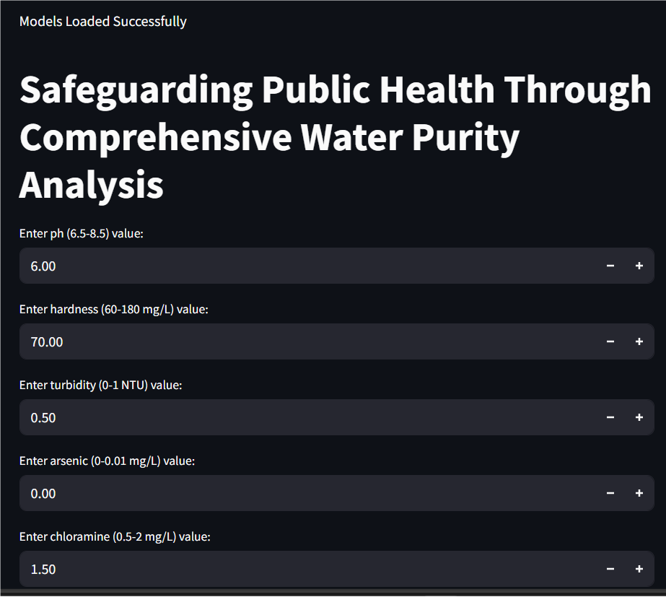
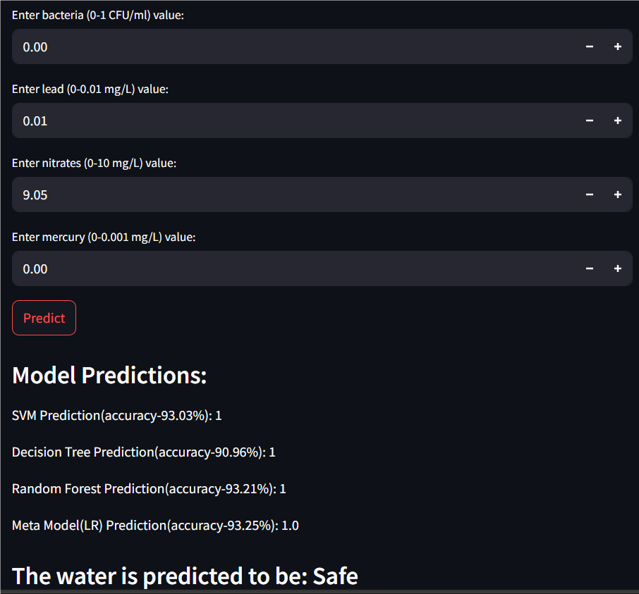

Slide 16
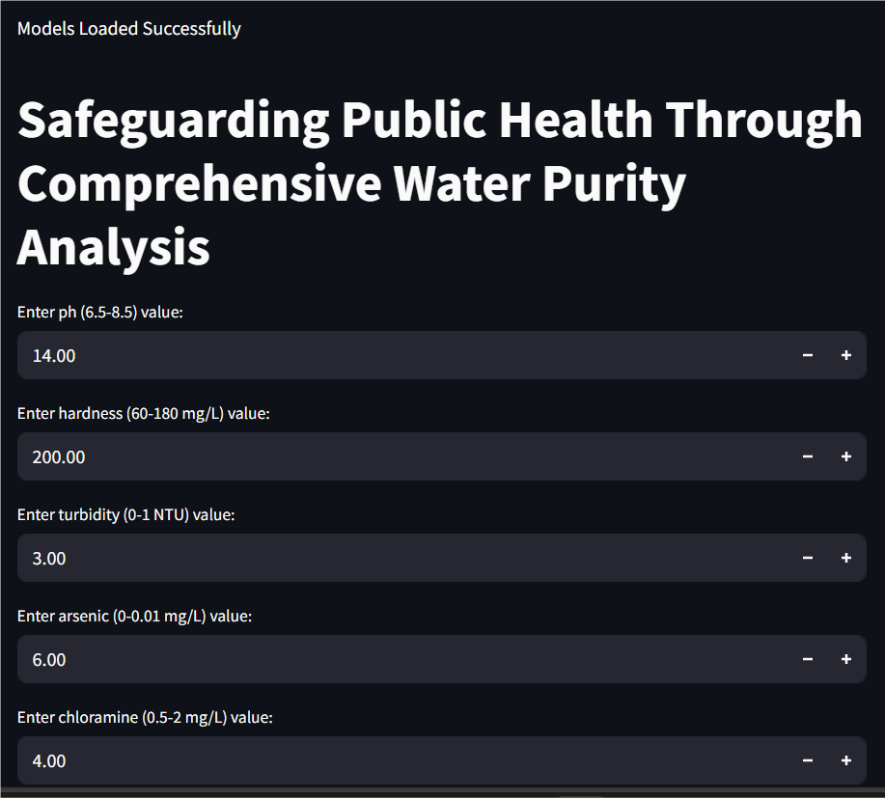
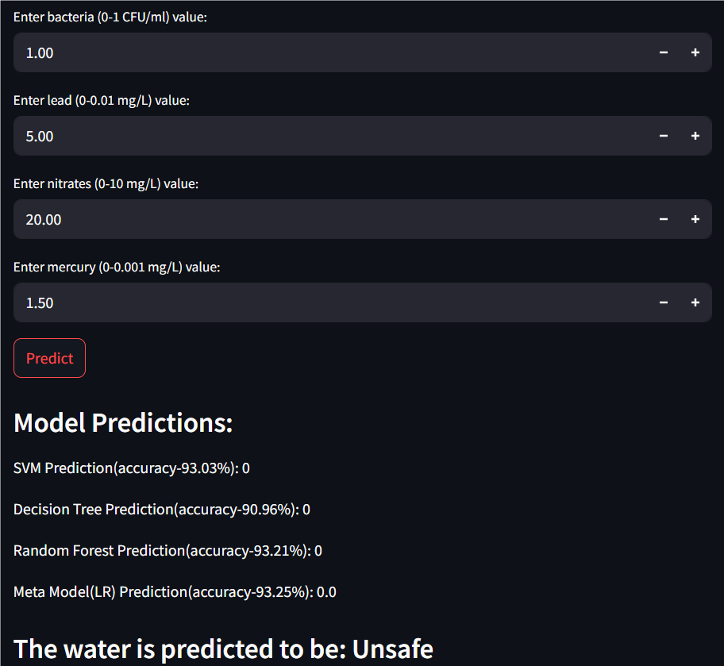

Slide 17
Analysis of Results
1. Accuracy:
Formula
Accuracy= Total Number of Predictions/Number of Correct Predictions
Use Case: Suitable for balanced datasets where classes are evenly distributed.
2. Precision:
Formula
precision=True Positives/True positives+false positives
Use Case: Important when the cost of false positives is high.

Slide 18
3. Recall:
Formula
Recall=True positives/True positives+False Negatives
Use Case: Important when the cost of false negatives is high.
4.Confusion Matrix:
Formula
True Positives (TP): Correctly predicted positive cases.
True Negatives (TN): Correctly predicted negative cases.
False Positives (FP): Negative cases incorrectly predicted as positive.
False Negatives (FN): Positive cases incorrectly predicted as negative.
Use Case: A confusion matrix provides insight into how well the classifier is performing.

Slide 19
Requirements
Hardware:
Processor: Intel Core i5
Hard Disk: Minimum 100GB
RAM: Minimum 8GB
Internet Connection: Stable connection (10 Mbps)
Software:
Operating System: Windows 10/11, macOS, or Linux (Ubuntu 20.04+)
Programming Language: Python 3.8 or higher
Framework: Flask/Streamlit
IDE: Google Colab

Slide 20
Conclusion
This project has successfully demonstrated the potential of machine learning in safeguarding public health by analyzing water purity and predicting whether water is safe for consumption. By combining multiple base models (Logistic Regression, Random Forest, Decision Tree, SVM) into a meta-model, the system was able to provide more accurate and robust predictions. This ensemble approach leverages the strengths of various algorithms, ensuring that the final prediction is reliable.The model can serve as an invaluable tool for public health authorities, enabling them to detect unsafe water early, mitigate contamination risks, and prevent health crises. With room for further enhancement, such as incorporating real-time data, expanding features, and refining models, this system has the potential to play a crucial role in protecting communities from waterborne diseases and ensuring clean, safe drinking water for all.

Slide 21
Future Scope
User-Friendly Application: Developing mobile apps or web dashboards would make the system more accessible, allowing local communities and authorities to monitor water safety efficiently.
Integration with Water Treatment Systems: Connecting the model with automated water treatment technologies could trigger real-time actions, ensuring water safety based on predictions.
Geospatial and Time-Series Analysis: Incorporating geographic and time-based data would help track regional water quality trends and seasonal variations for more accurate predictions.
Advanced Machine Learning Models: Implementing deep learning models or gradient boosting techniques like XGBoost could improve prediction accuracy and handle complex, non-linear relationships in the data.
Smart Water Purifiers: The demand for high-quality smart purifiers is increasing, especially in urban areas, as people become more health-conscious.

Slide 22
Thank You

