Slide 1
Morphological Multi-scale Decomposition and efficient representations with Auto-Encoders
Research Internship Project - April 23rd 2018 - September 28th 2018

Slide 2
Objectives

Slide 3
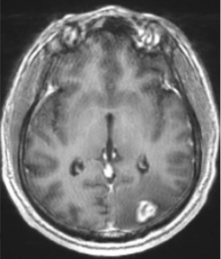
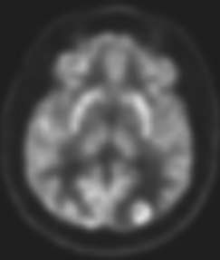
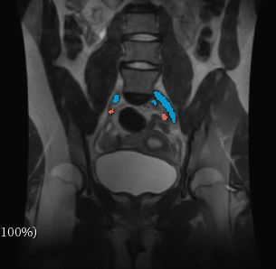
Application and Objectives
Object Detection using low dimensional representation
Brain Tumor detection on multi-modal brain images
Blood vessels detection on Pelvis images
MRI image
TEP
MRI image

Slide 4
Application and Objectives
Representation Learning and Dimensionality Reduction
Goals:
Learning the underlying structure and latent feature in the input.
Capturing the posterior distribution of the underlying explanatory factors for the observed input.
Many techniques:
Linear: Principal Components Analysis, Non-Negative Matrix Factorization…
Non Linear: Isomap, Kernel PCA, Multi-Dimensional Scaling...
Why using Auto-encoders:
Able to learn a wide range of (non-linear) functions.
Universal approximator theorem: a feedforward neural network with at least one hidden layer can represent an approximation of any function (within a broad class) to an arbitrary degree of accuracy, provided that it has enough hidden units.

Slide 5
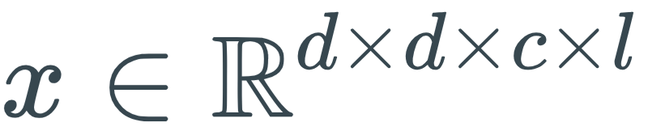
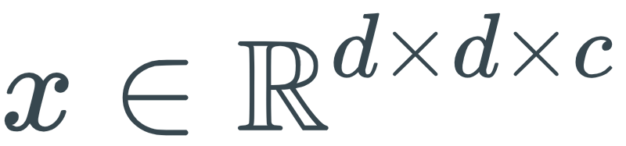



Application and Objectives
Enhancement using Mathematical Morphology
Idea:
Training and applying the auto-encoder on multi-scale decompositions of the images rather than on the original images.
Input: instead of , image dimension, number of channels, number of decompositions
Motivations:
Capturing structures into redundant representations preserving level-sets.
Orienting the representation learned by the Auto-Encoder.
Objective of the project:
Comparing the learned representations with and without prior Morphological Decompositions.
Various latent representation dimensions (code size).
Various Auto-Encoder architectures and flavours.
Various types of decomposition.

Slide 6
Auto-Encoders

Slide 7
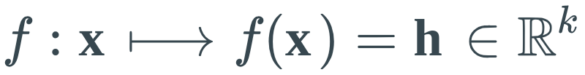
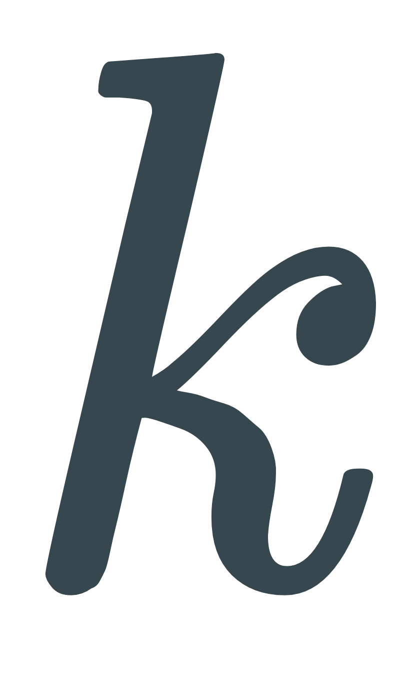
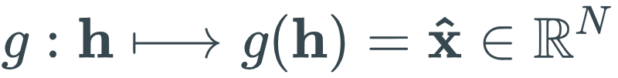
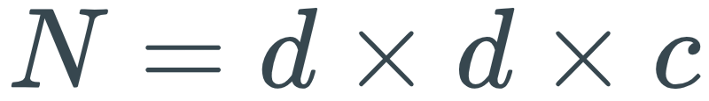

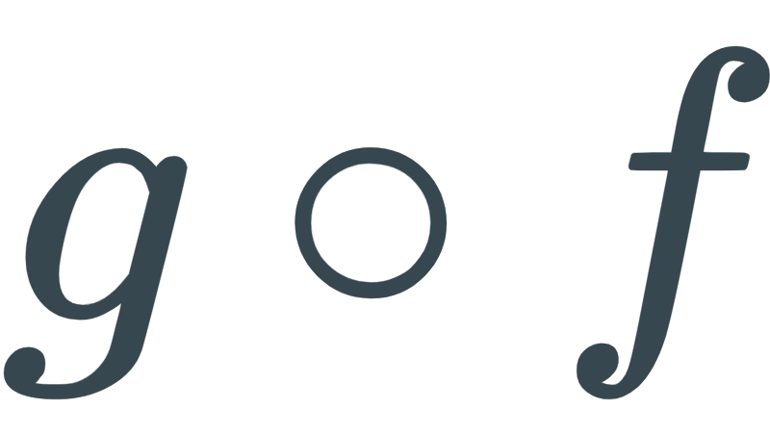
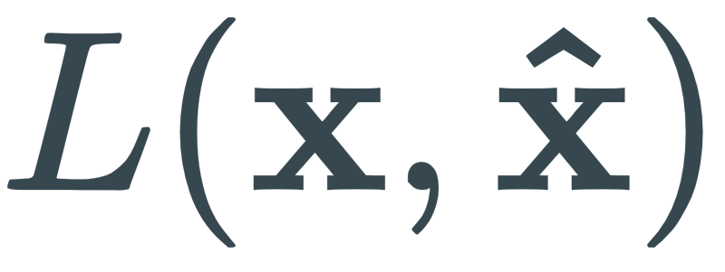
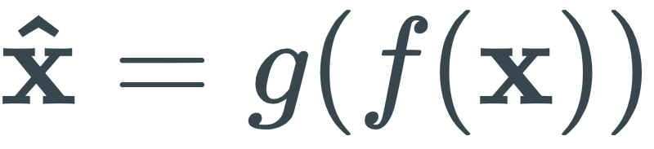

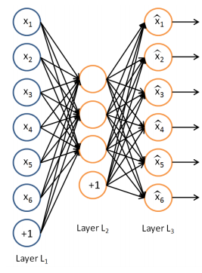
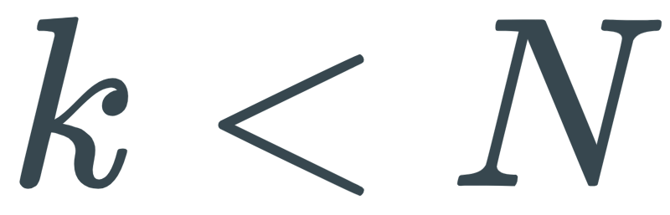
Auto-Encoders
Introduction to Auto-Encoders
An Auto-Encoder is a neural network made of two elements:
An Encoder: , is the code size
A Decoder: with or
is trained to approximate identity
Reconstruction error: where is the reconstruction of input sample
L can be of various type: mean squared error, binary cross-entropy, etc.
The capacity of the AE increases with the code size and the neural network depth.
Under-complete Auto-Encoders:
Learning a code of size : dimensionality reduction.
Similar to PCA when linear Encoder and Decoder and squared reconstruction error.
Regularized Auto-Encoders:
Limiting the model capacity by enforcing some properties by additional loss functions
Sparsity of the representation, smallness of the derivatives of the representation, robustness to noise, etc.

Slide 8
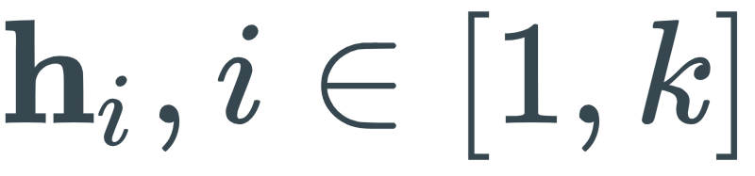
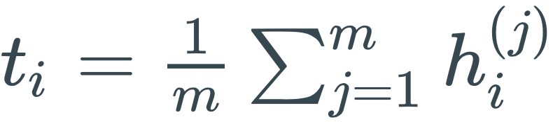



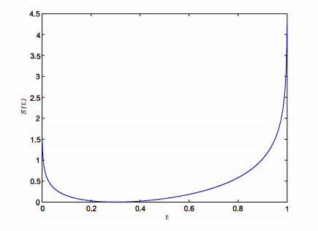
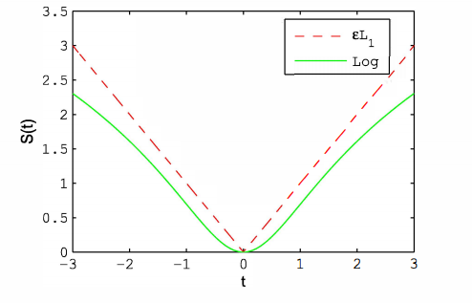
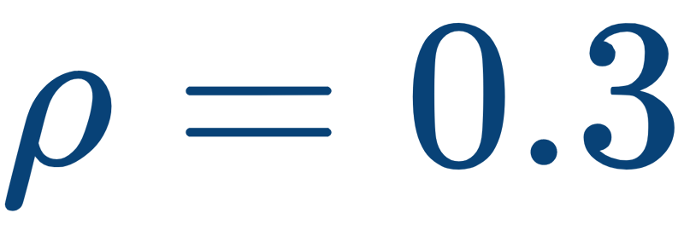
Auto-Encoders
Adding Sparsity Constraints
Regularization of the representation learned by the Auto-Encoders:
Enforcing most code coefficients to be close to 0 (to be inactive)
Capturing a more robust representation of the manifold structure.
Common implementation:
Adding a sparsity regularizer loss to the AE loss function:
With: , the mean of the activation of the latent code coefficient on a batch of input samples
Various sparsity regularizers :
Other methods exist: Intrinsic Plasticity, Weights pruning, etc.
Weight decay
Sparsity constraint

Slide 9
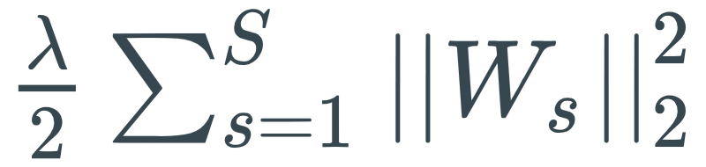
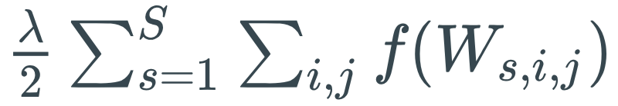
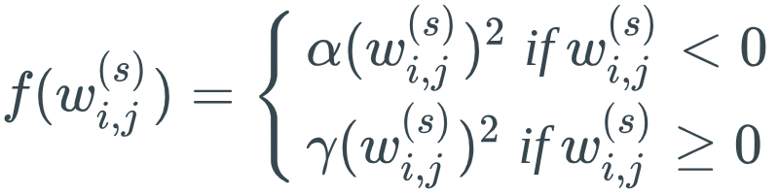
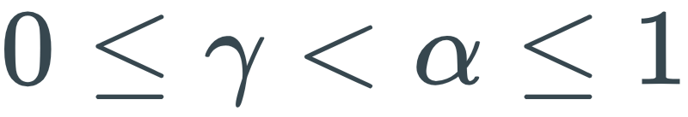
Auto-Encoders
Adding Non-Negativity Constraints
Another type of Auto-Encoder regularization
Enforcing the positivity of the parameters and states of the network
Motivation: part-based representation of the inputs (non negative) as composition of images
Common implementation:
Replacing the weight decay term in the AE cost function by an asymmetric decay term with:
and

Slide 10

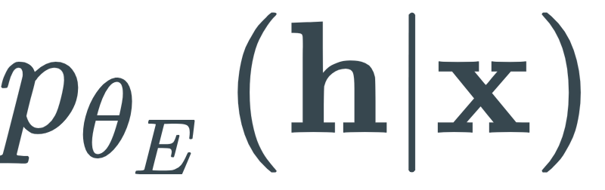
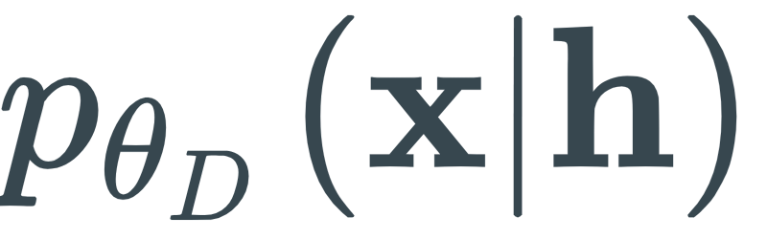
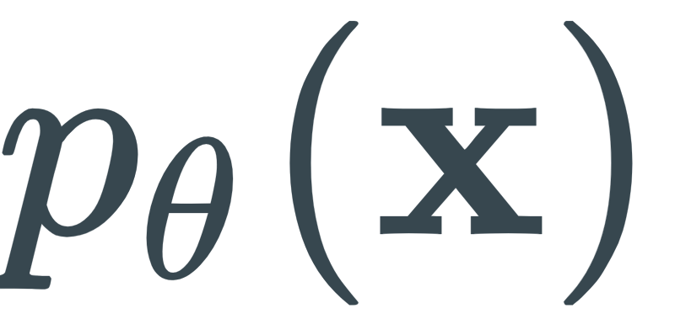
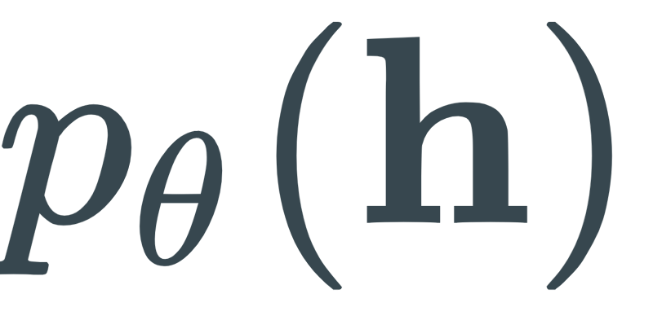
Auto-Encoders
A new popular approach : Variational Auto-Encoders
Using the Auto-Encoder as a generative model:
A stochastic AE:
In practice :
The Encoder maps each input to the parameters of some distribution
Usually the mean and variance of a multi-dimensional Gaussian distribution
The decoder map a sample from this distribution to a reconstruction of the input
Loss of the Variational Auto-Encoder:
Input
Latent representation
Input
Encoder
Decoder
marginal
prior
marginal
~ Regularization
~ Reconstruction Loss

Slide 11
Multi-Scale Morphological Decomposition

Slide 12
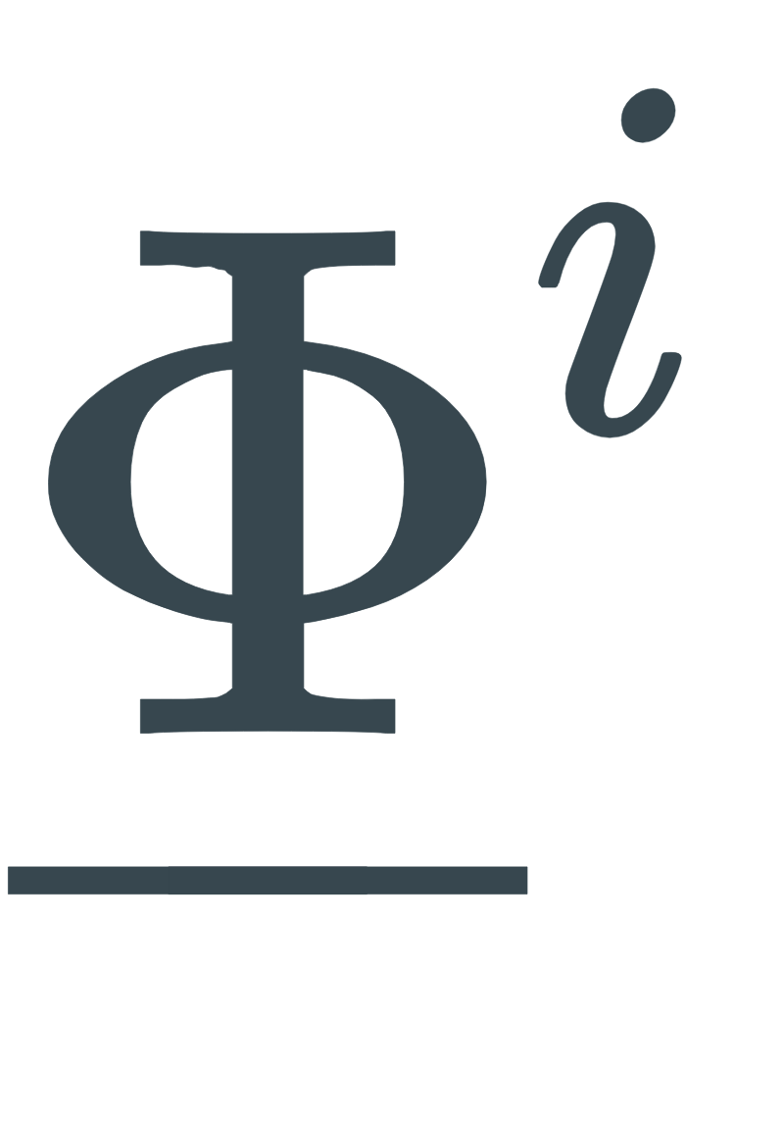
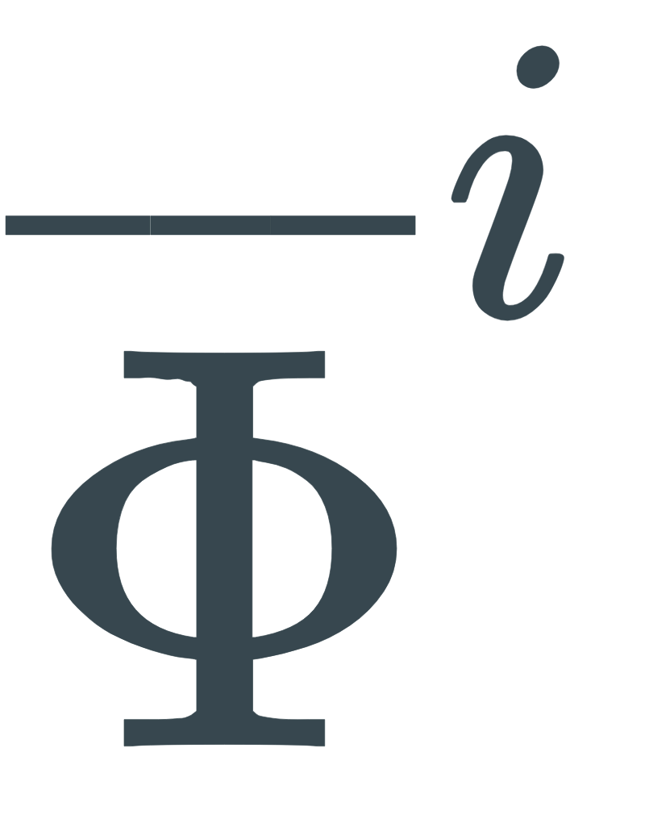

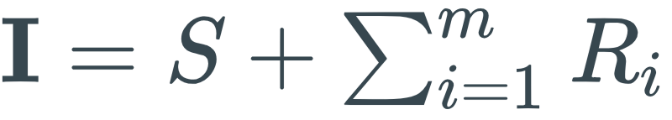

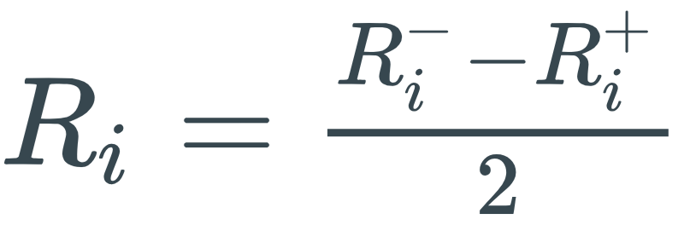


Multi-Scale Morphological Decomposition
Additive Morphological Decomposition
One of the considered Morphological Decomposition:
From Classification of hyperspectral images by tensor modeling and additive morphological decomposition, S. Velasco-Forero, J. Angulo
Given a set of m anti-extensive operators , and extensive operators such that:
The Additive Morphological Decomposition decomposes the image as:
with the residuals:
The input of our representation learning algorithm is then of size
Example of morphological operators: operator by reconstruction indexed by scale of structuring element.

Slide 13
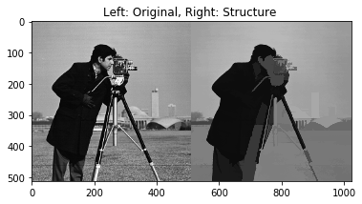
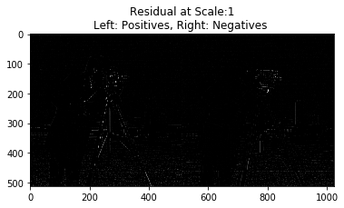
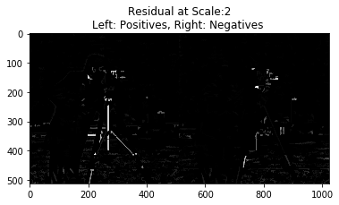
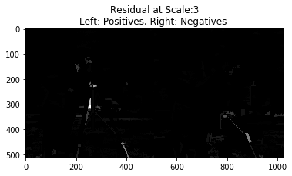

Slide 14
Implementation

Slide 15
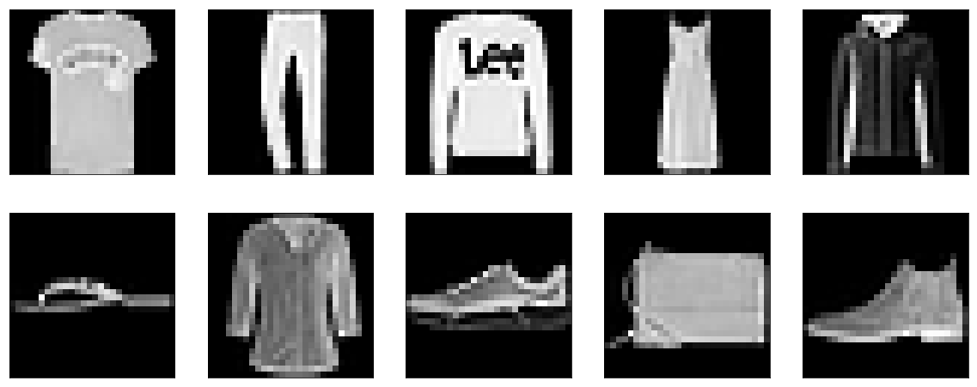
Implementation
Fashion MNIST Data Set
Zalando Research proposal as a remplacement to the original MNIST data set:
28 px
28 px
0: T-shirt/top
1: Trouser
2: Pullover
3: Dress
4: Coat
5: Sandal
6: Shirt
7: Sneaker
8: Bag
9: Ankle Boot

Slide 16
Implementation
Choice of Architecture: InfoGAN
Inspired from InfoGAN: Interpretable Representation Learning by Information Maximizing Generative Adversarial Nets, Xi Chen et al.
Designed for representation learning
State-of-the art deep-learning tricks: convolutional layers, Batch Normalization, lRELU activations, etc.
Encoder:
Decoder:
Limits:
Network high capacity and expensive training.
Input:
28x28 gray image
64 convolutional 4x4 filters, stride 2
Activation : lRELU
128 convolutional 4x4 filters, stride 2
Activation : lRELU
Batch Normalization
Fully connected layer
Activation : Sigmoid
Code:
k-dimensional vector
Fully connected layer
Activation : RELU
Batch Normalization
64 up-convolutional 4x4 filters, stride 2
Activation : RELU
1 up-convolutional 4x4 filters, stride 2
Activation : Sigmoid

Slide 17
Implementation
Adding Sparsity Constraints
Implemented sparsity constraint:
L1-regularization of activity of the last layer of the encoder
Noticed effects:
Poor reconstruction ability.
Collapsing of the code coefficients with very low standard deviation.
However a t-SNE on the learned representation still show some structure in the latent space.

Slide 18
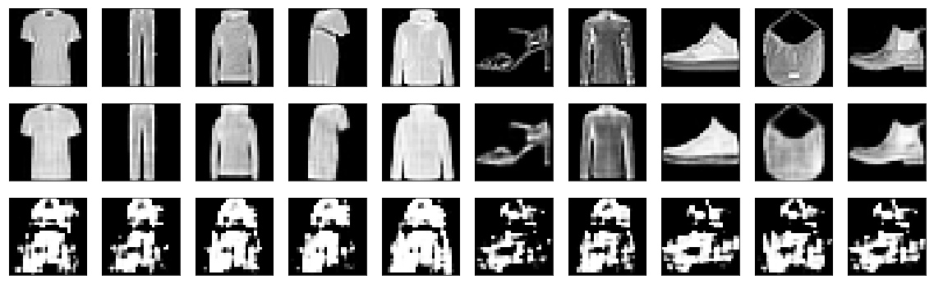

Slide 19
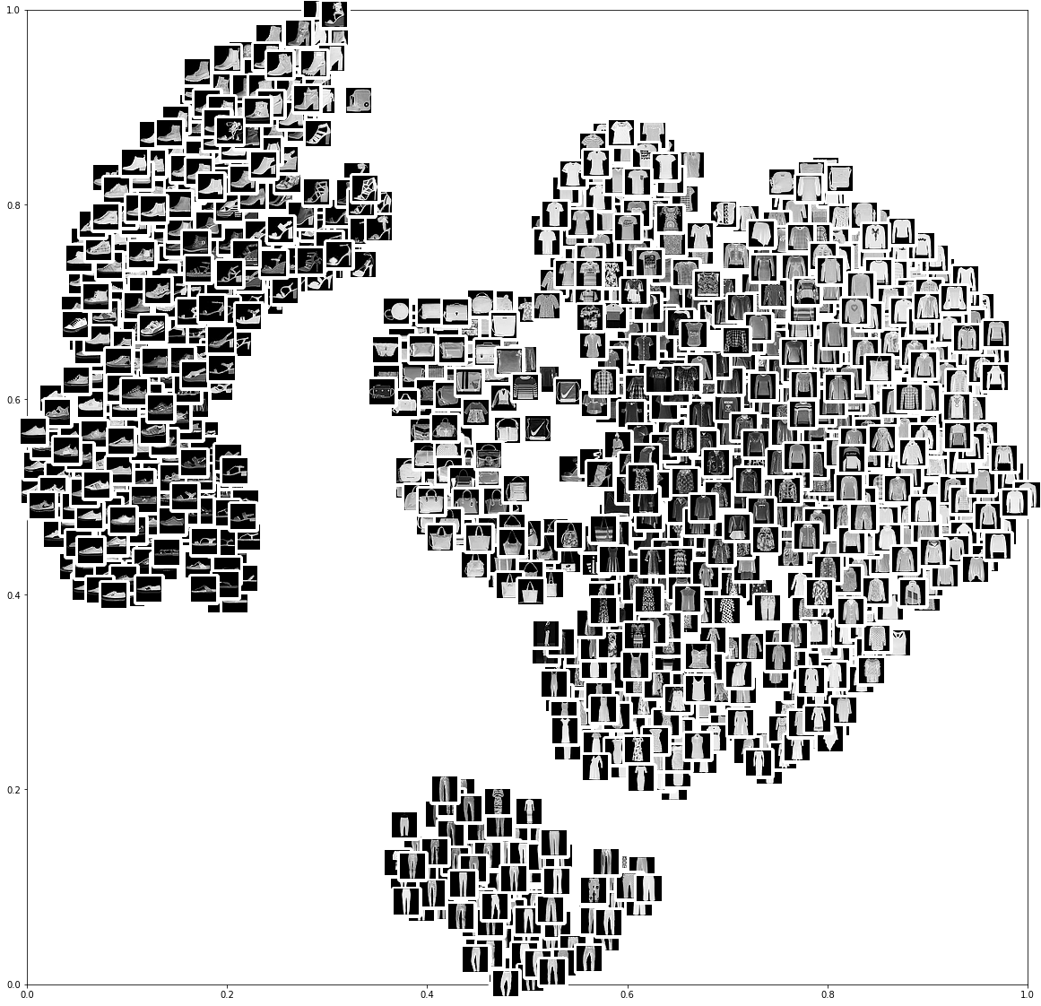

Slide 20
How to compare encodings ?

Slide 21
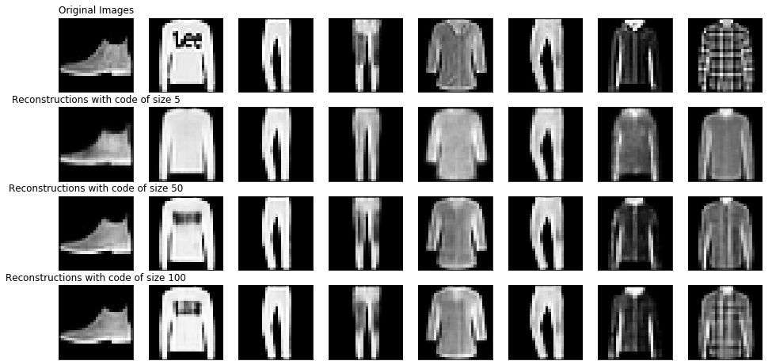
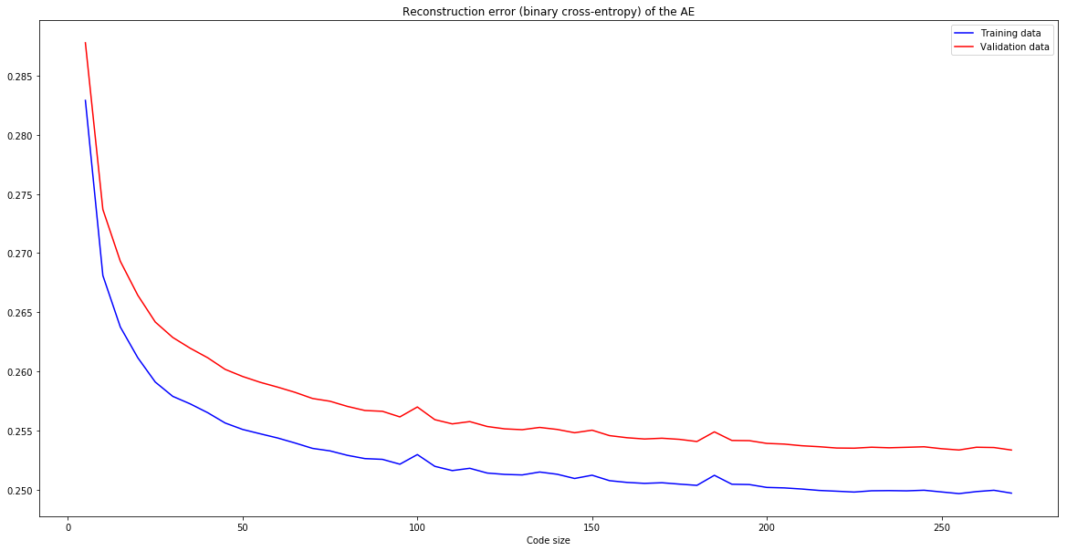
How to Compare Encodings ?
Reconstruction Errors
Reconstruction error is not a good metric of the efficiency of the learned representation:
A high enough capacity can get an arbitrary good reconstruction, without learning the underlying structure in the images

Slide 22
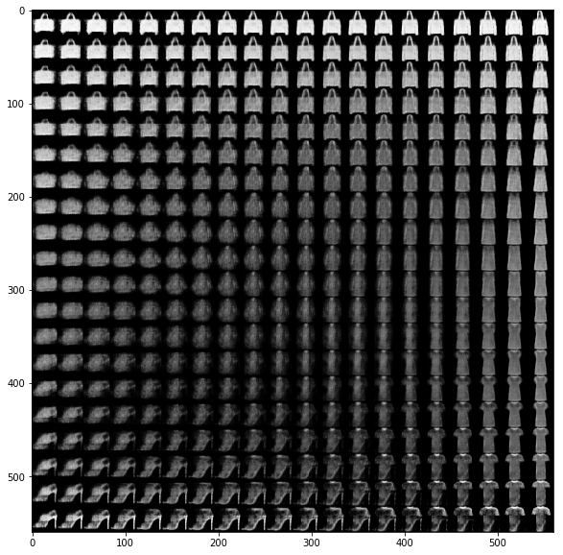
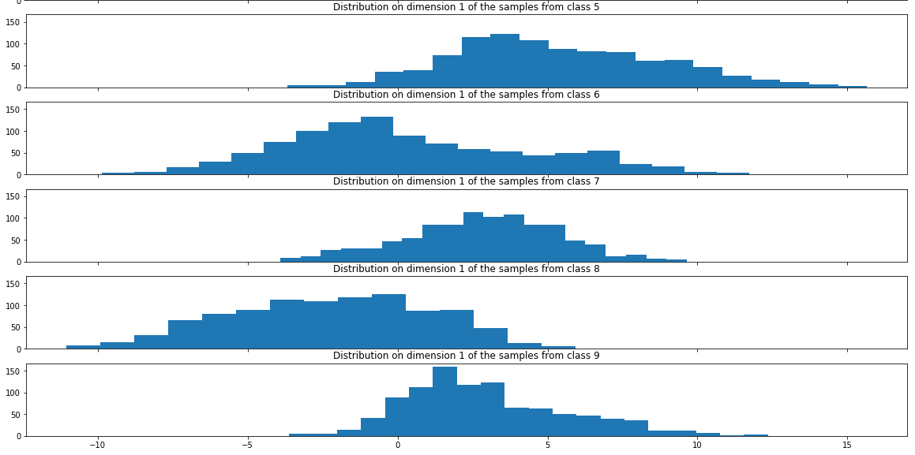
How to Compare Encodings ?
Code Visualization

Slide 23
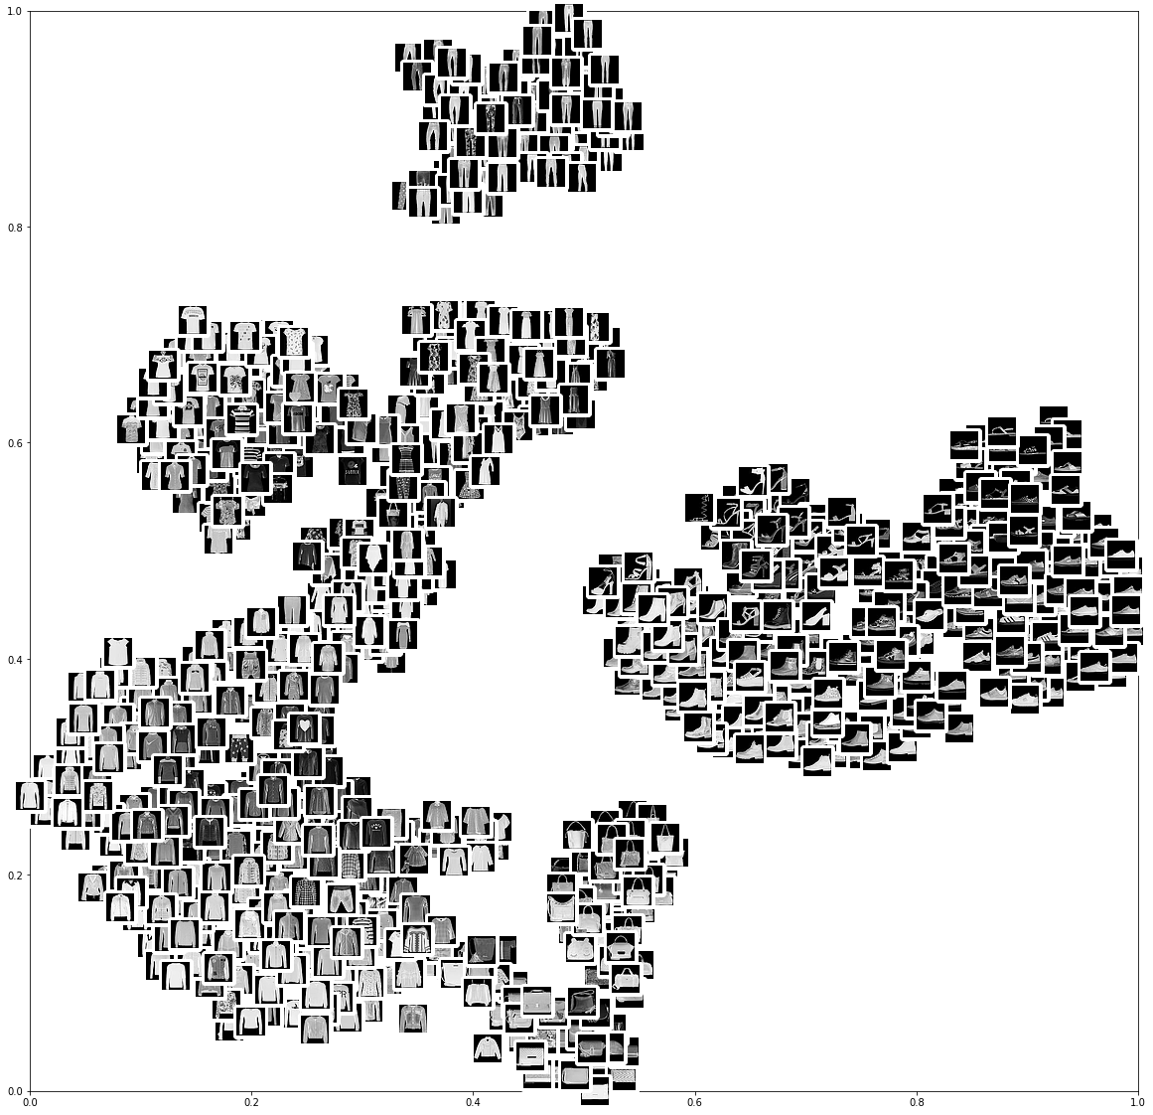
How to Compare Encodings ?
t-SNE
Visualizing the embedding of our data as a two or three dimensional space.
Iteratively minimizes the KL divergence between two probability distributions modeling the local similarity of points in both the high dimensional space and the 2-dimensional space
Limits:
The algorithm converges to a local minimum
t-SNE is sensitive to the value of a perplexity defining a notion of ‘neighborhood’ in the high dimensional space.
Cluster sizes and distances in the visualization are meaningless.

Slide 24
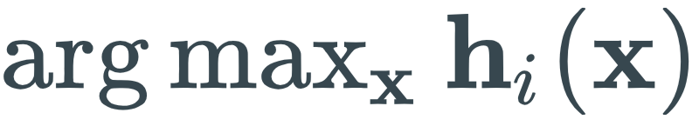
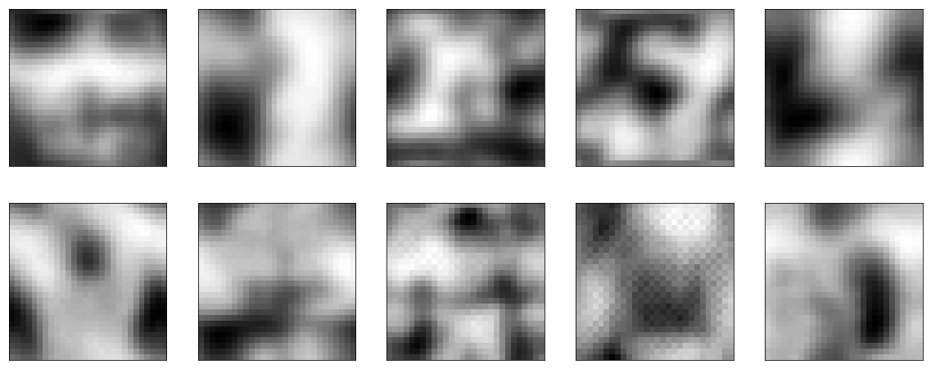
How to Compare Encodings ?
Activation Maximization
Generating an input image that maximize one of the components of the learned representation:
Trying to visualize the learned structure in the images.

Slide 25
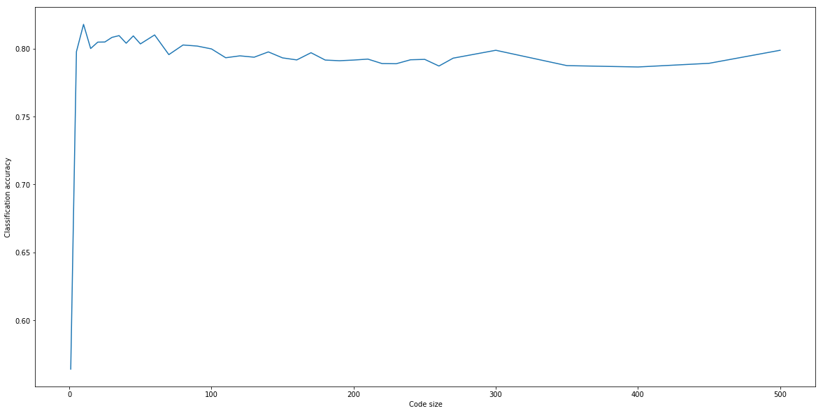
How to Compare Encodings ?
Classification Results
A common way of determining the efficiency of a learned representation
Training a classifier on the learned representations.

Slide 26
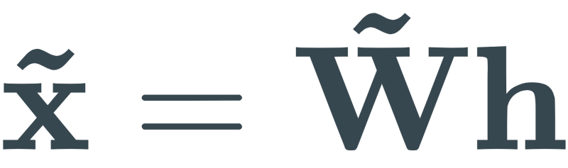

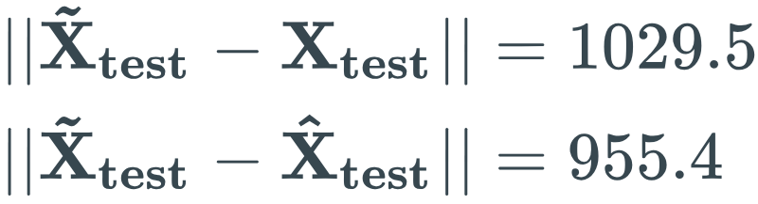
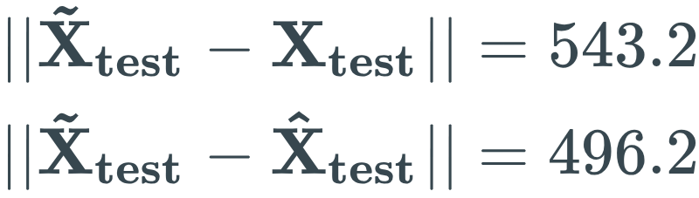
How to Compare Encodings ?
Approximation of the learned encoding function
Approximating the function learned by the Encoder by other known function.
Approximation with a linear function: comparing the input and the reconstruction with
where
Example:
infoGAN architecture with code of size 5:
Linear and shallow Auto-Encoder with code of size 5:
Decreases with code size

Slide 27
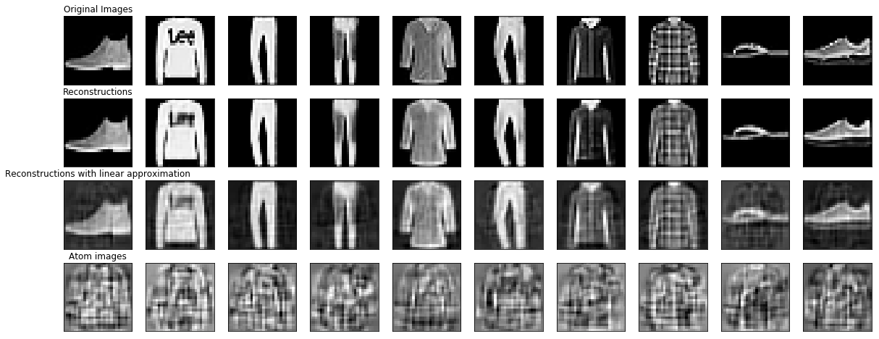

Slide 28
Conclusion

Slide 29
Conclusion
To Do List
Coming back to more shallow network architecture:
Dictionary images visualization abilities.
A decomposition closer to linear.
Implementation and testing of several sparsity regularizers.
Implementation and testing of several morphological decomposition.

