Slide 1

FUTUREME · UPDATED PROJECT CASE STUDY
FutureMe AI
STUDY ROUTE
TVET ROUTE
From “I think” to “I tried.”
ช่วยให้นักเรียนเข้าใจตัวเอง ก่อนตัดสินใจอนาคต
ME NOW
A runnable decision-support prototype for Thai secondary and vocational students.
RESEARCH-INFORMED · NOT VALIDATED GUIDANCE
SKILL TRIAL
NEXT EVIDENCE
Explore the next step—not one final answer.
Research · Data lineage · Product · Decision logic · Validation
Several hypotheses. One reversible next step.
Notes:
Opening: FutureMe helps a learner choose the next experiment, not a permanent identity.
[Sources]
- README.md — current product boundary and status
- 03_WebApp/READMEEN.md — implemented learner journey
[/Sources]

Slide 2

PROBLEM
02
Students decide before they have evidence
Thai education has visible forks; the day-to-day reality behind each route is harder to test.
Decisions arrive before experience.
CONSEQUENTIAL CHOICE POINTS
General upper secondary
Vocational ปวช.
Other / local options
ม.3
FutureMe’s design hypothesis
Students need a safe way to test a direction before committing time, prerequisites and money.
TCAS / university
Work / training
Continue vocational
ม.6
Criteria vary by school, campus, programme and admission year.
PRIMARY USER RESEARCH: NOT YET RUN
FutureMe AI · August 2026
Sources: Thai curriculum, VEC catalogue, TCAS70; FutureMe source audit (24 Jul 2026)
Notes:
The choice-point examples are context, not evidence that FutureMe improves outcomes.
[Sources]
- 03_WebApp/docs/02-research-and-evidence.md — Thai education and mismatch evidence
- 01_Research/Data/SOURCE_AUDIT.md — claim-status audit
[/Sources]

Slide 3
EVIDENCE
03
The cost is mismatch—and a moving target
The evidence supports earlier exploration, not a promise of one perfect match.
56%
27%
39%
work outside their field of study
work below their skill or qualification level
of core skills expected to change by 2030
TDRI CONTEXT
SAME POPULATION
WEF EMPLOYER SURVEY
Design implication: help students test, compare and revise—before a direction becomes expensive to change.
Caution: the TDRI public page describes a broadly highly educated group and does not expose its denominator or method. These figures are problem context, not a FutureMe performance baseline.
FutureMe AI · August 2026
Sources: TDRI (2025); WEF Future of Jobs (2025); scopes differ and are not combined causally
Notes:
Do not combine the percentages causally; their scopes and denominators differ.
[Sources]
- https://tdri.or.th/2025/09/thailand-human-capital-development/ — 56% and 27% public context
- https://www.weforum.org/publications/the-future-of-jobs-report-2025/in-full/3-skills-outlook/ — 39% core-skills outlook
- 01_Research/Data/SOURCE_AUDIT.md — interpretation limits
[/Sources]

Slide 4
DATA PIPELINE
04
The data pipeline keeps limits attached
Source dates, unknowns and integrity checks travel with every demo record.
SOURCE
TRANSFORM
VALIDATE
SERVE
Official registers
Audited research
Project items
Reproducible scripts
Typed JSON
Schema · counts
Hashes · cross-file
Browser API
Warnings included
→
→
→
Controls that stay visible
PROVENANCE
→
CHECKSUMS
→
UNKNOWNS
→
FRESHNESS
1,961 options / 1,375 institutions; 140 mapped. TCAS, fees, scholarships and living costs remain unavailable.
FutureMe AI · August 2026
Sources: education-data registry + MHESI/OVEC; checked 11 Aug 2026
Notes:
This is the current demo-data flow. Unknown values remain unknown instead of being inferred.
[Sources]
- 01_Research/Geography_and_Access/README.md — pipeline, counts and limitations
- 01_Research/Geography_and_Access/PROVENANCE.json — dates, licences and full checksums
- 03_WebApp/scripts/validate-research-data.mjs — integrity checks
- 03_WebApp/data/education-data-registry.json — coverage, status and decision-use boundary
[/Sources]

Slide 5
IDEA
05
The idea evolved from matching to learning
Each research input changed a product decision.
1
→
2
→
3
→
4
→
5
PROBLEM
THEORY
CONTEXT
ACTION
PRODUCT
Study–work mismatch is not one-to-one
RIASEC gives a six-part interest language
Socratic + STAR surface lived evidence
A mini mission tests self-report
0–3 routes + a 30-day experiment
FutureMe is an evidence loop, not a career oracle.
Conversation frameworks guide prompts; they do not validate the questionnaire.
FutureMe AI · August 2026
Sources: FutureMe research summaries; Holland RIASEC; interview framework files
Notes:
The route hypotheses are deliberately reversible.
[Sources]
- 03_WebApp/docs/01-project-overview.md — product thesis
- 03_WebApp/docs/03-user-experience.md — evidence-loop design
[/Sources]

Slide 6
RESEARCH FOUNDATION
06
Research shaped the model—and what we rejected
Only constructs that change the product’s output earn a place in the assessment.
R
Hands-on
INCLUDED
RIASEC interest vector
A starting hypothesis for exploration
C
I
Organise
RIASEC
Investigate
Socratic prompts + STAR
Conversation scaffolds—not psychometrics
DESIGN INPUT
one vector six interests
DEFERRED
Work values
Route catalogue lacks value profiles
E
A
Lead
Create
S
REJECTED
MBTI-type matching · VARK labels
Unstable types / weak evidence
Help
The live 30-item instrument and both future banks remain unvalidated for real learners.
FutureMe AI · August 2026
Sources: Holland (1997); O*NET Interest Profiler Manual; FutureMe methodology
Notes:
RIASEC structures reflection; it does not make this project-specific instrument validated.
[Sources]
- 03_WebApp/docs/questionnaire-methodology.md — construct and item provenance
- 01_Research/Adaptive_Questionnaire/README.md — research-only adaptive design
[/Sources]

Slide 7
DESIGN PRINCIPLES
07
Five product rules follow directly from the evidence
Research is useful only when it changes what the product does.
01
Interests still move in adolescence
→
Offer hypotheses—not a verdict; keep routes reversible
02
Self-report is only one signal
→
Add a scenario mission that can agree or disagree
03
AI recommendations can become opaque
→
Rules decide; show evidence, unknowns and contradictions
04
Admissions and labour data expire
→
Carry source, scope, last-checked date and freshness
05
The users are minors
→
Guest-first, browser-local; consent before saving or sharing
Private by default · Evidence before confidence · One useful next action
FutureMe AI · August 2026
Sources: Source audit, RAG data spec, interview research, privacy design
Notes:
These rules are product principles derived from the source audit and safeguarding boundary.
[Sources]
- 03_WebApp/docs/08-privacy-and-data.md — privacy boundary
- 03_WebApp/docs/09-source-review.md — provenance and freshness
[/Sources]

Slide 8
SOLUTION
08
FutureMe turns reflection into a low-stakes experiment
The experience accumulates evidence instead of manufacturing certainty.
1
→
2
→
3
→
4
→
5
REFLECT
TRY
EXPLORE
COMPARE
ACT
30 live items
+ first-answer follow-ups
One scenario mission
0–3 routes with reasons
Evidence · trade-offs unknowns · sources
A reversible 30-day plan
EVIDENCE — NOT CERTAINTY
A learner can revise answers, override the mission, compare routes or stop.
FutureMe AI · August 2026
Source: implemented FutureMe guest journey
Notes:
The first answer only changes order: all 30 live interest items are still asked and scoring is unchanged.
[Sources]
- 03_WebApp/lib/adaptive-engine.ts — branch plan
- 03_WebApp/tests/unit/adaptive-engine.test.ts — deterministic branch tests
[/Sources]

Slide 9
USER JOURNEY
09
Each step gives the learner control
The output at every stage is provisional, inspectable and editable.
1
2
3
4
5
What do I like—
and what follows?
Does action agree?
What can I explore now?
Why these options?
What can I test next?
30 items; answer 1
reorders the next two
Mission can corroborate or contradict
Tier gate · evidence · 0–3 routes
Reasons · evidence · unknowns · sources
30-day reversible experiment
CONTROL LOOP · change answers · choose another mission · compare again · keep, park or drop a route
FutureMe AI · August 2026
Source: implemented UX flow and session behavior
Notes:
The learner can review answers, override a suggested mission, compare again and delete local state.
[Sources]
- 03_WebApp/READMEEN.md — journey and control surfaces
- 03_WebApp/e2e/journey.spec.ts — implemented browser journey
[/Sources]

Slide 10
AI ARCHITECTURE
10
Rules decide. AI explains. Research stays gated.
The live decision path, future research inputs and production plan remain separate.
TODAY · IMPLEMENTED
RESEARCH / FUTURE
30 live items
+ 5 context prompts
90-item adaptive design
not live
1,000-item bilingual bank
structurally checked
Expert + student review
before import
→
→
↓
↓
First-answer ordering
+ deterministic rules
↓
Audited RAG retrieval
→
Evidence-grounded explanation
→
Interactive roadmap
0–3 routes
+ 30-day plan
Optional LLM: bounded chat + rewording
Outside scoring · offline fallback
Rules decide. Validated data grounds. AI explains.
FutureMe AI · August 2026
Sources: current code + education-data registry; Python backend and production RAG are not connected
Notes:
The 90-item and 1,000-item banks are future research inputs. Neither is imported by the live interview.
[Sources]
- 01_Research/Adaptive_Questionnaire/README.md — 90-item design boundary
- 03_WebApp/data/question_bank_1000.json — restored research bank
- 03_WebApp/scripts/validate-future-question-bank.mjs — structural validation
- 03_WebApp/docs/05-system-architecture.md — current/planned architecture boundary
- 03_WebApp/data/education-data-registry.json — held-out decision fields
[/Sources]

Slide 11
RECOMMENDATION LOGIC
11
Recommendation logic is explicit and auditable
Same answers, same routes. The model cannot change the decision.
30 live items
+ context
→
RIASEC vector
→
Mission vector
→
Tier gate
→
3-criterion matrix
→
0–3 routes
SCORED SIGNALS + UNVERIFIED PROMPTS · BLOCKS NOT TO SCALE
Interests 50%
Mission evidence 30%
Learning env. 20%
Practical prompts
Not scored
23 / 30
FLAT
WEAK
TIES
minimum items answered
profile → no route
all evidence insufficient → no route
shown, not falsely ranked
Live scoring uses 30 items. The 1,000-item bank is structurally checked and research-only.
FutureMe AI · August 2026
Source: adaptive-engine + decision-engine + future-bank validator (current prototype)
Notes:
Eligibility, scoring, refusal, ties and ordering are deterministic. The fixed weights are design judgement.
[Sources]
- 03_WebApp/lib/decision-engine — current implementation
- 03_WebApp/docs/04-ai-system.md — scoring and AI boundary
[/Sources]

Slide 12
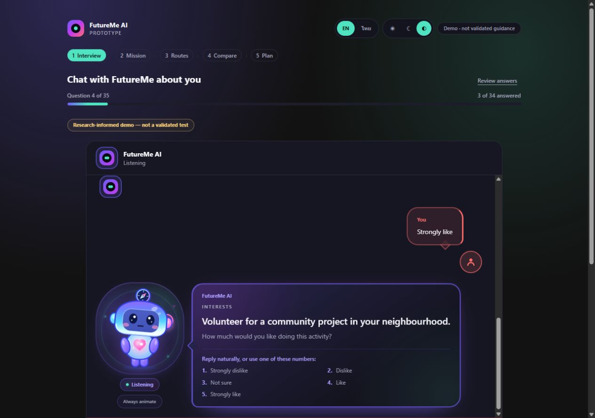
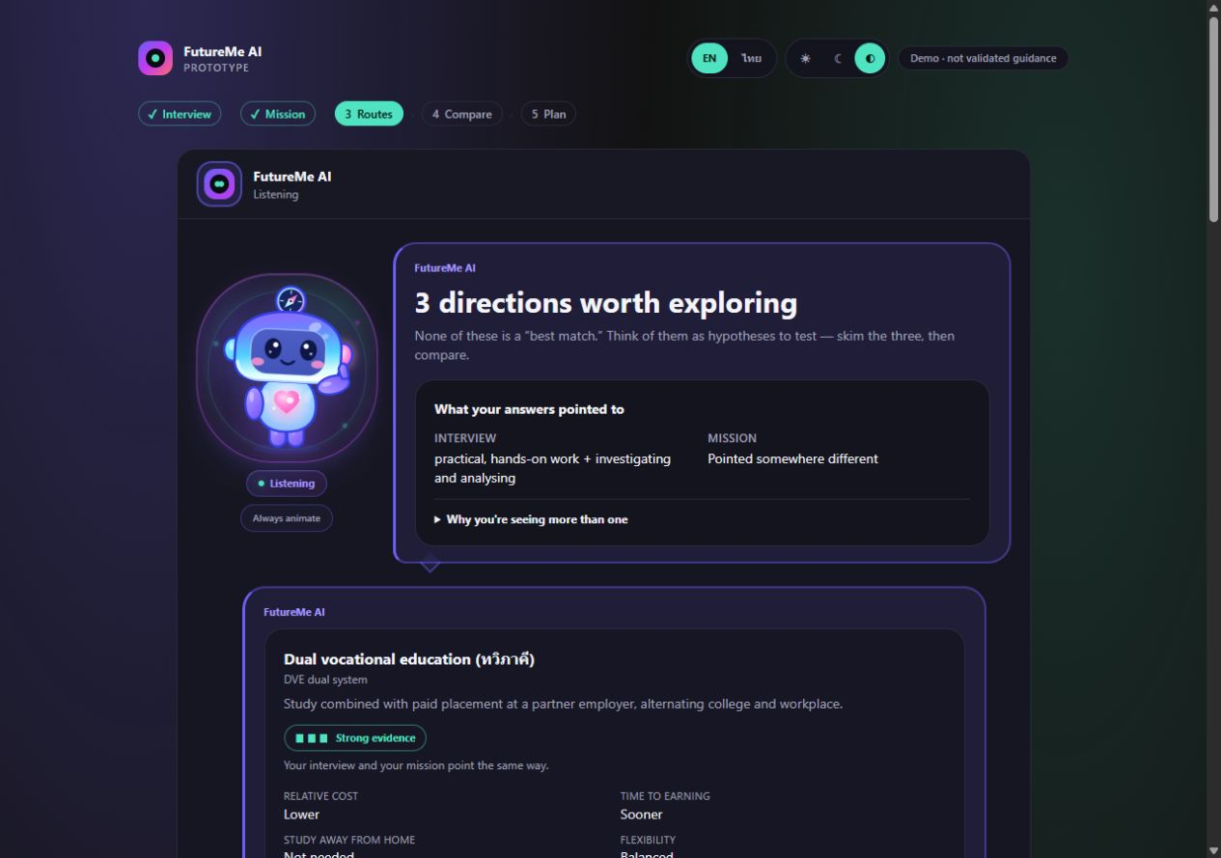
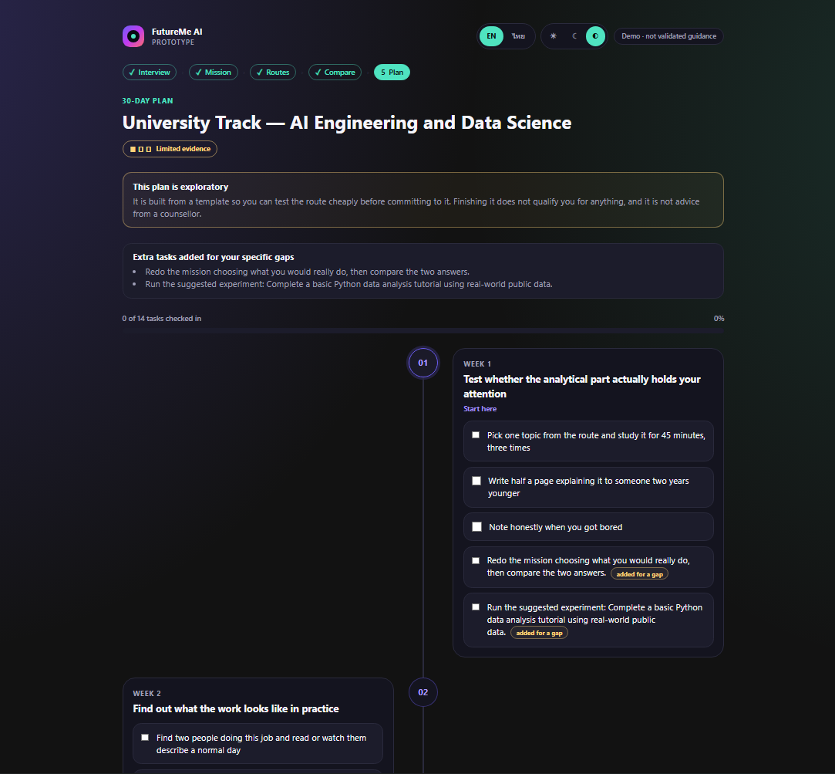
PROTOTYPE
12
The latest prototype runs end to end
Current app screenshots—not concept mockups. Mascot motion is on by default with a persisted system opt-out.
1 · REFLECT
3 · EXPLORE
5 · ACT
One item at a time
Several hypotheses
30-day experiment
TH / EN + THEMES
3 MISSIONS
12 ILLUSTRATIVE ROUTES
BROWSER-LOCAL
533 TESTS
95 E2E
Route profiles and mission rubrics remain illustrative and unvalidated.
FutureMe AI · August 2026
Verification rerun 11 Aug 2026: 533 Vitest tests and all 95 Playwright browser journeys passed.
Notes:
Screenshots were captured from the current app and retained at their inherited crop and placement.
[Sources]
- 03_WebApp/assets/screenshots/app/interview-2026-08-09.png — Reflect screen
- 03_WebApp/assets/screenshots/app/routes-2026-08-09.png — Explore screen
- 03_WebApp/assets/screenshots/app/plan-2026-08-09.png — Act screen
- npm run verify, 11 Aug 2026 — 27 files and 533 tests plus production build passed
- npm run test:e2e, 11 Aug 2026 — all 95 Playwright browser journeys passed
[/Sources]

Slide 13
VALUE PROPOSITION
13
The difference is what happens after the score
FutureMe changes a result into a testable next step.
TRADITIONAL CAREER TEST
FUTUREME EVIDENCE LOOP
Questionnaire
1
→
2
→
3
→
4
→
5
↓
Reflect
Try
Explore
Compare
Act
Score / type
provisional signal
independent evidence
reasons + unknowns
evidence + trade-offs
30-day experiment
↓
new evidence updates the next exploration
Career list
↓
✓
✓
✓
✓
✓
Stops
Refuses to guess
Shows disagreement
No manufactured winner
Sources + freshness
Vocational routes are first-class
FutureMe AI · August 2026
Source: product design and implemented behavior
Notes:
FutureMe continues after the score by making evidence, uncertainty and a reversible action visible.
[Sources]
- 03_WebApp/docs/03-user-experience.md — evidence-loop UX
- 03_WebApp/READMEEN.md — implemented comparison and plan
[/Sources]

Slide 14
VALIDATION
14
Validation is the next product—not a footnote
Software and data pipelines are verified. The instrument and outcomes are not.
PIPELINES VERIFIED ≠ PEOPLE VALIDATED
PROPOSED SUCCESS MEASURES
ASSESSMENT
Reliability · item quality · construct structure
0
Ethics gate
Approval · parent consent · student assent · PDPA
1
Cognitive debrief
n ≈ 30–40 · meaning and translation
ROUTES
Relevance · counsellor agreement · diversity
2
Pilot
target n = 250 · minimum 200
EXPERIENCE
Completion · comprehension · route exploration
3
Measurement
α + ω · item-total · “not sure” rate
4
Structure
RIASEC circular-order randomisation test
LONG-TERM
Can the student still explain and defend the choice?
5
Revise + re-pilot
then invariance and outcome studies
No reliability, validity, fairness or outcome evidence yet.
FutureMe AI · August 2026
Sources: FutureMe validation plan + pre-registered pilot protocol (30 Jul 2026)
Notes:
Passing code and synthetic-pipeline checks does not establish reliability, validity, fairness or effectiveness.
[Sources]
- 03_WebApp/docs/validation-plan.md — validation sequence
- 03_WebApp/docs/pilot-protocol.md — proposed pilot gates
- 01_Research/Adaptive_Questionnaire/sim/README.md — limits of synthetic respondents
[/Sources]

Slide 15
ROADMAP
15
From runnable demo to trusted decision support
Current phase: validate with people, not just pipelines.
1
2
3
4
5
Foundation
Runnable prototype
Validation
School pilot
Ecosystem
DONE
DONE
CURRENT · NEXT
PLANNED
EXPLORATORY
Phase 3: expert + student review · questionnaire + mission pilot · licensed dynamic data · bias, privacy + safety audit
SELECTED REFERENCES
Career test → AI career discovery companion
• [1] TDRI — การพัฒนาทุนมนุษย์ไทย (2025)
• [2] NSO — Social Indicators 2025, p.185
• [3] NESDC — ภาวะสังคมไทย Q2/2568
• [4] OECD — PIAAC 2023 mismatch evidence
• [5] WEF — Future of Jobs 2025
• [6] Holland (1997) + O*NET Interest Profiler Manual
• [7] FutureMe Source Audit, Methodology & Pilot Protocol
ช่วยให้เด็กเข้าใจตัวเอง ทดลองทางเลือก และตัดสินใจด้วยเหตุผลที่อธิบายได้
FutureMe AI · August 2026
Repository evidence: education-data registry · source audit · data coverage · validation plan
Notes:
Do not present school, platform or cloud partnerships as confirmed until an agreement exists.
[Sources]
- README.md — current status and repository boundary
- 03_WebApp/docs/07-roadmap.md — staged roadmap
- 01_Research/Data/REFERENCES.md — source registry
- 03_WebApp/data/education-data-registry.json — current data coverage and source status
- https://data.mhesi.go.th/dataset/dqe_11_01 — official programme dataset
- https://ckan.vec.go.th/en/dataset/publicschool — official public vocational register
- https://ckan.vec.go.th/en/dataset/privateschool — official private vocational register
- https://www.mytcas.com/ — official TCAS70 portal; reference only
[/Sources]

