Slide 1
Airbnb price analysis and opportunity
Presented by: Pongsakorn Akarach
Update date: 23/11/2023

Slide 2

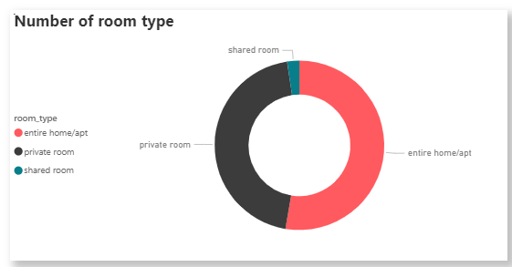
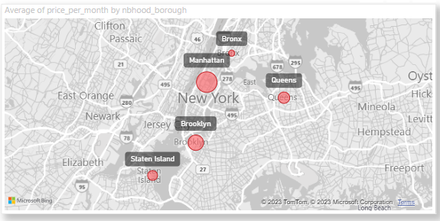
Overview of Airbnb dataset
About data set
Price analysis data from Jan - July 2019
25,202 transaction
Base on 3 room type: Share room, Private room and Entire home/apt
Base on 5 location in NYC: Bronx, Queens ,Brooklyn Manhattan and Staten island
Factor that affect the price
Time
Location
room type

Slide 3
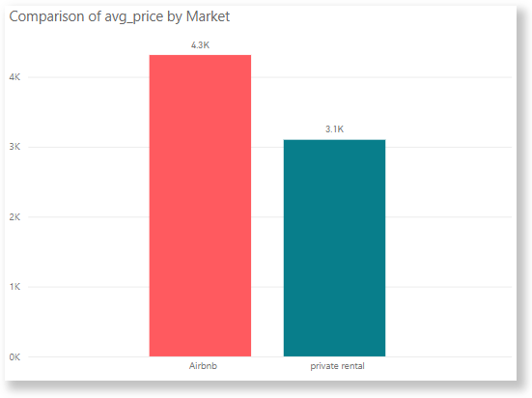
Comparing cost to private rental market
Key takeaway
Avg of price are higher than 1200 USD or 39.11%
What is the root cause

Slide 4
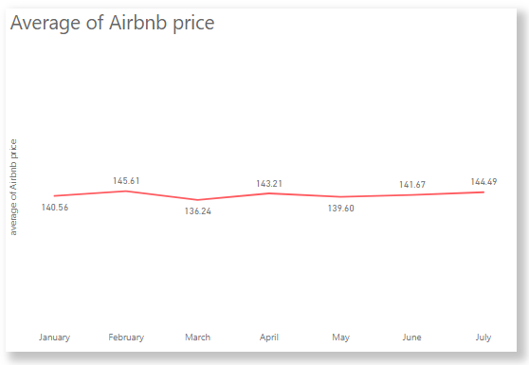
Is a time affect on average price or not ?
Key takeaway
Plot price vs time Jan 2019 to July 2019
Time has no effect on price
Go next to the room type

Slide 5
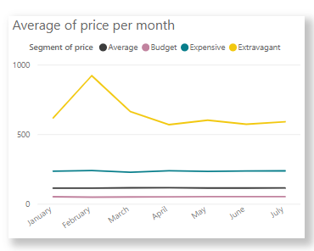
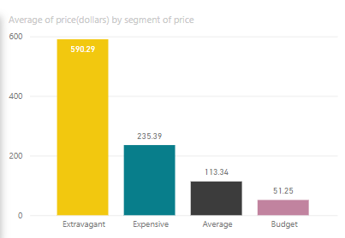
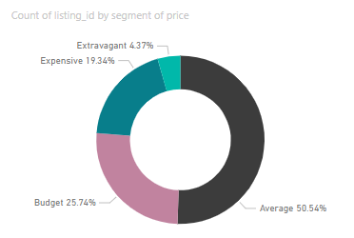
Grouping of price to find a extreme case
key takeaway
the average price of extravagant is very high but the number of booking is very low so it should be analyze with a special group as extreme case
Filter extravagant out average price are only average only 3,690 USD per month
we should reduce the price the extravagant
Next step will analyze by not get extravagant to involve

Slide 6
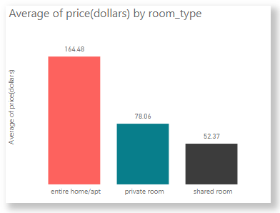
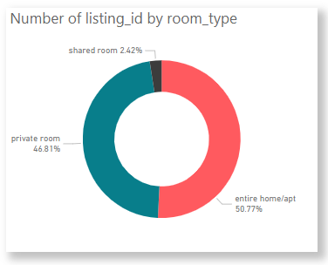
Is a room type affect on price or not ?
Key takeaway
price of entire home are clearly higher than private room and share room so they should be analyzed separately
Although the price of the private room and shared room vary slightly, the number of bookings difference are huge so we should reduce the price of the shared room

Slide 7
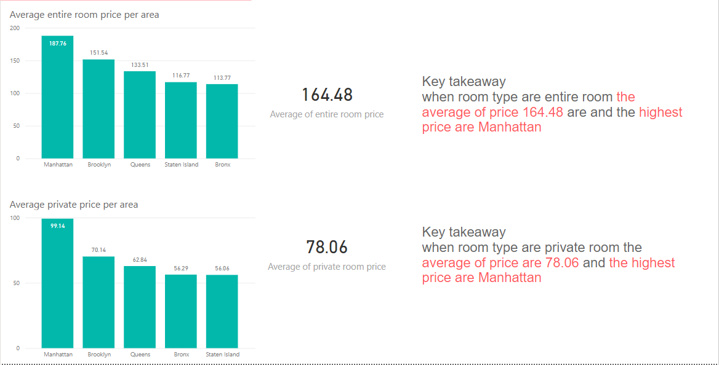
Location analysis

Slide 8
summary and discuss
The price of are many rank and rank extravagant should analysis separately
Shared room and private room type have a average price nearly
Private and entire room are not the same so should analyze separately
Manhattan area have a highest price

Slide 9
Action and opportunity
The price of the shared room and private room is too close to each other, making the shared room unsold. If you want to increase shared room sales, you may have to lower the shared room price or increase the price of private room.
Prices for a room in Manhattan are particularly high than other places. In other sizes, the price is very low, it may be possible to adjust the new price.
Rooms with a price extravagant level should be separated to sell in other markets because it will make Brand's image look expensive.

