Slide 1
Executing ALU, Memory and Control Instructions in Pipeline
Group Presentation
Computer Organization & Architecture
October 27, 2023
Presented to Dr. Devashree Tripathy

Slide 2
Table of Contents
01. Introduction
02. ALU Instructions
Group Members
Overview of Pipelining
Overview of MIPS ISA
ALU R-Format
ALU I-Format
03. Memory Instructions
04. Control Instructions
05. References
Load
Store
Branch
Jump
Additional Resources

Slide 3

Introduction

Slide 4
Group Members
Ponnanna A H [21CS02003]
Priyam Saha [21CS01076]
Shubh Modi [21CS01073]
Tejas Singh [21CS01011]
Arihant Garg [21CS01033]
Aditya Trivedi [21CS01074]

Slide 5
Overview of Pipelining
Pipelining is a computer architecture technique that divides the execution of instructions into stages to improve throughput.
It allows multiple instructions to be processed concurrently by overlapping their execution stages.
The classic pipeline stages in a CPU include instruction fetch, decode, execute, memory access, and write-back.
Pipelining reduces the time it takes to execute multiple instructions, enhancing overall system performance.

Slide 6
Overview of Pipelining
Hazards, such as data hazards and control hazards, can occur in pipelines and need to be managed.
Forwarding and stalling are techniques used to mitigate hazards and ensure the correct execution order of instructions.
Pipelining is commonly found in modern processors, like CPUs and GPUs, to achieve high levels of instruction throughput.
It's crucial for achieving efficient parallelism and improving the performance of various computing tasks.

Slide 7
Overview of MIPS ISA
MIPS (Microprocessor without Interlocked Pipeline Stages) is a RISC (Reduced Instruction Set Computer) architecture known for its simplicity and efficiency.
It uses a fixed 32-bit instruction format, making instruction decoding straightforward.
MIPS has a load-store architecture, where arithmetic and logical operations only operate on registers, and memory accesses are done through load and store instructions.

Slide 8
Overview of MIPS ISA
The architecture includes 32 general-purpose registers, each 32 bits in size.
MIPS instructions are grouped into three formats: R (Register), I (Immediate), and J (Jump), which makes instruction encoding and decoding predictable.
Commonly used in embedded systems, networking devices, and academic settings, MIPS has several instruction sets, including MIPS32 and MIPS64, tailored for different applications.

Slide 9
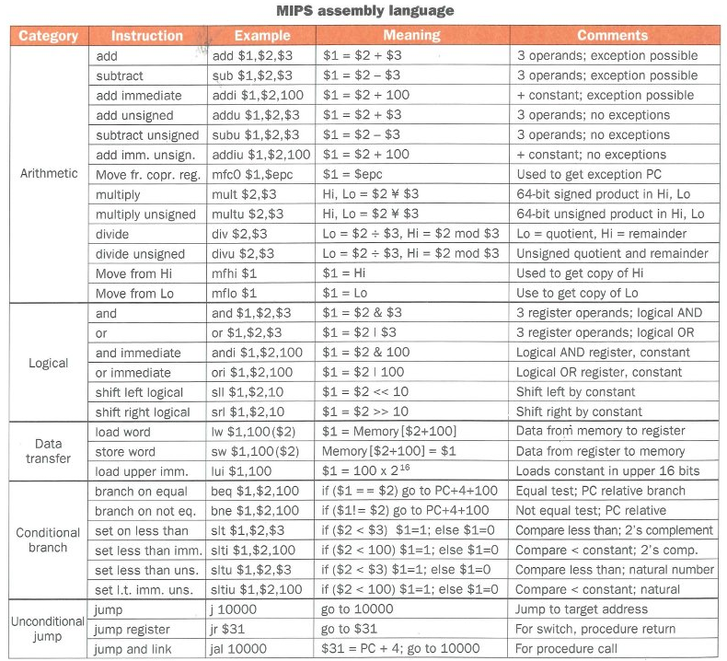

Slide 10
ALU Instructions

Slide 11
MIPS R-format ISA
op: Basic operation of the instruction, traditionally called the opcode.
rs: The first register source operand.
rt: The second register source operand.
rd: The register destination operand. It gets the result of the operation.
shamt: Shift amount.
funct: This field, often called the function code, selects the specific variant of the operation in the op field.

Slide 12
ALU R-Format
4
ADD
IF
ID
ID
EX
EX
MEM
MEMWB
Shift Left 2
ADD
Instruction Memory
Register Bank
PC
Data Memory
ALU
Sign Extend
16
32

Slide 13
Examples of ALU R-Format Instruction
Instruction | op[6] | rs[5] | rt[5] | rd[5] | shamt[5] | funct[6]
ADD | 0 | 16 | 17 | 20 | 0 | 32
SUB | 0 | 18 | 21 | 19 | 0 | 34
SLL | 0 | 0 | 16 | 11 | 4 | 0

Slide 14
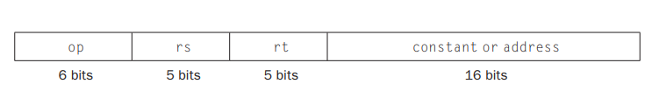
MIPS I-format ISA
op: Basic operation of the instruction, traditionally called the opcode.
rs: Specifies the source register from which data is read. This register typically contains one of the operands for the operation.
rt: Specifies the destination register where the result will be stored(for load type). This register may be the same as the source register for some instructions(for store type).
Immediate Value (or Offset): This field contains a 16-bit immediate value, which is an offset for load instructions.

Slide 15
ALU I-Format
4
ADD
IF
ID
ID
EX
EX
MEM
MEMWB
Shift Left 2
ADD
Instruction Memory
Register Bank
PC
Data Memory
ALU
Sign Extend
16
32

Slide 16
Examples of ALU I-Format Instruction
Instruction | op[6] | rs[5] | rt[5] | offset[16]
ADDI | 8 | 16 | 17 | 5000

Slide 17
Memory Instructions

Slide 18
LOAD
4
ADD
IF
ID
ID
EX
EX
MEM
MEMWB
Shift Left 2
ADD
Instruction Memory
Register Bank
PC
Data Memory
ALU
Sign Extend
16
32

Slide 19
Example of Load Instruction
Instruction | op[6] | rs[5] | rt[5] | Offset[16]
load | 35 | 16 | 17 | 2000

Slide 20
STORE
4
ADD
IF
ID
ID
EX
EX
MEM
MEMWB
Shift Left 2
ADD
Instruction Memory
Register Bank
PC
Data Memory
ALU
Sign Extend
16
32

Slide 21
Example of Store Instruction
Instruction | op[6] | rs[5] | rs[5] | Offset[16]
store | 43 | 8 | 9 | 1000

Slide 22
Control Instructions

Slide 23
BRANCH
4
ADD
IF
ID
ID
EX
EX
MEM
MEMWB
Shift Left 2
ADD
Branch
AND
Instruction Memory
Register Bank
PC
Data Memory
ALU
Sign Extend
16
32

Slide 24
Examples of Branch instruction
Instruction | op[6] | rs[5] | rt[5] | address[16]
BNE | 5 | 19 | 20 | 60000
BEQ | 4 | 16 | 20 | 500

Slide 25
MIPS J-format ISA
op: Basic operation of the instruction, traditionally called the opcode.
address: Gives the address of the instruction to jump to.

Slide 26
JUMP
4
Shift Left 2
31-0
ADD
IF
ID
25-0
ID
EX
EX
MEM
MEMWB
26
28
Shift Left 2
ADD
31-28
Instruction Memory
Register Bank
PC
Data Memory
ALU
Sign Extend
16
32

Slide 27
Examples of Jump instruction
Instruction | op[6] | Address[26]
J | 2 | 200000

Slide 28
References

Slide 29
Additional References
Computer Organization & Design [The Hardware/Software Interface] by David A. Patterson & John L. Hennessy (Fifth Edition)
https://minnie.tuhs.org/CompArch/Lectures/week02.html [For the image listing all MIPS instructions on page 12]
https://www.cs.gordon.edu/courses/cs311/handouts-2015/MIPS%20ISA.pdf

Slide 30
Thank You

