Slide 1
Coordinate Kernel-Aware Warp Scheduling and Warp Sharing Mechanism for Advanced GPUs

Slide 2
Table of Contents
Introduction
Motivation
Brief Overview of GPU Architecture
Kernel-Aware Warp Scheduling
Warp-Sharing Mechanism
Hardware Implementation
Implementation in the GPGPU-Sim Simulator
Performance
Resource Utilization
Concluding Remarks

Slide 3
Introduction

Slide 4
Introduction
In the last ten years, GPUs have become an appealing option for their exceptional computing capabilities in graphic applications.
The key features of a GPU are its high degree of throughput and exceptional computation capability.
The high computational power of GPUs mainly comes from their ability to quickly switch between tasks to reduce delays and their extensive use of multi-threading.

Slide 5
Motivation

Slide 6
Motivation
The traditional warp scheduler policy (loose round-robin [LRR]) assigns equal priority to each warp in the scheduler’s scheduling list.
This dramatically reduces the latency-hiding capability.
LRR capitalizes on inter-warp locality but can't make use of intra-warp locality due to frequent warp changes each cycle.

Slide 7
Motivation
Another widely used warp scheduler is the Greedy Then Oldest (GTO) scheduler, which is considered a standard for comparison. GTO offers improved warp prioritization.
Intra-warp locality is maintained as GTO scheduler issues the same warp until it stalls before moving to the oldest warp.
Thus, we suggest a warp-sharing mechanism that allows each scheduler to be aware of others' activities, enhancing the overall scheduling efficiency among multiple warp schedulers in an SM.

Slide 8
Brief Overview of GPU Architecture

Slide 9
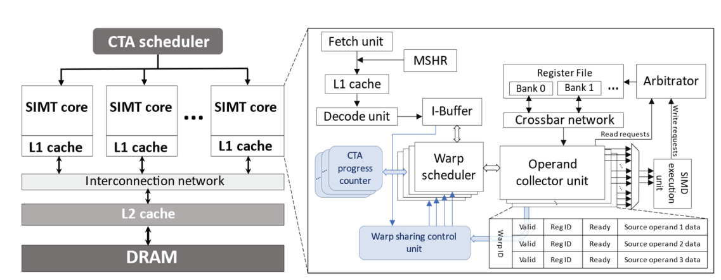
Brief Overview of GPU Architecture
Baseline GPU architecture. The blue components represent additional hardware in this study.

Slide 10
Brief Overview of GPU Architecture
In an advanced GPU architecture designed for parallel computing, multiple SMs are employed.
Each SM includes a sophisticated memory hierarchy, which comprises register files (RF), L1 cache, shared memory, L2 cache, and off-chip GDDR DRAM, addressing memory-related aspects.
The L1 cache is private foreach SM and is responsible for caching temporary register spills of complex programs.

Slide 11
Brief Overview of GPU Architecture
In advanced GPU designs, an SM usually has two or four warp schedulers, with each scheduler capable of issuing up to two instructions from the I-buffer to the GPU cores per cycle.
When a warp instruction is issued, it's assigned an operand collector unit (OCU) to load a source operand value.
GPGPU applications are composed of one or more kernels that organize threads into cooperative thread arrays (CTAs), where the threads within a CTA are further grouped into 32-thread units called warps.

Slide 12
Kernel-Aware Warp Scheduler

Slide 13
Kernel-Aware Warp Scheduler
Observation:
Resource underutilization occurs when the active CTAs in the system are fewer
than the system's capacity to handle them. Therefore, to prevent resource
underutilization, the primary goal is to optimize the system's usage by assigning
the highest possible number of CTAs to it.
Each SM in a GPU can handle up to four concurrent CTAs, and there are 32 CTAs
in a kernel.
Initially, SM_0 and SM_1 are allocated four CTAs each in a round-robin manner
from the CTA scheduler.

Slide 14
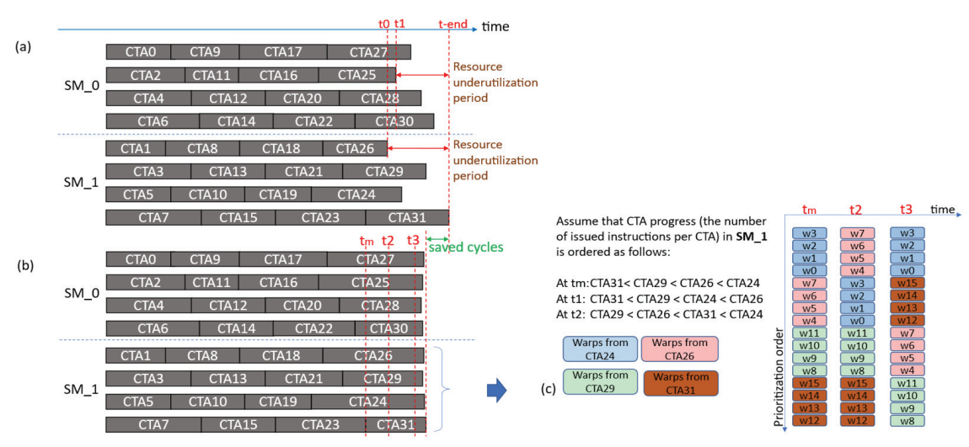
Kernel-Aware Warp Scheduler
Resource underutilization at the completion of kernel execution: (a) conventional kernel-unaware
warp scheduler, (b) proposed kernel-aware warp scheduler, and (c) warp-level illustration for kernel-
aware warp scheduler.

Slide 15
Kernel-Aware Warp Scheduler
Resource underutilization in SM_x occurs when a CTA in SM_x completes its execution after the SM has received the final CTA from the scheduler.
The milestone is defined as the time when the last CTA in the kernel was issued to SM_x.
This kernel-aware warp sched prioritizes warps based on their ages during normal kernel execution.

Slide 16
Kernel-Aware Warp Scheduler
When the final CTA in the kernel is issued, the scheduler switches to a progress-based prioritization policy.
The progress-based policy initially prioritizes warps from the last issued CTA, ensuring that recently issued CTAs are completed faster.
Older CTAs, which tend to issue more instructions, are deprioritized to speed up younger CTAs.
This approach aims to balance execution times among CTAs, filling the SM with running CTAs most of the time.

Slide 17
Warp-Sharing Mechanism

Slide 18
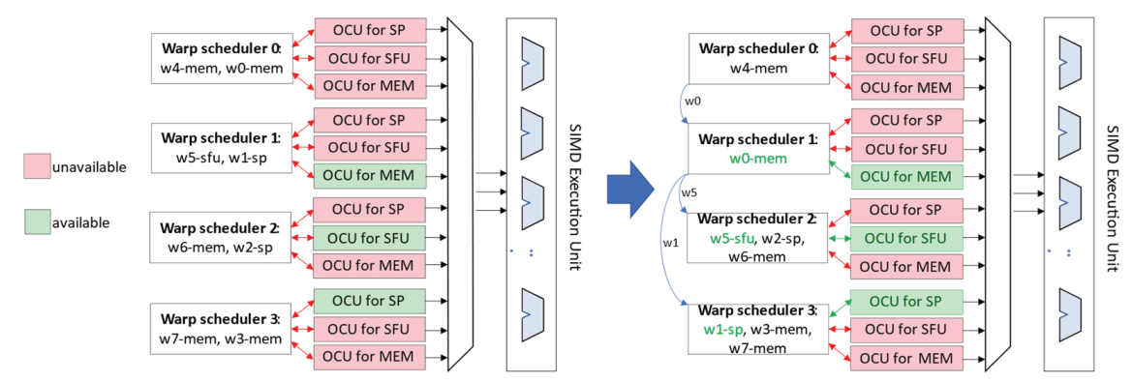
Warp-Sharing Mechanism
Pictorial representation of Warp-Sharing mechanism

Slide 19
Warp-Sharing Mechanism
In this scenario, eight warps are managed by four warp schedulers.
The warp scheduler's function includes identifying the type of instructions carried by each warp, such as memory (MEM), special function unit (SFU), and scalar processor (SP) instructions.
Each warp scheduler is responsible for issuing instructions according to the execution units they require.

Slide 20
Warp-Sharing Mechanism
Warp schedulers face potential issues when the Operand Collection Unit (OCU) for a specific execution unit is unavailable, resulting in stalls.
To address this, a "warp-sharing control unit" is introduced, which monitors OCU statuses and analyzes instruction information from the instruction buffer (I-buffer) to make intelligent warp-sharing decisions.
The warp-sharing control unit optimizes resource utilization by allowing the oldest warp with compatible instruction requirements to issue its instructions, minimizing idle time and enhancing overall execution efficiency.

Slide 21
Hardware Implementation

Slide 22
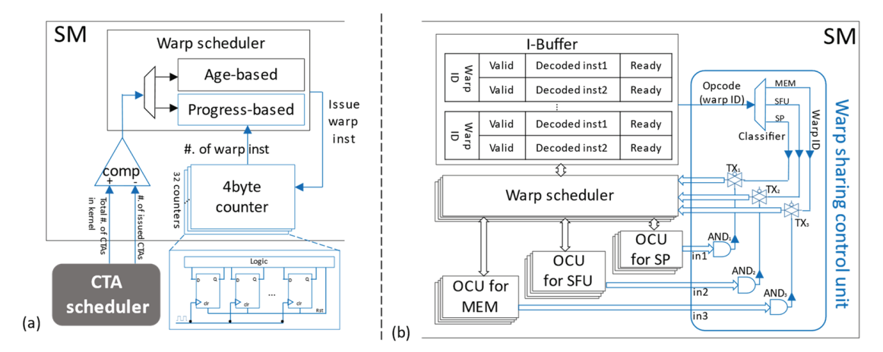
Hardware Implementation
Details of hardware implementation. Additional hardware (in blue) and how these communicate
with existing components in the SM. (a) Employed comparator and counter for kernel-aware warp
scheduler. (b) Warp sharing control unit to manage the sharing mechanism

Slide 23
Hardware Implementation
Hardware overhead for the kernel-aware warp scheduler involves using 32 instruction counters and 4 B registers per CTA to track CTA progress.
This results in a storage overhead of 128 B per SM, which is sufficient for Pascal architecture with a maximum of 32 CTAs per SM.
An additional comparator signals the warp scheduler to switch to a progress-based policy once all CTAs in the kernel have been issued, improving resource utilization.

Slide 24
Hardware Implementation
The hardware implementation of the warp-sharing mechanism involves four layers of warp schedulers and OCUs within an SM, with a "warp sharing control unit" responsible for coordinating sharing.
This control unit scans warp instruction opcodes, classifies them, and selects the appropriate execution unit for each warp instruction based on its type.
Sharing of warp IDs between warp schedulers is controlled by transmission gates (TX1, TX2, TX3) and requires that the availability conditions of the corresponding OCUs are met, enhancing resource utilization efficiently.

Slide 25
Implementation in the GPGPU-Sim Simulator

Slide 26
Implementation in the GPGPU-Sim Simulator
Possible files to implement:
1. gpgpu-sim.cc:
shader_core_ctx::issue_block2core() Lines 1576, 1680, 1679
gpgpu_sim::cycle() Line 1740
2. shader.cc: shader_core_ctx::init_warps()
Lines 497, 539
3. shader.h: shd_warp_t::init()
Line 125

Slide 27
Performance

Slide 28
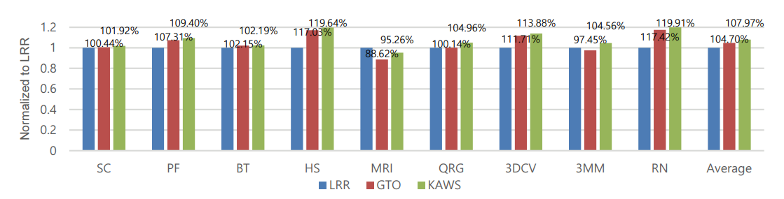
Performance
Performance comparison using various benchmark applications.

Slide 29
Performance
We select the Pascal configuration (Titan X; it is a cutting-edge GPU architecture) as a baseline for comparison
We evaluated the performance based on nine benchmarks SC, PF, BT, HS, MRI, QRG, 3DCV, 3MM and RN
KAWS shows a significant improvement in RN (19.91%), HS (19.64%), and 3DCV (13.88%)

Slide 30
Resource Utilization

Slide 31
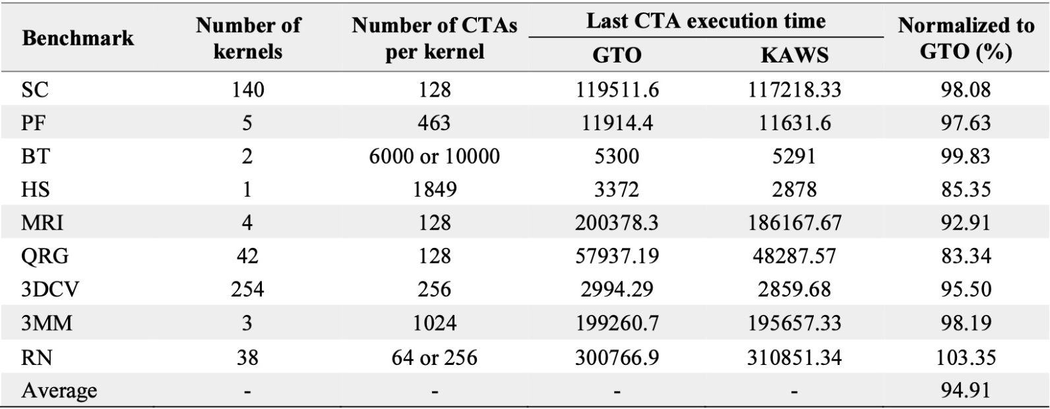
Resource Utilization
Average execution time (cycle) of last issued CTA in kernel.

Slide 32
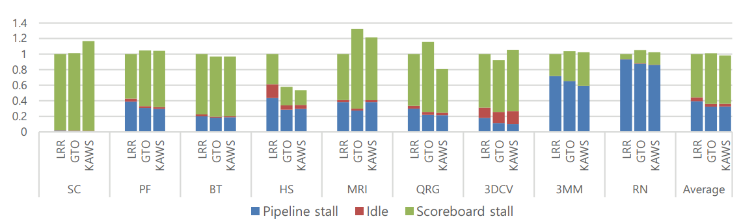
Resource Utilization
Details of stalls in LRR, GTO, and KAWS scheduler.

Slide 33
Resource Utilization
KAWS operates to reduce the execution time of the last issued CTA in the kernel while prolonging that of previously issued CTAs
We compare our design only with GTO because resource underutilization generally occurs in GTO
Inactive cycles can be categorized into the following three stalls:- idle, scoreboard stall, pipeline stall

Slide 34
Concluding Remarks

Slide 35
Concluding Remarks
The study introduces a kernel-aware warp scheduler to prevent hardware underutilization by balancing CTA execution times
A warp sharing mechanism (KAWS) is employed to reduce pipeline stalls, resulting in a performance improvement over other methods
The research aims to adapt KAWS for future GPU advancements, demonstrating a commitment to ongoing hardware utilization enhancements

Slide 36
Group Members
Ponnanna A H [21CS02003]
Priyam Saha [21CS01076]
Shubh Modi [21CS01073]
Tejas Singh [21CS01011]
Arihant Garg [21CS01033]
Aditya Trivedi [21CS01074]

Slide 37
Thank You

