Slide 1
Mobile IP & TCP Performance Improvement
By:
Batch – 5
R.Dharnish (71052307009)
A.Mohamed Wasim (71052307023)
P.Nithya (71052307029)
A.Ponnarasi (71052307031)

Slide 2
Introduction
Mobile communication systems require efficient data routing and reliable transmission. Mobile IP enables devices to move across networks without losing connectivity, while TCP ensures reliable data transfer.

Slide 3
Key Components of mobile ip
Mobile Node (MN): User device Home Agent (HA): Tracks mobile node location Foreign Agent (FA): Provides temporary address Care-of Address (CoA): Temporary IP address

Slide 4
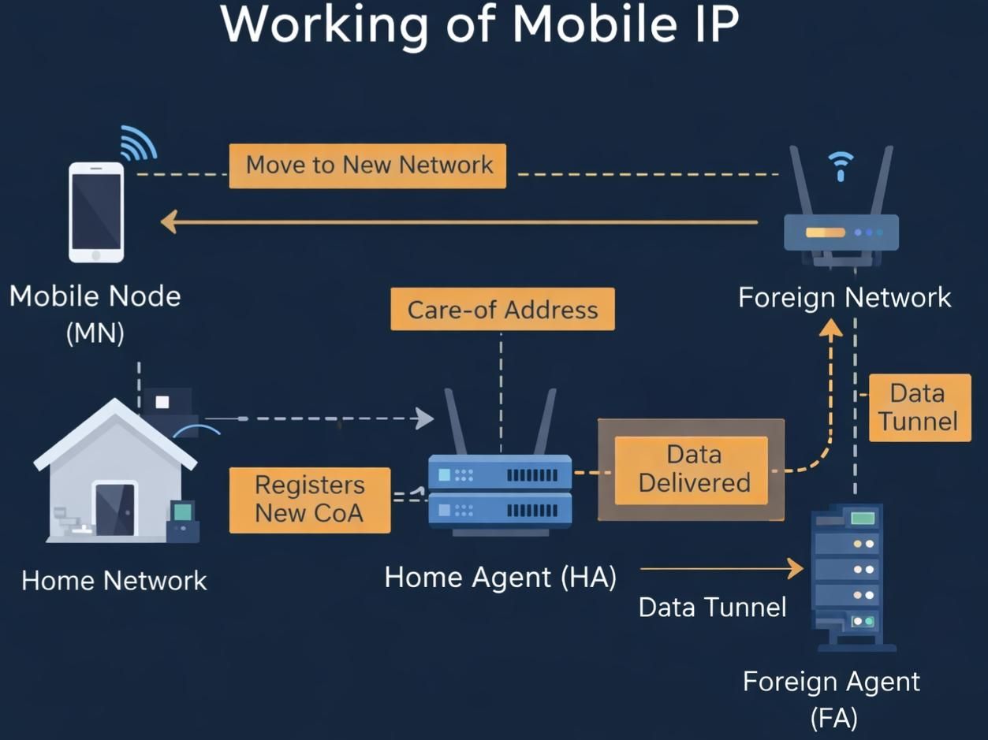
Working of mobile ip
Working of Mobile IP Mobile node moves to a new network Gets a Care-of Address Registers with Home Agent Data is tunneled from HA to FA Data delivered to Mobile Node

Slide 5
Advantages of Mobile IP
Seamless mobility Continuous connectivity Transparent to users Supports roaming

Slide 6
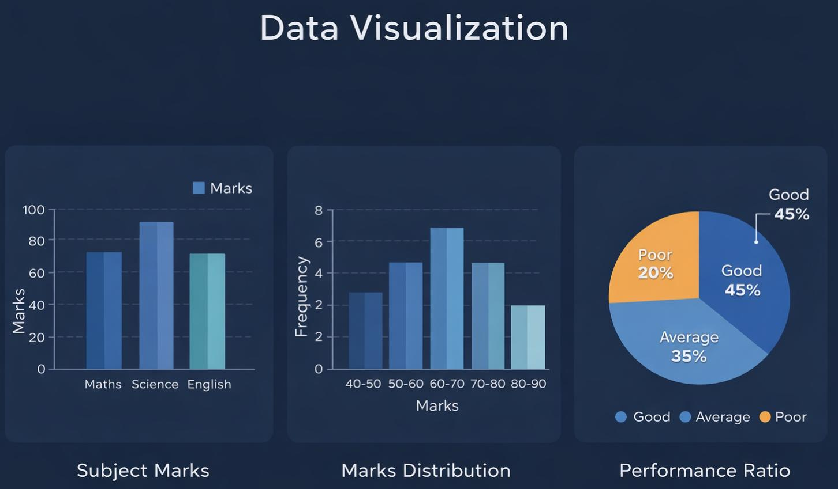
TCP Overview
Transmission Control Protocol (TCP) ensures reliable data transmission over networks. It provides: Error detection Flow control Congestion control

Slide 7
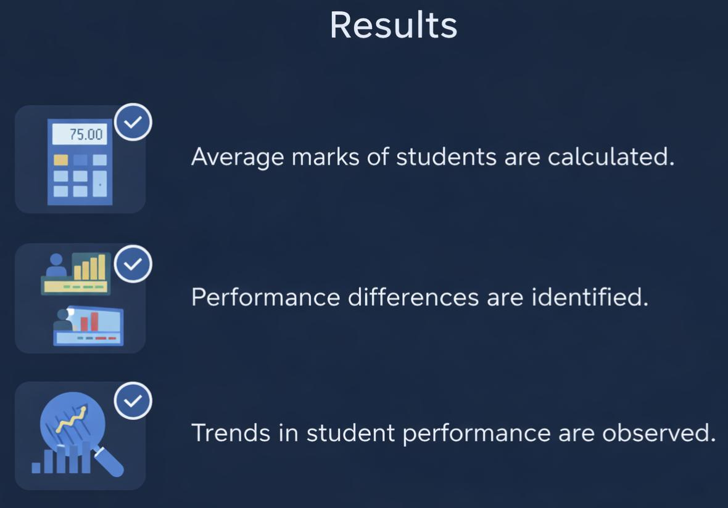
TCP Performance Improvement Techniques
TCP Reno / New Reno Selective Acknowledgement (SACK) Fast Retransmit & Recovery Window Scaling Explicit Congestion Notification (ECN)

Slide 8
Mobile IP + TCP Integration
Combining Mobile IP with TCP improves:
Routing efficiency Data reliability Network performance

Slide 9
Conclusion
Mobile IP ensures seamless mobility, while TCP guarantees reliable data transmission. Together, they enhance overall network performance in mobile environments.

Slide 10
Thank you

