Slide 1

Students Avoid Missed Submissions Through Organized Assignment Notifications
Mentor: N.Mithraa(Assistant professor)
Batch – 5
R.Dharnish (71052307009)
A.Mohamed Wasim (71052307023)
P.Nithya (71052307029)
A.Ponnarasi (71052307031)

Slide 2
Introduction
Assignments are important in academic learning
Students often miss deadlines due to lack of reminders
Staff posting in different places causes confusion
Centralized assignment notification system is needed.

Slide 3
Problem Statement
In many educational institutions, assignments are communicated through multiple sources such as messaging apps, notice boards, and verbal instructions. This creates confusion among students and makes it difficult to track deadlines effectively. As a result, students often miss submissions, leading to poor academic performance. Additionally, there is no centralized system to organize assignments or monitor overdue tasks. Hence, there is a need for a structured system that provides centralized assignment tracking, timely notifications, and proper deadline management.

Slide 4
Abstract
This project focuses on developing a centralized assignment management and notification system to help students avoid missing submission deadlines. In many institutions, assignments are shared through multiple platforms such as WhatsApp and notice boards, which leads to confusion and missed updates. The proposed system allows staff to upload assignments based on department, year, and subject, while students can access them through a unified dashboard. The system includes features such as due date tracking, submission status monitoring, overdue highlighting, and optional sound-based alerts. This improves communication, reduces manual effort, and enhances academic performance by ensuring students stay informed about their tasks.

Slide 5
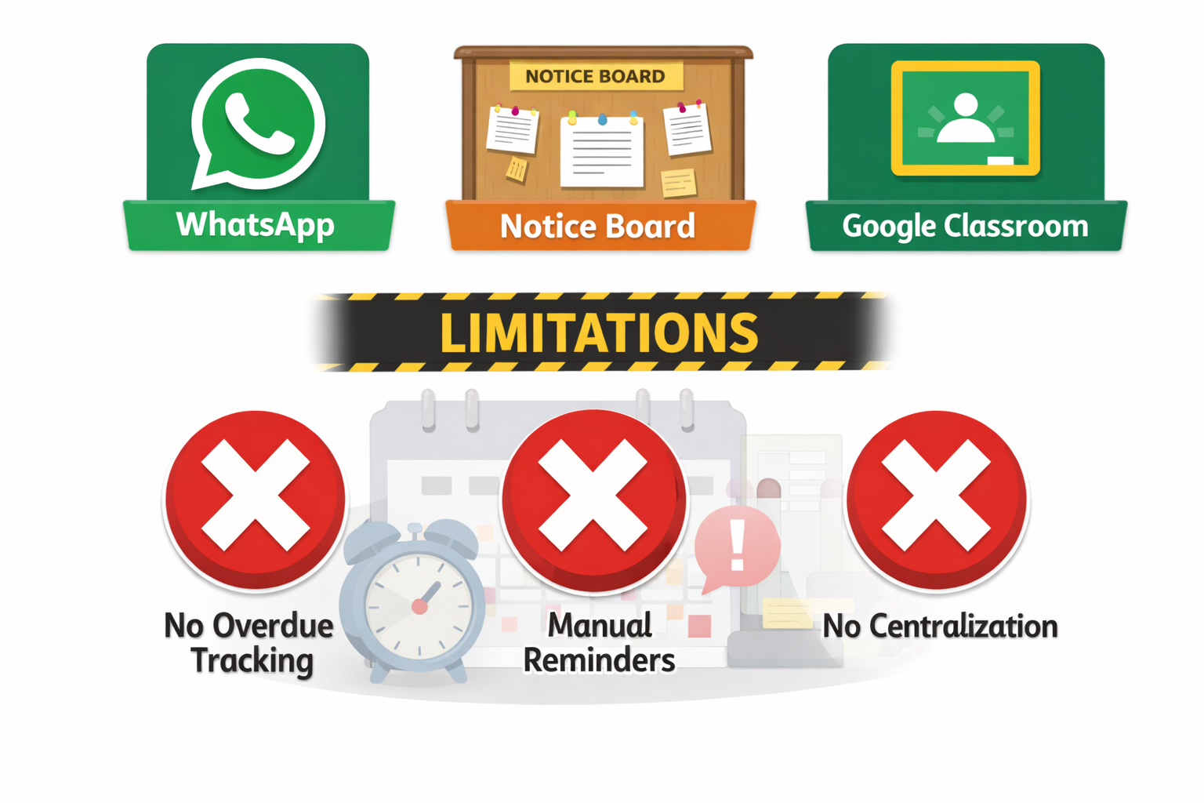
Existing System
Assignments informed through WhatsApp / Notice board
Google Classroom not fully centralized department-wise
Notifications may be ignored or missed
Lack of proper tracking systems leads to missed academic tasks.
Technology can improve student productivity and organization
Limitations:
No overdue tracking
No organized dashboard
Manual reminders required

Slide 6
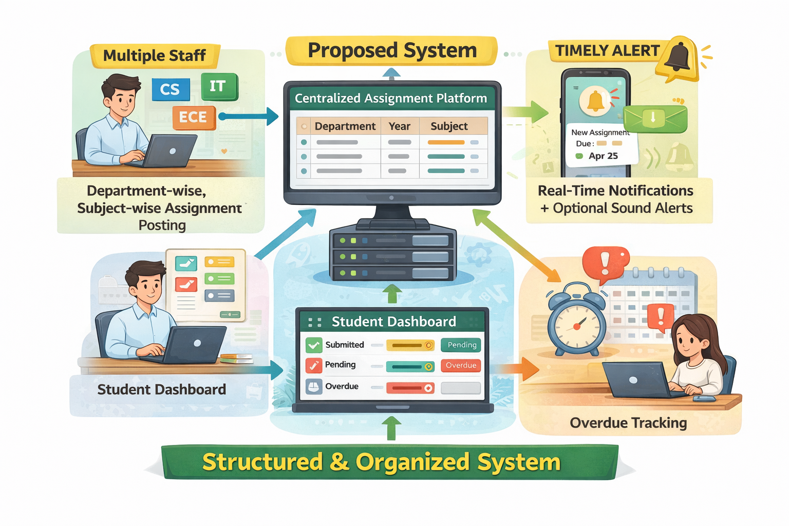
Proposed System
The proposed system introduces a centralized platform for managing and tracking assignments efficiently. It allows multiple staff members to upload assignments based on department, year, and subject, ensuring all updates are available in a single location. Students can access assignments through a user-friendly dashboard, where they can view details, track deadlines, and manage submission status.
The system provides real-time notifications and optional sound alerts to ensure that students do not miss important deadlines. It also includes overdue tracking, which highlights missed assignments even if notifications were not received. This structured approach improves communication, reduces confusion, and enhances overall academic task management.

Slide 7
Key Features (Novelty)
Centralized assignment system
Department-wise structured dashboard
Due date & overdue tracking
Submission status monitoring
Push notification + sound alert
Missed alert recovery system

Slide 8
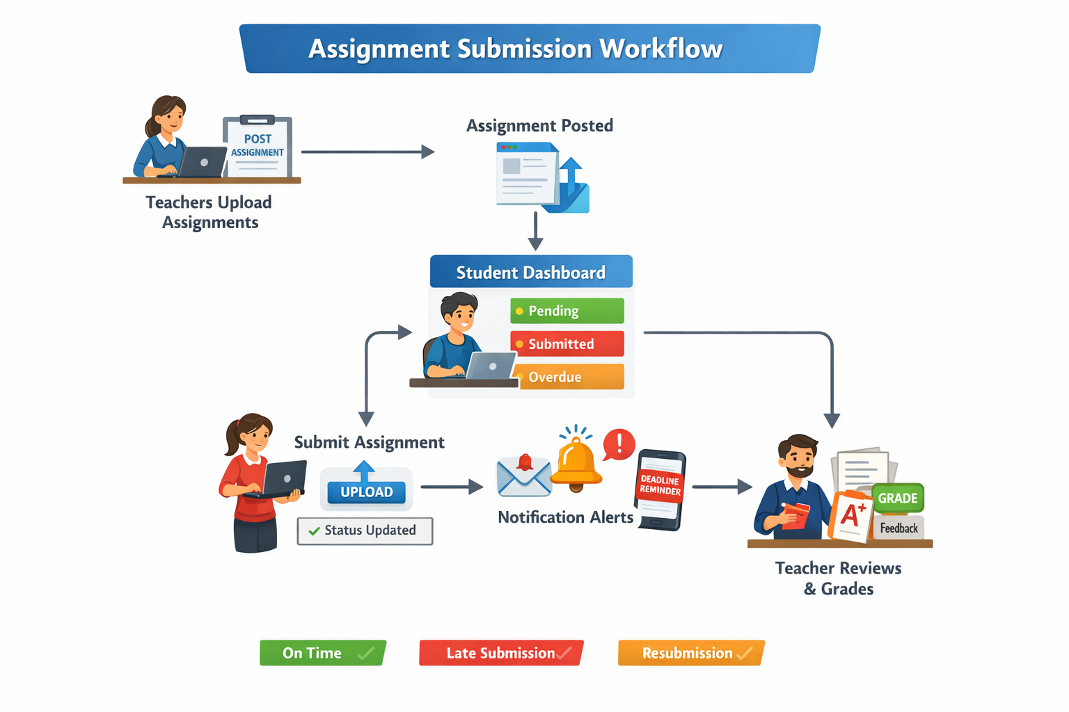
Workflow
1. Staff login and post assignment with due date.
2. Assignment stored in dashboard.
3. Students receive notification.
4. Students view and mark submission status.
5. System tracks due date and shows overdue tasks.

Slide 9
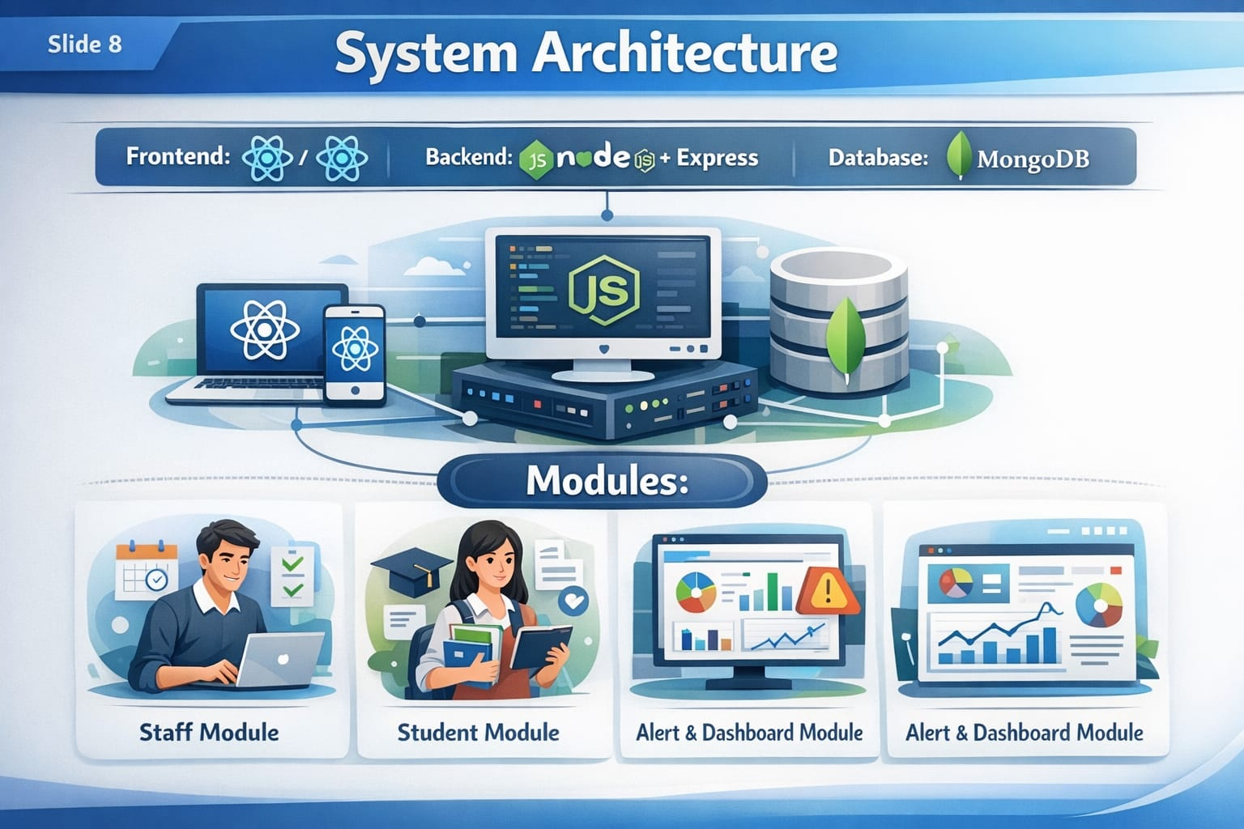
System Architecture
Frontend: React / React Native
Backend: Node.js + Express
Database: MongoDB
Modules:
Staff Module
Student Module
Alert & Dashboard Module

Slide 10
Literature Survey
Existing academic reminder systems help students track deadlines using mobile notifications.
Learning Management Systems like Google Classroom provide assignment posting but lack centralized department-wise visibility.
Research shows that push notifications improve student engagement and reduce procrastination.
However, most existing systems do not provide overdue tracking or multi-staff centralized dashboards.

Slide 11
Advantages
Prevents missed submissions
Reduces staff workload
Organized tracking
Improves student time management
Centralized communication

Slide 12
Thank You

