Slide 1

IOT

Slide 2
Agenda
IOT
MQTT
Event Driven Architecture
CoAP
Data Semantics
Demo

Slide 3
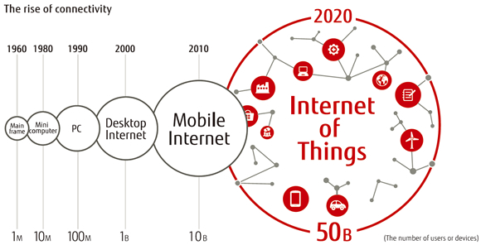
Rise of Connectivity

Slide 4
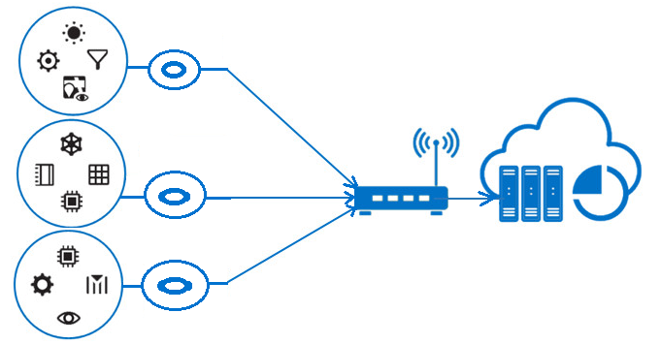
IOT
Edge Routers
6LoWPAN
Network
Sensors
Aggregators
Private
network
IPV4/V6
Internet
Ref :intel.com

Slide 5


IOT : Scenario
Edge Routers
Data
6LoWPAN
Network
Sensors
Aggregators
Private
network
IPV4/V6
Internet
Control
Ref :intel.com

Slide 6
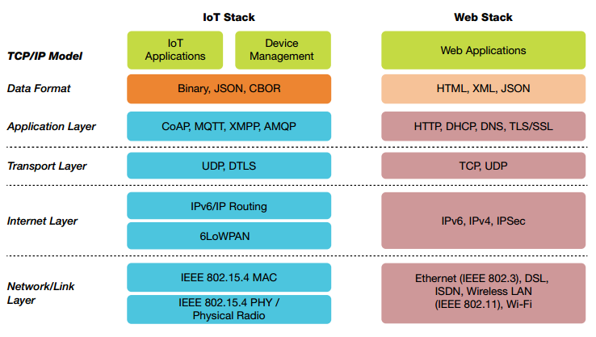
IOT Stack

Slide 7
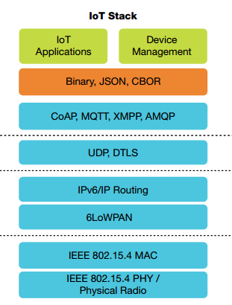

Slide 8
Representational State Transfer (REST)
IBM MQ series
Developed along the HTTP/1.1 protocol and HTTP/1.1 adheres to it.
URI
Client
http://www.amazon.com/ep?wadl
Server
Resource
Resource Representation(WADL / WSDL)
New State
Communication
Server
Client

Slide 9
CoAP (Constrained Appln. Protocol)
CoAP is based on REST Architecture
CoAP is binary HTTP like based on UDP
Request/Response model.
GET, PUT, POST DELETE methods
Observer pattern available
Separate response/response after a while

Slide 10
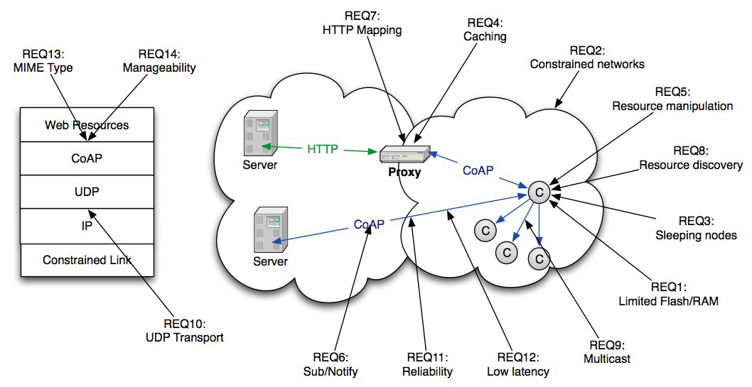
Eco System
Ref :Arm zach shelby

Slide 11
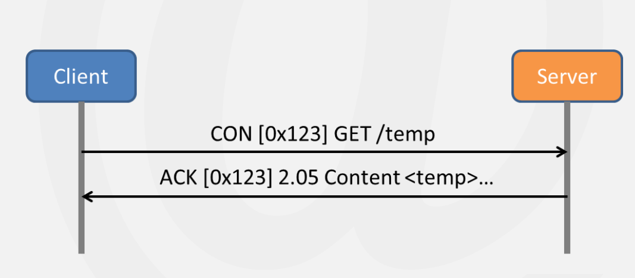
CoAP: QoS and Architecture
QoS : confirmable and non-confirmable messages
Has DTLS (Datagram TLS) security
Resource discovery (CORE link format)

Slide 12
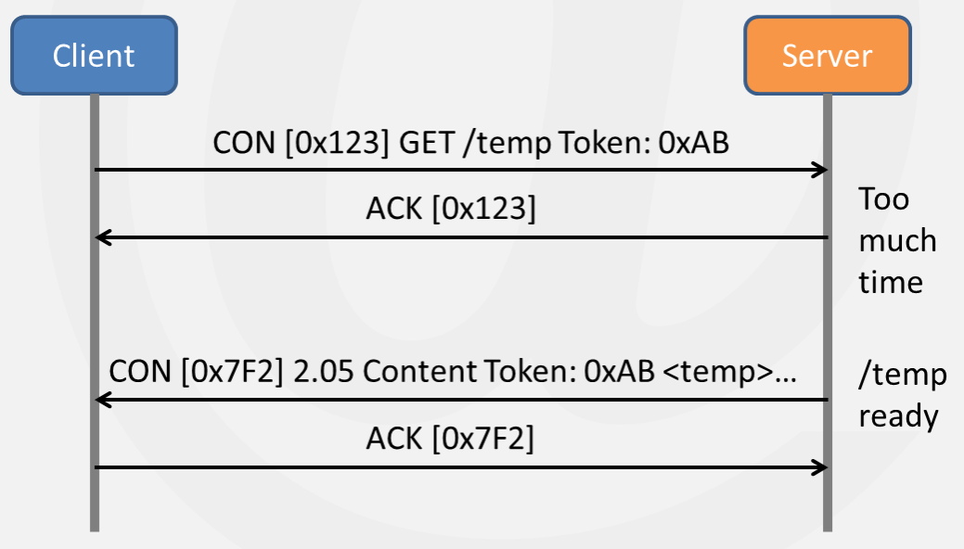
Separate Resource

Slide 13
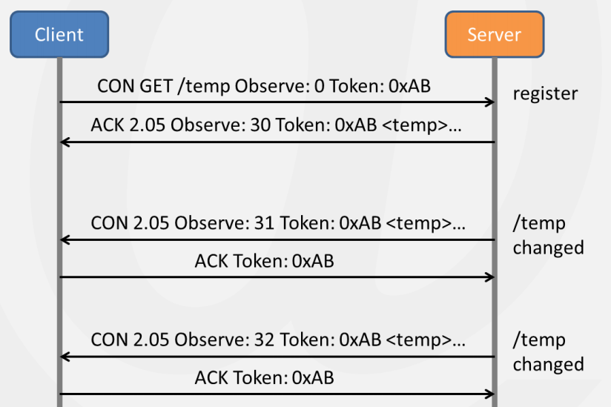
Observe Pattern

Slide 14
Event Driven Architecture

Slide 15
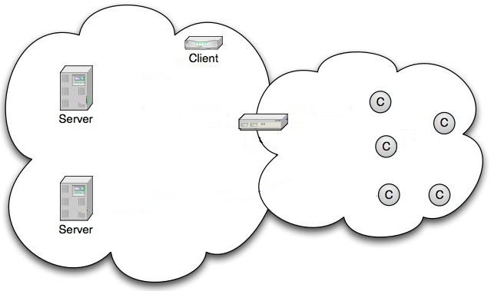
Event Driven Architecture
Consumers
Gateway
Distributer
M2M
Public Network
Private Network

Slide 16

Event Driven Architecture : Scenario
Constrained Networks
Temperature
Gateway
Distributer
Average
M2M
Display Unit
Public Network
Private Network
Sensors(Constrained devices)

Slide 17
MQ Telemetry Transport
IBM MQ series
Approved OASIS Standard
Space decoupling: Publisher and subscriber do not need to know each other (by IP address and port for example)
Time decoupling: Publisher and subscriber do not need to run at the same time.
Synchronization decoupling: Operations on both components are not halted during publish or receiving

Slide 18
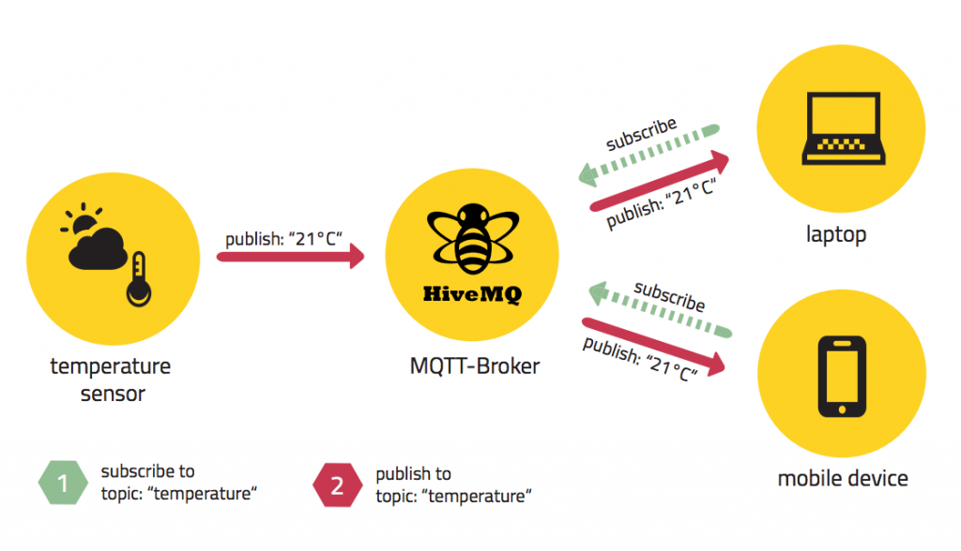
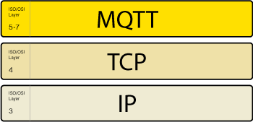
MQTT
Ref :http://www.hivemq.com/blog/mqtt-essentials-wrap-up

Slide 19

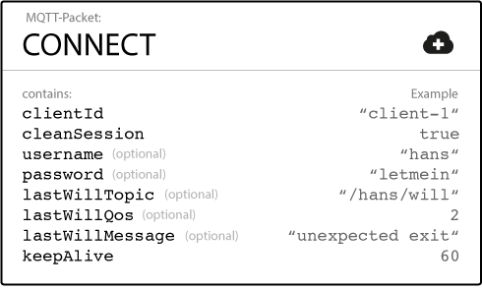
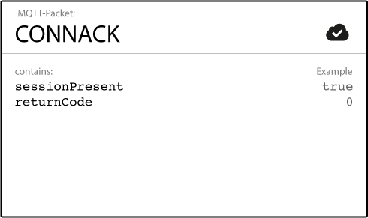
MQTT

Slide 20
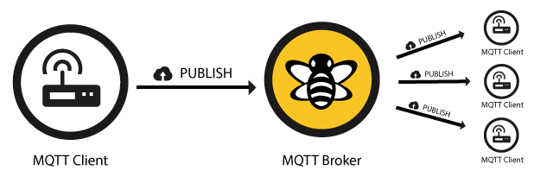
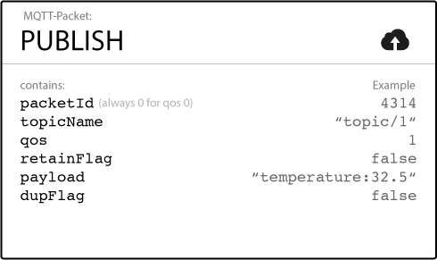
MQTT : Publish

Slide 21
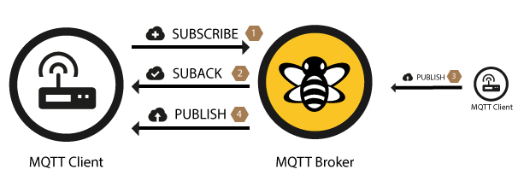
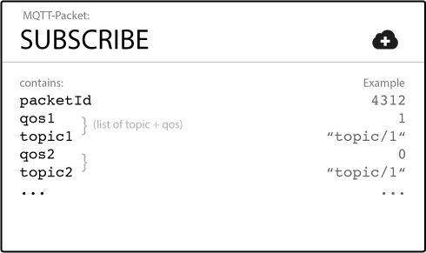
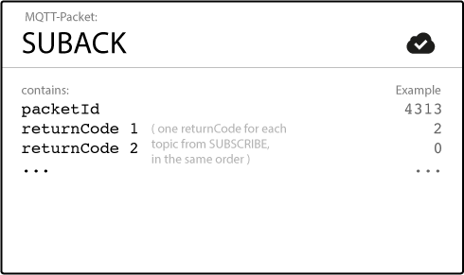
MQTT : Subscribe

Slide 22
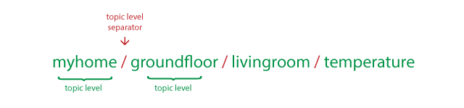


MQTT : Topics
UTF-8 and Case Sensitive
Single Level :+
Multi Level : #

Slide 23
SenML
Sensor Markup Language
IETF
Interoperability
HTTP CoAP MQTT

Slide 24
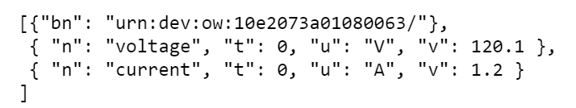
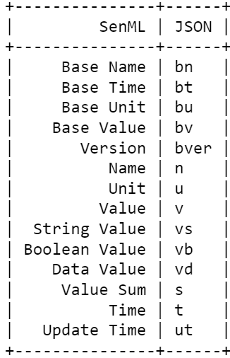
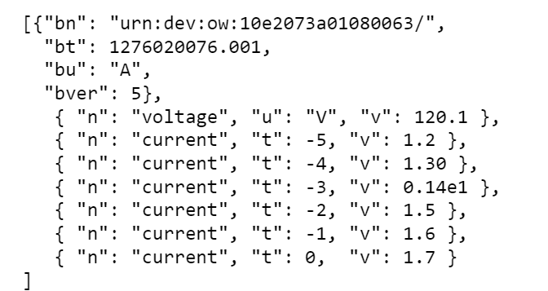
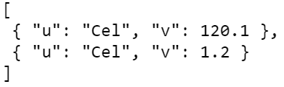
SenML
Example 1
Example 2
Table
Example 3

