Slide 1
Objectives
Lightweight
Event Driven Model
Has Multi-Threading Support as Library
Dynamic Loading and Replacement of Individual Services

Slide 2
Features
Minimalist Event Driven Kernel, even runs on 8-bit Microcontrollers
TCP/IP Stack Support
Dynamic Loading and Unloading of Individual Programs and services
Small Memory Requirements
Optional Preemptive Multithreading through Proto-threads

Slide 3
Features
implemented in the C language and has been ported to a number of microcontroller architectures.
Contiki provides IP communication, both for IPv4 and IPv6.
It has an IPv6 stack that, combined with power-efficient radio mechanisms such as ContikiMAC, allow battery-operated devices to participate in IPv6 networking.
Contiki supports 6lowPAN header compression and the CoAP application layer protocol.

Slide 4
Threads and Events
A “thread” in a programming environment is the smallest sequence of programmed instructions that can be managed and run independently by a scheduler.
An event driven program typically runs an event loop,]. It keeps waiting for an event, e.g. input from internal alarms. When an event occurs , the program collects data about the event and dispatches the event to the event handler software to deal with it.
Contiki has a hybrid model:the system is based on an event-driven kernel where pre-emptive multi-threading is implemented as an application library

Slide 5
Threads and Events
For example consider a MAC protocol that turns off the radio subsystem on a periodic basis; but you want to make sure that the radio subsystem completes the communication before it goes to sleep state.
At t=t₀ set the radio ON
The radio remains on for a period of t_{awake} seconds
Once t_{awake} is over, the radio has to be switched off, but any on-going communication needs to be completed.
If there is an on-going communication, the MAC protocol will wait for a period, t_{wait_max} before switching off the radio.
If the communication is completed or the maximum wait time is over, then the radio will go off and will remain in the off state for a period of t_{sleep.}
The process is repeated.

Slide 6
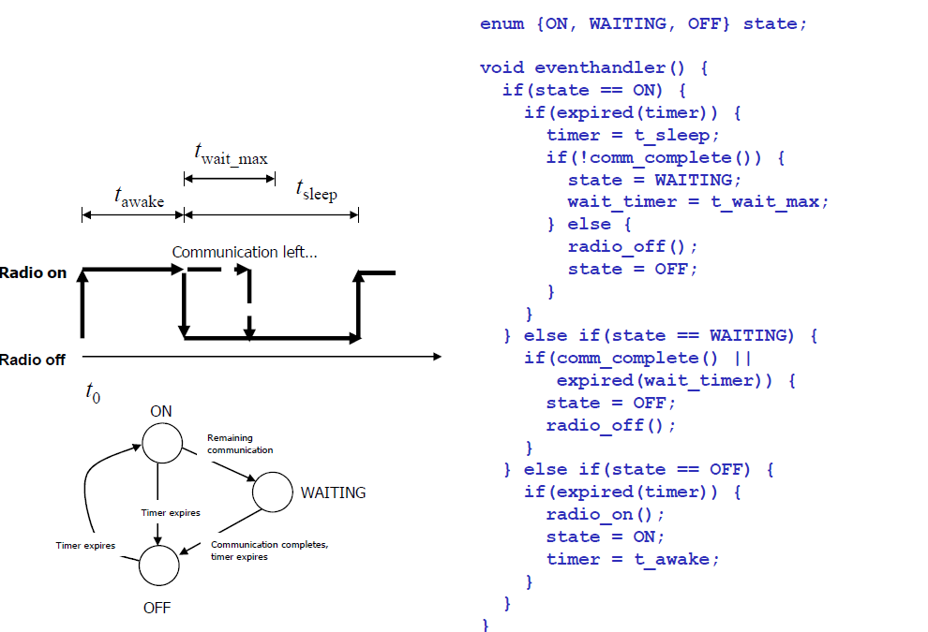
Threads and Events
Event driven code can be
messy and complex
Source: Adam Dunkels, Oliver Schmidt, Thiemo Voigt, and Muneeb Ali. 2006. Protothreads: simplifying event-driven programming of memory-constrained embedded systems. In Proceedings of the 4th international conference on Embedded networked sensor systems (SenSys '06). ACM.

Slide 7
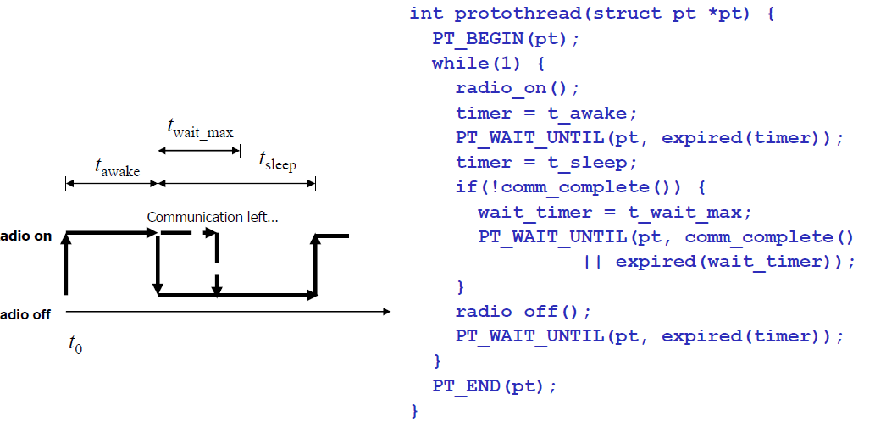
Threads and Events
Source: Adam Dunkels, Oliver Schmidt, Thiemo Voigt, and Muneeb Ali. 2006. Protothreads: simplifying event-driven programming of memory-constrained embedded systems. In Proceedings of the 4th international conference on Embedded networked sensor systems (SenSys '06). ACM.

Slide 8
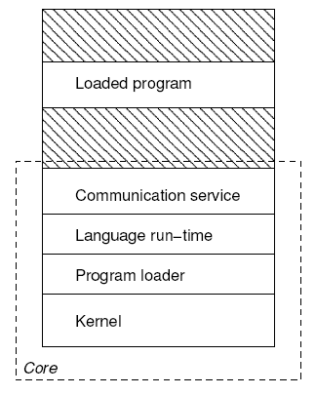
Contiki OS

Slide 9
Contiki OS
The partitioning is made at compile time and is specific to the deployment in which Contiki is used

Slide 10
Kernel Architecture
Synchronous and Asynchronous events
Polling mechanism
Contiki kernel uses a single shared stack for all process execution
Power save mode
Contiki has mechanisms to save power
MAC Layer protocols
Radio Duty cycling.

Slide 11
Service Layer
Works with Kernel
Provides lookup for specific service
Returns a Service Interface
Has pointers to all functions service provides
Contains a version Number
Interface description implemented by Service Process

Slide 12
Service Example

Slide 13
Header files
#include "contiki.h"
PROCESS(sample_process, "My sample process");
AUTOSTART_PROCESSES(&sample_process);
PROCESS_THREAD(sample_process, ev, data) {
PROCESS_BEGIN();
while(1) {
PROCESS_WAIT_EVENT();
}
PROCESS_END();
}
Defines the name of the process
Defines the process will be started every time module is loaded
contains the process code
Threads must have an end statement
Event parameter; process can respond to events
process can receive data during an event

Slide 14
Burning the code
Write your code
Compile Contiki and the application
make TARGET=XM1000 sample_process
Make file
If you plan to compile your code on the chosen platfrom more than once;
make TARGE=XM1000 savetarget
Upload your code
make simple_process.upload
Login to the device
make login
CONTIKI = ../..
all: simple_process
include $(CONTIKI)/Makefile.include

