Slide 1
Siddhi: A Complex Event Processing Engine
DREAM:Lab
Presenter:
Rajrup Ghosh
M.Tech. Computational Science,
CDS, IISc Bangalore

Slide 2
Introduction
Event Stream and Event Stream Processing
Complex Event Processing (CEP)
Why to use Siddhi – CEP?
How to use Siddhi?
A quick look into Siddhi Architecture
Siddhi + MQTT
Hands On demo on event processing using CEP

Slide 3
Event Stream
An event stream is a sequence of events ordered with time.
One or more event streams can be imported and manipulated using queries.
Identification of patterns on these events is required.
Examples:
Stock quotes
Click streams
Sensor network data

Slide 4
Event Processing
Event processing is a method of tracking and analyzing (processing) streams of information (data) about things that happen (events) and deriving a conclusion from them.
Events may be of varied form such as data from environmental sensors.
Finding patterns in this data requires complex event processing.

Slide 5
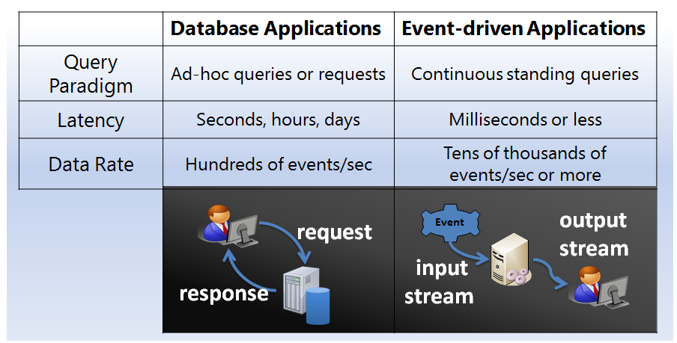
Database vs Event-driven Applications

Slide 6
Complex Event Processing
Complex event processing or CEP, is event processing that combines data from multiple sources to infer events or patterns that suggest more complicated circumstances.
In abstract, the tasks of the CEP is to identify meaningful patterns, relationships and data abstractions among unrelated events and fire an immediate response such as an Alert message.

Slide 7
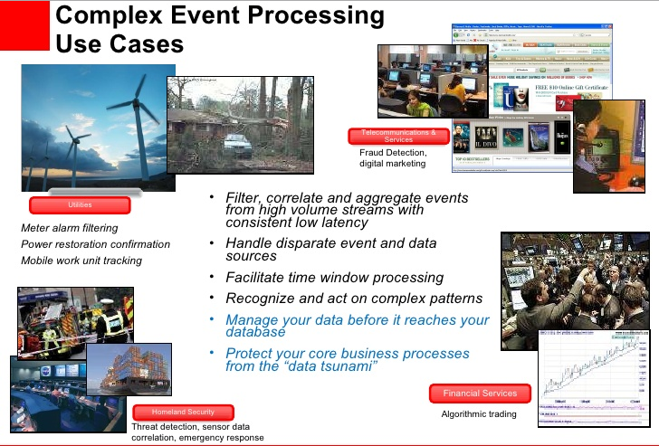

Slide 8
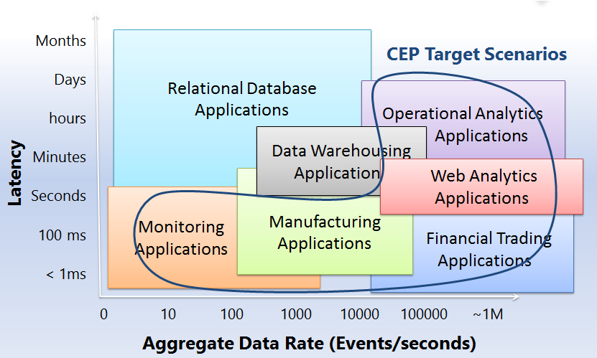
Scenarios of Complex Event Processing

Slide 9
Current CEP Solutions
S4
STREAM
Esper
SASE
SAP ESP
Oracle Event Processing
HiFi
Aurora
CompAS.
Niagara

Slide 10
Amazon Kinesis
Amazon Kinesis Streams is a CEP solution from Amazon.
Amazon Kinesis Streams can continuously capture and store terabytes of data per hour from sources such as
website clickstreams
financial transactions
social media feeds
IT logs
location-tracking events.
Supported as a service from Amazon EC2.

Slide 11
Amazon Kinesis: Benefits
Amazon Kinesis Client Library (KCL) support, which allows streaming data to power real-time dashboards, generate alerts, implement dynamic pricing and advertising, and more.
Emit data from Amazon Kinesis Streams to other AWS services such as
Amazon Simple Storage Service (Amazon S3)
Amazon Redshift
Amazon Elastic Map Reduce (Amazon EMR)
AWS Lambda.

Slide 12
Azure Streaming
Real time processing engine in the cloud.
Service provided by Microsoft.
Advantages:
Real-time analytics for IoT solutions
Stream millions of events per second
Achieve mission-critical reliability and scale
Real-time dashboards and alerts over data
Correlate across multiple streams of data
Use SQL-based language for rapid development

Slide 13
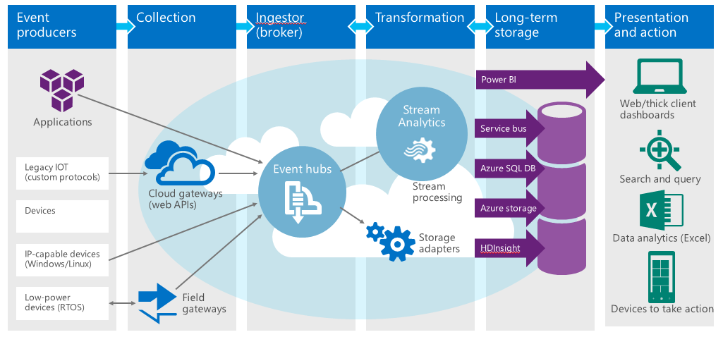
End to End processing on Microsoft Azure

Slide 14
Problems with current CEP solutions
Many are proprietary
Not enough support for complex queries
Less efficient
High latency
High memory consumption

Slide 15
Advantages of using Siddhi
Siddhi is open-source
A lightweight engine for identifying complex events
Useful to deploy in low end computational resources such as:
Raspberry Pi
UAVs
mobile phones, etc.
Supports a query language to detect patterns in events.

Slide 16
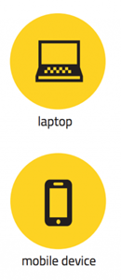


How can we apply Siddhi CEP
Siddhi Running
Publish: “21.5° C”
Publish: “21° C”
Subscribe
Subscribe
Siddhi Running
Publish: “21.9° C”
Subscribe to topic: “temperature”
Publish to topic: “temperature”
Publish to topic: “Avg. temperature”

Slide 17
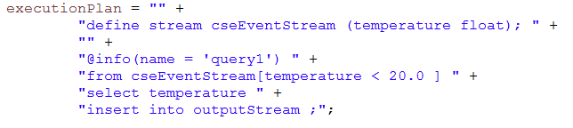
Siddhi CEP Queries
Selection or filtering and projection (like select in SQL)
Filter query creates an output stream and inserts any events from the input stream that satisfies the conditions defined.
Filters support following types of conditions
>, <, ==, >=, <=, !=
contains, instanceof
and, or, not

Slide 18
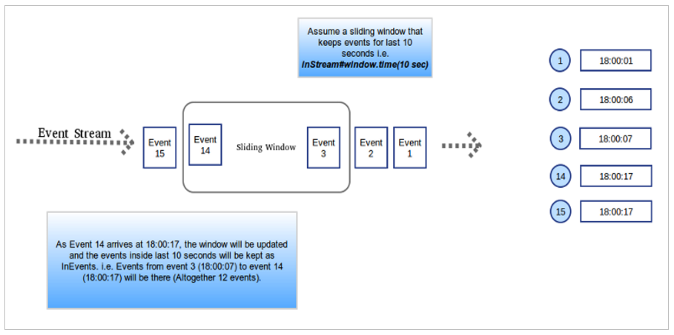
Windows – events are processed within a window (e.g. for aggregation).
Time window
Length window
Time batch window
Length batch window

Slide 19
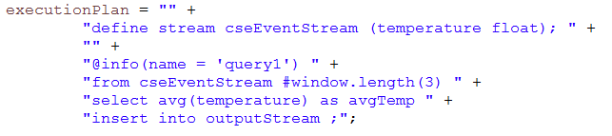
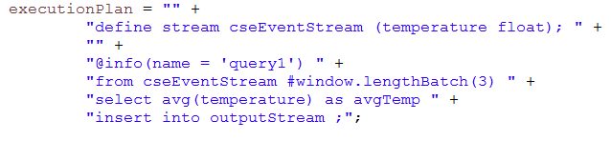
Window Query Examples
Window Query:
Length Sliding Window
Length Batch Window

Slide 20
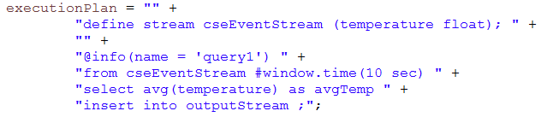
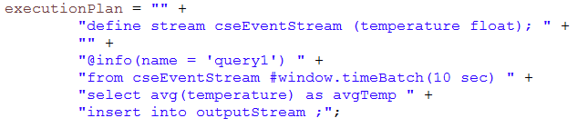
Time Sliding Window:
Time Batch Window:

Slide 21
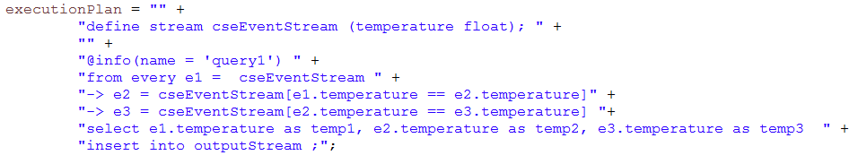
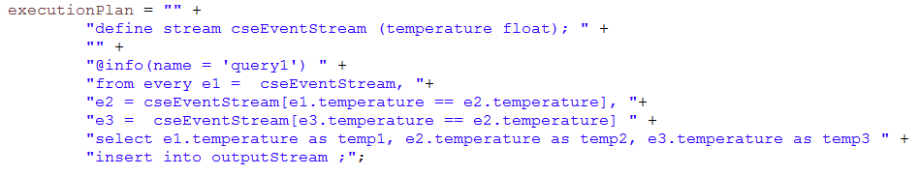
Ordering – sequences and patterns (before, followed by conditions e.g. new location followed by small and a large purchase might suggest a fraud)
Pattern Query
Sequence Query

Slide 22
Other Siddhi CEP Queries
Split
Join
Partition
Advanced Queries:
https://docs.wso2.com/display/CEP300/Advanced+Queries

Slide 23
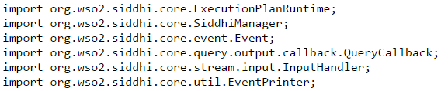
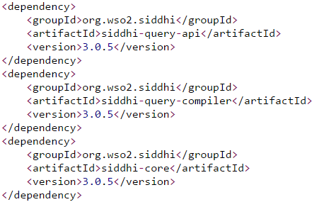
Use Siddhi API
Packages to be imported:
Maven to get Siddhi dependencies:

Slide 24
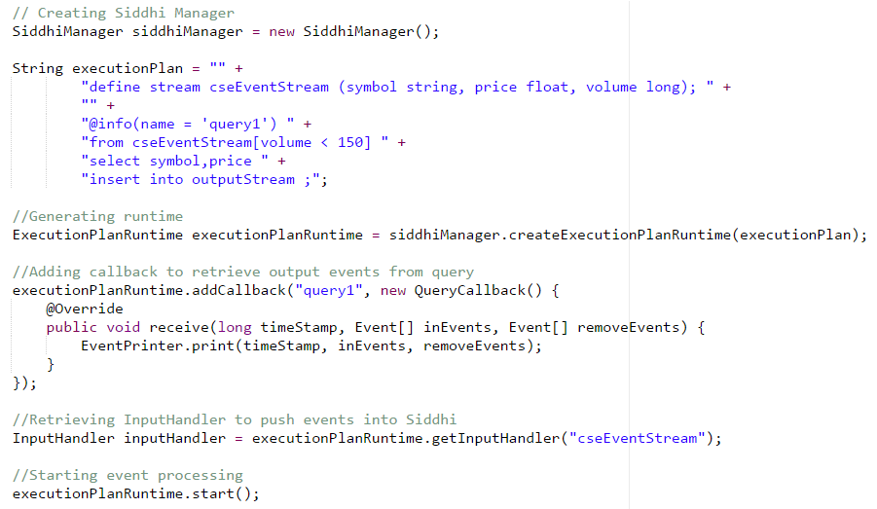
Use Siddhi API
Starting Siddhi Manager:

Slide 25
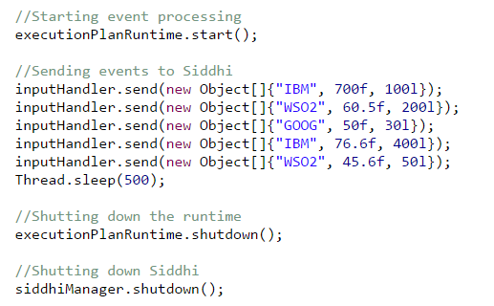
Input to Siddhi

Slide 26
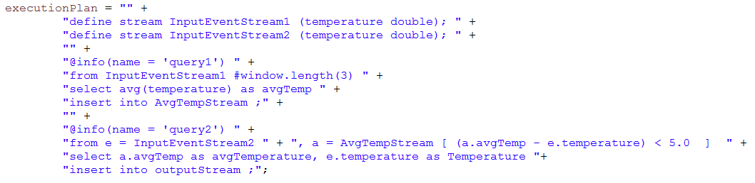
Some More on Siddhi
Connected Queries:
This requires appropriate manipulation of output callbacks.
Requires 2 input handlers to send streams.

Slide 27
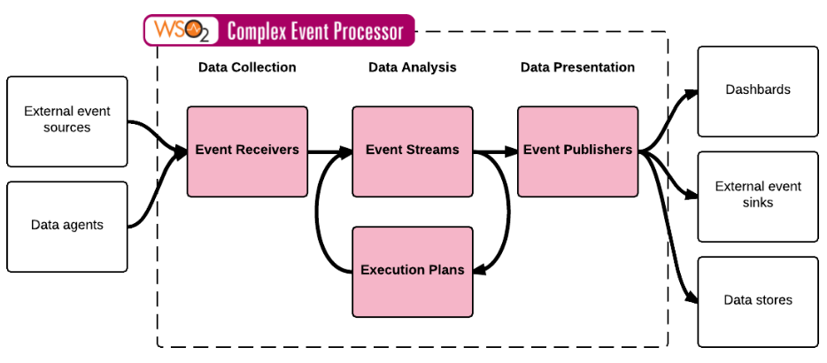
Siddhi Architecture and Event Flow

Slide 28

User
Output Adapters
Input Adapters
Compiler
Siddhi Manager
User Input a Query

Slide 29
User
Output Adapters
Input Adapters
Compiler
Siddhi Manager
Compiling the query

Slide 30
User
Output Adapters
Input Adapters
Compiler
Siddhi Manager
Query get compiled into an object model

Slide 31
User
Output Adapters
Input Adapters
Compiler
Siddhi Manager
Query Object Model is parsed to the Siddhi Manager

Slide 32
User
Output Adapters
Input Adapters
Compiler
Siddhi Manager
Event arrives to the Input Adapter

Slide 33
User
Output Adapters
Input Adapters
Compiler
Siddhi Manager
Convert Event to a Tuple and place it to the input event queue

Slide 34
User
Output Adapters
Input Adapters
Compiler
Siddhi Manager
Processor takes the tuple from the queue

Slide 35
User
Output Adapters
Input Adapters
Compiler
Siddhi Manager
Executing the queries… Other Events arrives at the same time

Slide 36
User
Output Adapters
Input Adapters
Compiler
Siddhi Manager
Non matching event thrown away

Slide 37
User
Output Adapters
Input Adapters
Compiler
Siddhi Manager

Slide 38
User
Output Adapters
Input Adapters
Compiler
Siddhi Manager
Matching Event creates the output Event

Slide 39
User
Output Adapters
Input Adapters
Compiler
Siddhi Manager
Pushing generated Events to the output queue

Slide 40
User
Output Adapters
Input Adapters
Compiler
Siddhi Manager
User get notified through output Adapter

Slide 41
User
Output Adapters
Input Adapters
Compiler
Siddhi Manager
Same procedure happens again and again…

Slide 42

OPEN YOUR LAPTOP
Start of Hands On
And let the data flow!

Slide 43
DEMO SETUP
Clone the siddhi-mqtt or iot-school folder
Open README.txt file
cd iot-school/common/analytics/cep/siddhi-mqtt/
Find pom.xml here.
mvn clean compile package -Dmaven.test.skip=true
If possible import the project in JAVA IDE
Go through the source code
Follow the steps in README.txt to
Subscribe
Perform analytics
Publish (result)

Slide 44
Overall Picture
BROKER
Running on AZURE
Data Flow
Publish
Subscribe
Temperature
Avg. Temperature
Temperature
Avg. Temperature
Publisher
SIDDHI
(AVG Temperature)
Subscriber

Slide 45
Useful References
https://github.com/wso2/siddhi
https://docs.wso2.com/display/CEP400/SiddhiQL+Guide+3.0
https://docs.wso2.com/display/CEP400/Siddhi+Try+It+Tool
https://docs.wso2.com/display/CEP300/WSO2+Complex+Event+Processor+Documentation

Slide 46
THANKS!
Any Questions?
Best of luck with CEP!

