Slide 1
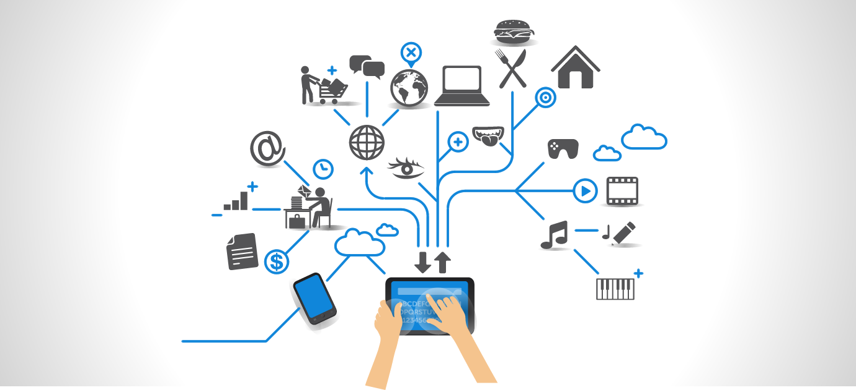
IoT Summer School

Slide 2
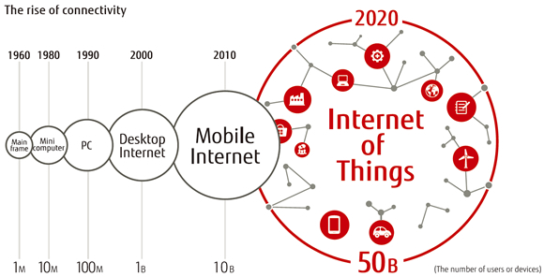
Rise of Connectivity
http://iotdevzone.com/blog/2015/04/30/iot-m2m-and-the-wireless-device-technology-panorama/

Slide 3
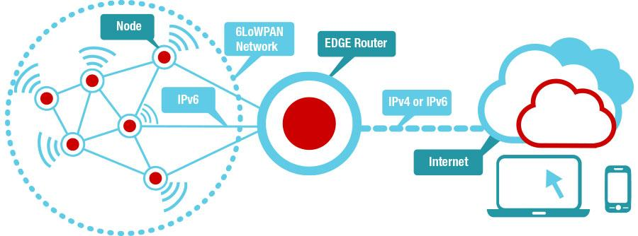
End to End Network
www.ti.com/wireless-connectivity

Slide 4
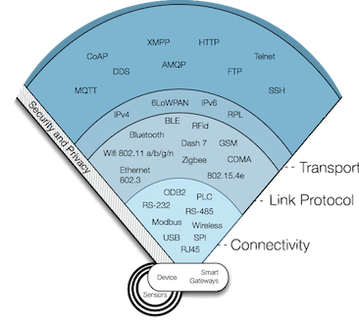
Net work Stack & Protocols
http://iotdevzone.com/blog/2015/04/30/iot-m2m-and-the-wireless-device-technology-panorama/

Slide 5
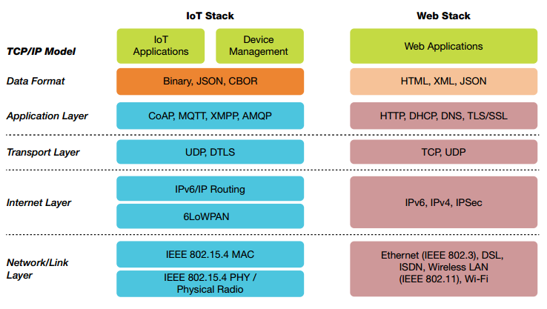
Mphasis presentation

Slide 6
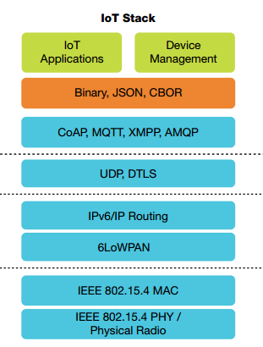

Slide 7
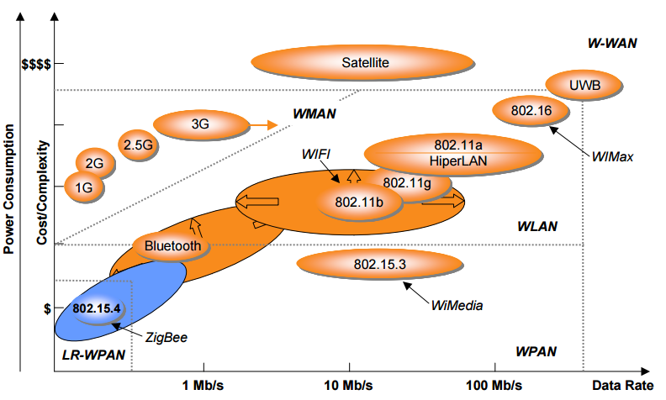
Ieee 802.15.4 Mac & Phy
Eat-on iot slides

Slide 8
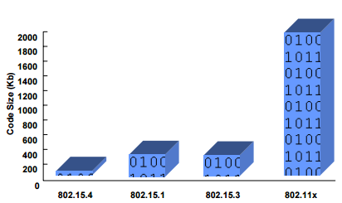
Eat-on iot slides

Slide 9
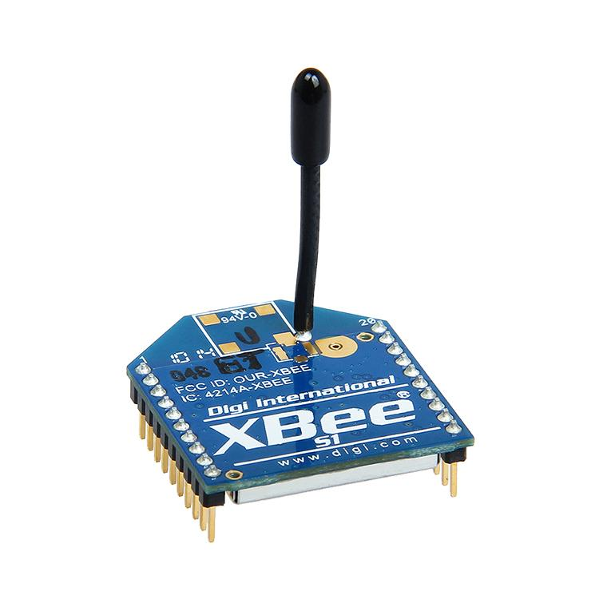
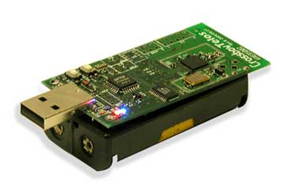
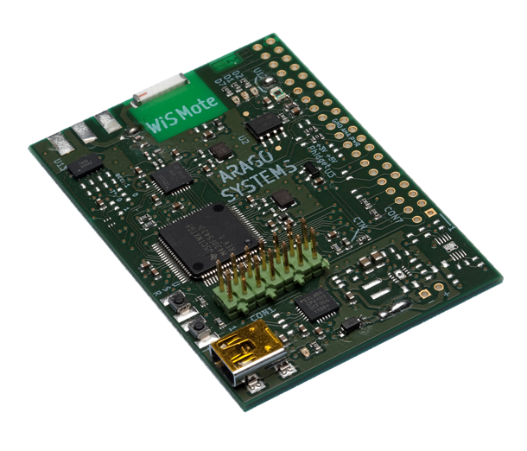
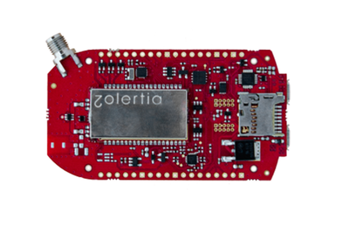
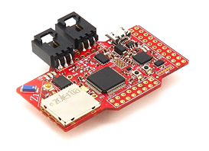
Characteristics
Data rates of 250 Kb/s, 40 Kb/s and 20 Kb/s.
Star or peer-peer operation.
Support for low-latency devices.
CSMA-CA channel access.
Frequency bands of operation .
- 16 channels in 2.4 GHz ISM band.
- 10 channels in 915 MHz ISM band.
- 1 channel in European 868 MHz band

Slide 10
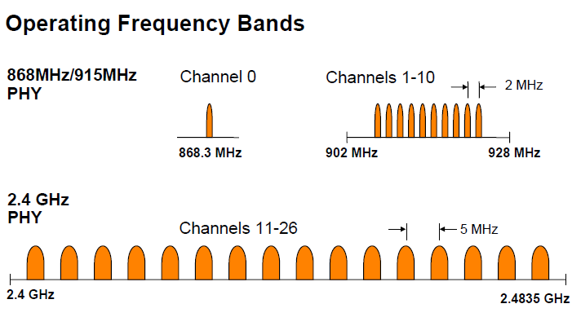
Phy Layer
Eat-on iot slides

Slide 11
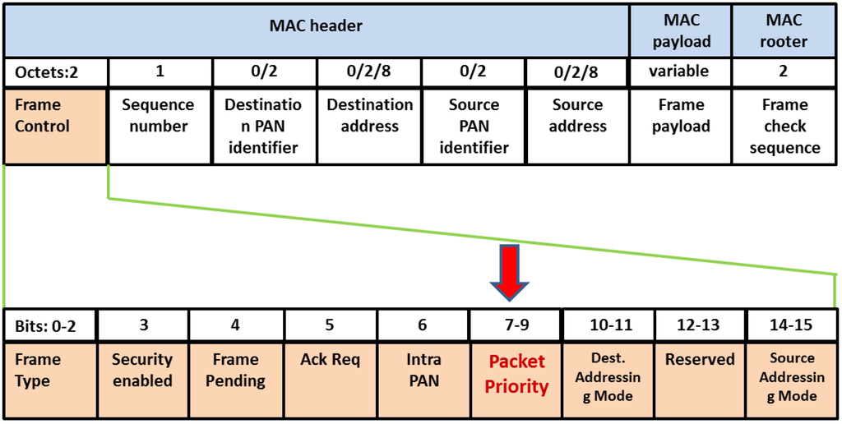
802.15.4 MAC Header
Eat-on iot slides

Slide 12
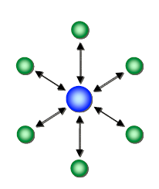
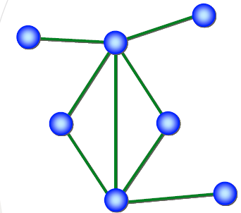
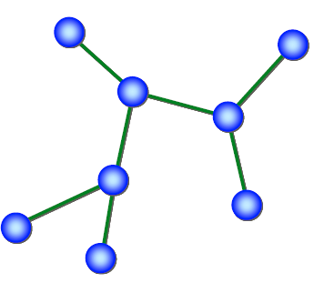
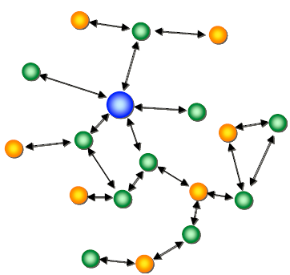
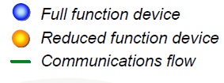
802.15.4 Network topologies
Eat-on iot slides

Slide 13

IETF 6lowpan

Slide 14
Transmission of IPv6 Packets over 802.15.4 networks
Enables IP networking for constrained devices.
Defines frame format for IP packets.
Formation of IPv6 link-local addresses
Statelessly auto-configure address.
Adaptation Layer.
Header Compression.

Slide 15
Challenges
IPv6 header size is 40 octets, UDP header is 8 octets.
802.15.4 MAC header can be up to 25 octets (null security) or 25+21= 46 octets (AES-CCM-128)
with 802.15.4 frame size 127 octets, we have
127-25-40-8= 54 octets (null security)
127-46-40-8= 33 octets (AES-CCM-128)
space left for application data!..
MTU for IPv6 is 1280 octets
Fragmentation and re-assembly layer needed.

Slide 16
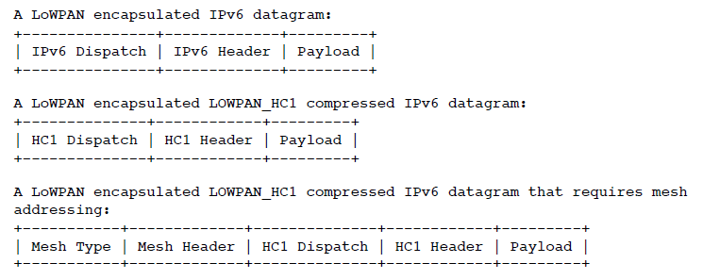
6LoWPAN Headers.
6LoWPAN defines 3 encapsulation headers Dispatch, Fragmentation and mesh headers.
IETF 6lowpan

Slide 17
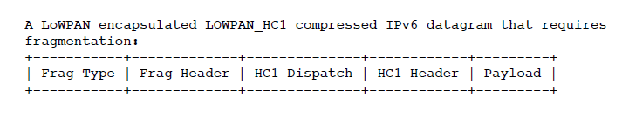
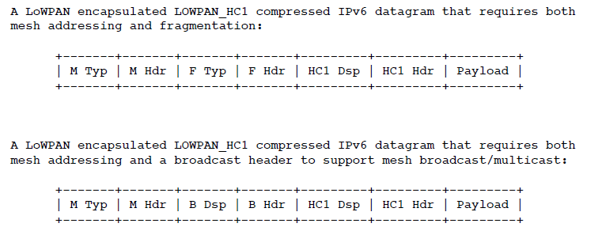
6LoWPAN Frame Formats
IETF 6lowpan

Slide 18
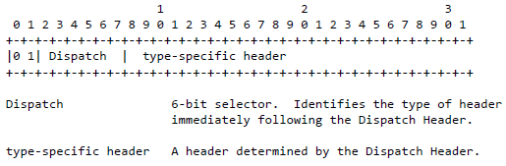
Dispatch Type and Header
IETF 6lowpan

Slide 19
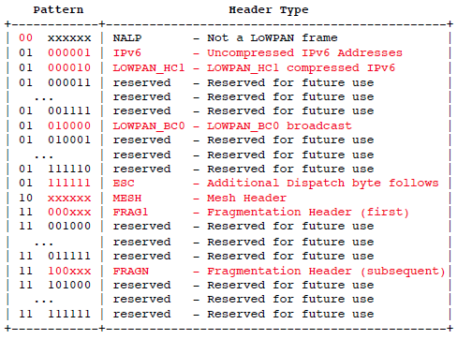
IETF 6lowpan

Slide 20

Uncompressed IPv6/UDP (worst case)
Dispatch code (01000001) indicates no compression.
Up to 54/33 octets are remaining for payload with max.size MAC header with null/AES-CCM-128 security.
http://cnds.eecs.jacobs-university.de/

Slide 21
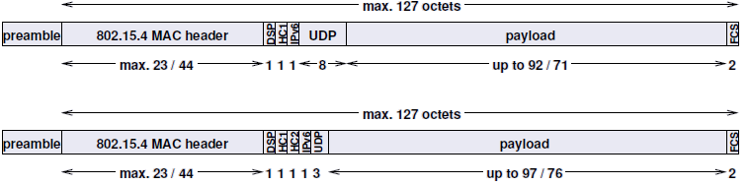
Compressed IPv6/UDP (Best case)
Dispatch code (01000010) indicates HC1 compression.
This shows max. achievable compression for link-local address.
Any non-compressed fields are carried after HC1 or HC1/HC2 header field
HC1 compression may indicate HC2 compression follows
http://cnds.eecs.jacobs-university.de/

Slide 22

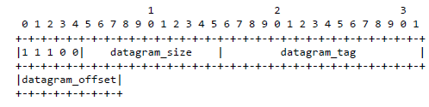
Mesh Addressing Type and Header
Fragmentation Type and Header
IETF 6lowpan

Slide 23

Stateless Address Auto-configuration
IEEE EUI-64 bit IID.
16 bit short Address (pseudo 48 bit address).
Then
IETF 6lowpan

Slide 24
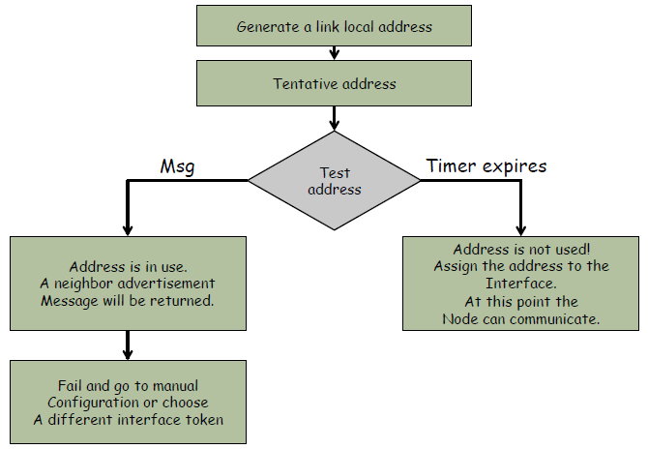

6LoWPAN –the wireless embedded networks (wiley publications & IETF 6LoWPAN

Slide 25
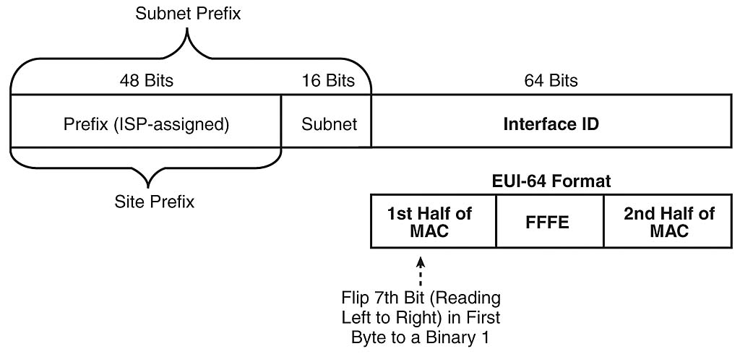
http://www.networkworld.com/article/2294347/lan-wan/chapter-17--ip-version-6.html?page=3

Slide 26
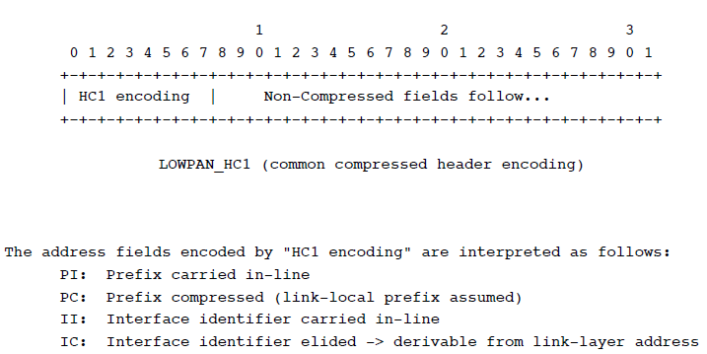
Header Compression
IETF 6lowpan rfc 4944

Slide 27
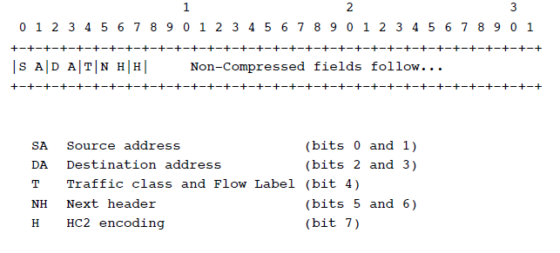
IETF 6lowpan

Slide 28
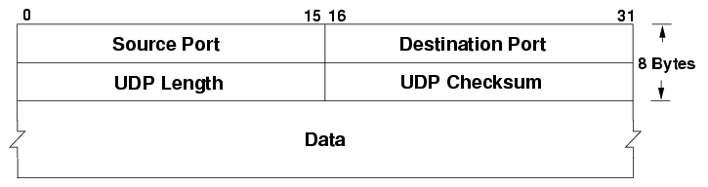

UDP Header
IETF 6lowpan

Slide 29
UDP length info can be obtained from elsewhere.
UDP source port (bit 0) destination port (bit 1).
0: Not compressed, carried in-line
1 : compressed to 4 bits.
length (bit 2).
0: Not compressed, carried in-line
1 : compressed.
Reserved bit 3 to bit 7

Slide 31
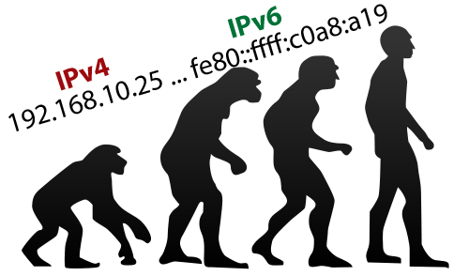
http://www.thetelecomblog.com/2015/07/29/goodbye-ipv4-hello-ipv6-why-embracing-next-gen-internet-protocols-is-essential-to-help-your-business-evolve/

Slide 32
IPv6 and Routing.
Larger address space.
Stateless address auto-configuration.
Extension headers.
Address Types are :
Unicast : One to One (Global, Link local, Site local, Compatible)
Any cast : One to Nearest (Allocated from Unicast)
Multicast : One to Many
Reserved

Slide 33
16-bit fields in case insensitive colon hexadecimal representation
2031:0000:130F:0000:0000:09C0:876A:130B
Leading zeros in a field are optional:
2031:0:130F:0:0:9C0:876A:130B
2031:0:130F::9C0:876A:130B
2031::130F::9C0:876A:130B
0:0:0:0:0:0:0:1 => ::1
0:0:0:0:0:0:0:0 => ::
IPv4-compatible address representation
0:0:0:0:0:0:192.168.30.1 = ::192.168.30.1 = ::C0A8:1E01

Slide 34
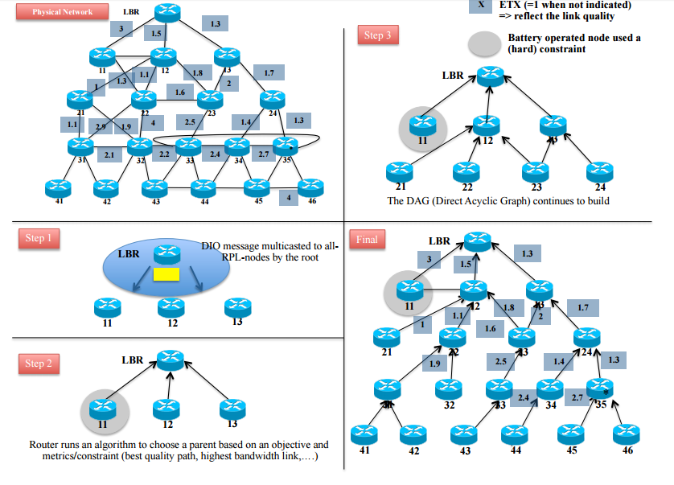
RPL (Ripple Routing Protocol)
IPSO Alliance white paper on RPL

Slide 35
RPL ICMPv6 Control Msgs.
RPL defines a new ICMPv6 message with three possible types:
DAG Information Object (DIO) - carries information that allows a node to discover an RPL Instance, learn its configuration parameters and select DODAG parents.
DAG Information Solicitation (DIS) - solicit a DODAG Information Object from a RPL node
Destination Advertisement Object (DAO) - used to propagate destination information upwards along the DODAG.

Slide 36
DODAG Construction
Nodes periodically send link-local multicast DIO messages.
Nodes listen for DIOs and use their information to join a new DODAG, or to maintain an existing DODAG
Nodes may use a DIS message to solicit a DIO
Based on information in the DIOs the node chooses parents that minimize path cost to the DODAG root
Trickle Timers
RESULT-Upward routes towards the DODAG root..

Slide 37
Downward Routes and Destination Advertisement
Objective Functions.
Nodes inform parents of their presence and reachability to descendants by sending a DAO message
Node capable of maintaining routing state → aggregate routes
Node incapable of maintaining routing state → attach a next-hop address to the reverse route stack contained within the DAO message
Local Repair & Global Repair.
Storing and non-storing mode

Slide 39


Application layer protocols

Slide 40
MQTT
Message queuing telemetry transport.
Open : created by IBM & Eurotech and donated to Eclipse “Paho” M2M project (OASIS standard in 2014)
Lightweight : smallest packet size 2 bytes (header), reduced clients footprint (C# M2Mqtt library 30 KB)
Reliable : three QoS and patterns to avoid packet loss on client disconnection
Simple :
TCP based
Asynchronous
Publish/Subscribe

Slide 41
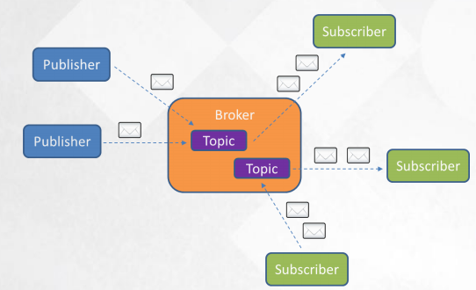
MQTT : publish/subscribe
Broker and connected Clients
Topics for publish and subscribe (PUB-SUB)

Slide 42
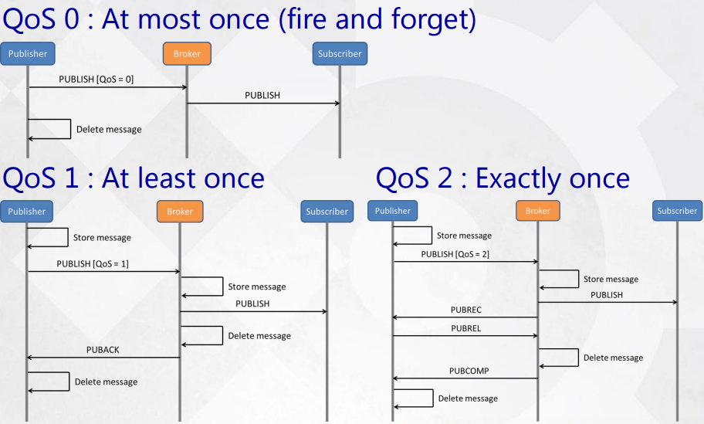
MQTT : Quality of Service

Slide 43
Mqtt: Security..
Common big problem in all IoT-M2M protocols
MQTT works on TCP… uses SSL/TLS for security
Username/Password in CONNECT message
Encrypt payload

Slide 44
CoAP(Constrained Appln. Protocol)
CoAP is based on REST Architecture
CoAP is binary HTTP like based on UDP
Request/Response model.
GET, PUT, POST DELETE methods
Observer pattern available
Separate response/response after a while

Slide 45
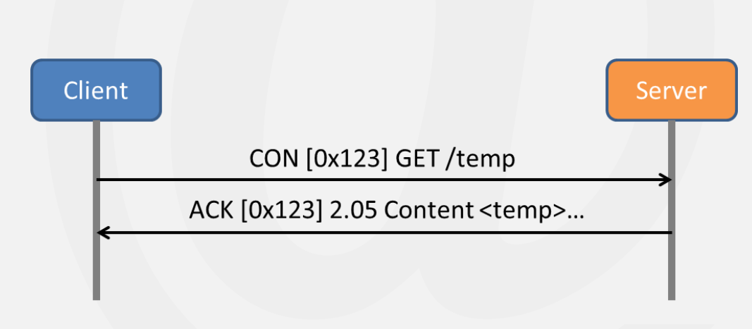
CoAP: QoS and Architecture
QoS : confirmable and non-confirmable messages
Has DTLS (Datagram TLS) security
Resource discovery (CORE link format)

Slide 46
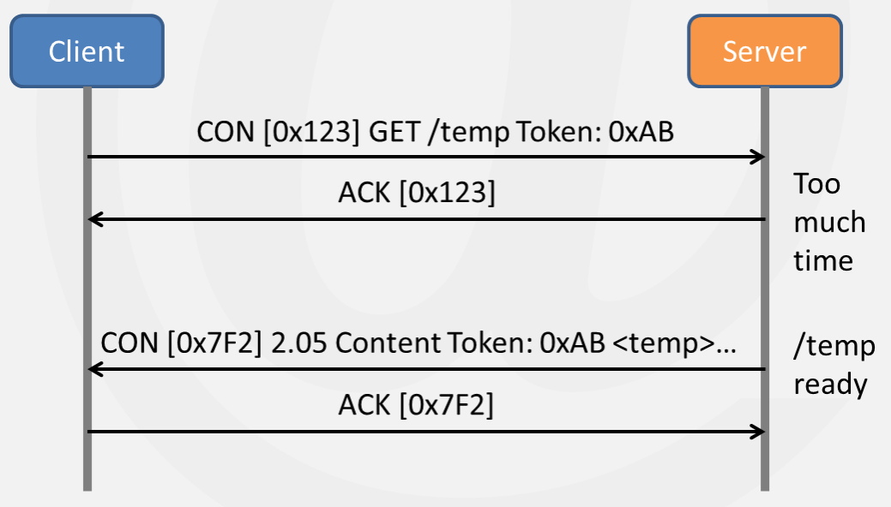
Separate Resource

Slide 47
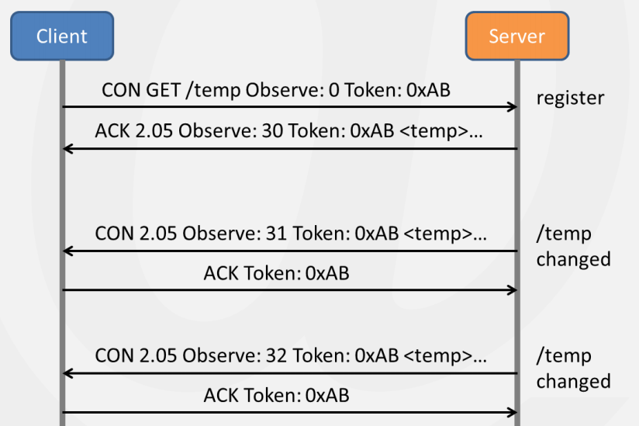
Observe Pattern

