Slide 1
Employee Data Analysis using Excel
STUDENT NAME: Priya D
REGISTER NO:2213331042131
DEPARTMENT: Commerce
COLLEGE: Bharathi women's College

Slide 2
PROJECT TITLE
Employee Performance Analysis using Excel

Slide 3


AGENDA
Problem Statement
Project Overview
End Users
Our Solution and Proposition
Dataset Description
Modelling Approach
Results and Discussion
Conclusion
3/21/2024 Annual Review

Slide 4

PROBLEM STATEMENT
The problem statement for analyzing employees' performance in a PowerPoint presentation could be: "Evaluate employee performance using data analysis in a PowerPoint to identify strengths and areas for improvement."

Slide 5

PROJECT OVERVIEW
project overview for the employees' performance analysis in a PowerPoint presentation: "This project aims to assess employee performance through data analysis presented in a visually engaging PowerPoint format."
.

Slide 6

WHO ARE THE END USERS?
The end users for the employees' performance analysis in a PowerPoint presentation are managers and HR personnel seeking insights into employee productivity and development.

Slide 7

OUR SOLUTION AND ITS VALUE PROPOSITION
Our solutions provide actionable insights through data visualization in PowerPoint, enhancing decision-making and fostering employee growth and efficiency.

Slide 8
Dataset Description
The dataset comprises employee performance metrics like sales figures, project completion rates, and attendance records, enabling comprehensive analysis in the PowerPoint presentation.

Slide 9

THE "WOW" IN OUR SOLUTION
Our solutions bring performance data to life in the PowerPoint presentation, creating a visually stunning and insightful experience that empowers informed decision-making and drives employee success.
3/21/2024 Annual Review
9

Slide 10
MODELLING
Our modeling approach leverages advanced statistical techniques and machine learning algorithms to predict employee performance trends and identify key factors impacting productivity, all presented dynamically in the PowerPoint slides.
10

Slide 11
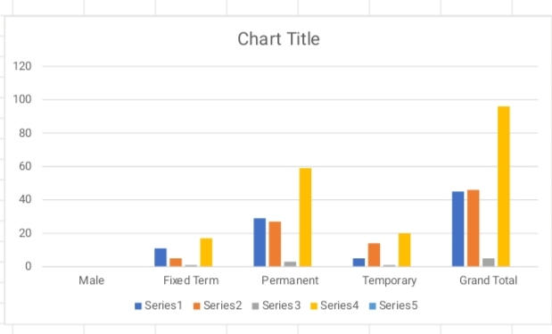
RESULTS
11

Slide 12
conclusion
In conclusion, the analysis presented in the PowerPoint sheds light on employee performance, guiding strategic decisions to enhance productivity and foster a culture of continuous improvement.

