Slide 1

Blazor - .NET 8 Architecture, Rendering Modes & Azure Deployment
Presented
By
MS PONNIEASWARI

Slide 2

Agenda
What is Blazor?​
Blazor Architecture Overview
Project Folder Structure
Rendering Modes in .NET 8

Slide 3

What is Blazor?
A framework for building interactive web applications using C# instead of JavaScript
Runs on WebAssembly or Server
Uses Razor components (.razor files)
Now supports new rendering modes in .NET 8

Slide 4
Blazor Architecture Overview
Razor Components
Rendering Modes (Server / WebAssembly / Auto / Static )
Blazor Router
Dependency Injection
Hosting Model: Blazor Web App (.NET 8 default)

Slide 5
Rendering Modes in .NET 8
Mode | Runs On | Use Case
Static Rendering | Server | SEO pages, non-interactive content
Interactive Server | Server + SignalR | Fast load, secure data access
Interactive WebAssembly | Browser (WASM) | Offline use, client-heavy apps
Interactive Auto Mode | Server → WASM | Best of both worlds

Slide 6
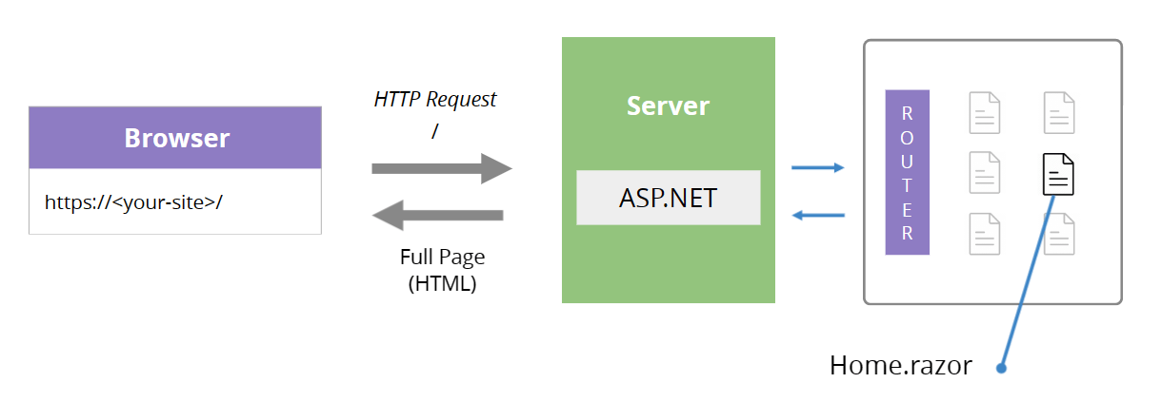
Static Rendering
No interactivity (no events, no button clicks)
Renders HTML only once on the server
Extremely fast initial load
SEO-friendly output (pure HTML)
Great for content-heavy pages
Default mode when @rendermode is not specified

Slide 7
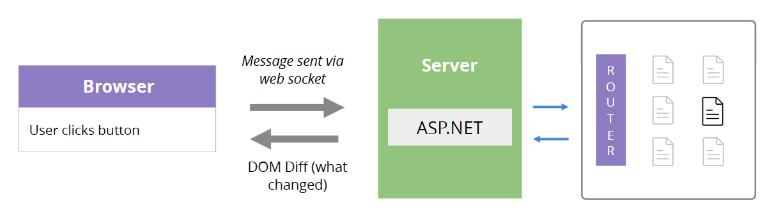

Interactive Server (SignalR)
Fast initial load
UI logic runs on server
Uses SignalR circuits

Slide 8

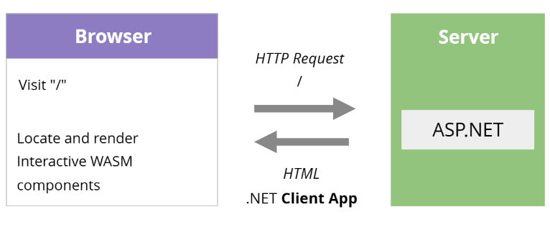
Interactive WebAssembly
Runs inside browser
No server dependency
Ideal for offline apps

Slide 9
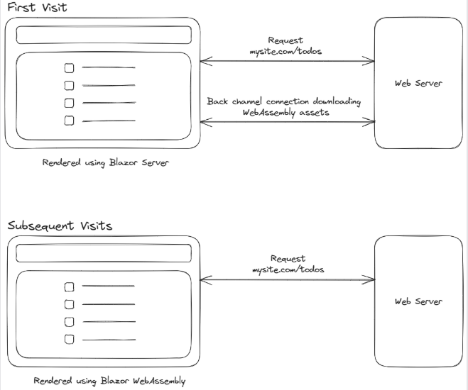
Auto Rendering Mode
Starts as server-rendered static
Automatically upgrades to WASM

Slide 10

Deployment to Azure App Service
Steps:
Publish → Right-click project → Publish
Choose Azure App Service
Select subscription
Configure runtime (.NET 8 (LTS))
Create Web App
Deploy

Slide 11
Thank You

