Slide 1

Dependency Injection

Slide 2
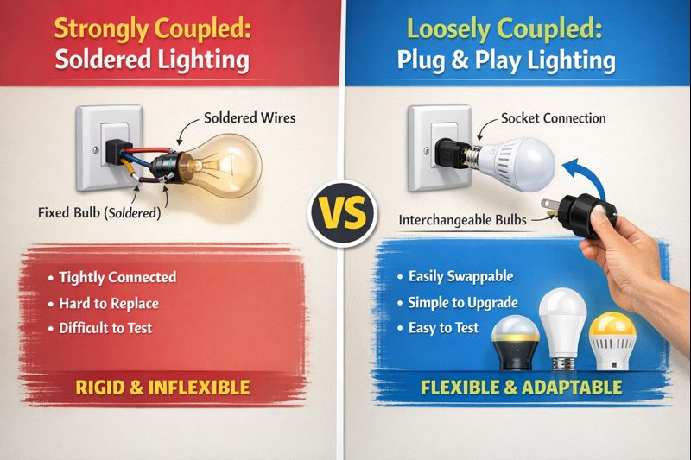

Slide 3
Strong Coupling (Soldered Lighting System)
Loose Coupling (Plug-and-Play Lighting System)
Components are tightly bound to each other
One class creates and controls its dependencies
Change in one component forces changes everywhere
Hard to modify, hard to test, hard to maintain
Like a bulb soldered to the wire – replacement needs rewiring
Components depend on abstractions (interfaces)
Dependencies can be easily replaced or upgraded
Changes are isolated and safe
Easy to test, flexible, maintainable
Like a bulb plugged into a socket – just unplug and replace
Dependencies are NOT created inside the class
They are provided from outside (injected)
Promotes loose coupling by design
Managed by a DI Container in modern frameworks

Slide 4
Demo

Slide 5

Thank You

