Slide 1
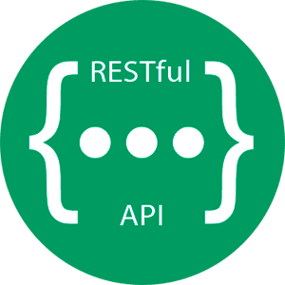
INTRODUCTION TO REST API

Slide 2
What is an API ?
API stands for Application Programming Interface
It is a software interface which allows two applications to interact with each other.
An API is a set of defined rules that explain how computers or applications communicate with one another. It sits between a client application and the web server, acting as an intermediary layer that processes data transfer between systems.

Slide 3
How API works ?
Client
Request
Web Server
HTTP
Response
Rest API

Slide 4
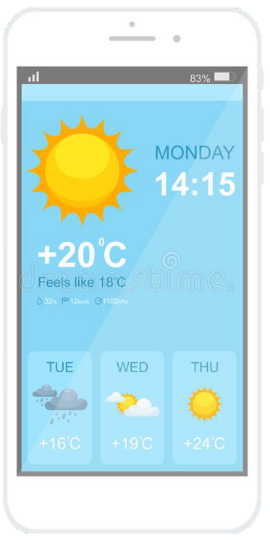
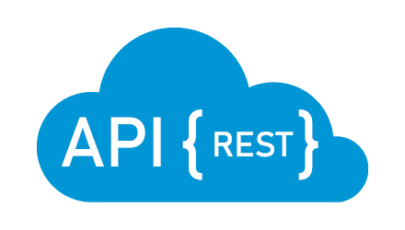

Real life example of an API
Request
Response
Openweathermap.org

Slide 5
What is REST ?
REST stands for Representational State Transfer
It is an architectural style for creating HTTP based services
REST API works on the concept of resources. Every resource have a unique URI and an associated Http Verb.

Slide 6
HTTP Verbs
GET – To Get the Data
POST – For Creating Data
PUT – For Updating Data
DELETE – For Deleting Data
https://www.cybershop.com/api/products

Slide 7
GET All Information from REST API
Request
Response
GET /api/products
[
{id: 1, name: ‘Laptop’},
{id: 2, name: ‘Camera’},
……
]

Slide 8
GET Information from REST API
Request
Response
GET /api/products/1
{id: 1, name: ‘Laptop’}

Slide 9
POST Information to REST API
Request
Response
POST /api/products
Request Body
{
Id: 3,
Name: ‘Tablet’
}
{status: 200, message: ‘Product Added’}

Slide 10
Update Information to REST API
Request
Response
PUT /api/products/2
Request Body
{
Id: 3,
Name: ‘Tablet’
}
{status: 200, message: ‘Product Updated’}

Slide 11
DELETE Information from REST API
Request
Response
DELETE /api/products/1
{status: 200, message: ‘Product Deleted’}
{id: 1, name: ‘Laptop’}

Slide 12
Lets Code a Simple REST API in ASP .NET Core

